Slide 1
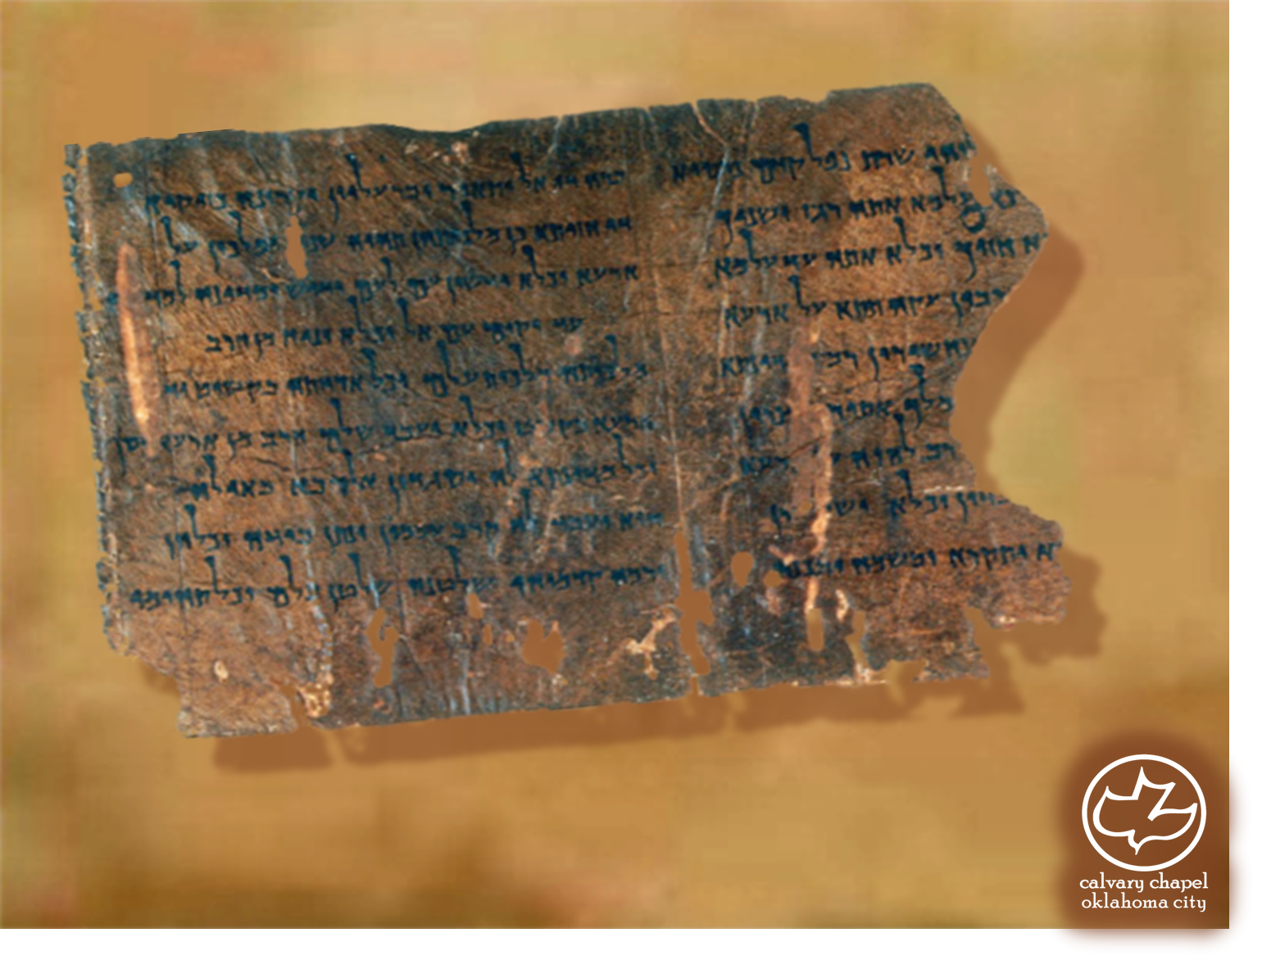

Minor Prophets … Major Message:
Haggai 1:1-2:23
A CD of this message will be available (free of charge) immediately following today's message
This message will be available via podcast later this week at calvaryokc.com

Slide 2
Haggai 1:1-2:23
Jehoiachin
597 BC
50,000 return
536 BC
Work began
520 BC
Work competed
515 BC
590BC
580BC
570BC
550BC
540BC
530BC
520BC
Haggai
Zechariah
Daniel
Ezekiel

Slide 3
Haggai 1:1-2:23
August 29, 520 BC
1st day would have been a feast day
Zerubbabel ~ sown in Babylon

Slide 4
Haggai 1:1-2:23
Literally, Set your heart on your ways

Slide 5
Haggai 1:1-2:23
Matt. 11:12 ~ And from the days of John the Baptist until now the kingdom of heaven suffers violence, and the violent take it by force.

Slide 6
Haggai 1:1-2:23
3-part sermon:
1. Go to the mountains
2. Get some wood
3. Do the work

Slide 7
Haggai 1:1-2:23
Oct. 17, 520 BC ~ last day of the Feast of Tabernacles

