Slide 1
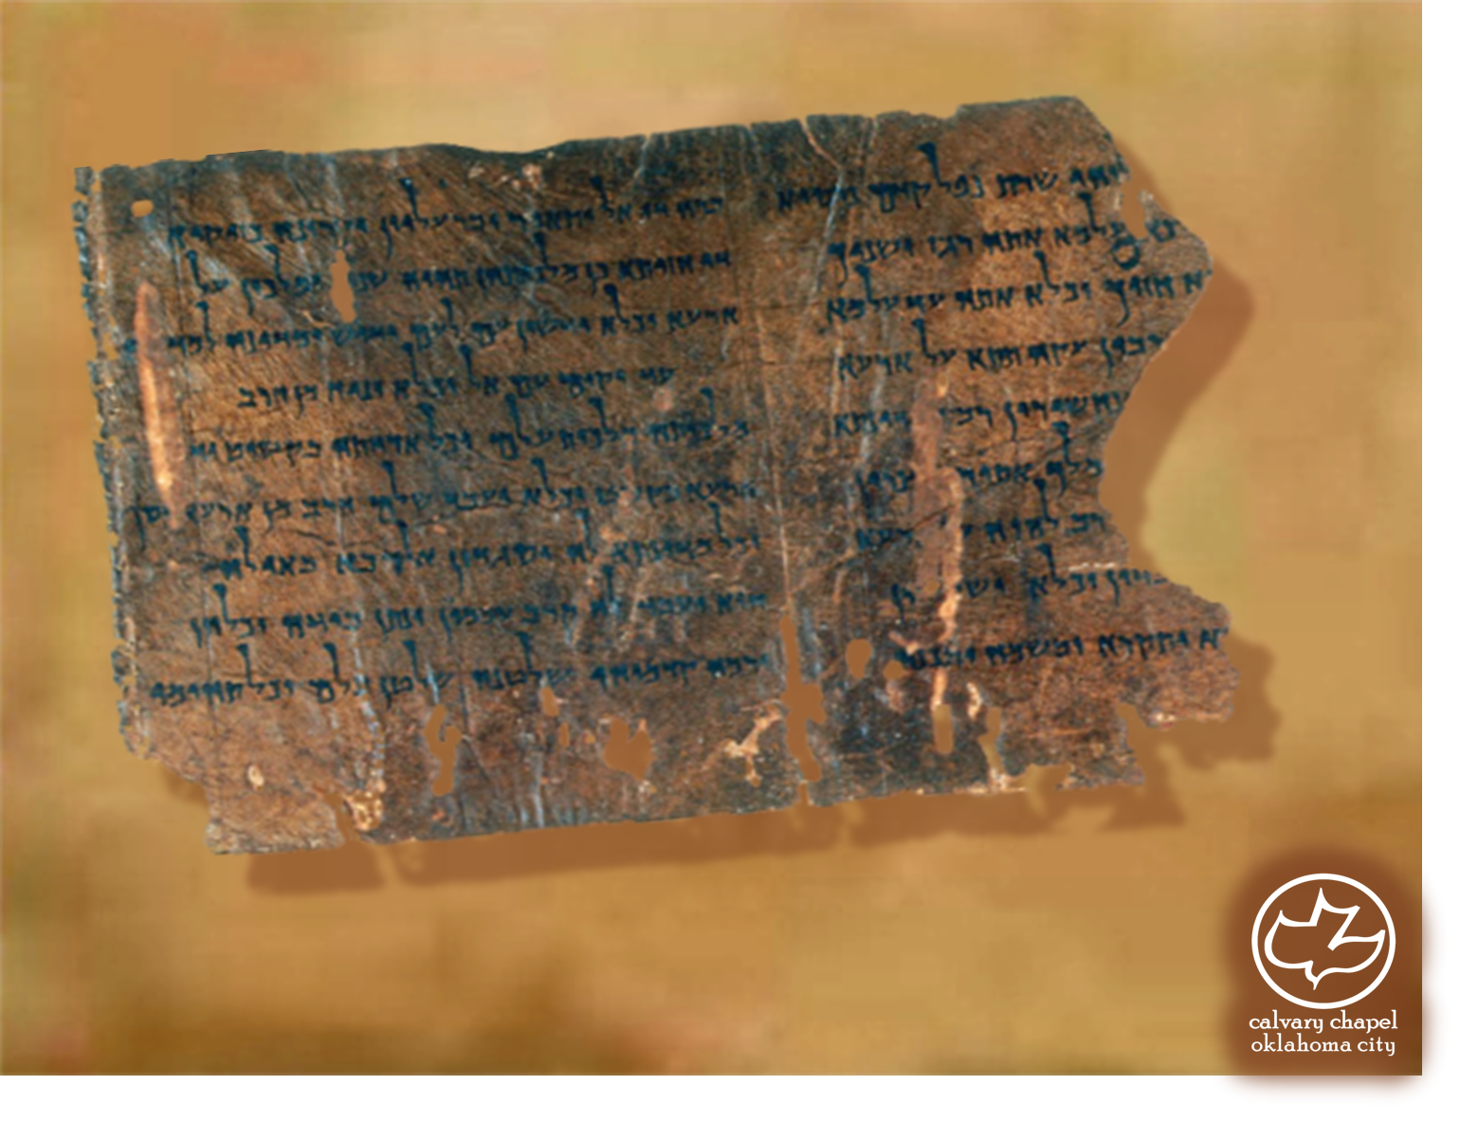

Minor Prophets … Major Message:
Habakkuk 1:1-3:19
A CD of this message will be available (free of charge) immediately following today's message
This message will be available via podcast later this week at calvaryokc.com

Slide 2
HABAKKUK 1:1-3:15
Habakkuk ~ meaning embrace
From root (`abaq) meaning to wrestle – Gen. 32

Slide 3
HABAKKUK 1:1-3:15
640BC
630BC
620BC
610BC
600BC
590BC
Habakkuk
Jeremiah

Slide 4
HABAKKUK 1:1-3:15
Cry out ~ more like scream

Slide 5
HABAKKUK 1:1-3:15
Judah
Babylon
GOOD
BAD
Bad-o-meter

Slide 6
HABAKKUK 1:1-3:15
Blaise Pascal – “In faith there is enough light for those who want to believe and enough shadows to blind those who don't.”

Slide 7
HABAKKUK 1:1-3:15
Rev. 22:12 ~ And, behold, I come quickly; and my reward is with me, to give every man according as his work shall be.
Quickly ~ tachu – rapidly

Slide 8
HABAKKUK 1:1-3:15
Rom. 1:17 (just) ~ Justification
Gal. 3:11 (live) ~ Sanctification
Heb. 10:38 (faith) ~ Now the just shall live by faith; but if anyone draws back, My soul has no pleasure in him.

Slide 9
HABAKKUK 1:1-3:15
Hell ~ better – NASB, Sheol

Slide 10
HABAKKUK 1:1-3:15
Shigionoth ~ unknown meaning, possibly the idea of emotion

Slide 11
HABAKKUK 1:1-3:15
Heb. 11:1 ~ Faith is the substance of things hoped for and the evidence of things not seen.

