Slide 1
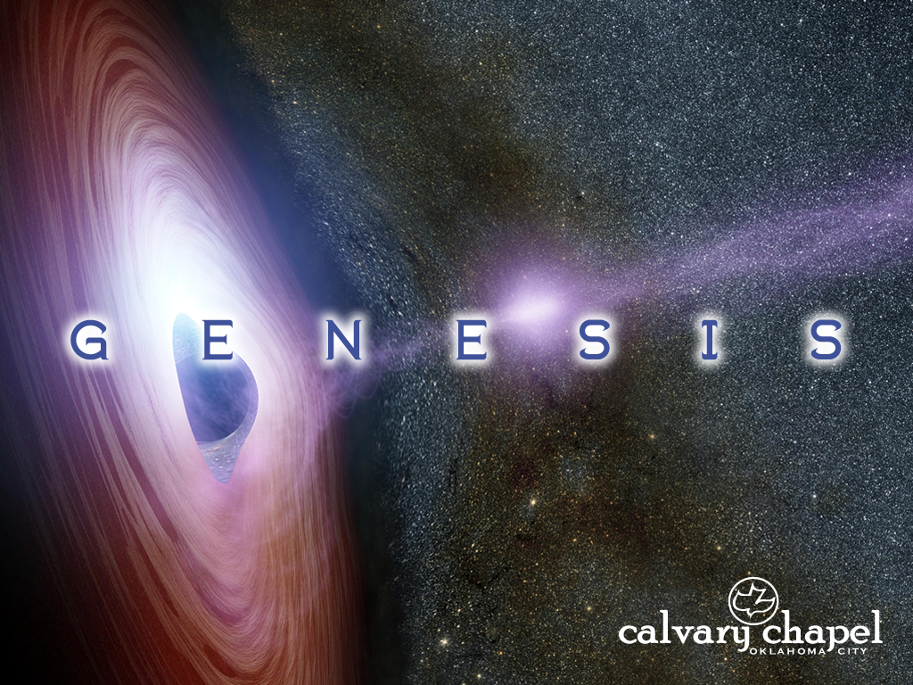
46-48

Slide 2
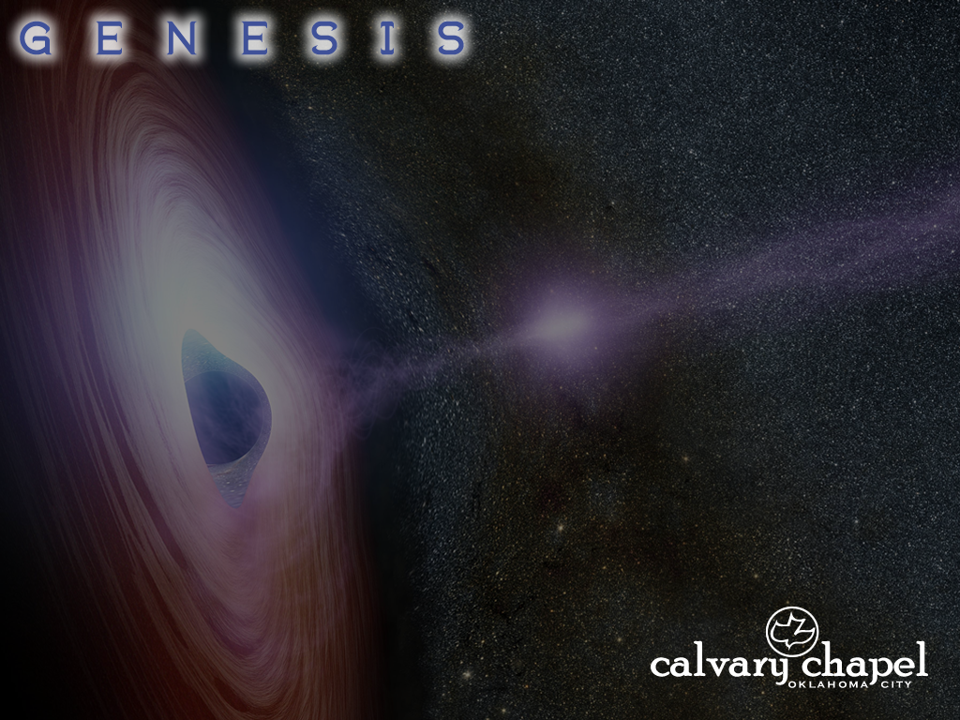
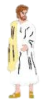
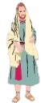
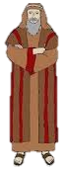


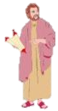

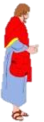
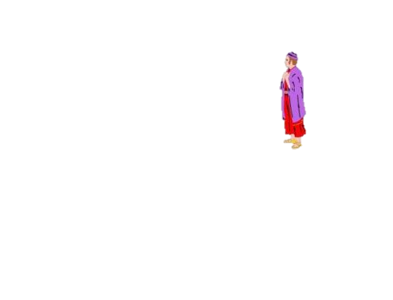
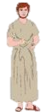
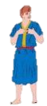
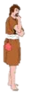
46-48
Joseph is alive!
No way!
Way!

Slide 3
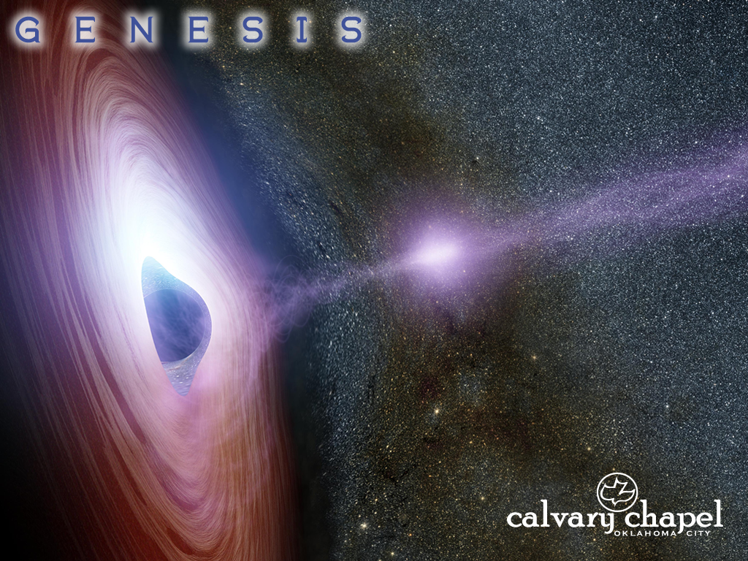
46-48

Slide 4


46-48
You Are Now Leaving Canaan
Bethel
Last Gas
For 225 miles
Beersheba
Egypt – thataway
City
Limits

Slide 5
46-48

Slide 6
46-48
Jacob in Haran ~ God’s man in the flesh
Jacob in Canaan ~ God’s man in his own strength
Jacob in Egypt ~ God’s man walking by faith

Slide 7
46-48

Slide 8
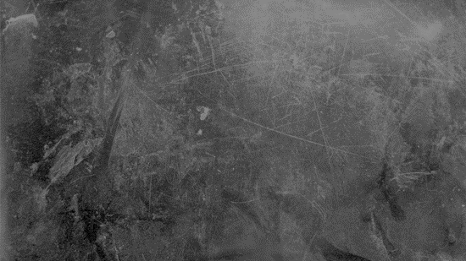

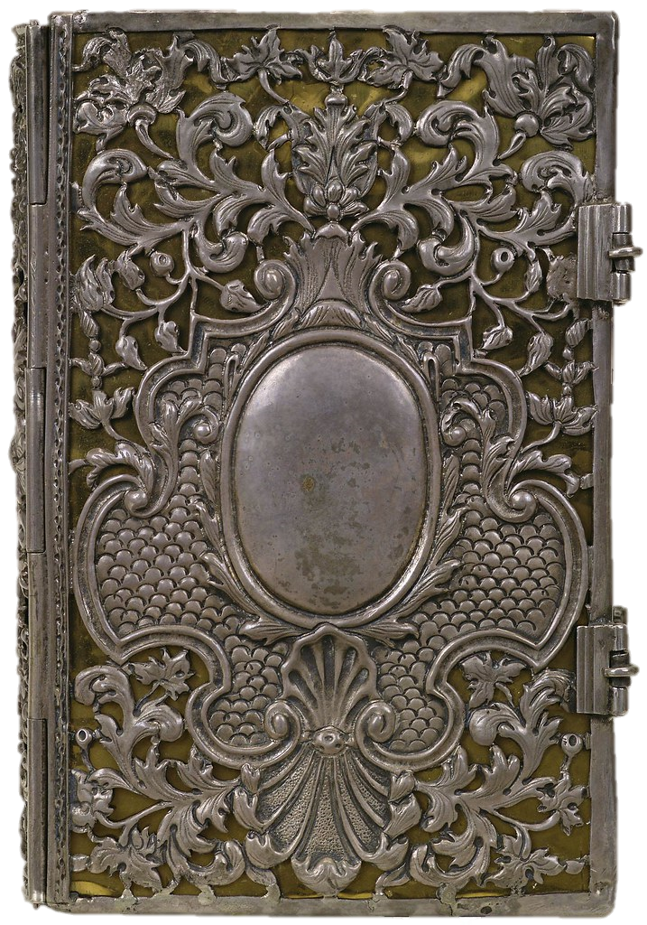
46-48
The Complete book of Hebrew (good) Baby boy Names
A
א
Aaron
אַהֲרוֹן
Abel
הֶבֶל
Abraham
אַבְרָהָם
Abner
אַבְנֵר
Adam
אָדָם
Amos
עָמוֹס
Asa
אָסָא

Slide 9
46-48

Slide 10
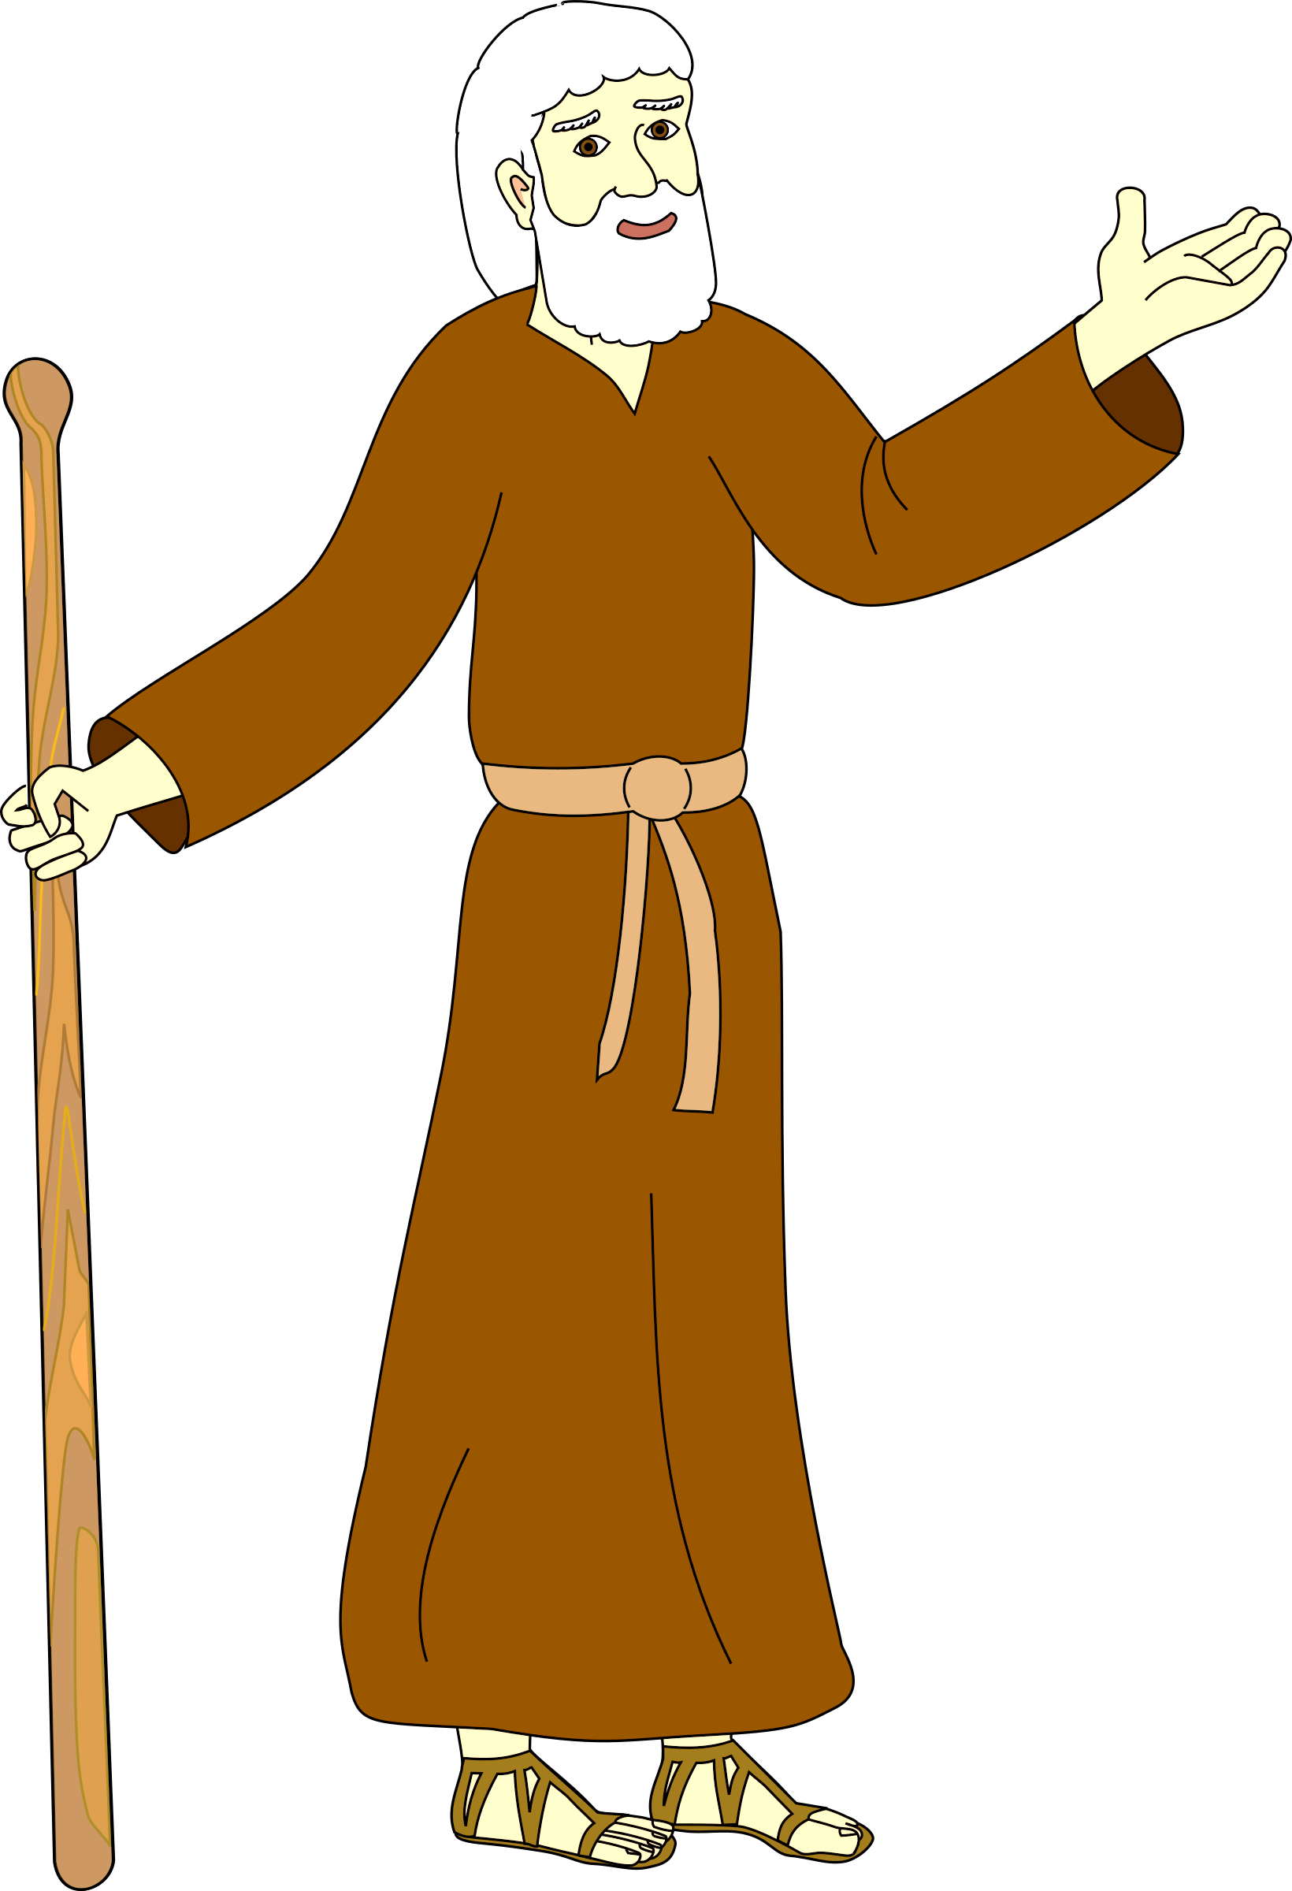
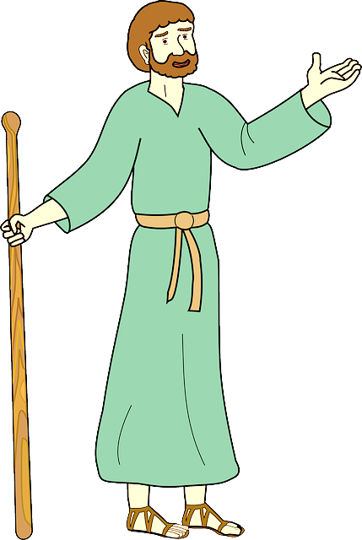

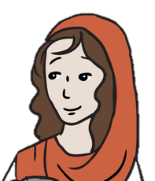


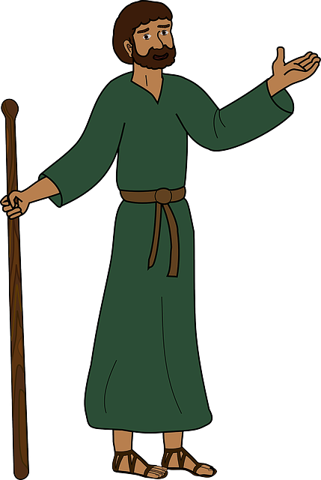

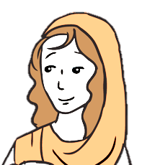
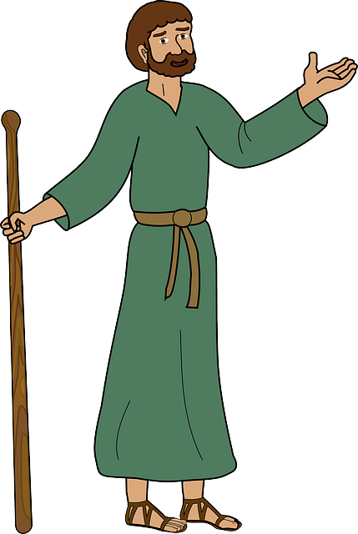


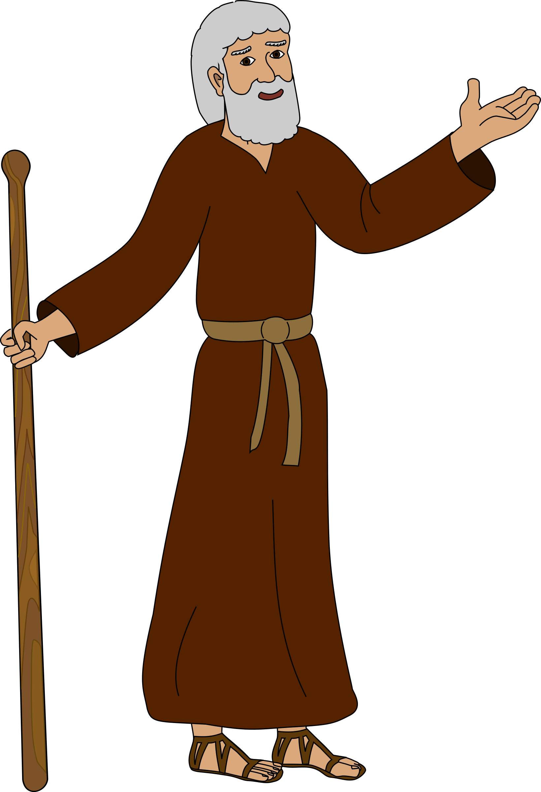


46-48
Don’t make me come back there!
How many more minutes?
How many more minutes?
How many more minutes?
How many more minutes?
How many more minutes?
Baaa

Slide 11
46-48

Slide 12
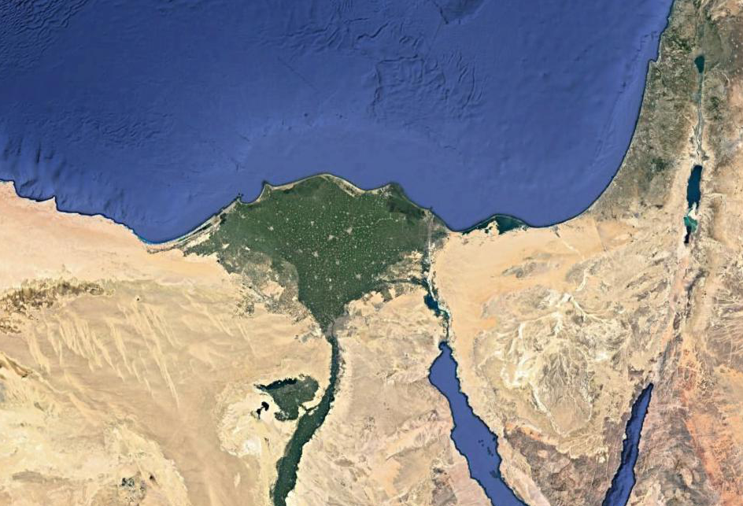
46-48

Slide 13
46-48

Slide 14

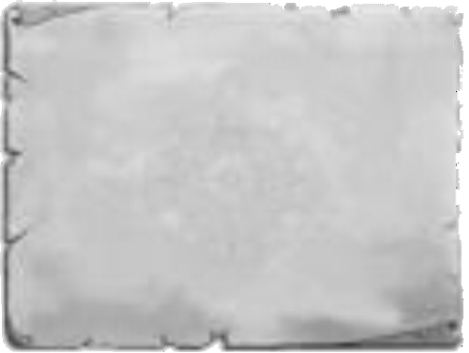
46-48
Bucket List
Get rich
My bucket list – Yakov ben Yitzak
Have bunch of kids
Wrestle w/ an Angel
Reconcile w/ Esau
Reunite w/ Joseph

Slide 15
46-48

Slide 16
46-48
livestock ~ KJV, cattle

Slide 17
46-48

Slide 18
46-48
come to dwell ~ KJV, better, sojourn
NIV ~ to live here awhile

Slide 19
46-48

Slide 20
46-48
Heb. 7:7 ~ Now beyond all contradiction the lesser is blessed by the better.

Slide 21
46-48

Slide 22
46-48
God, before whom my fathers Abraham and Isaac walked (God the Father)
God who has fed me (God the Holy Spirit)
ra’ah – to tend or to shepherd
Angel who has redeemed me (God the Son)
ga’al – redeemer

Slide 23
46-48
Genesis 01-02 ~ generation
Genesis 03-12 ~ degeneration
Genesis 13-50 ~ regeneration

Slide 24
46-48

Slide 25
46-48
1.
Reuben
7.
Gad
2.
Simeon
8.
Asher
3.
Levi
13.
Ephraim
9.
Issachar
4.
Judah
14.
Manasseh
10.
Zebulun
5.
Dan
11.
Joseph
6.
Naphtali
12.
Benjamin

Slide 26
46-48

Slide 27
46-48
one portion ~ shechem – shoulder or ridge (as NIV)

Slide 28
46-48

