Slide 1

43-45

Slide 2
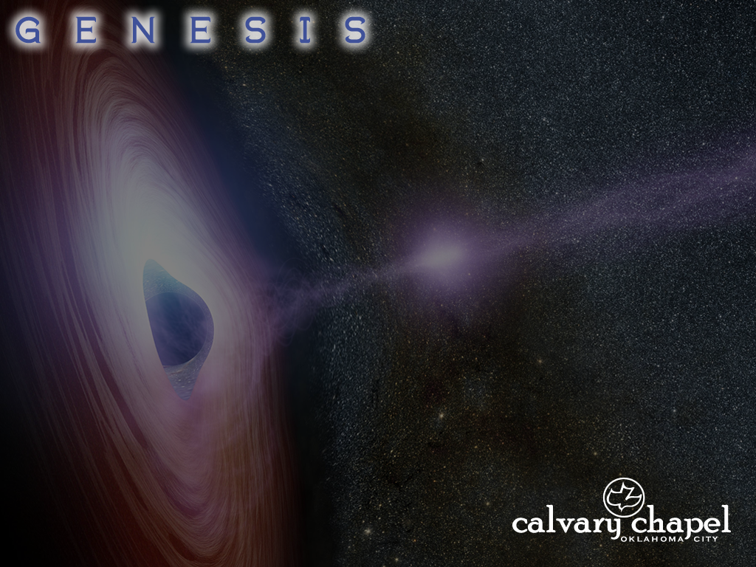
43-45
wrongfully ~ ra`ah – literally, evilly or wickedly

Slide 3
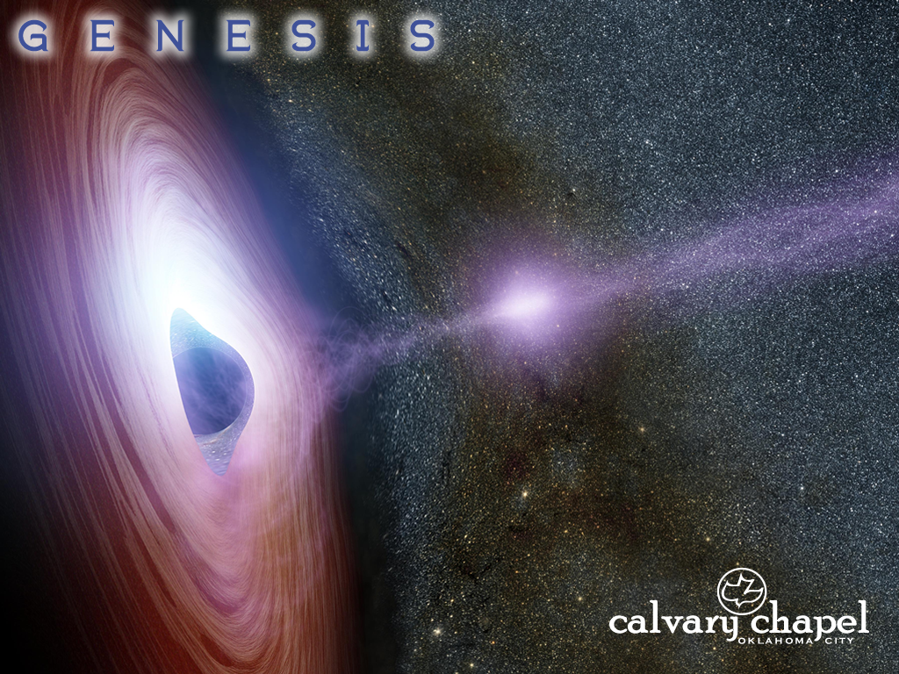
43-45

Slide 4
43-45
blame (v. 9) ~ chata’ – almost 200 of the 238x in the Old Testament it is translated sin, sinner or sinful

Slide 5
43-45

Slide 6
43-45
Gen. 42:38 ~ But he (Jacob) said, “My son shall not go down with you, for his brother is dead, and he is left alone. If any calamity should befall him along the way in which you go, then you would bring down my gray hair with sorrow to the grave.”

Slide 7
43-45

Slide 8
43-45
Reuben
Simeon
Levi
Judah
Dan
Joseph
Naphtali
Gad
Benjamin
Zebulun
Issachar
Asher

Slide 9
43-45

Slide 10
43-45
heart yearned ~ KJV, his bowels did yearn upon

Slide 11
43-45

Slide 12
43-45
servings ~ KJV, messes

Slide 13
43-45

Slide 14
43-45
1 John 3:16 ~ By this we know love, because He laid down His life for us. And we also ought to lay down our lives for the brethren.

Slide 15
43-45

Slide 16
43-45
dismayed ~ bahal – literally, terrified
Zech. 12:10 ~ And I will pour on the house of David and on the inhabitants of Jerusalem the Spirit of grace and supplication; then they will look on Me whom they pierced. Yes, they will mourn for Him as one mourns for his only son, and grieve for Him as one grieves for a firstborn.

Slide 17
43-45

Slide 18
43-45
Sold as a slave (1899 BC)
7 yr. of plenty (1886-1879 BC)
Family reunited (1876 BC)
1910 BC
1910 BC
1905 BC
1900 BC
1895 BC
1890 BC
1885 BC
1880 BC
1875 BC
Joseph born (1916 BC)
Becomes vizier (1886 BC)
7 yr. of famine (1879-1872 BC)

Slide 19
43-45

Slide 20
43-45
created ~ bara – always has God as the subject
Latin, ex nihilo ~ out of nothing

Slide 21
43-45

