Slide 1
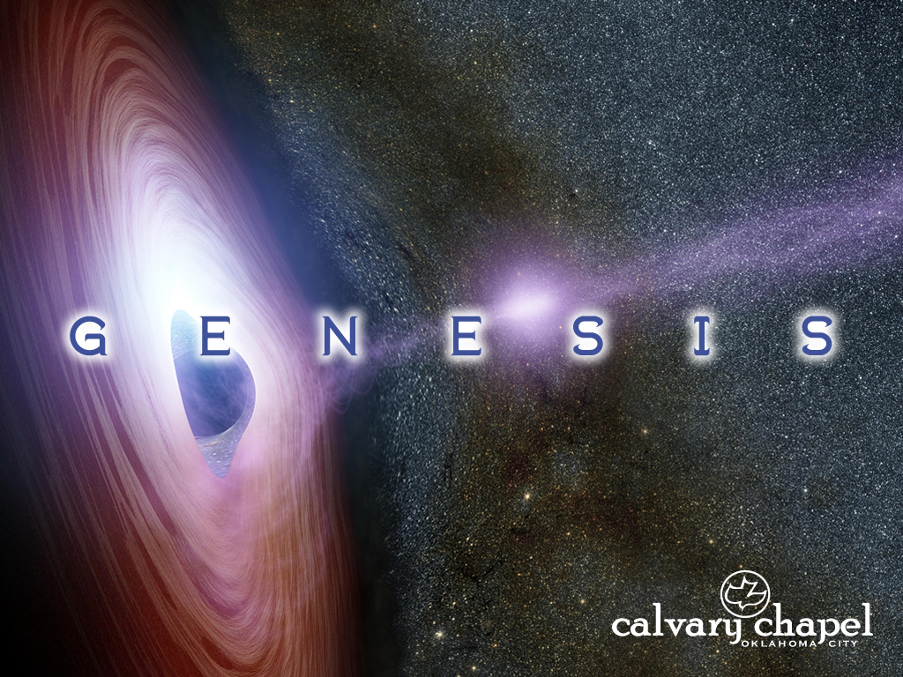
41-42

Slide 2
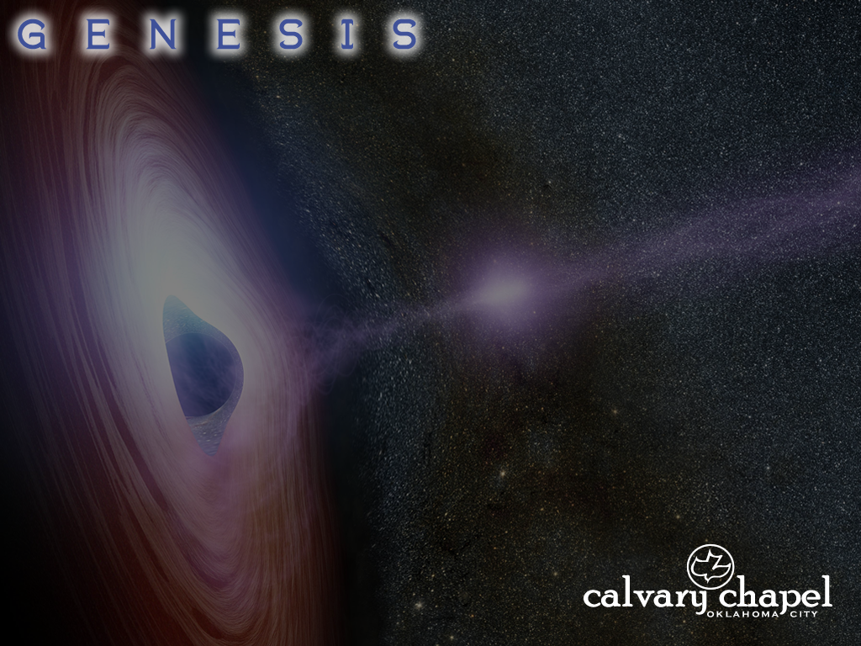
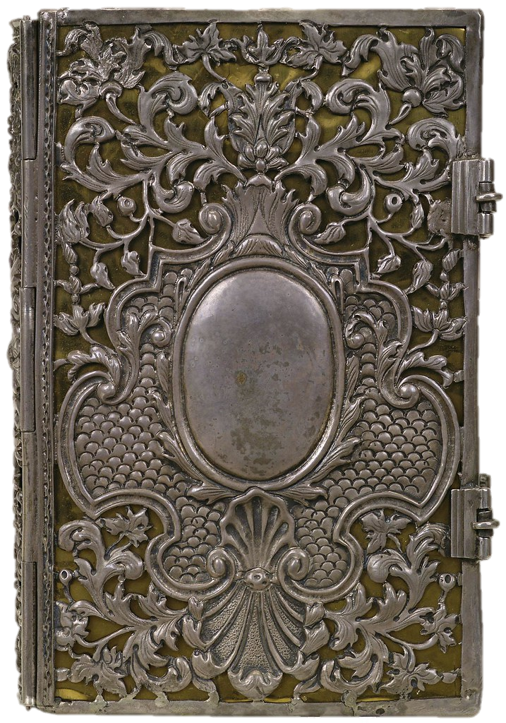
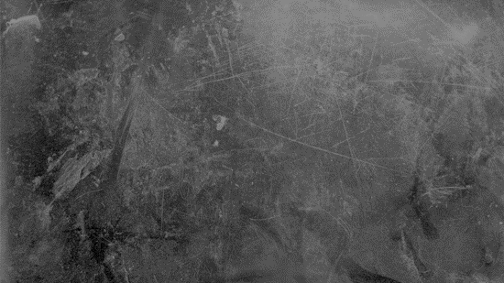

41-42
Table of Contents
Chapters 1-40
– Introduction
Chapters 41-50
– The story of Redemption
Chapter One
1 In the beginning God created the Heauen, and the Earth. 2 And the earth was without forme, and voyd, and darkenesse was vpon the face of the deepe: and the Spirit of God mooued vpon the face of the waters. 3 And God said, Let there be light: and there was light. 4 And God saw the light, that it was good: and God diuided the light from the darkenesse. 5 And God called the light, Day, and the darknesse he called Night: and the euening and the morning were the first day.
6¶ And God said, Let there be a firmament in the midst of the waters: and let it diuide the waters from the waters. 7 And God made the firmament; and diuided the waters, which were vnder the firmament, from the waters, which were aboue the firmament: and it was so. 8 And God called the firmament, Heauen: and the euening and the morning were the second day.
9¶ And God said, Let the waters vnder the heauen be gathered together vnto one place, and let the dry land appeare: and it was so.
10 And God called the drie land, Earth, and the gathering together of the waters called
the
book of Genesis

Slide 3
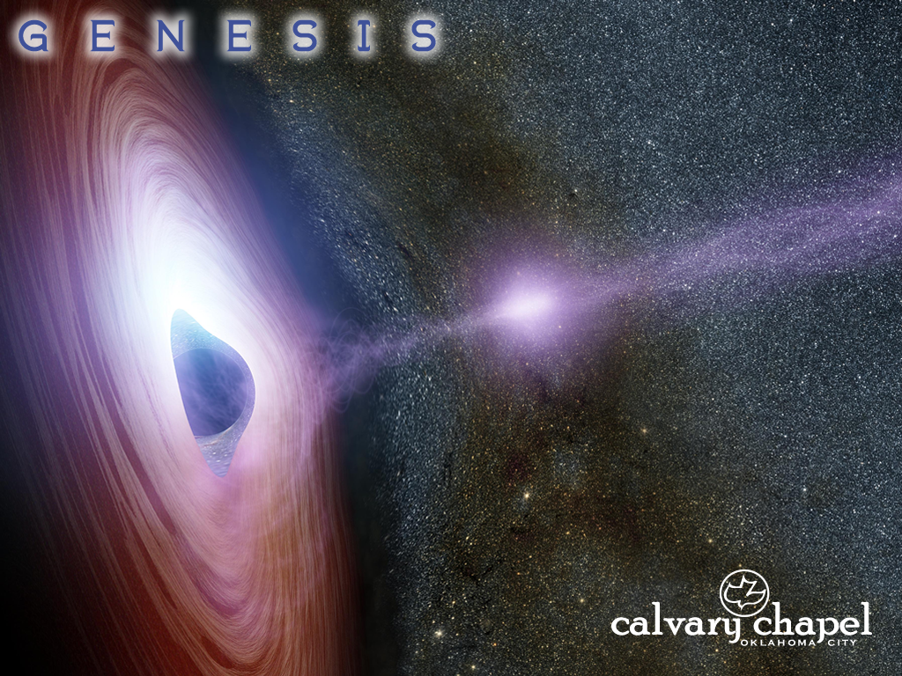
41-42

Slide 4
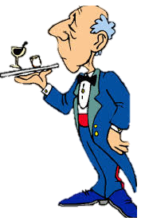

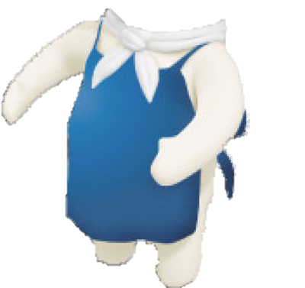
41-42

Slide 5
41-42
Gen. 40:23 ~ Yet the chief butler did not remember Joseph, but forgot him.
This Photo by Unknown Author is licensed under CC BY-SA
This Photo by Unknown Author is licensed under CC BY-SA
This Photo by Unknown Author is licensed under CC BY-SA
This Photo by Unknown Author is licensed under CC BY-SA
This Photo by Unknown Author is licensed under CC BY-SA-NC

Slide 6
41-42

Slide 7
41-42
720 days
2 full years
17,280 hours
1,036,800 minutes
This Photo by Unknown Author is licensed under CC BY-SA
This Photo by Unknown Author is licensed under CC BY-SA
This Photo by Unknown Author is licensed under CC BY-SA
This Photo by Unknown Author is licensed under CC BY-SA
This Photo by Unknown Author is licensed under CC BY-SA-NC

Slide 8
41-42

Slide 9
41-42
magicians ~ related to the Hebrew word for stylus
This Photo by Unknown Author is licensed under CC BY-SA
This Photo by Unknown Author is licensed under CC BY-SA
This Photo by Unknown Author is licensed under CC BY-SA
This Photo by Unknown Author is licensed under CC BY-SA
This Photo by Unknown Author is licensed under CC BY-SA-NC

Slide 10
41-42

Slide 11
41-42
faults ~ chēt – usually translated sins
NIV, shortcomings

Slide 12
41-42

Slide 13
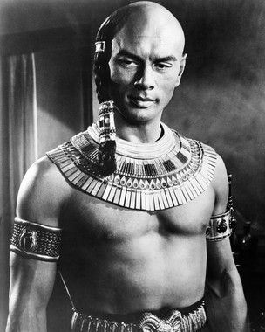
41-42

Slide 14
41-42

Slide 15
41-42
ugly ~ translated from 2 Hebrew words meaning evil and appearance

Slide 16
41-42

Slide 17
41-42
severe ~ Hebrew, kabed – heavy

Slide 18
41-42

Slide 19
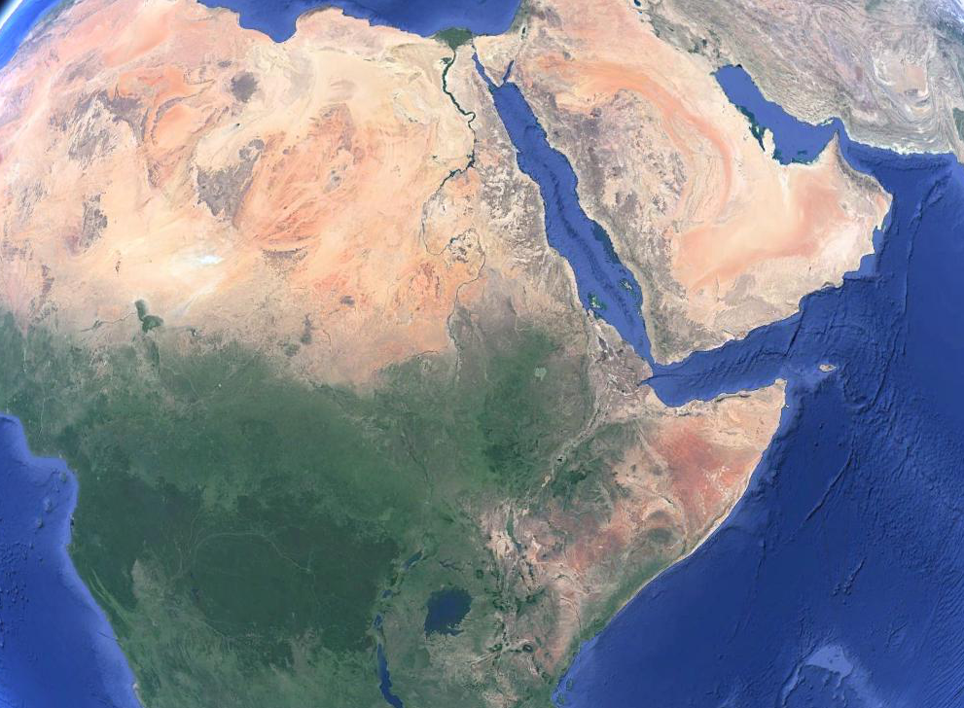
41-42
Over 3,300 mi.

Slide 20
41-42

Slide 21
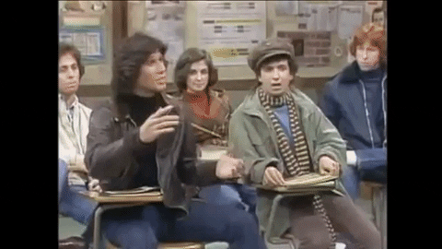
41-42
“Oh, oh, oh … oh, me, oh … oh, pick me, pick me … oh, oh me, me”

Slide 22
41-42

Slide 23
41-42
(Merrihew Standard Version) ~ ⁵ Think about this in the same way Jesus did. ⁶ Even though He was God Himself, He didn’t think the rights and privileges of being God were something He had to hold on to. ⁷ In fact, He completely emptied Himself of those rights as He entered this world in the lowest stature of humanity – that of a servant who is bound to His Master for life. ⁸ As a “Man without rights,” He obeyed His Master’s will without question – even to die in the most shameful, painful, excruciating way possible: to be crucified.
Phil. 2:5-8

Slide 24
41-42

Slide 25
41-42
Zaphnath-Paaneah ~ One Who Discovers Hidden Things or Treasury of the Golden Rest

Slide 26
41-42

Slide 27
41-42
Manasseh ~ Forgetful
“Amnesia”
“Ambrosia”
Ephraim ~ Fruitful

Slide 28
41-42

Slide 29
41-42
earth ~ eh’rets – 2,504x in the Old Testament
1,543x (KJV) ~ country
140x (KJV) ~ land
712x (KJV) ~ earth
9x (KJV) ~ miscellaneous
NIV ~ … for the famine was severe throughout Egypt.
NLT ~ So with severe famine everywhere,

Slide 30
41-42

Slide 31

41-42
bowed down ~ shachaw – same as 37:7
This Photo by Unknown Author is licensed under CC BY-NC

Slide 32
41-42

Slide 33
41-42
Matt. 5:16 ~ Let your light so shine before men, that they may see your good works and glorify your Father in heaven.

Slide 34

41-42
Matt. 5:16 ~ Let your light so shine before men, that they may see your good works and glorify your Father in heaven.
Steve Taylor © 1994

Slide 35
41-42

