Slide 1
39-40

Slide 2
39-40
Joseph ~ He will add

Slide 3
39-40

Slide 4
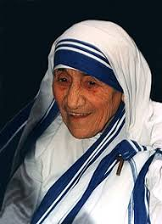
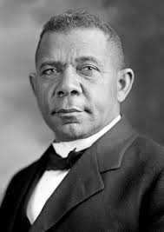
39-40
Booker T. Washington (1856-1915) ~ “We shall prosper as we learn to do the common things of life in an uncommon way. Let down your buckets where you are.”
Mother Theresa (1910-1990) ~ “God has not called me to be successful; he has called me to be faithful.”

Slide 5
39-40

Slide 6
39-40
Old English proverb ~ “He who would climb the ladder must begin at the bottom.”

Slide 7
39-40

Slide 8
39-40
Gen. 29:17b ~ Rachel was beautiful of form and appearance.
Gen. 24:16a ~ Now the young woman (Rebekah) was very beautiful to behold,

Slide 9
39-40
Is. 53:2 ~ For He shall grow up before Him as a tender plant,
And as a root out of dry ground.
He has no form or comeliness;
And when we see Him,
There is no beauty that we should desire Him.

Slide 10
39-40

Slide 11
39-40
officer (v. 1) ~ saris – is usually translated eunuch

Slide 12
39-40

Slide 13
39-40
KJV ~ My master wotteth not what is with me …

Slide 14
39-40

Slide 15
39-40
1 Thess. 4:3 ~ For this is the will of God, your sanctification: that you should abstain from sexual immorality;
sexual immorality ~ porneia – all illicit sex
, but all illicit sex
Not moicheuō – adultery

Slide 16
39-40

Slide 17
39-40
SKINNY UGLY KIDS’ HIGH SCHOOL

Slide 18
39-40

Slide 19
39-40

Slide 20
39-40
love hormone
cuddle hormone
bonding hormone

Slide 21
39-40

Slide 22
39-40
Song of Sol. 8:4 (NLT) ~ Promise me, O women of Jerusalem,
not to awaken love until the time is right. *
* Or, not to awaken love until it is ready.

Slide 23
39-40
Marriage
Premarital sex
Bisexuality
Homosexuality
Transgenderism
???????
Heb. 13:4 ~ Marriage is honorable among all, and the bed undefiled; but fornicators and adulterers God will judge.

Slide 24
39-40

Slide 25
39-40
Is. 49:15 ~ Can a woman forget her nursing child, And not have compassion on the son of her womb?
Surely they may forget,
Yet I will not forget you.

Slide 26
39-40

Slide 27
39-40
butler ~ masqeh – better, cupbearer (same as Nehemiah)

Slide 28
39-40

Slide 29
39-40
Pharaoh’s 2nd
In command
Favorite son
hills
Potiphar’s chief steward
Prison manager
Slavery
Imprisonment 2.0
valleys
Imprisonment
Age
15
17
20
25
30

Slide 30
39-40

