Slide 1

34-36

Slide 2

34-36
NASB ~ he took her and lay with her by force.

Slide 3

34-36

Slide 4
34-36
Abraham (Sarah)
Isaac (Rebekah)
Gen. 3:15 ~ And I will
put enmity
Between you and the
woman,
And between your seed
and her Seed;
He shall bruise your head,
And you shall bruise His heel.”
Jacob (Leah)
Judah (Tamar)
Jesse (Nitzevet)
David (Bathsheba)
Jesus

Slide 5
34-36

Slide 6
34-36
honorable ~ literally, heavy – could mean position

Slide 7
34-36

Slide 8
34-36
James 1:20 ~ … for the wrath of man does not produce the righteousness of God.

Slide 9
34-36

Slide 10
34-36
obnoxious ~ NASB, odious
NIV ~ stench
KJV ~ stink

Slide 11
34-36

Slide 12

34-36
Chinese Proverb: “If thine enemy wrong thee, buy each of his children a drum.”

Slide 13
34-36

Slide 14
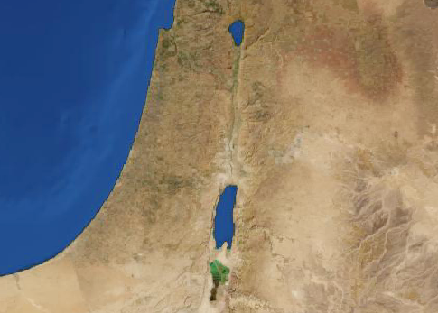
34-36
Shechem
15 mi
Bethel
This Photo by Unknown Author is licensed under CC BY-SA

Slide 15
34-36
dwell ~ NIV, settle
This Photo by Unknown Author is licensed under CC BY-SA

Slide 16
34-36

Slide 17
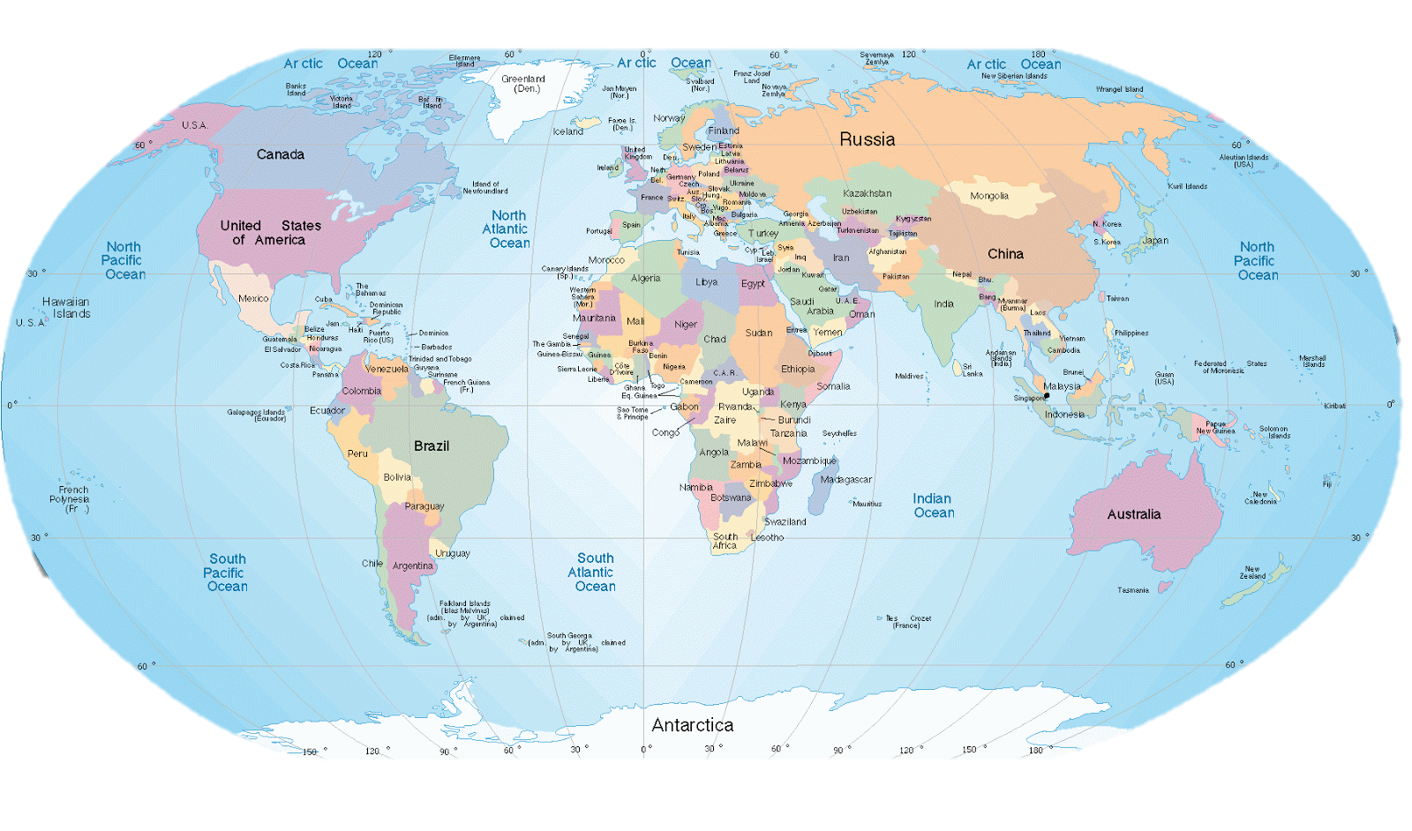
34-36
Vortexes, Arizonia
You Are Here, US
Glastonbury Tor,
UK
Vatican, Rome
Mt. Kailash,
Tibet
Jerusalem, Israel
Cenote Sagrado, Mexico
Mecca,
Saudi Arabia
This Photo by Unknown Author is licensed under CC BY-SA

Slide 18
34-36

Slide 19
34-36
Ben
-Oni
~ son of my sorrow
Benjamin
~ son of my right hand

Slide 20
34-36

Slide 21
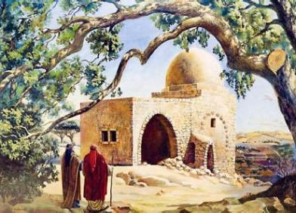
34-36
Rachel’s tomb

Slide 22
34-36

Slide 23
34-36
43 years
1720 BC
1710 BC
1700 BC
1600 BC
Isaac blesses Jacob (BC 1724)
Isaac’s death (180 y/o)

Slide 24
34-36

Slide 25
34-36
Eliphaz the Temanite (Job 2:11)?

Slide 26
34-36

Slide 27
34-36
chiefs ~ KJV, dukes

Slide 28
34-36

Slide 29
34-36
Jobab ~ Job?

Slide 30
34-36

