Slide 1
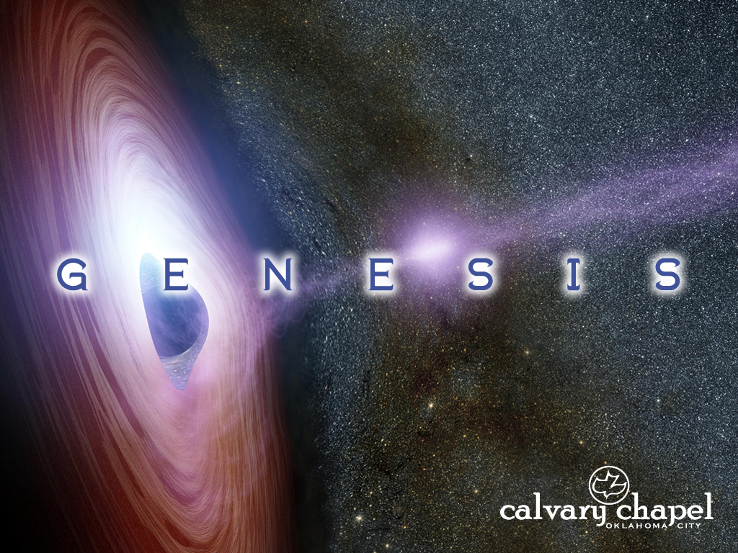
32-33

Slide 2
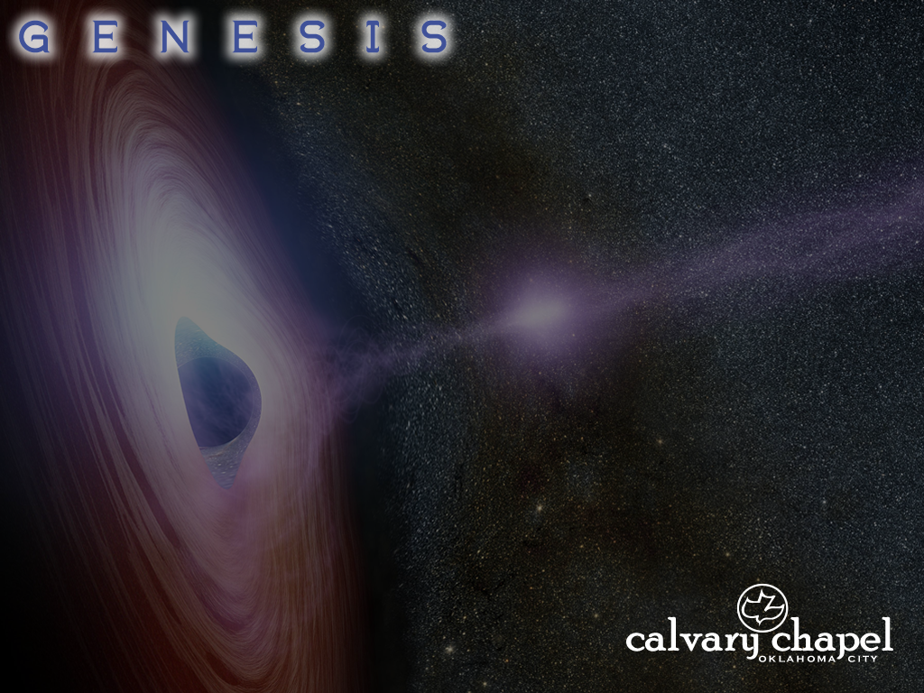
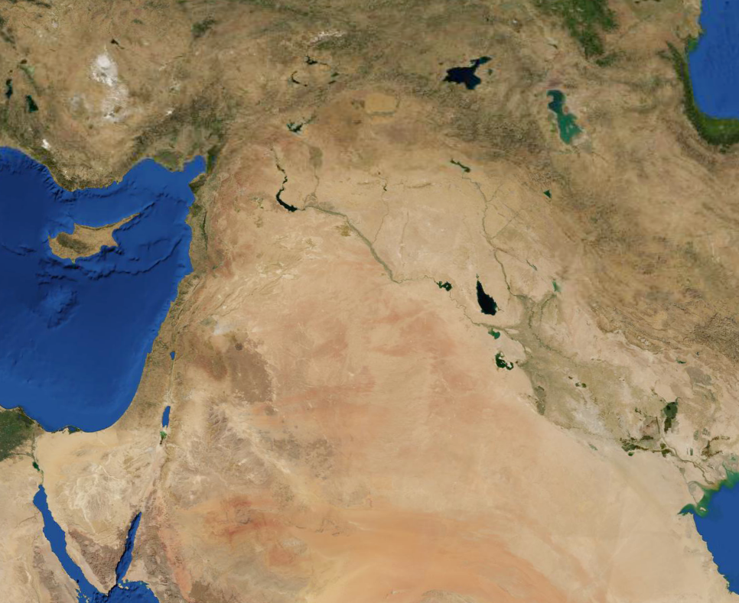
32-33
Haran
Jacob’s journeys
Mahanaim
(Double camp)
Mt. Seir

Slide 3
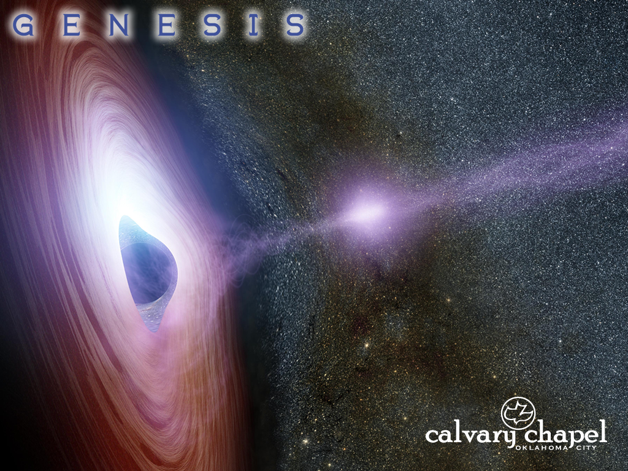
32-33

Slide 4
32-33
Jacob’s journeys
Bethel
R. Jabbok

Slide 5
32-33

Slide 6
32-33
Hosea 12:2-5 ~ ² The Lord also brings a charge against Judah,
And will punish Jacob according to his ways;
According to his deeds He will recompense him.
³ He took his brother by the heel in the womb,
And in his strength he struggled with God.
⁴ Yes, he struggled with the Angel and prevailed;
He wept, and sought favor from Him.
He found Him in Bethel,
And there He spoke to us —
⁵ That is, the Lord God of hosts.
The Lord is His memorable name.

Slide 7
32-33
Bethel ~ House of God (Gen. 28:10-22)
Jabbok ~ Emptying (Gen. 32:24-30)
Jacob receives all of God
God receives all of Jacob
A type of salvation (John 20:22)
A type of the Baptism with the Holy Spirit (Acts 1:8)

Slide 8
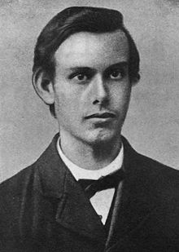

32-33
The Hound of Heaven
– Francis Thompson (1857-1907)
I fled Him down the nights and down the days;
I fled Him down the arches of the years;
I fled Him down the labyrinthine ways
Of my own mind, and in the midst of tears
I hid from him, and under running laughter.
Up vistaed hopes I sped; and shot, precipitated,
Adown titanic glooms of chasmed fears,
From those strong feet that followed, followed after.
(read by Richard Burton)

Slide 9
32-33

Slide 10
32-33
Israel ~ Ruled by God

Slide 11
32-33

Slide 12
32-33
Peniel ~ Face of God

Slide 13
32-33

Slide 14
32-33
John 20:27 ~ Then He said to Thomas, “Reach your finger here, and look at My hands; and reach your hand here, and put it into My side. Do not be unbelieving, but believing.”

Slide 15
32-33

Slide 16
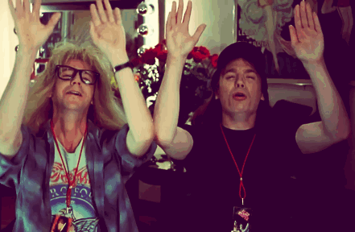
32-33

Slide 17
32-33

Slide 18
32-33
enough (v. 9) ~ rab - abundant, excess
enough (v. 11) ~ kol - full, whole

Slide 19
32-33

Slide 20
32-33
Jacob’s journeys
Shechem
Succoth
Jacob
Esau
Mt. Seir

Slide 21
32-33

Slide 22
32-33
El Elohe Israel ~ God, the God of Israel

Slide 23
32-33

