Slide 1

29-31

Slide 2

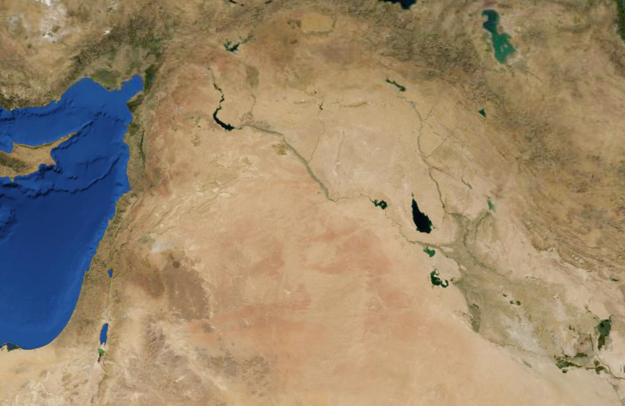
29-31
Haran
Jacob’s journeys
Bethel
Beersheba

Slide 3
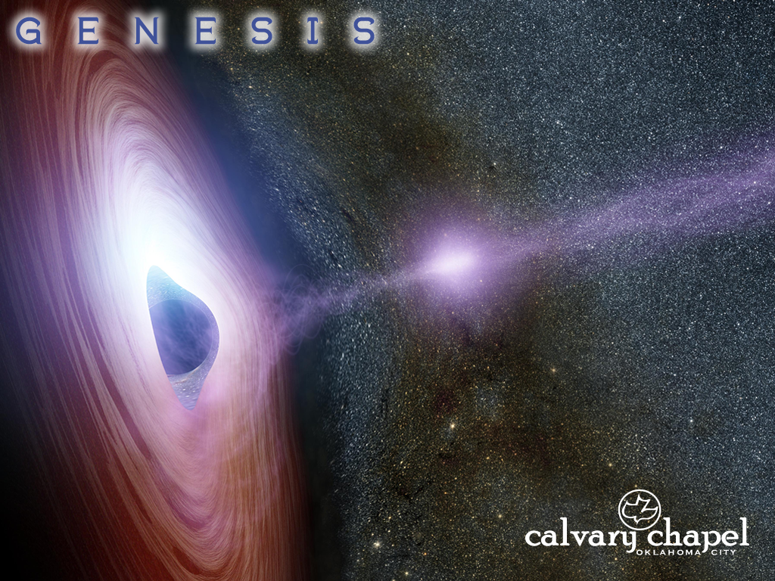
29-31

Slide 4
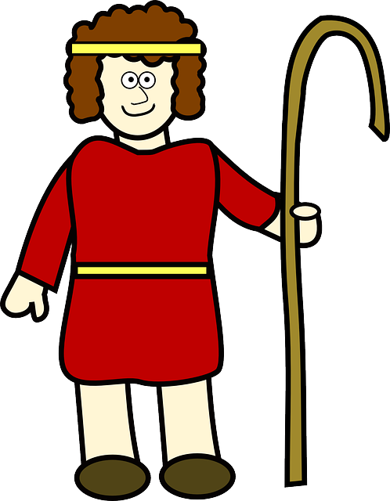
29-31
Laban ~ white

Slide 5
29-31

Slide 6
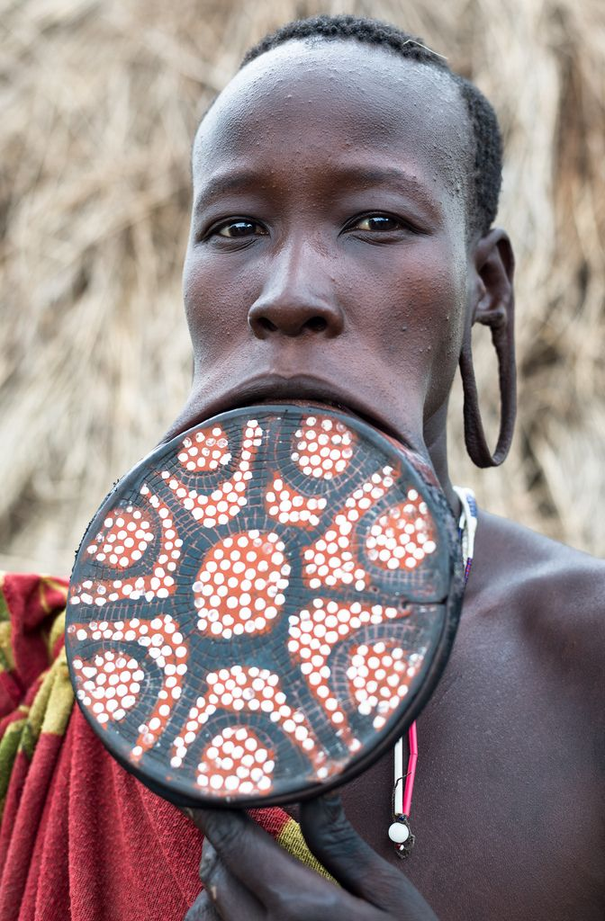
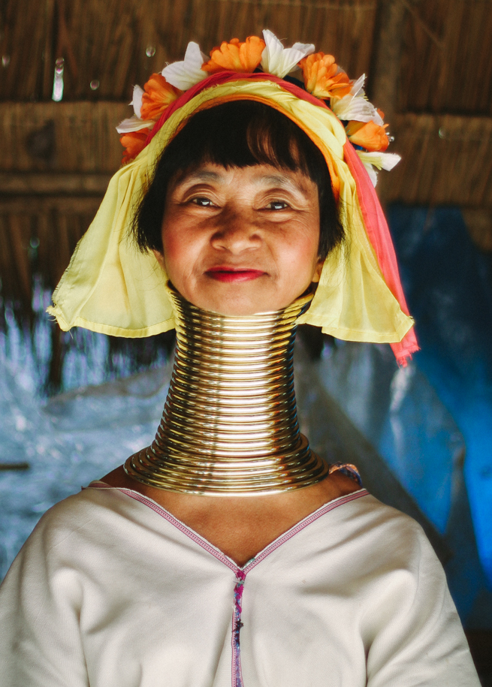
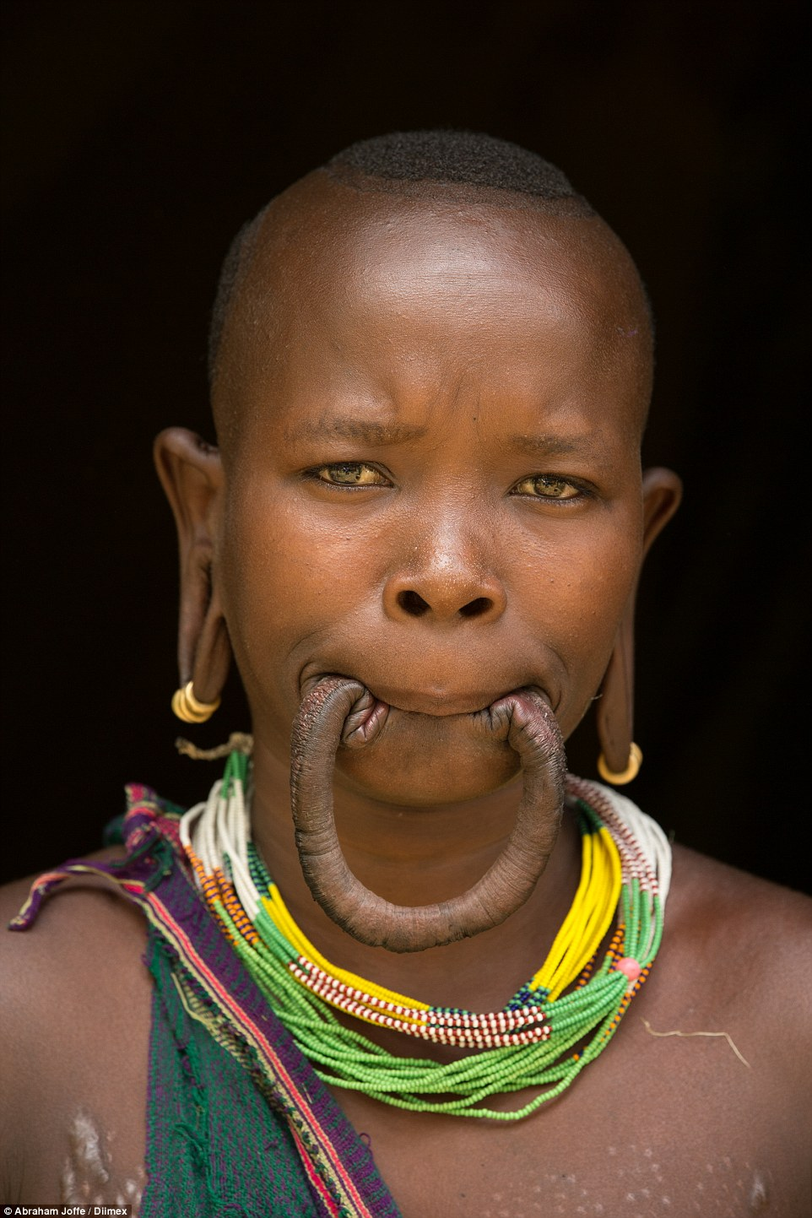
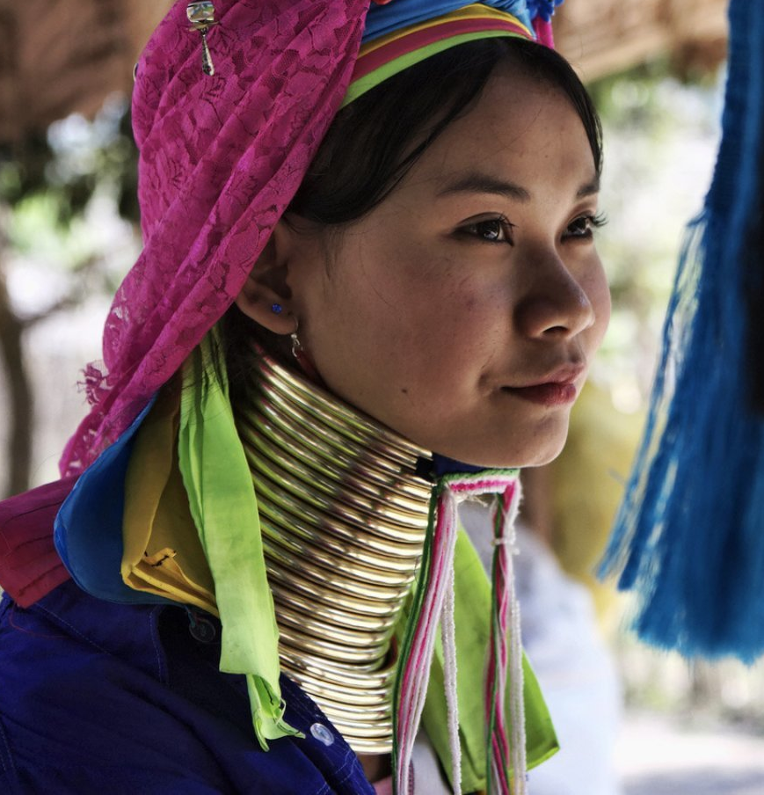
29-31
delicate ~ NASB, NIV – weak
Lip stretching Southern Ethiopia
Neck rings
in Thailand

Slide 7
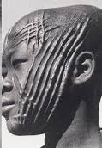
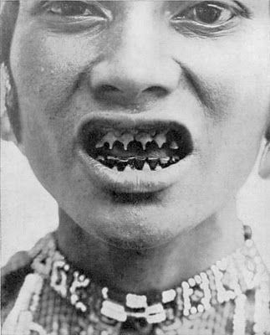
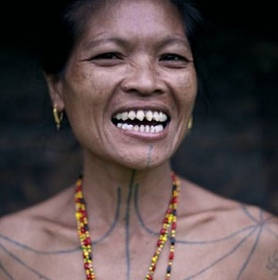
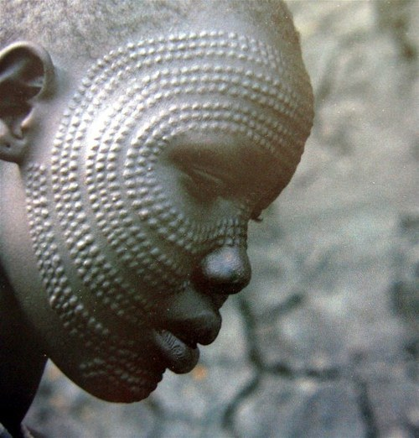
29-31
delicate ~ NASB, NIV – weak
Teeth filing
in Indonesia
Scarification
in Africa

Slide 8
29-31

Slide 9
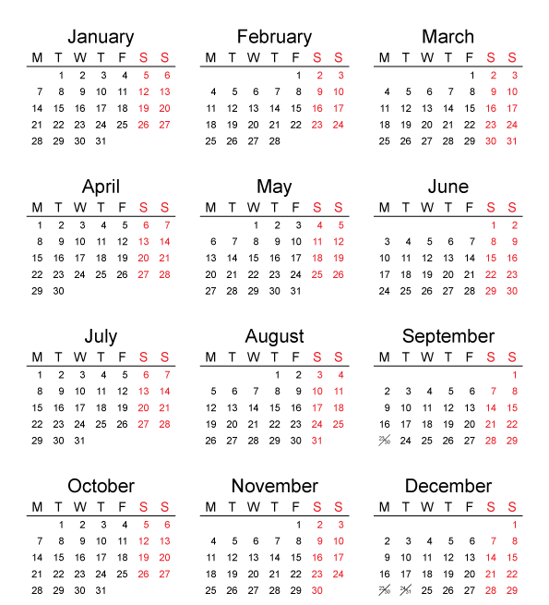
29-31
1696 BC
1695 BC
1694 BC
1693 BC
1692 BC
1691 BC
1690 BC

Slide 10
29-31

Slide 11
29-31
1696 BC
1695 BC
1694 BC
1693 BC
1692 BC
1691 BC
1690 BC
1689 BC
1688 BC
1687 BC
1686 BC
1685 BC
1684 BC
1683 BC

Slide 12
29-31

Slide 13
29-31
Parallel polygamy
Wife
Husband
Wife
Wife

Slide 14
29-31
Serial polygamy
Husband
Wife
Wife
Wife

Slide 15
29-31

Slide 16
29-31
unloved ~ KJV, hated

Slide 17
29-31

Slide 18
29-31
Leah
Reuben ~ Behold a son
Simeon ~ Heard
Levi ~ Joined
Judah ~ Praise
Zilpah
Gad ~ Troop or Good fortune
Asher ~ Happy
Bilhah
Dan ~ Judge
Naphtali ~ Wrestling

Slide 19
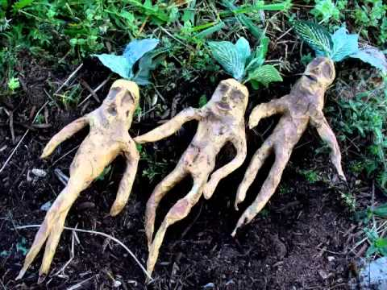
29-31
Mandrakes

Slide 20
29-31
Leah
Reuben ~ Behold a son
Simeon ~ Heard
Levi ~ Joined
Judah ~ Praise
Issachar ~ There is recompense
Zebulun ~ A dwelling
Dinah ~ feminine form of Judge
Zilpah
Gad ~ Troop or Good fortune
Asher ~ Happy
Bilhah
Dan ~ Judge
Naphtali ~ Wrestling
Rachel
Joseph ~ Jehovah has added

Slide 21
29-31

Slide 22
29-31
learned experience ~ nachash – NASB, have divined
NIV ~ learned by divination

Slide 23
29-31

Slide 24
29-31
white ~ laban

Slide 25
29-31

Slide 26
29-31
conceived (vv. 38, 39) ~ yacham – a primitive root meaning hot

Slide 27
29-31

Slide 28
29-31
gray-spotted ~ KJV, grisled

Slide 29
29-31

Slide 30
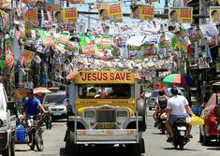
29-31
idols ~ teraphim – probably a symbol of preeminence

Slide 31
29-31

Slide 32
29-31
Haran
Jacob’s journeys
Bethel
Gilead
Beersheba

Slide 33
29-31

Slide 34
29-31
my sons and my daughters ~ i.e., grandchildren
NLT ~ my daughters and grandchildren
NIV ~ my grandchildren and my daughters

Slide 35
29-31

Slide 36
29-31
saddle ~ KJV, furniture

Slide 37
29-31

Slide 38
29-31
Galeed ~ heap of testimony
Mizpah ~ watchtower

Slide 39
29-31

