Slide 1
26-28

Slide 2
26-28
Dwell ~ gür – better, Sojourn (KJV, NASB, ESV)

Slide 3
26-28

Slide 4
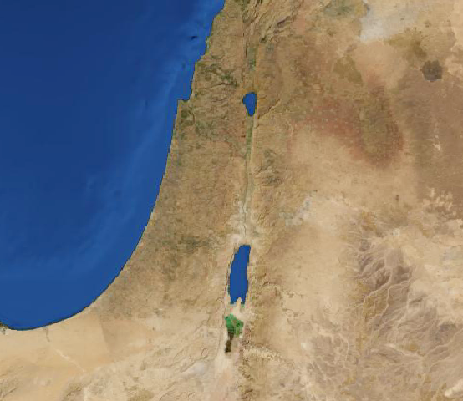
26-28
Via Maris
Gerar
Negev
Egypt

Slide 5
26-28

Slide 6
26-28
endearment ~ KJV, sporting

Slide 7
26-28

Slide 8
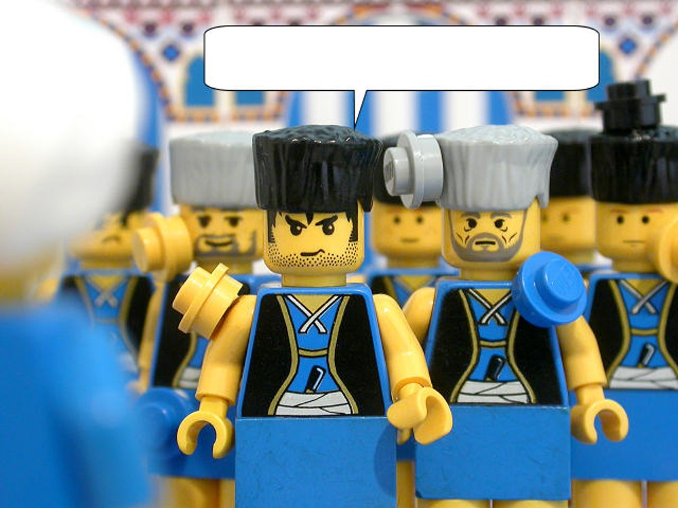
26-28
“Flocks and herds and
servants, oh my!”

Slide 9
26-28

Slide 10
26-28
Esek ~ Contention
Sitnah ~ Strife
Rehoboth ~ Wide places

Slide 11
26-28

Slide 12
26-28
Abraham 175 yr.
Isaac
180 yr.
Jacob
147 yr.
1900 BC
1800 BC
1700 BC
43 yr.
Isaac blesses Jacob (BC 1724)
Jacob and Esau over 75 years old

Slide 13
26-28
Gen. 25:23 ~ And the Lord said to her:
“Two nations are in your womb,
Two peoples shall be separated from your body;
One people shall be stronger than the other,
And the older shall serve the younger.”

Slide 14
26-28

Slide 15
26-28
NASB footnote ~ literally, trembled with a very great trembling

Slide 16
26-28

Slide 17
26-28
Heb. 5:14 ~ But solid food belongs to those who are of full age, that is, those who by reason of use have their senses exercised to discern both good and evil.

Slide 18
26-28

Slide 19
26-28
Heimdall

Slide 20
26-28

Slide 21
26-28
Bethel ~ house of God
John 1:49-51 ~ ⁴⁹ Nathanael answered and said to Him, “Rabbi, You are the Son of God! You are the King of Israel!” ⁵⁰ Jesus answered and said to him, “Because I said to you, ‘I saw you under the fig tree,’ do you believe? You will see greater things than these.” ⁵¹ And He said to him, “Most assuredly, I say to you, hereafter you shall see heaven open, and the angels of God ascending and descending upon the Son of Man.”

Slide 22
26-28

Slide 23
26-28
created ~ bara – always has God as the subject
Latin, ex nihilo ~ out of nothing

Slide 24
26-28

