Slide 1
22-23

Slide 2
22-23
Abraham = God, the Father
Sarah = Israel (wife of God)
Isaac = God, the Son
Rebekah (chapter 24) = the Church
(bride of Christ)
Eliezer = God, the Holy Spirit

Slide 3
22-23

Slide 4
22-23
tested ~ KJV, tempted – nasa
Places of testing:
1. Places where we are most confident.
2. Places where we are most vulnerable.

Slide 5
22-23

Slide 6
22-23
Moriah ~ chosen of Jehovah
love ~ 1st mention
Matt. 3:17 ~ This is My beloved Son …
Also, Mark 1:11, Luke 3:22
John 3:16 ~ For God so loved the world …

Slide 7
22-23

Slide 8
22-23
Talmud ~ young men are Ishmael and Eliezer
na`ar

Slide 9
22-23

Slide 10
22-23
worship ~ 1st mention
lad ~ na`ar – translated variously – child, servant, young man
4 yr.
8 yr.
12 yr.
16 yr.
20 yr.
24 yr.
28 yr.
32 yr.

Slide 11
22-23

Slide 12
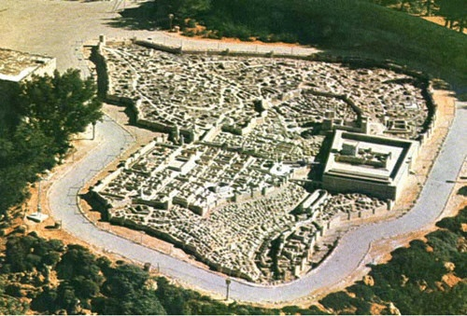
22-23
Calvary
Mt. Moriah
The Temple
City of David
1st century Jerusalem

Slide 13
22-23

Slide 14
22-23
“Behold! The
Lamb of God who takes away the sin of the world!”
“But where
is the lamb for a burnt offering?”
Gen. 22:7
John 1:29
1800 BC
1400 BC
800 BC
400 BC
200 BC

Slide 15
22-23

Slide 16
22-23
KJV, God will provide Himself
Literally, God will see to it Himself
1st mention of lamb (v. 7)

Slide 17
22-23

Slide 18
22-23
Heb. 11:17-19 ~ ¹⁷ By faith Abraham, when he was tested, offered up Isaac, and he who had received the promises offered up his only begotten son, ¹⁸ of whom it was said, “In Isaac your seed shall be called,” ¹⁹ concluding that God was able to raise him up, even from the dead, from which he also received him in a figurative sense.

Slide 19
22-23

Slide 20
22-23
Heaven’s Academy
Report Card
Abram ben Terah
Student’s name _______________________
Leaving family and country
B -
Going down to Egypt
F
Dividing the land with Lot
A-
Refusing spoils from king of Sodom
A
Offering Isaac as a burnt sacrifice
A+

Slide 21
22-23

Slide 22
22-23
John 8:56 ~ Your father Abraham rejoiced to see My day, and he saw it and was glad.

Slide 23
22-23

Slide 24
22-23
Gal. 3:16 ~ Now to Abraham and his Seed were the promises made. He does not say, “And to seeds,” as of many, but as of one, “And to your Seed,” who is Christ.

Slide 25
22-23

Slide 26
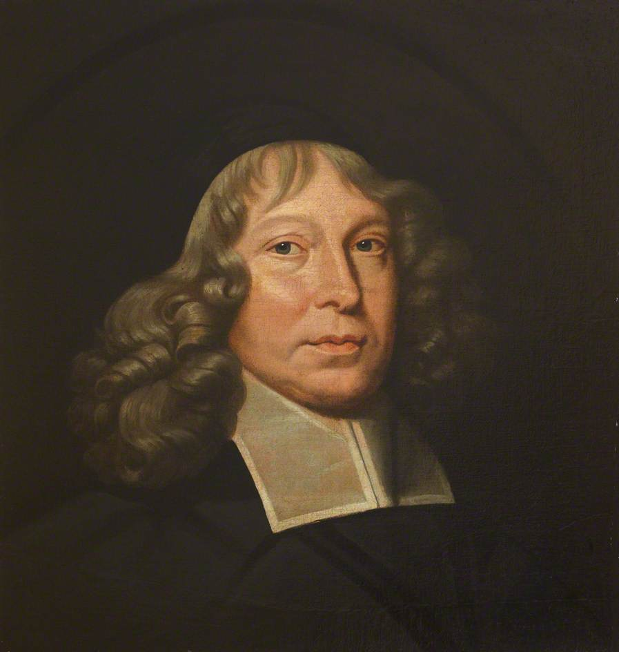
22-23
The-Lord-Will-Provide ~ Jehovah Jireh
Samuel Rutherford (1600-1661) ~ “When I am in the cellar of affliction, I look for the Lord’s choicest wines.”

Slide 27
22-23

Slide 28
22-23
Gal. 3:16 ~ Now to Abraham and his Seed were the promises made. He does not say, “And to seeds,” as of many, but as of one, “And to your Seed,” who is Christ.

Slide 29
22-23

Slide 30
22-23
1st mention of weeping
Ps. 116:15 ~ Precious in the sight of the Lord
Is the death of one of His saints.

Slide 31
22-23

Slide 32
22-23
Heth ~ Son of Canaan and ancestor of the Hittites

Slide 33
22-23

Slide 34
22-23
mighty ~ elohim
ESV ~ “You are a prince of God among us.”

Slide 35
22-23

Slide 36
22-23
Heb. 11:10 ~ for he waited for the city which has foundations, whose builder and maker is God.

Slide 37
22-23

Slide 38
22-23
love ~ 1st mention
worship ~ 1st mention
lamb ~ 1st mention
weeping ~ 1st mention

Slide 39
22-23

Slide 40
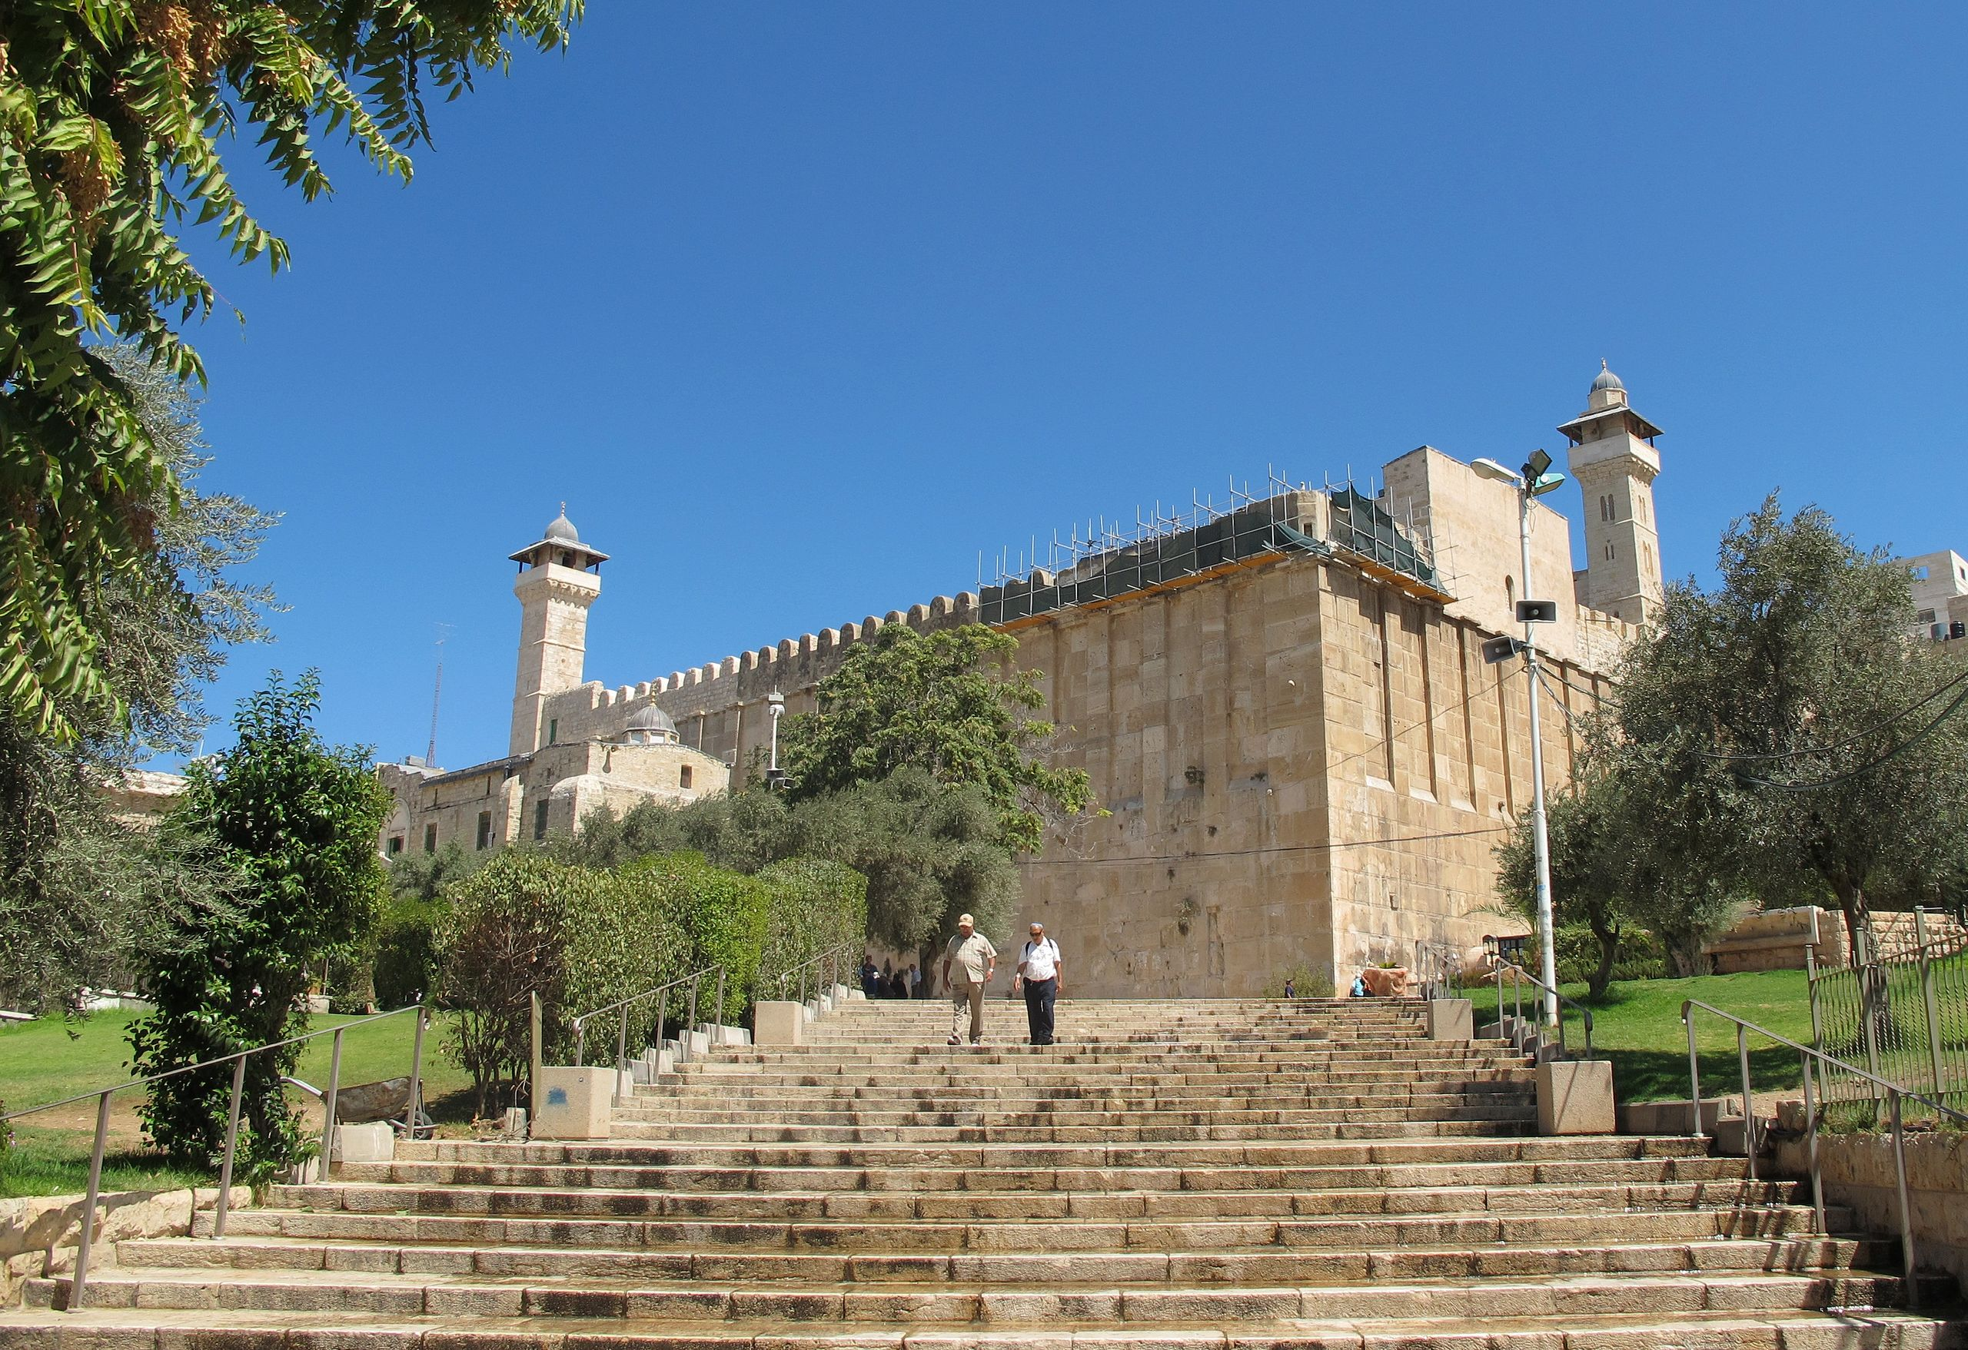
22-23
Tomb of the Patriarchs
Abraham
Isaac and Rebekah
Jacob and Leah

Slide 41
22-23

