Slide 1
15:8-17:27

Slide 2
15:8-17:27
horror and great darkness ~ NIV, thick and dreadful darkness

Slide 3
15:8-17:27

Slide 4
15:8-17:27
made a covenant ~ karath b’rit
cutting a covenant
Origin of the phrase “to cut a deal”

Slide 5
15:8-17:27

Slide 6
15:8-17:27
pragmatic : “concerned with practical results”

Slide 7
15:8-17:27

Slide 8
15:8-17:27
Ishmael ~ God hears

Slide 9
15:8-17:27

Slide 10
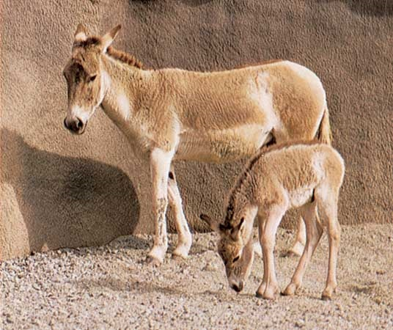
15:8-17:27
wild man ~ literally, donkey-man
onager ~ a strong and valuable donkey in the Middle East
Equus Hermionus

Slide 11
15:8-17:27
How not to handle a mistake:
Sarai ~ blame someone else
Abram ~ do nothing
Hagar ~ run from it

Slide 12
15:8-17:27

Slide 13
15:8-17:27
Sarah
Abraham
Hagar
Isaac
Ishmael
Israelites
Arabs

Slide 14
15:8-17:27

Slide 15
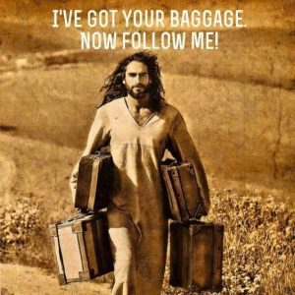
15:8-17:27

Slide 16
15:8-17:27

Slide 17
15:8-17:27
Left Haran
(75 y/o)
Called by God
80 y/o
Sojourn in Egypt
Ishmael born
(86 y/o)
Defeats the 5 kings
100 y/o
karath b’rit
Circumcision
(99 y/o)
Isaac born
(100 y/o)
Judgment of Sodom
120 y/o
Hagar & Ishmael exiled
Isaac offered as sacrifice
Sarah dies
(137 y/o)
140 y/o
Marries Keturah
Events in white are approximate dates
160 y/o
Abraham dies
(175 y/o)

Slide 18
15:8-17:27
blameless ~ KJV, perfect
Almighty God ~ El Shaddai
El ~ God
Shaddai ~ from a word meaning “overpowering”

Slide 19
15:8-17:27

Slide 20
15:8-17:27
Abram ~ lofty father
Abraham ~ father of multitudes

Slide 21
15:8-17:27

Slide 22
15:8-17:27
Sen. James Inhofe ~ “As a nation, we should support and promote freedom and democracy in the region, but we should not do so at the expense of Israel. That land belongs to Israel – period.
“Based on archeological evidence and historical right, that land belongs to Israel.”

Slide 23
15:8-17:27

Slide 24
15:8-17:27
SET
APART
FOR
GOD
S A F G

Slide 25
15:8-17:27

Slide 26
Sarai ~ princess
15:8-17:27
Sarai ~ princess
Sarah ~ noblewoman

Slide 27
15:8-17:27

