Slide 1
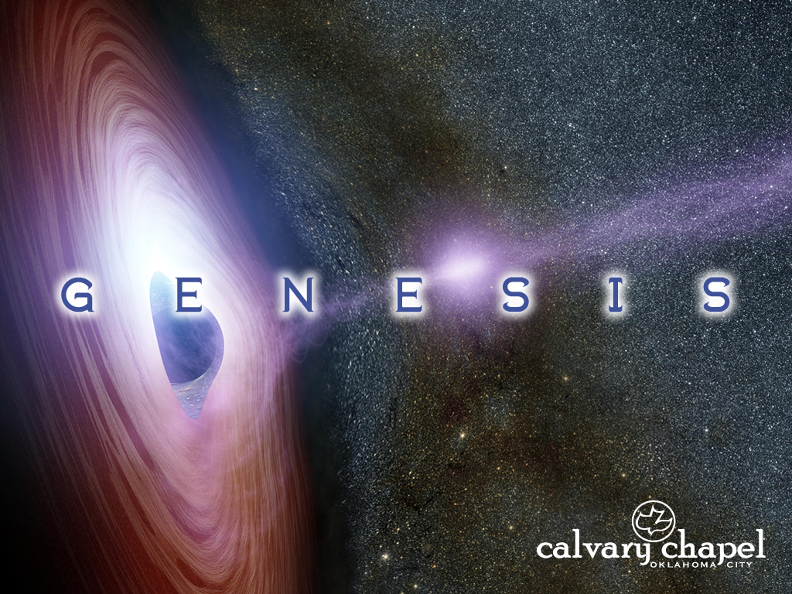
13:1-15:7

Slide 2
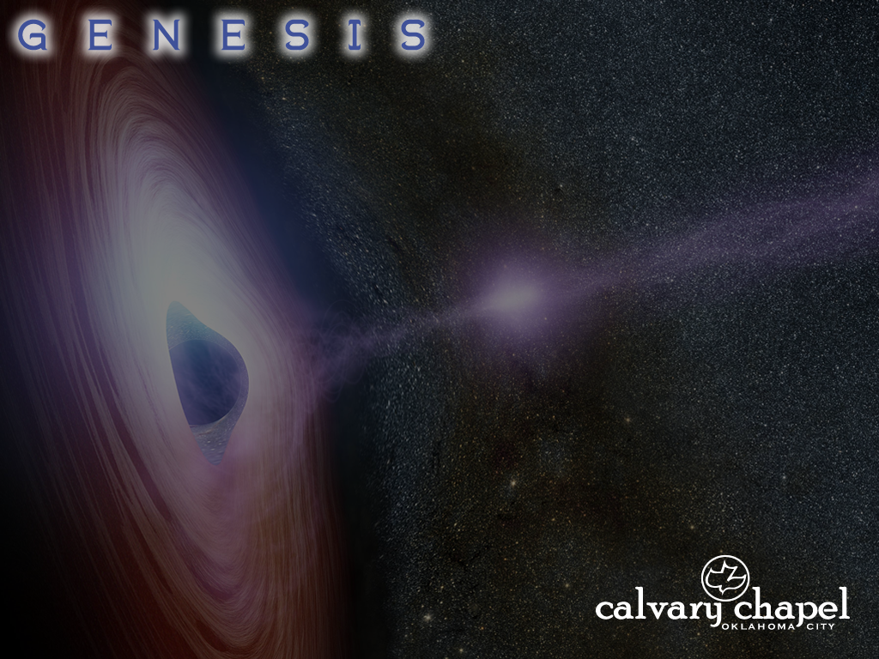
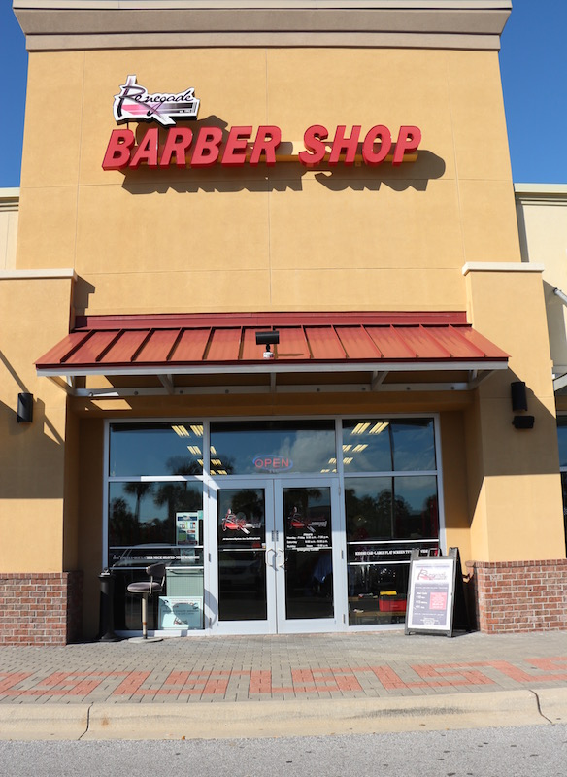
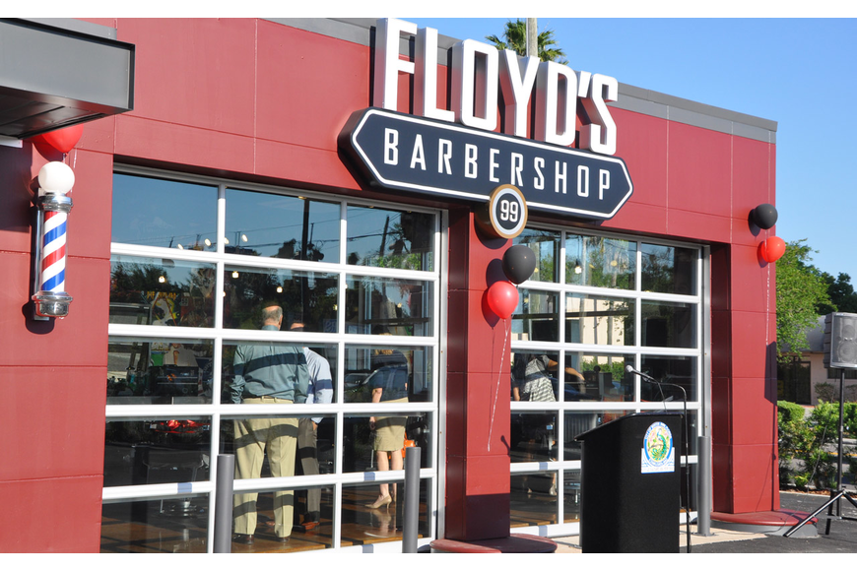
13:1-15:7
We give $7 haircuts
We fix $7 haircuts

Slide 3
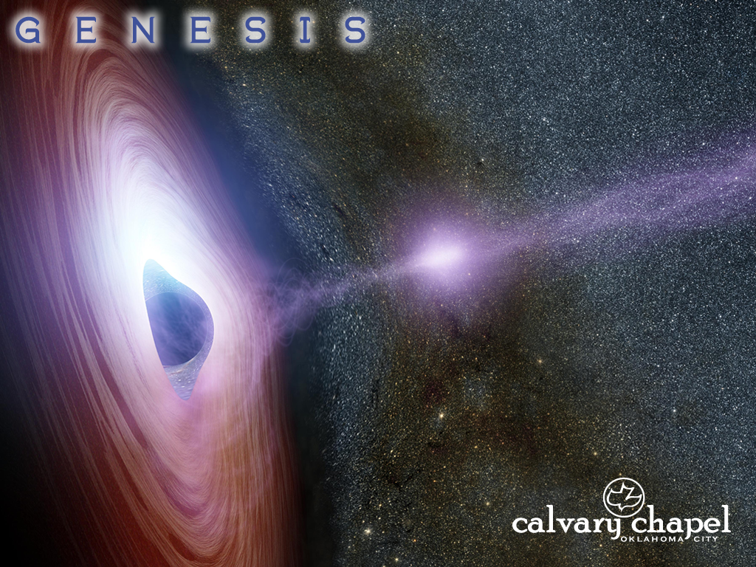
13:1-15:7

Slide 4
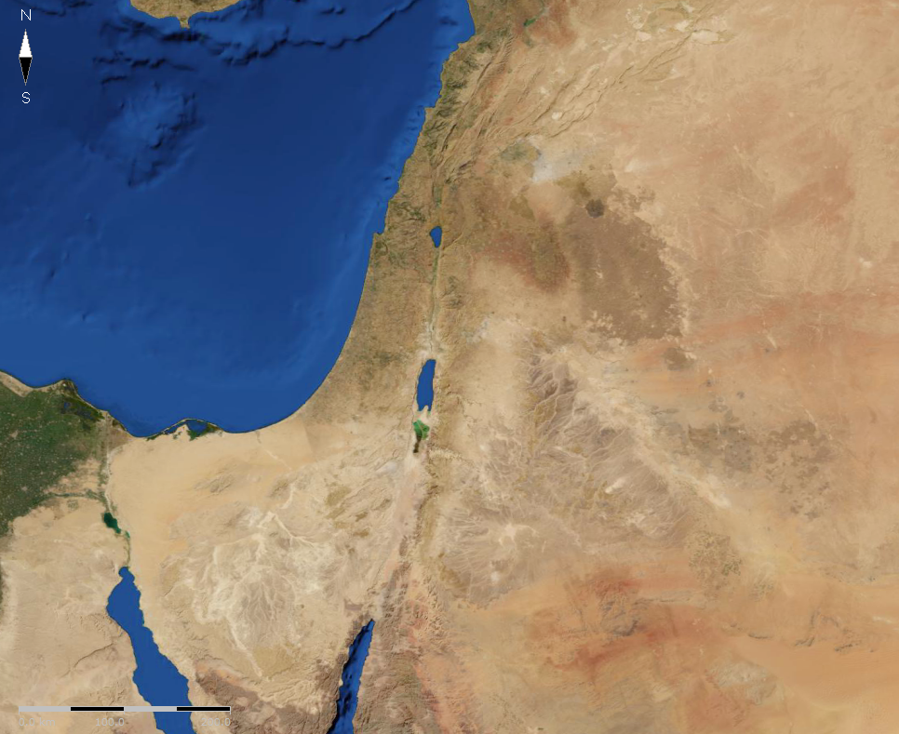
13:1-15:7
Mamre ~ strength or fatness
Terebinth trees
of Mamre (Hebron)

Slide 5
13:1-15:7

Slide 6
13:1-15:7
nations (v. 1) ~ goyim – Gentiles (i.e. any non-Hebrew)

Slide 7
Top trimmed with 2” ripped planking
13:1-15:7

Slide 8
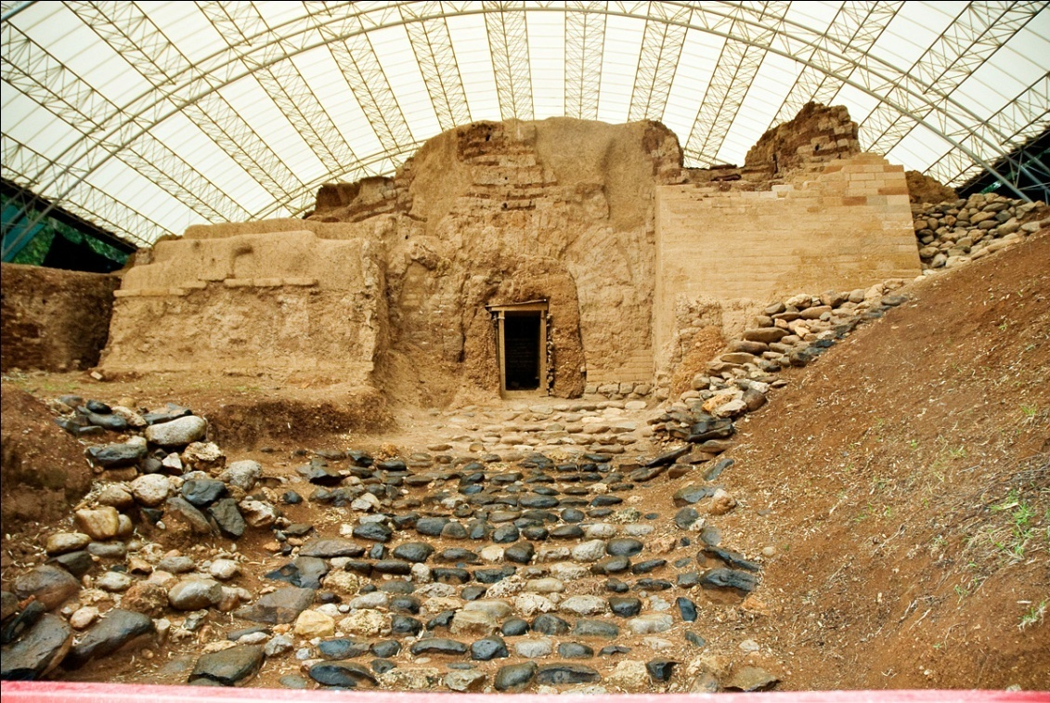
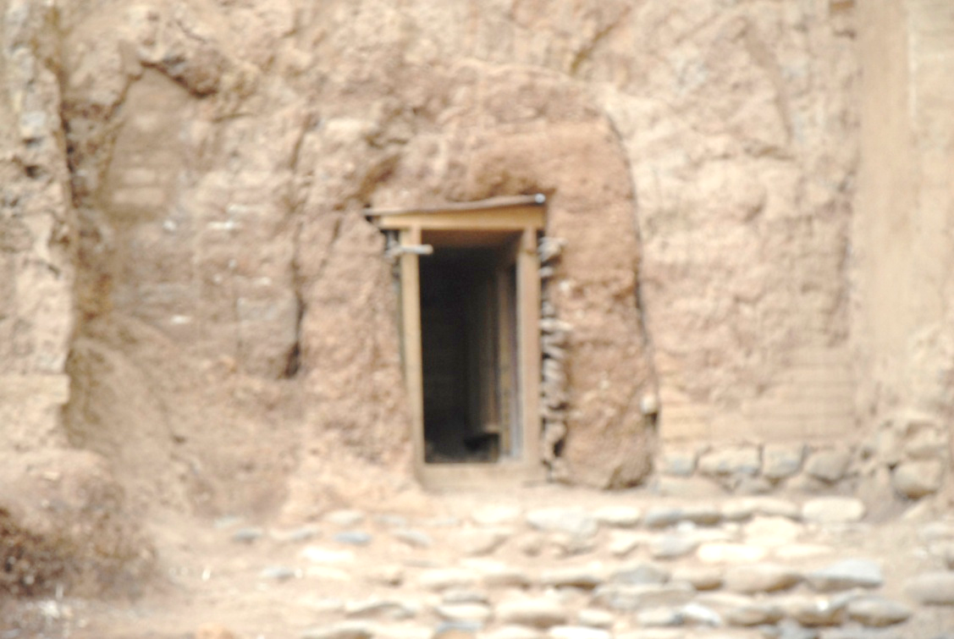
13:1-15:7
Hobah
Abram’s defeat of the
Babylonian Kings
Damascus
Dan (Laish)
4 Kings of the North
Salem (Valley of Shaveh)
Abram
En Mishpat (Kadesh Barnea)
5 Cities of the Plain
4,000 y/o city gate of Laish
El Paran

Slide 9
13:1-15:7

Slide 10
13:1-15:7
Melchizedek ~ king of righteousness
king of Salem ~ king of peace
Ps. 110:4 ~ The Lord has sworn
And will not relent,
“You are a priest forever
According to the order of Melchizedek.”

Slide 11
13:1-15:7
Genesis
Psalms
Hebrews
1750 BC
1250 BC
750 BC
250 BC
AD 250
1000 years (+/- 70 yr.)
1000 years (+/- 70 yr.)

Slide 12
13:1-15:7
Melchizedek ~ king of righteousness
King of Salem ~ king of peace
Ps. 110:4 ~ The Lord has sworn
And will not relent,
“You are a priest forever
According to the order of Melchizedek.”
Bera ~ son of evil
king of Sodom ~ king of burning
persons ~ nephesh – souls

Slide 13
13:1-15:7

Slide 14
13:1-15:7
Prov. 3:5-6 ~ ⁵ Trust in the Lord with all your heart,
And lean not on your own understanding;
⁶ In all your ways acknowledge Him,
And He shall direct your paths.

Slide 15
13:1-15:7

Slide 16


13:1-15:7
Heaven’s Academy
Report Card
Abram ben Terah
Student’s name _______________________
Leaving family and country
B -
C+
Going down to Egypt
F
Dividing the land with Lot
A-
Refusing spoils from king of Sodom
A

Slide 17
13:1-15:7

Slide 18
13:1-15:7
“Do not be afraid,” ~ KJV, “Fear not,” – 1st mention of “Fear not”
shield ~ I AM your protection
reward ~ I AM your provision

Slide 19
13:1-15:7

Slide 20
13:1-15:7
Eliezer ~ el + ‘ezer – God is my Helper
paraklētos – Paraclete

Slide 21
13:1-15:7

Slide 22
13:1-15:7
Repeated in Rom. 4:9; Gal. 3:6 and James 2:23
Rom. 4:11 ~ And he received the sign of circumcision, a seal of the righteousness of the faith which he had while still uncircumcised, that he might be the father of all those who believe, though they are uncircumcised, that righteousness might be imputed to them also …

Slide 23
13:1-15:7

