Slide 1
11:1-12:20

Slide 2
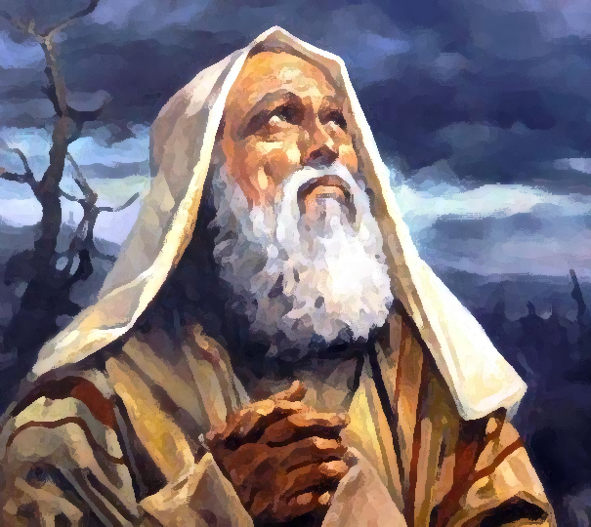
11:1-12:20
Nimrod
Abraham
The father of idolatry
The father of the faith

Slide 3
11:1-12:20

Slide 4
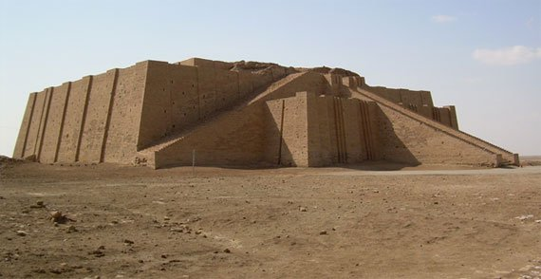
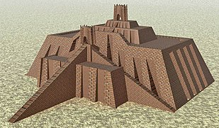
11:1-12:20
Ziggurat of Ur

Slide 5
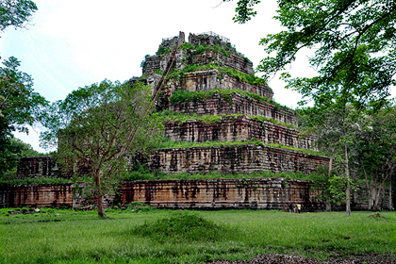
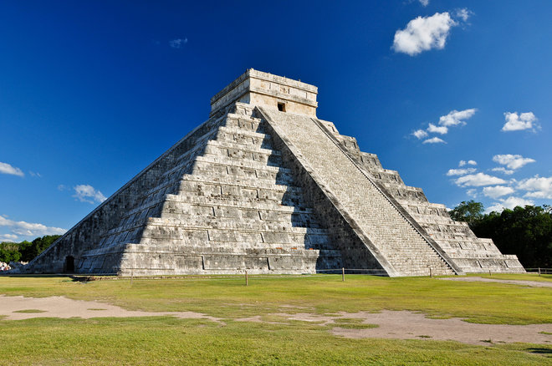
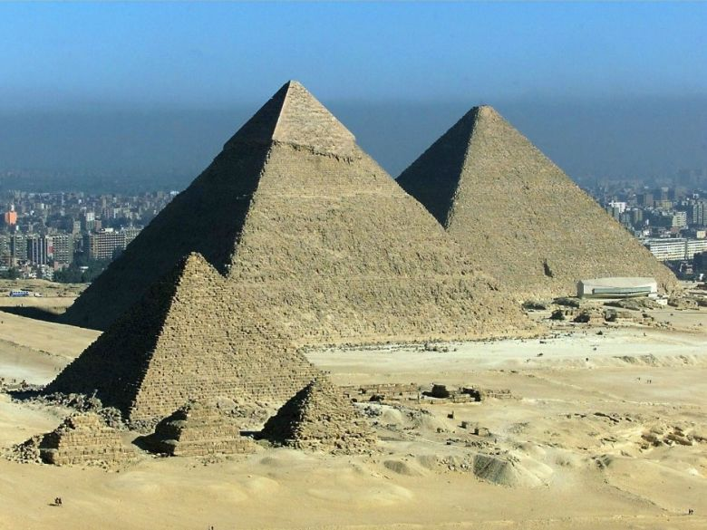
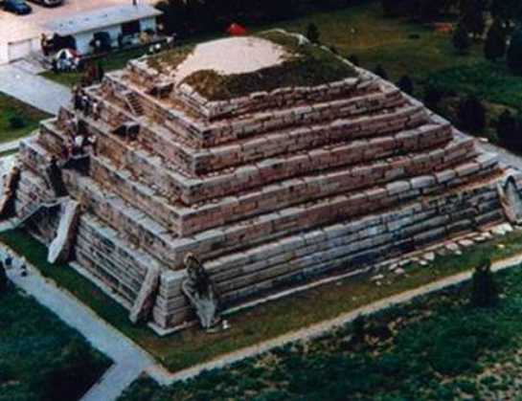
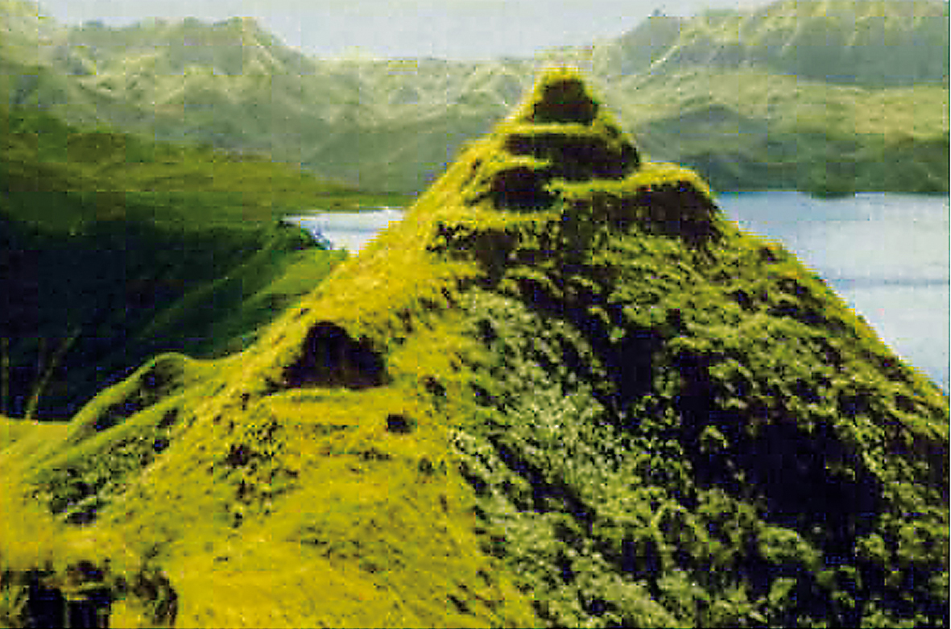
11:1-12:20
Pyramids of Egypt
Prasat Thom - Cambodia
Chichen Itza- Mexico
Tomb of the General - China
Rapa Iti - Polynesia

Slide 6
11:1-12:20
Job 38:31-32 ~ ³¹ Can you bind the cluster of the Pleiades,
Or loose the belt of Orion?
³² Can you bring out Mazzaroth in its season?
Or can you guide the Great Bear with its cubs?
Mazzaroth ~ (Strong’s) Some noted constellation (only in the plural), perhaps collectively, the zodiac

Slide 7
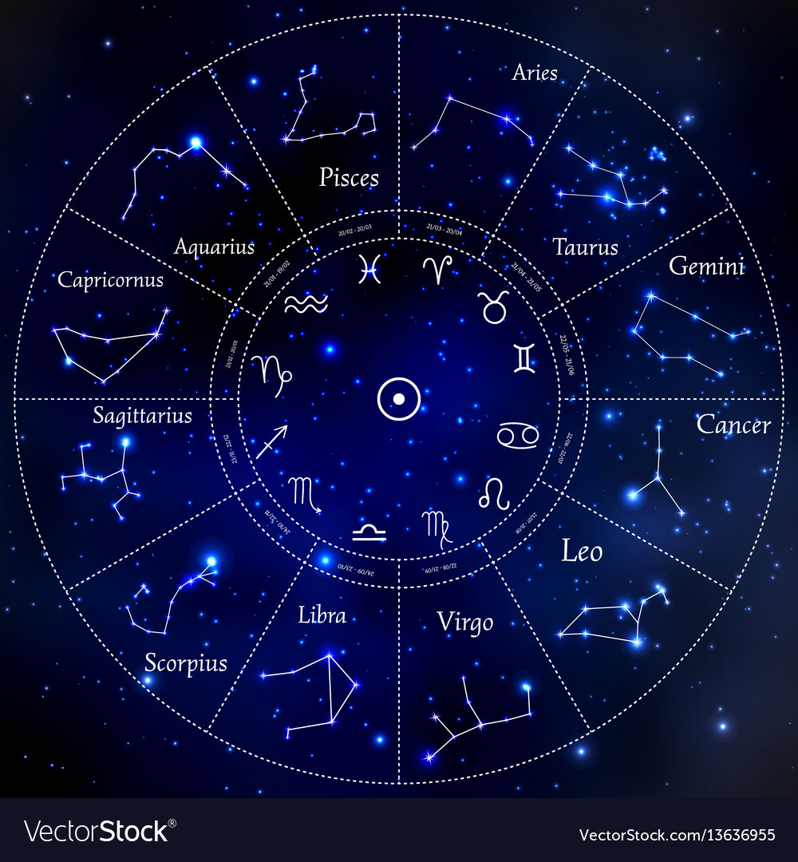
11:1-12:20
Pisces – The multitudes who will follow; the blessings of the redeemed
Aries – The ram or lamb; wounded and slain for the redeemed
Aquarius – The living waters of blessing poured out for the redeemed
Taurus – The judge; the coming judge of all the earth
Capricornus – The goat of atonement
Gemini – The two natures of Jesus
Mazzaroth
Sagittarius – The gracious one; the redeemer’s triumph
Cancer – The redeemer's possessions held fast.
Scorpio –attack of the enemy; the redeemer’s conflict
Leo – The Lion of the tribe of Judah
Libra – The scales; the price lacking balanced by the price sufficient
Virgo – The virgin; the promised seed of the woman

Slide 8
11:1-12:20

Slide 9
11:1-12:20
Babel ~ gate of God (Hebrew) and confusion (Akkadian)

Slide 10
11:1-12:20

Slide 11
11:1-12:20
Eber ~ where the name Hebrew comes from

Slide 12
11:1-12:20

Slide 13
11:1-12:20
Gen. 11:26 (Henry Morris and John C. Whitcomb) ~ And Terah lived seventy years and begat the first of his three sons, the most important of whom (not because of age but because of the Messianic line) was Abram.

Slide 14
11:1-12:20

Slide 15
11:1-12:20
Noah (950 years)
900
1000
1100
1200
1300
1400
1500
1600
1700
1800
1900
2000
Year
Event
AM
1056
Birth of Noah
BC
c. 2948
Flood
Birth of Abram
AM
1656
The Great Flood
Tower of Babel
BC
c. 2348
AM
1757
Tower of Babel
BC
c. 2247
Anno Mundi
From Creation forward
AM
AM
2050
Birth of Abram
Before Christ
From Jesus backward
BC
c. 1954
BC
AM
2006
Death of Noah
BC
c. 1998

Slide 16
11:1-12:20

Slide 17
11:1-12:20
Josh. 24:15 ~ And if it seems evil to you to serve the Lord, choose for yourselves this day whom you will serve, whether the gods which your fathers served that were on the other side of the River, or the gods of the Amorites, in whose land you dwell. But as for me and my house, we will serve the Lord.

Slide 18
11:1-12:20
Gen. 1-11
Gen. 12-Rev. 22
Modern Era
3000 BC
2000 BC
1000 BC
BC/AD
AD 1000

Slide 19
11:1-12:20

Slide 20
11:1-12:20
Terah means “delay”

Slide 21
11:1-12:20

Slide 22
11:1-12:20
Bethel means “house of God”
Ai means “heap of ruins”

Slide 23
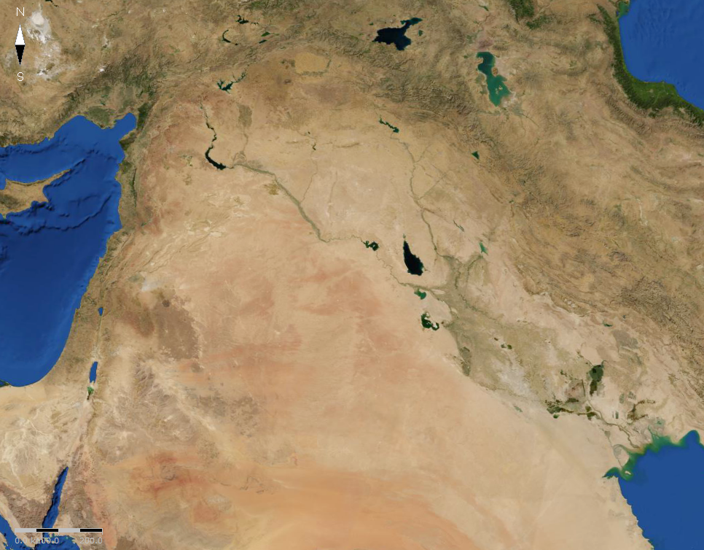
11:1-12:20
Haran
Ai
Fertile Crescent
Bethel
Ur
Migration of Abram

Slide 24
11:1-12:20

Slide 25
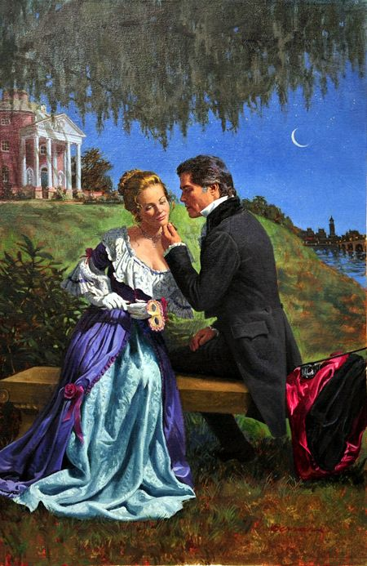
11:1-12:20
Oh, Abe! You’re such a flatterer!
Indeed I
know that you are a woman of beautiful countenance

Slide 26
11:1-12:20

Slide 27
11:1-12:20
In your dreams, you jive turkey!
Yes, lord
I’m only thinking
of what’s best for you, my turtle dove

Slide 28
11:1-12:20
1 Pet. 3:5-6 ~ ⁵ For in this manner, in former times, the holy women who trusted in God also adorned themselves, being submissive to their own husbands, ⁶ as Sarah obeyed Abraham, calling him lord, whose daughters you are if you do good and are not afraid with any terror.

Slide 29
11:1-12:20

Slide 30
11:1-12:20
1 Cor. 10:11 ~ Therefore let him who thinks he stands take heed lest he fall.

Slide 31
11:1-12:20

