Slide 1
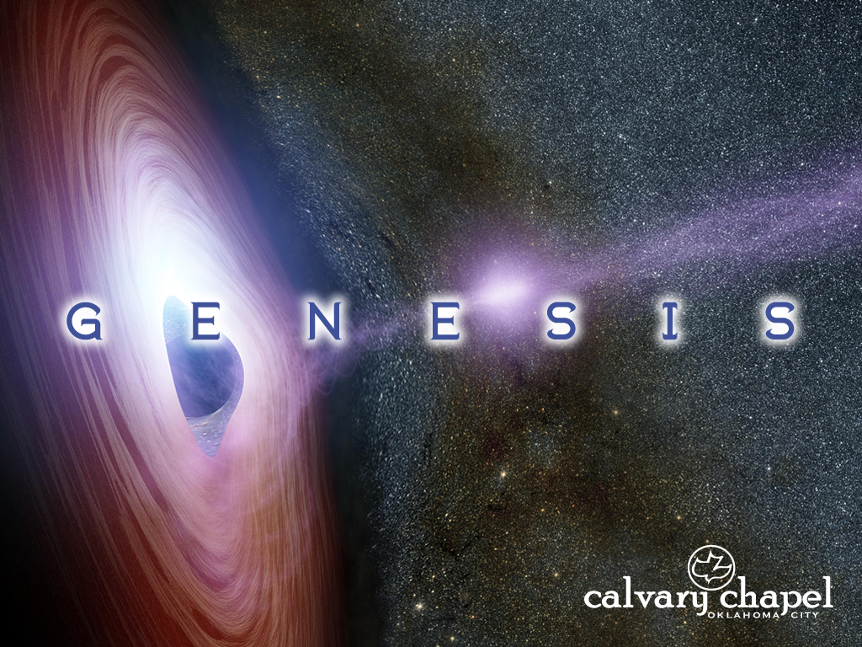
8:1-10:32

Slide 2
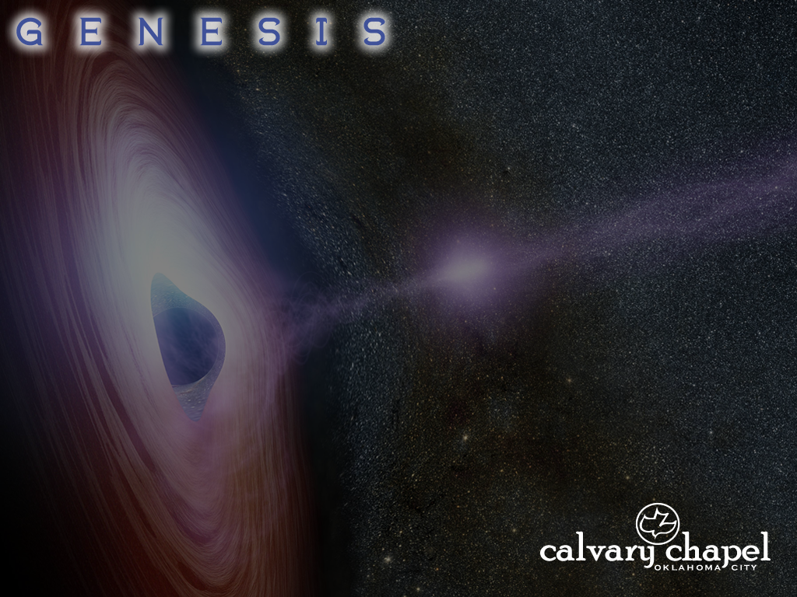
8:1-10:32
Noah enters Ark – God shuts the door (7:11, 16)
Flood begins (7:16)
Rain stops (7:17)
Ark lands on mountain and waters recede (8:3, 4)
Tops of mountains are seen (8:5)
Raven and dove sent out (8:6, 7)
Dove sent out, brings back olive leaf (8:10, 11)
Dove sent out, does not return (8:12)
Noah opens the door, ground is dry (8:13)
Noah exits the Ark (8:14-16)
Day
50
100
150
200
250
300
350
320 days
One year

Slide 3
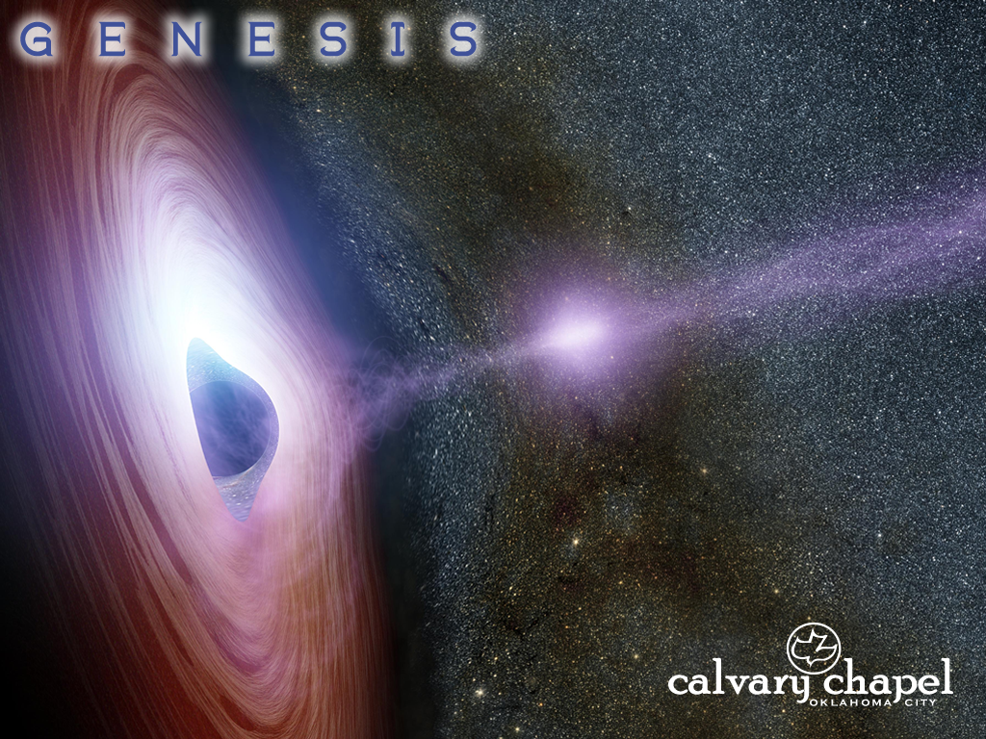
8:1-10:32

Slide 4
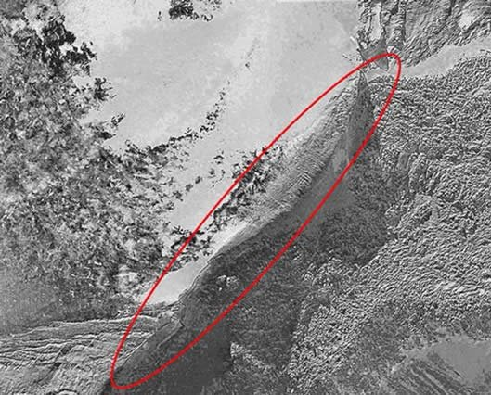
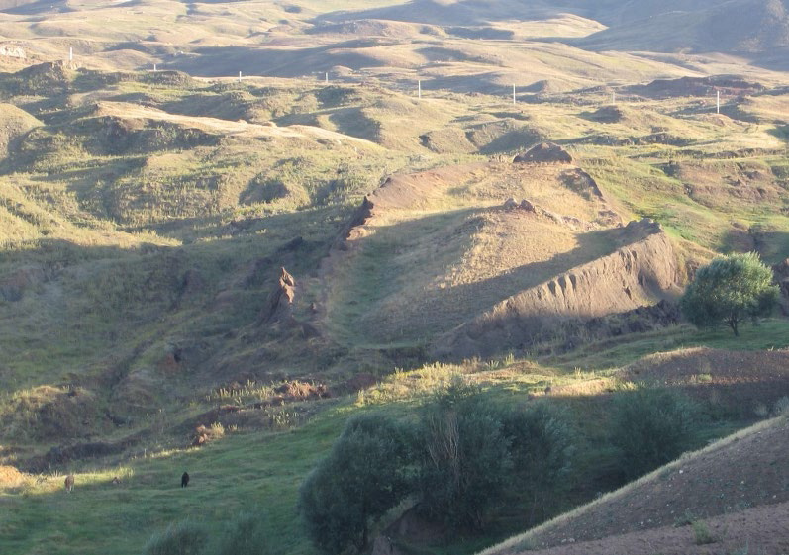
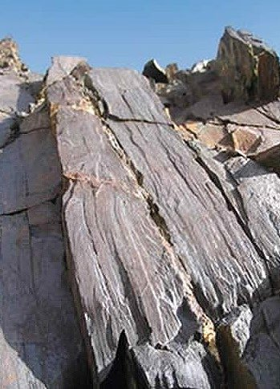
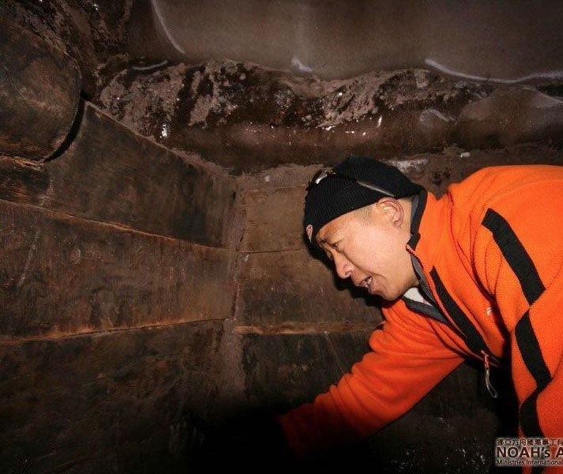
8:1-10:32
The “Ark Anomaly”
“Durupinar formation”
Beam-shaped rocks
The “Ark interior”

Slide 5
8:1-10:32

Slide 6
8:1-10:32
Noah enters Ark – God shuts the door (7:11, 16)
Flood begins (7:16)
Rain stops (7:17)
Ark lands on mountain and waters recede (8:3, 4)
Tops of mountains are seen (8:5)
Raven and dove sent out (8:6, 7)
Dove sent out, brings back olive leaf (8:10, 11)
Dove sent out, does not return (8:12)
Noah opens the door, ground is dry (8:13)
Noah exits the Ark (8:14-16)
Day
50
100
150
200
250
300
350
320 days

Slide 7
8:1-10:32

Slide 8
8:1-10:32
2 Cor. 1:4 ~ who comforts us in all our tribulation, that we may be able to comfort those who are in any trouble, with the comfort with which we ourselves are comforted by God.

Slide 9
8:1-10:32

Slide 10
8:1-10:32
life ~ nephesh – soul

Slide 11
8:1-10:32

Slide 12
8:1-10:32
Rom. 13:4 ~ For he is God’s minister to you for good. But if you do evil, be afraid; for he does not bear the sword in vain; for he is God’s minister, an avenger to execute wrath on him who practices evil.
Exod. 20:13 ~ You shall not murder.
murder ~ ratsach
– murder
Matt. 5:21, 19:18 and Rom. 13:9 ~ You shall not murder,
murder ~ phoneuō
– murder

Slide 13
8:1-10:32

Slide 14
8:1-10:32
Prov. 11:13 ~ A talebearer reveals secrets,
But he who is of a faithful spirit conceals a matter.

Slide 15
8:1-10:32

Slide 16
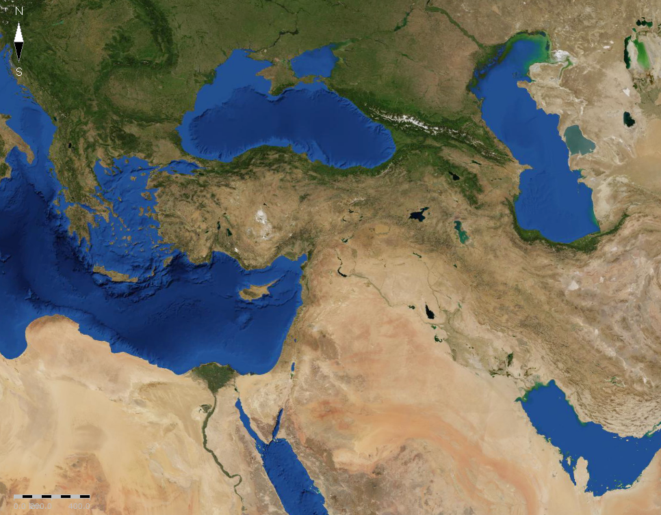
8:1-10:32
Mountains of Ararat
Japheth
Ham

Slide 17
8:1-10:32

Slide 18
8:1-10:32
Noah
Ham
(son)
Cush
(grandson)
Nimrod
(great-grandson)
Nimrod ~ from verb meaning to rebel
before ~ against or instead of

Slide 19
8:1-10:32

Slide 20
8:1-10:32
Mountains of Ararat
Japheth
Ham
Shem

Slide 21
8:1-10:32

Slide 22
8:1-10:32
divided ~ either tectonic plates shifting or division of tongues

Slide 23
8:1-10:32

