Slide 1
6:1-7:24

Slide 2
6:1-7:24
giants ~ nephilim – plural noun form of the verb to fall

Slide 3
6:1-7:24
Who were Sons of God and the Daughters of Men?
1) Powerful kings practicing forced harems
2) Godly line of Seth and ungodly line of Cain
3) Fallen angels cohabiting with human woman
sons of God ~ bene elohim (only here and Job 1:6; 2:1; 38:7)
Matt. 22:30 ~ For in the resurrection they neither marry nor are given in marriage, but are like angels of God in heaven.

Slide 4
6:1-7:24
Who were Sons of God and the Daughters of Men?
1) Powerful kings practicing forced harems
2) Godly line of Seth and ungodly line of Cain
3) Fallen angels cohabiting with human woman
Jude 1:6 ~ And the angels who did not keep their proper domain, but left their own abode, He has reserved in everlasting chains under darkness for the judgment of the great day;
2 Pet. 2:4 ~ For if God did not spare the angels who sinned, but cast them down to hell and delivered them into chains of darkness, to be reserved for judgment;

Slide 5
6:1-7:24
Who were Sons of God and the Daughters of Men?
1) Powerful kings practicing forced harems
2) Godly line of Seth and ungodly line of Cain
3) Fallen angels cohabiting with human woman
Jude 1:6
2 Pet. 2:4
hell ~ tartaroō – verb form of tartaros

Slide 6
6:1-7:24
Who were Sons of God and the Daughters of Men?
1) Powerful kings practicing forced harems
Demon-possessed man attempting to create a super-race of very evil giants
2) Godly line of Seth and ungodly line of Cain
3) Fallen angels cohabiting with human woman

Slide 7
6:1-7:24

Slide 8
6:1-7:24
intent ~ KJV, imaginations

Slide 9
6:1-7:24

Slide 10
6:1-7:24
sorry ~ anthropopathic term referring to God’s strong emotions
anthropopathic : the assignment of human feelings or passions to something not human, as a deity or an animal.

Slide 11
6:1-7:24

Slide 12
6:1-7:24
KJV ~ and it repenteth Me that I have made them
NLT ~ So the Lord was sorry he had ever made them and put them on the earth. It broke his heart.

Slide 13
6:1-7:24

Slide 14
6:1-7:24
Noah ~ mentioned 50x in 9 different books

Slide 15
6:1-7:24

Slide 16
6:1-7:24
gopherwood ~ probably cypress or cedar
rooms ~ literally, nests or cells
pitch ~ kopher – same as covering
From kaphar ~ atonement

Slide 17
6:1-7:24

Slide 18
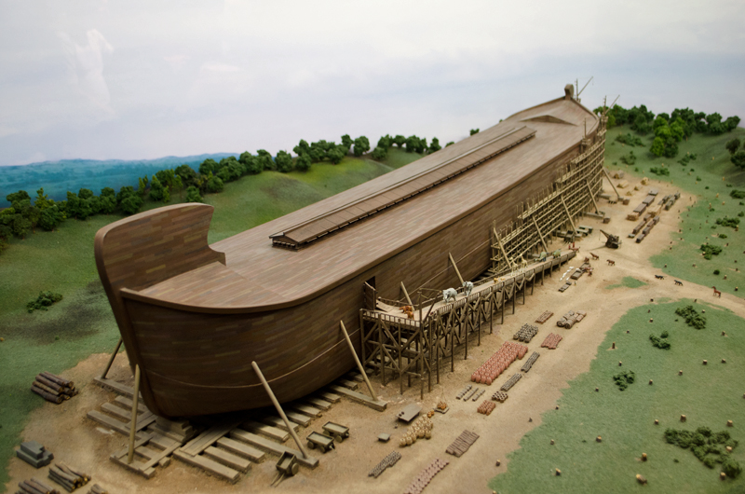
6:1-7:24
1,518,750 cu ft
45’
75’
450’

Slide 19
6:1-7:24
The Weebles wobble
But they won’t fall down

Slide 20
6:1-7:24

Slide 21
6:1-7:24
Matt. 24:37-39 ~ ³⁷ But as the days of Noah were, so also will the coming of the Son of Man be. ³⁸ For as in the days before the flood, they were eating and drinking, marrying and giving in marriage, until the day that Noah entered the ark, ³⁹ and did not know until the flood came and took them all away, so also will the coming of the Son of Man be.

Slide 22
6:1-7:24

Slide 23
6:1-7:24
Come ~ NASB, Enter; NIV, Go

Slide 24
6:1-7:24

Slide 25
6:1-7:24
flood ~ mabbul – only in Gen. 6-9 (and Ps. 29:10

Slide 26
6:1-7:24

Slide 27
6:1-7:24
6.5 sq. mm. per animal
45 feet
Height:
175 feet
51 feet
882 feet
510 feet
Length:
450 feet
Width:
75 feet
92 feet
85 feet
Construction:
Steel
Gopher wood
Capacity;:
3547 people
Enough food and water for 2 weeks
8 people
17,400 birds
12,000 reptiles
9,000 mammals
5,000 amphibians
2,000,000 insects
Enough food and water for a year

Slide 28
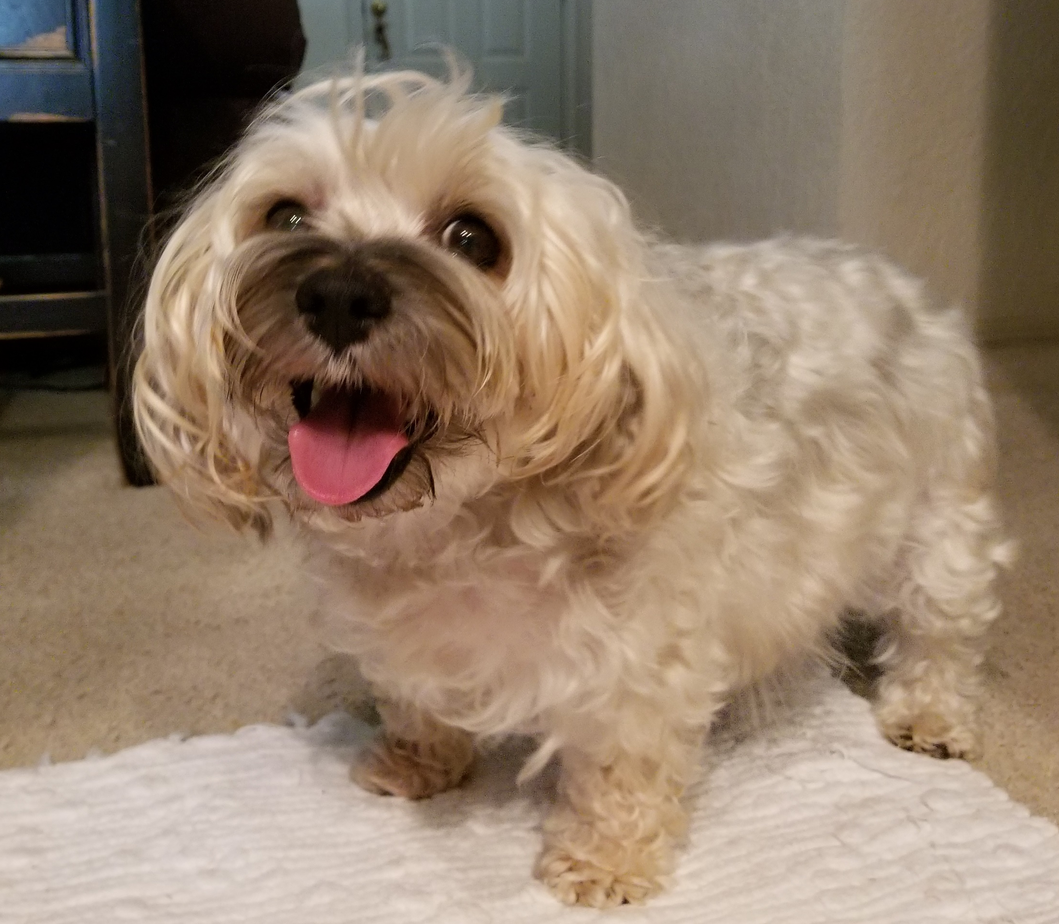
6:1-7:24
Kingdom ~
Animalia (animal)
Phylum ~
Chordata (vertebrate)
Class ~
Mammalia (mammal)
Order ~
Carnivora (carnivore)
Family ~
Canidae (dog)
Genus ~
Canis
Species ~
Tucker
Eating, pooping machine

Slide 29
6:1-7:24
Height:
175 feet
51 feet
Length:
882 feet
510 feet
Width:
92 feet
85 feet
Construction:
Steel
Gopher wood
8 people
Less
Than
20,000
Animals
Enough food and water for a year
Capacity;:
3547 people
Enough food and water for 2 weeks
8 people
17,400 birds
12,000 reptiles
9,000 mammals
5,000 amphibians
2,000,000 insects
Enough food and water for a year

Slide 30
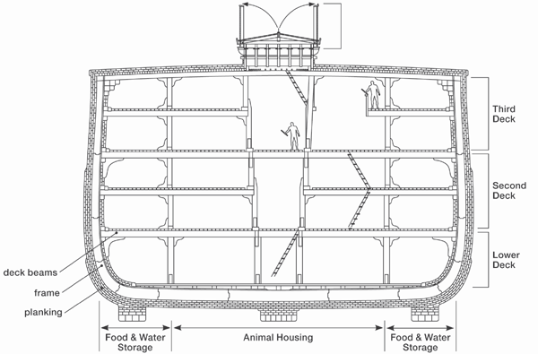
6:1-7:24
Animal housing
Food storage

Slide 31
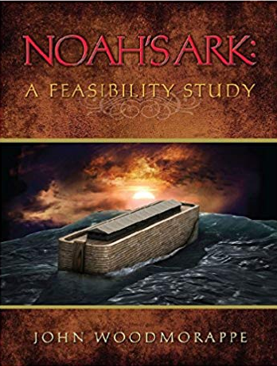
6:1-7:24

Slide 32
6:1-7:24

Slide 33
6:1-7:24
Noah enters Ark – God shuts the door (7:11, 16)
Flood begins (7:16)
Rain stops (7:17)
Ark lands on mountain and waters recede (8:3, 4)
Tops of mountains are seen (8:5)
Raven and dove sent out (8:6, 7)
Dove sent out, brings back olive leaf (8:10, 11)
Dove sent out, does not return (8:12)
Noah opens the door, ground is dry (8:13)
Noah exits the Ark (8:14-16)
Day
50
100
150
200
250
300
350

Slide 34
6:1-7:24
2 Evidences the Flood was about 5,000 years ago:
1. Erosion from watherfalls
Erosion from Niagara Falls is about 4-5 inches per year
2. Silt deposits in deltas
Tigris and Euphrates delta has filled in at least 150 miles since earliest recorded maps

Slide 35
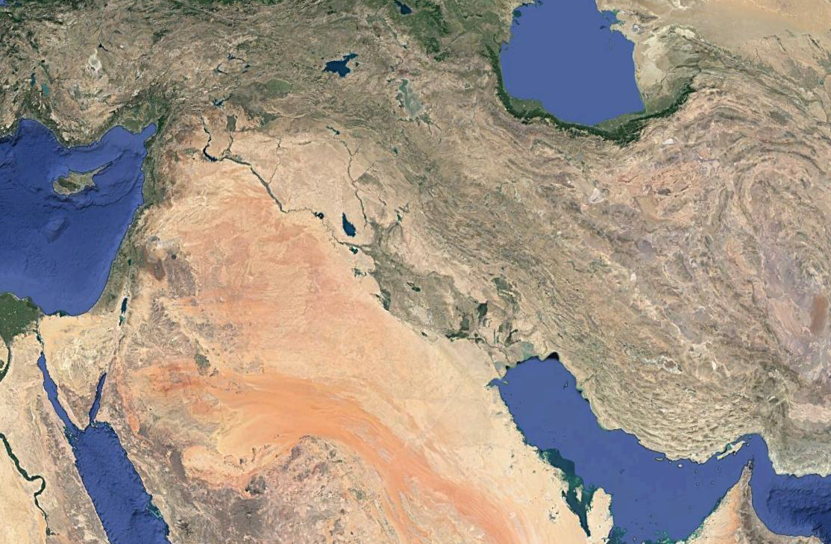
6:1-7:24
Euphrates
Tigris
Ur

Slide 36
6:1-7:24

