Slide 1
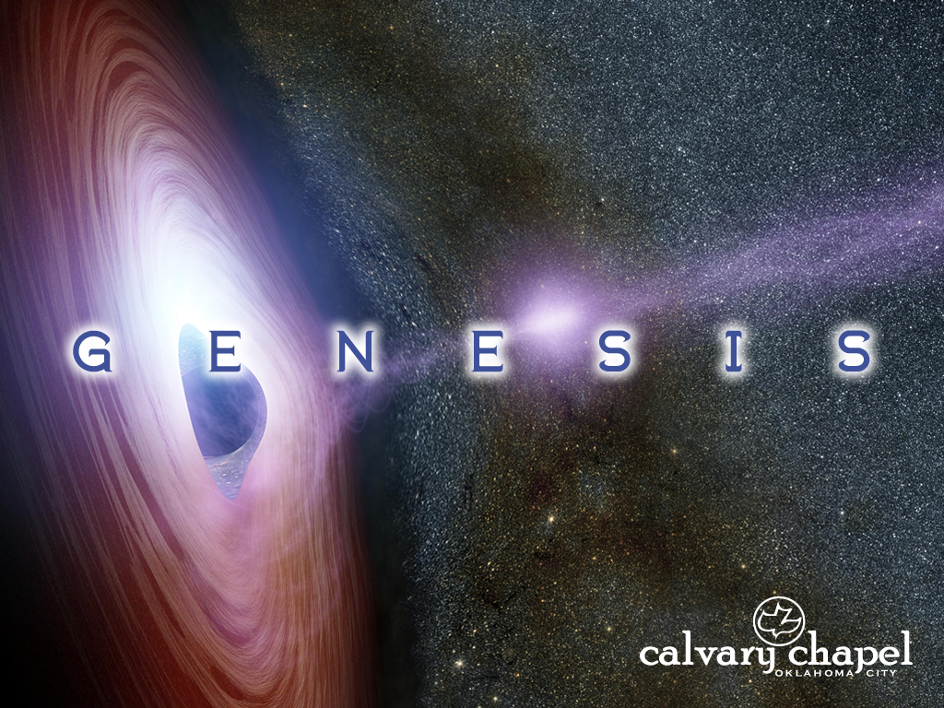
2:8-3:7

Slide 2
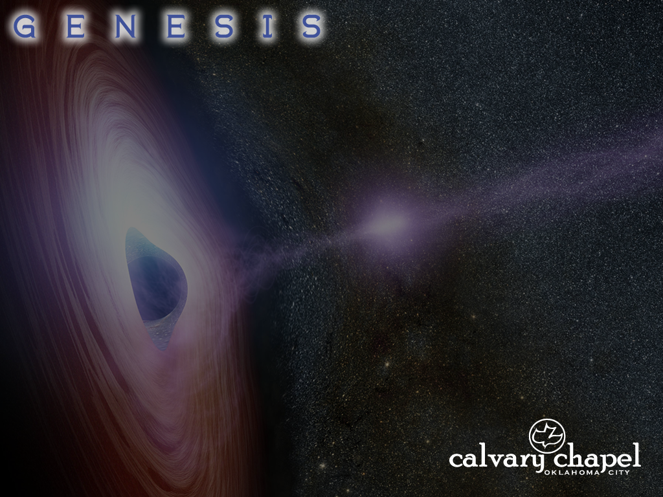
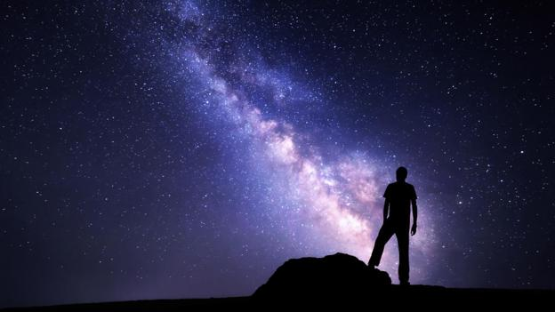
2:8-3:7

Slide 3
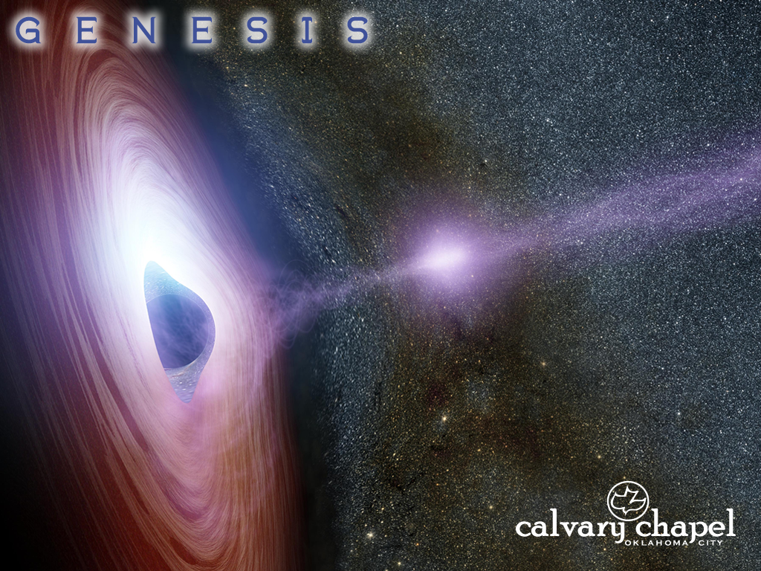
2:8-3:7

Slide 4

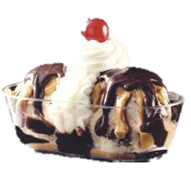
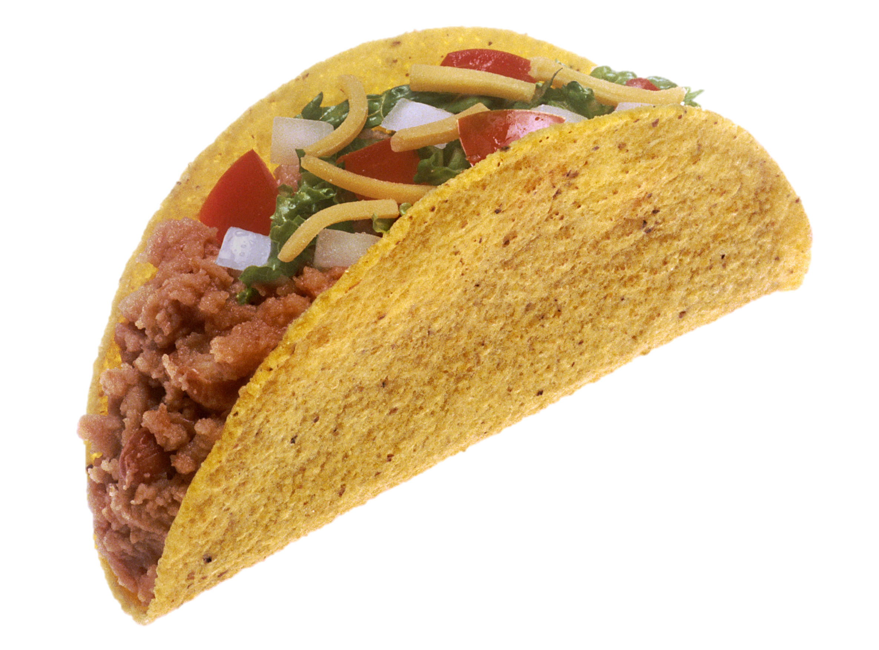
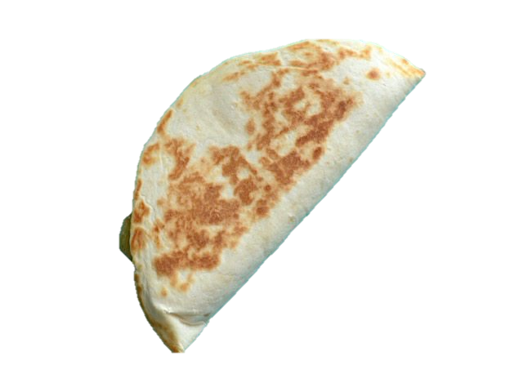

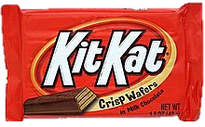
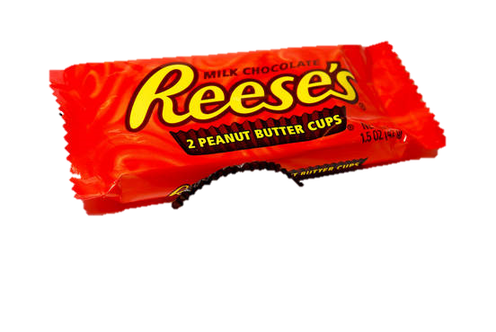
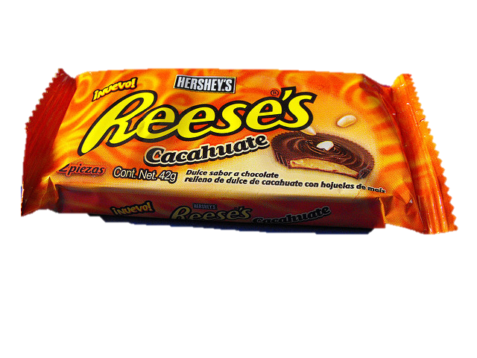
2:8-3:7
Shelby Mack (age 7) ~ “Kids know that candy is not better than God because candy can’t love us. Plus God doesn’t give you no cavities.”
Sara Clogston (age 6) ~ “God is in love with your heart. He made people with hearts and people are a lot harder to make than trees.”
This Photo by Unknown Author is licensed under CC BY-SA-NC

Slide 5
2:8-3:7

Slide 6
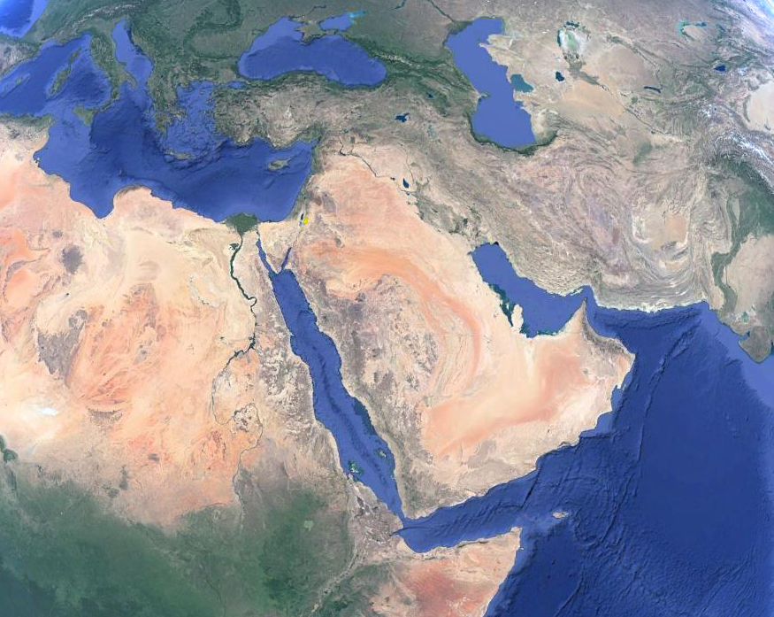
2:8-3:7
Death Valley, CA
Novosibirsk, Siberia
University of Texas
This Photo by Unknown Author is licensed under CC BY-SA-NC

Slide 7
2:8-3:7

Slide 8


2:8-3:7
This Photo by Unknown Author is licensed under CC BY-SA-NC

Slide 9
2:8-3:7

Slide 10
2:8-3:7
helper ~ ‘ezer – helper
comparable ~ neged – counterpart
A “complementing partner”
This Photo by Unknown Author is licensed under CC BY-SA-NC

Slide 11
2:8-3:7

Slide 12
2:8-3:7
Dustin Laumach (age 6) ~ “The only people God made really big and growed was Adam and Eve and he had to make them grown ups because they had to name the animals.”
This Photo by Unknown Author is licensed under CC BY-SA-NC

Slide 13
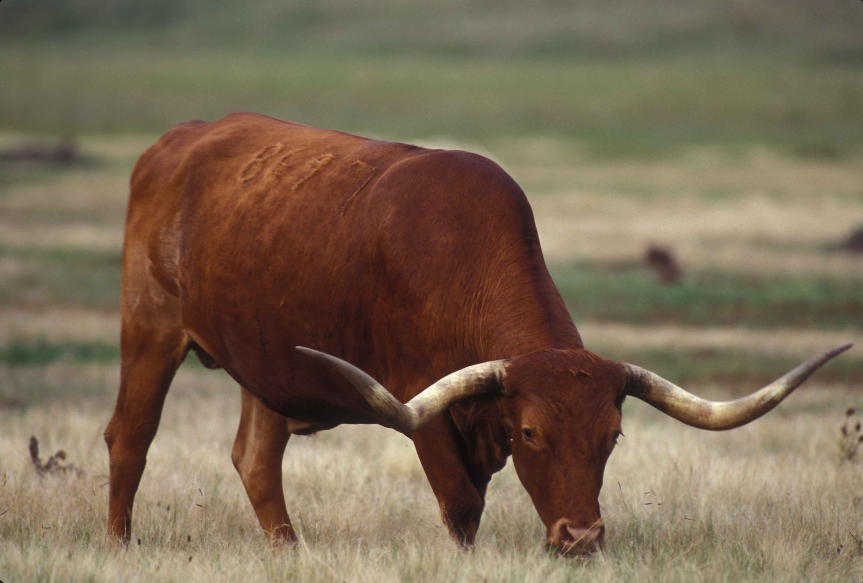
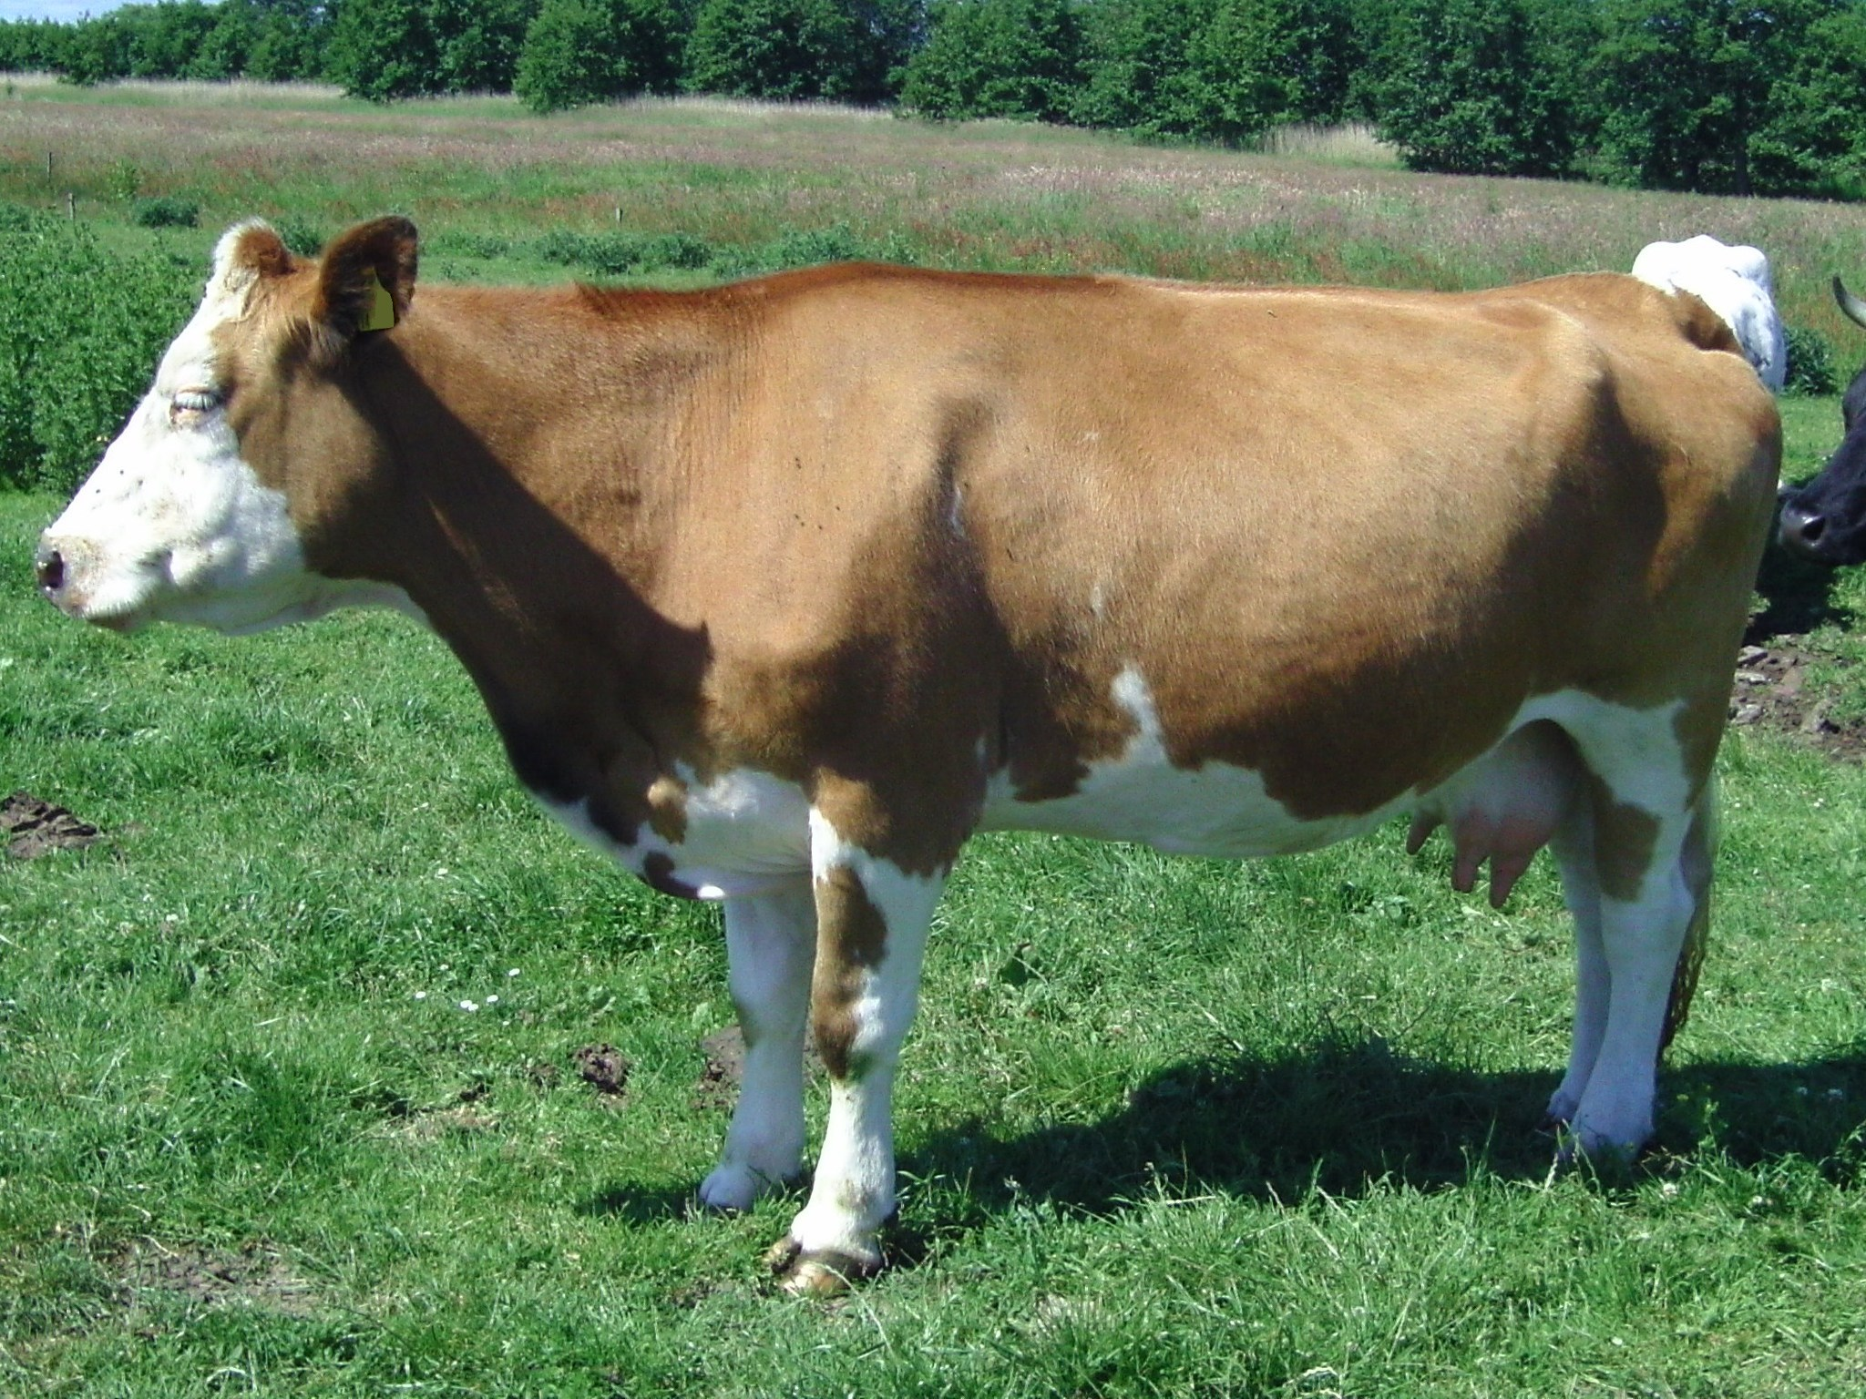

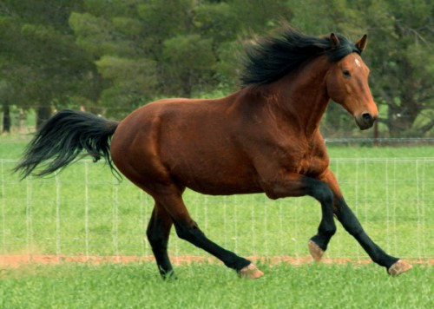
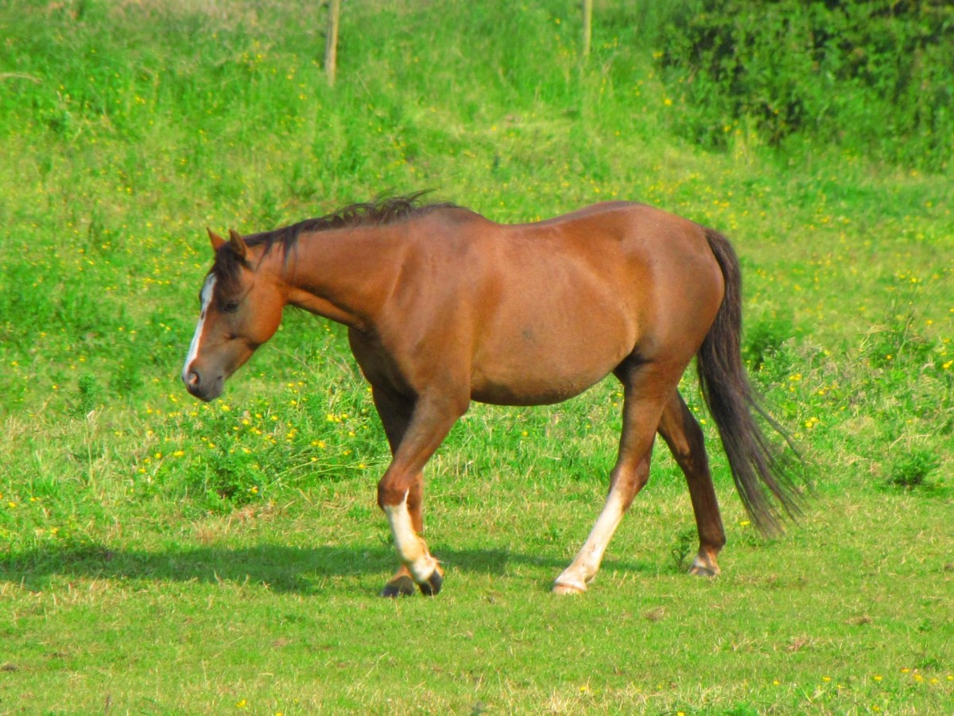
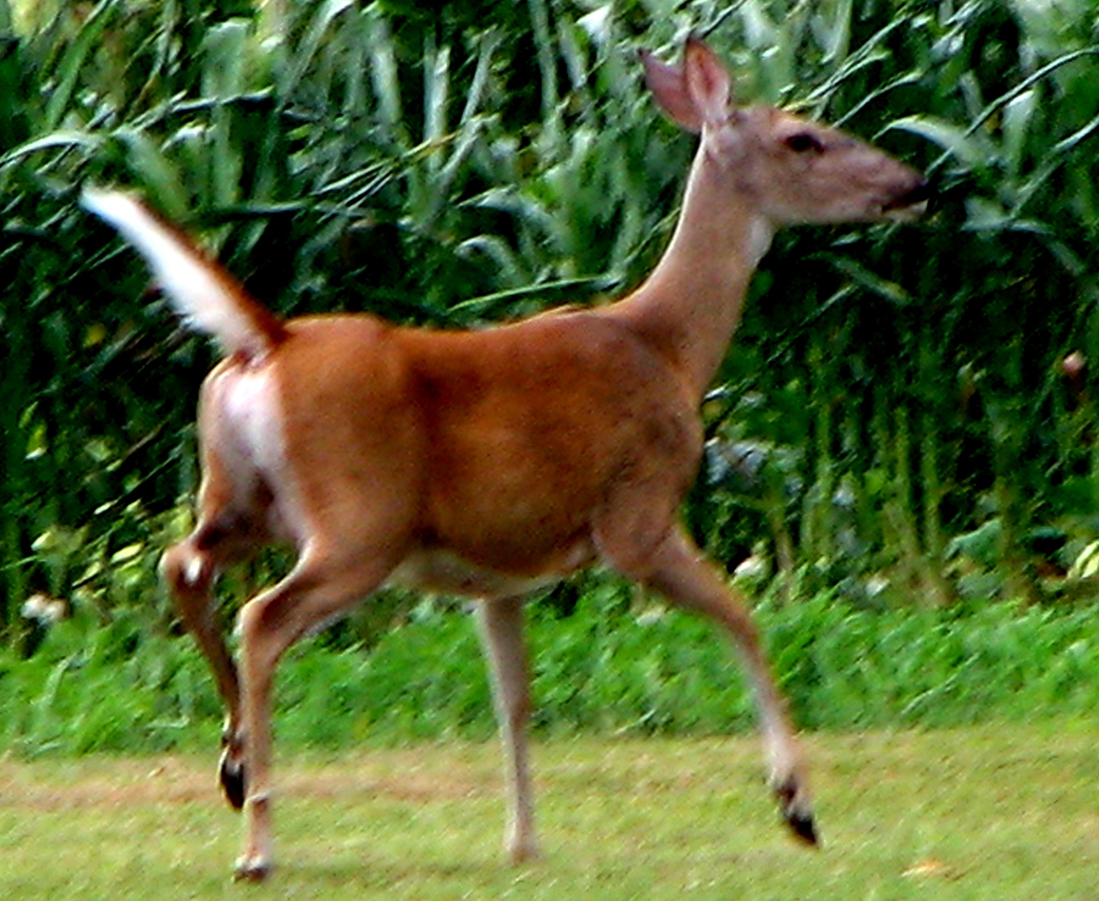
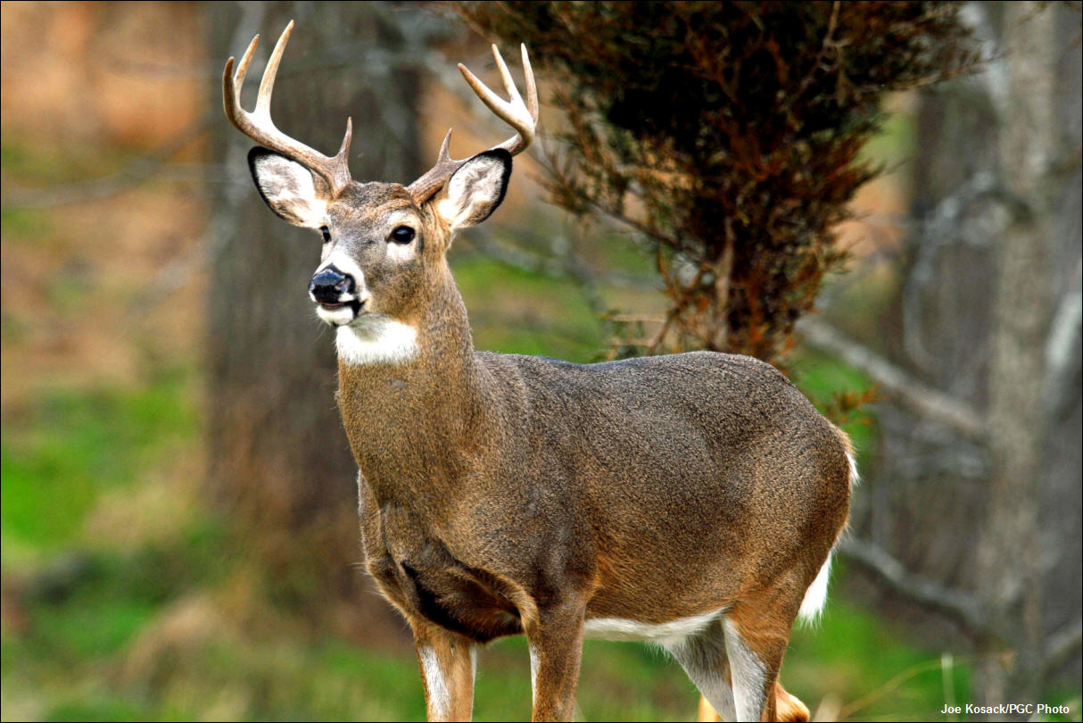
2:8-3:7
bull
cow
stallion
mare
lady bug
doe
buck

Slide 14
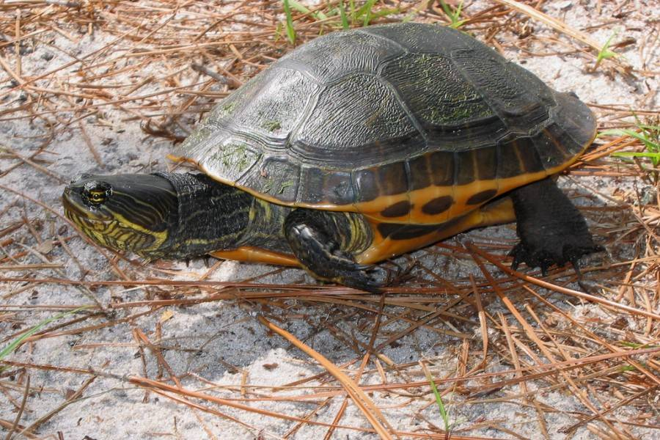
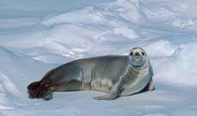
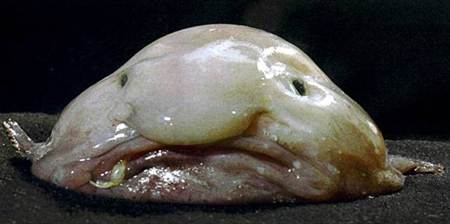
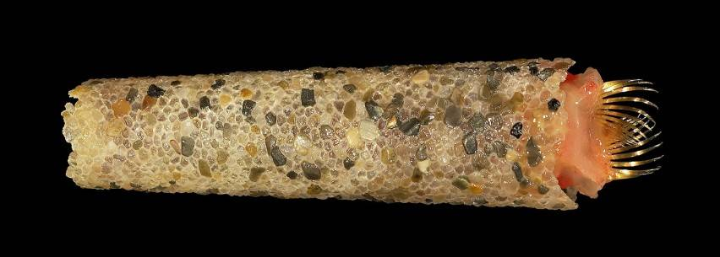
2:8-3:7
Crabeater seal
Chicken turtle
Ice cream cone worm
Blob fish

Slide 15
2:8-3:7

Slide 16
2:8-3:7
rib ~ tsela’ – ambiguous term (could be side or cell)

Slide 17
2:8-3:7

Slide 18
2:8-3:7
Jack Finlay (age 6) “God made shoes so your socks won’t get dirty. He makes laces so shoes won’t fall off. And you get skin so your bones won’t fall out.”
Brent Glover (age 8) ~ “God makes us babies so that we fit in our mother’s stomach and he puts food in there that only babies like.”

Slide 19
2:8-3:7

Slide 20

2:8-3:7
She stays in bed
until 10, lives at the beauty parlor and insists on eating out all
the time
He lets her sleep late,
wants her to go the beauty parlor and takes her out to eat several nights a week
Of her son’s wife
Of her daughter’s husband

Slide 21
2:8-3:7

Slide 22
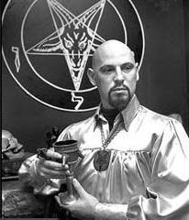
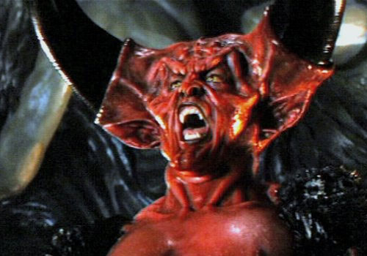





2:8-3:7
Angel of Light

Slide 23
2:8-3:7

Slide 24
2:8-3:7
Luke 10:18 ~ And He said to them, “I saw Satan fall like lightning from heaven.”
Rev. 12:3-4 ~ ³ And another sign appeared in heaven: behold, a great, fiery red dragon having seven heads and ten horns, and seven diadems on his heads. ⁴ His tail drew a third of the stars of heaven and threw them to the earth. And the dragon stood before the woman who was ready to give birth, to devour her Child as soon as it was born.
This Photo by Unknown Author is licensed under CC BY-SA-NC

Slide 25
2:8-3:7

Slide 26
2:8-3:7
Ezek. 28:14-15 ~ ¹⁴ You were the anointed cherub who covers;
I established you;
You were on the holy mountain of God;
You walked back and forth in the midst of fiery stones.
¹⁵ You were perfect in your ways from the day you were created, Till iniquity was found in you.

Slide 27
2:8-3:7
Is. 14:12-15 ~ ¹² How you are fallen from heaven,
O Lucifer, son of the morning!
How you are cut down to the ground,
You who weakened the nations!
¹³ For you have said in your heart:
“I will ascend into heaven,
I will exalt my throne above the stars of God;
I will also sit on the mount of the congregation
On the farthest sides of the north;
¹⁴ I will ascend above the heights of the clouds,
I will be like the Most High.”
¹⁵ Yet you shall be brought down to Sheol,
To the lowest depths of the Pit.

Slide 28
2:8-3:7

Slide 29
2:8-3:7
Gap between Gen. 1:1 and 1:2
Gen. 1:1 ~ In the beginning God created the heavens and the earth.
Gen. 1:2 ~ The earth was without form, and void; and darkness was on the face of the deep. And the Spirit of God was hovering over the face of the waters.
Gen. 1:1
Gen. 1:2
indeterminate
eons of time

Slide 30
2:8-3:7
Gap between Gen. 1:1 and 1:2
Is. 45:18 ~ For thus says the Lord,
Who created the heavens,
Who is God,
Who formed the earth and made it,
Who has established it,
Who did not create it in vain,
Who formed it to be inhabited:
“I am the Lord, and there is no other.
vain ~ tohu (same as without form in Gen. 1:2)

Slide 31
2:8-3:7
Job 38:7 ~ When the morning stars sang together,
And all the sons of God shouted for joy?
sons of God ~ bene Elohim – only in Gen. 6; Job 2 and 38

Slide 32
2:8-3:7
Ezek. 28:13 ~ You were in Eden, the garden of God;
Every precious stone was your covering:
The sardius, topaz, and diamond,
Beryl, onyx, and jasper,
Sapphire, turquoise, and emerald with gold.
The workmanship of your timbrels and pipes
Was prepared for you on the day you were created.

Slide 33
2:8-3:7

Slide 34
2:8-3:7
Literally, you will be like gods

Slide 35
2:8-3:7

Slide 36
2:8-3:7
1 John 2:16 ~ For all that is in the world – the lust of the flesh, the lust of the eyes, and the pride of life – is not of the Father but is of the world.
it was good for food
it was pleasant to the eyes
it would make one wise

Slide 37
2:8-3:7
Matt. 4:3 ~ “If You are the Son of God, command that these stones become bread.”
lust of the flesh
Matt. 4:9 ~ “All these things I will give You if You will fall down and worship me.”
lust of the eyes
Matt. 4:6 ~ “If You are the Son of God, throw Yourself down. For it is written:
‘He shall give His angels charge over you.’
and, “In their hands they shall bear you up,
Lest you dash your foot against a stone.’”
lust of the flesh

Slide 38
2:8-3:7

Slide 39
2:8-3:7
1 Tim. 2:13-14 ~ ¹³ For Adam was formed first, then Eve. ¹⁴ And Adam was not deceived, but the woman being deceived, fell into transgression.

Slide 40
2:8-3:7

