Slide 1
1:8-2:7

Slide 2
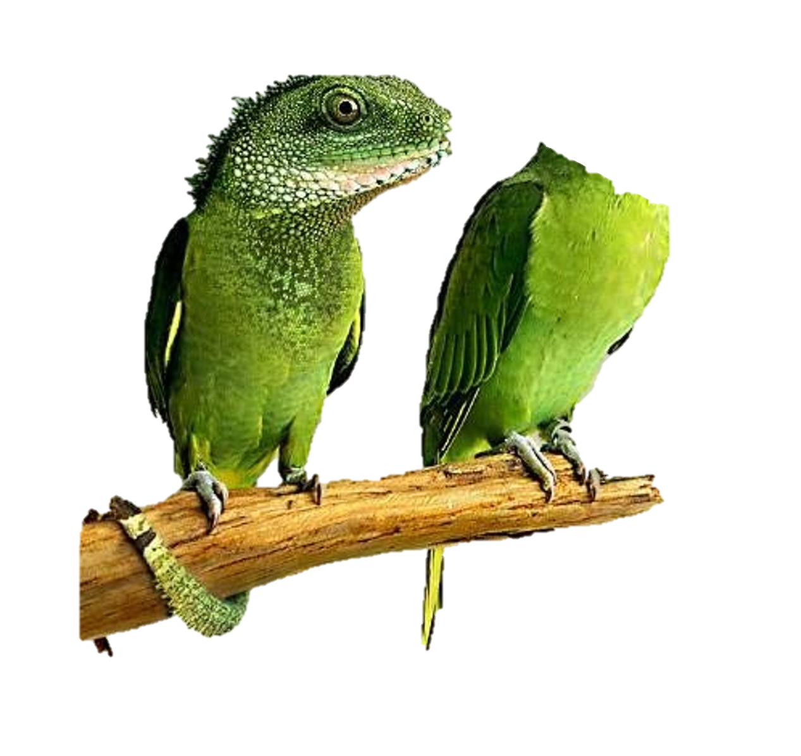
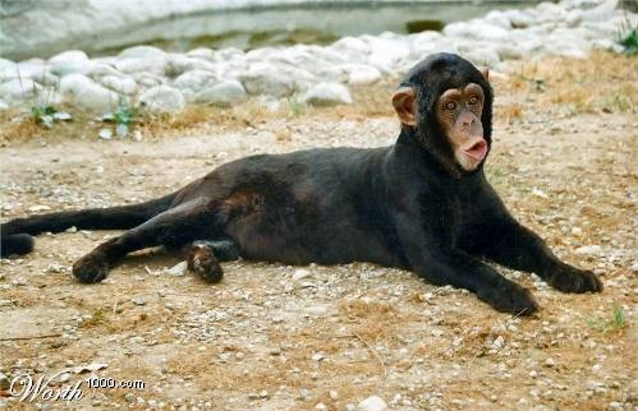
1:8-2:7
seed is in itself ~ principle of reproduction
according to its kind ~ apple seeds make apple trees
Macro evolution

Slide 3
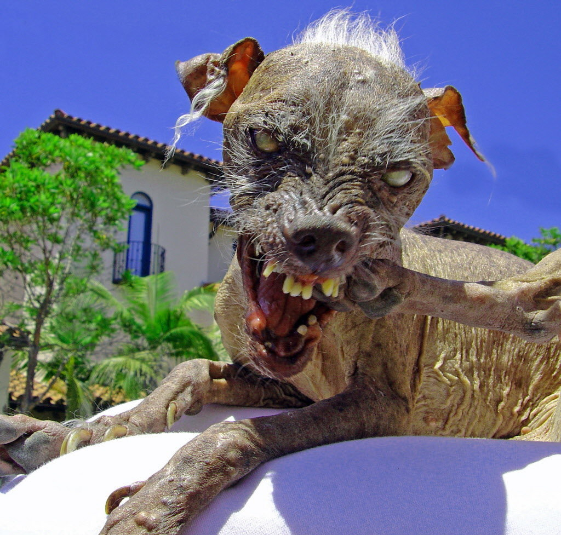
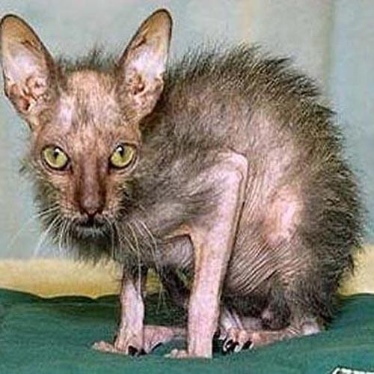
1:8-2:7
Micro evolution

Slide 4
1:8-2:7

Slide 5
1:8-2:7
creature ~ nepesh – soul (consciousness)
This Photo by Unknown Author is licensed under CC BY-SA-NC

Slide 6
1:8-2:7

Slide 7
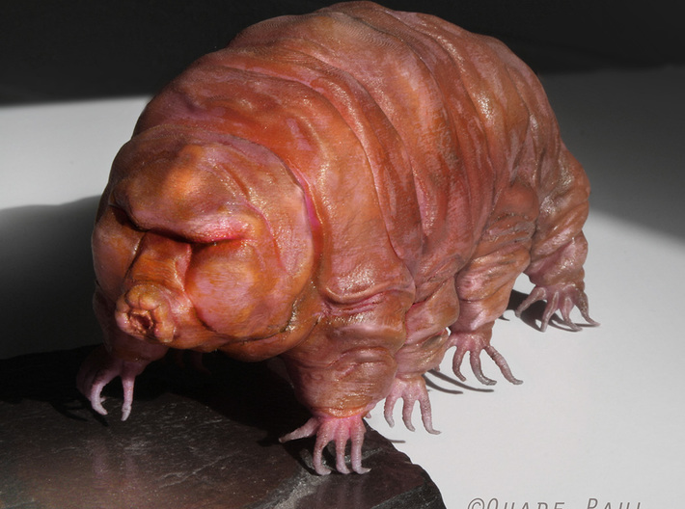
1:8-2:7
“Water bear” (tardigrade)
This Photo by Unknown Author is licensed under CC BY-SA-NC

Slide 8
1:8-2:7

Slide 9
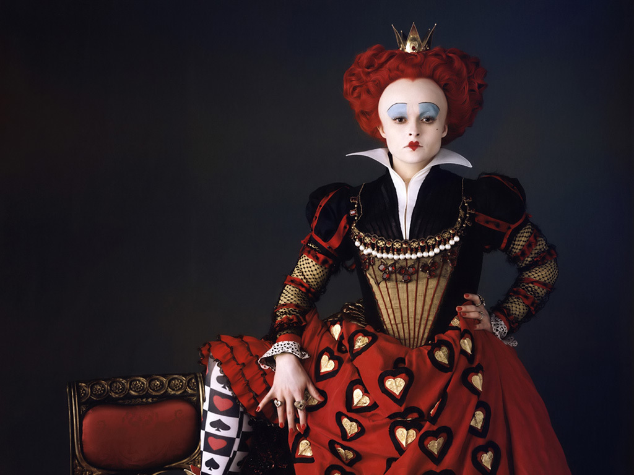
1:8-2:7
We are not amused.

Slide 10
1:8-2:7

Slide 11
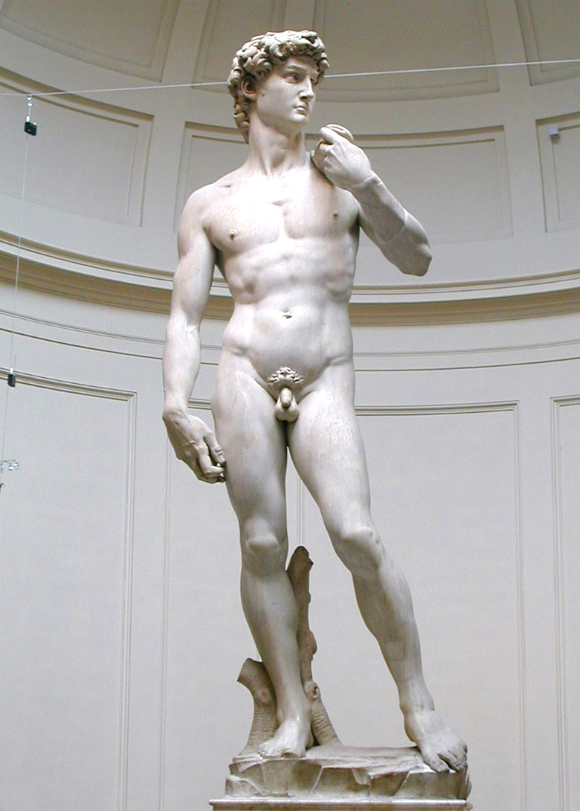
1:8-2:7
created ~ bara – 3x in verse 27

Slide 12
1:8-2:7
Sarah Roark (age 11) ~ “God is very powerful. He made the whole world in 6 days. It takes me that long to clean my room.”
Rachel McKelvy (age 9) ~ “I think God looks like a Hispanic-Chinese person because I think He’s black and white and that kinda equals to Hispanic-Chinese.”
Courtni Smeltzer (age 11) ~ “There are so many people talking to God at the same time. He listens to every one of them and doesn’t even have call waiting.”
Jeff Smith (age 7) ~ “The funny thing is we don’t know if God is a he or a she. That’s why we call God thee.”

Slide 13
1:8-2:7

Slide 14
1:8-2:7
Day | # | Comment
Sunday | 1
Monday | 2
Tuesday | 3
Wednesday | 4
Thursday | 5
Friday | 6
“it was good” (v. 4)
????
“it was good” (v. 10, 12)
“it was good” (v. 18)
“it was good” (v. 21)
“it was very good” (v. 31)

Slide 15
1:8-2:7

Slide 16
1:8-2:7
formed ~ yatsar – fashioned
Gen. 1: 27 ~ created – bara (3x)
Others 4%
Nitrogen 3%
$1985.77
Hydrogen 10%
Carbon 18%
Oxygen
Carbon
Hydrogen
99%
Oxygen 65%
Nitrogen
Calcium
Phosphorus

Slide 17
1:8-2:7
Joseph Langer (age 7) ~ “I believe in God, but I still wonder about a lot of things. Like I wonder how He made eyeballs.”
Jack Finlay (age 6) ~ “God makes us head first and then He adds body and legs. And last He reaches inside His own body and puts some soul in us. And He gives us guts. His guts.”
Sierra Wood (age 9) ~ “I think God is there even when I don’t want him there.”
This Photo by Unknown Author is licensed under CC BY-SA-NC

Slide 18
1:8-2:7

Slide 19
1:8-2:7
1 Pet. 1:20-21 ~ ²⁰ He indeed was foreordained before the foundation of the world, but was manifest in these last times for you ²¹ who through Him believe in God, who raised Him from the dead and gave Him glory, so that your faith and hope are in God.
This Photo by Unknown Author is licensed under CC BY-SA-NC

Slide 20
1:8-2:7

