Slide 1
1:1-8

Slide 2
1:1-8
Hebrew ~ b’resith – in the beginning
LXX ~ genesis – origins, creation

Slide 3
1:1-8

Slide 4
1:1-8
3 beginnings in the Bible:
Genesis 1:1 ~ In the beginning, God …
The beginning of the physical creation
John 1:1 ~ In the beginning was the Word …
The beginning of the Incarnation
1 John 1:1 ~ What was from the beginning …
The beginning of eternity

Slide 5
1:1-8
created ~ bara – always has God as the subject
Latin, ex nihilo ~ out of nothing
made ~ asah – to do, make

Slide 6
1:1-8
Time, space, matter continuum
continuum: a continuous series or whole, no part of which is perceptibly different from the adjacent parts.
Time
Time
Matter
Space
Space
Matter
www.rationalwiki.org ~ Lists of creationist scientists

Slide 7
1:1-8

Slide 8
1:1-8
Its purpose is not to tell us how the heavens go
But to tell us how to go to heaven

Slide 9
1:1-8
Fortitudinous Concurrences of Accidental Circumstances
Hey, baby!
Sir Frederick Hoyle (1915-2001) ~ 1:10¹²⁰
Harold Morowitz (1927-2016), George Mason Universitry ~ 1:10^{100,000,000,000}

Slide 10
1:1-8
Fortitudinous Concurrences of Accidental Circumstances

Slide 11
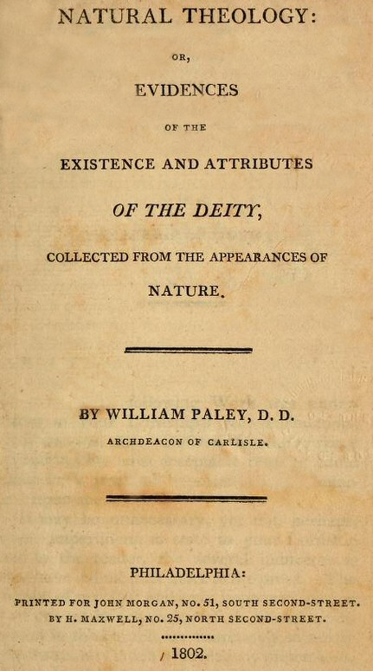
1:1-8
Fortitudinous Concurrences of Accidental Circumstances
William Paley (1802) ~ “Natural Theology, or Evidences of the Existence and Attributes of the Deity Collected from the Appearances of Nature”

Slide 12
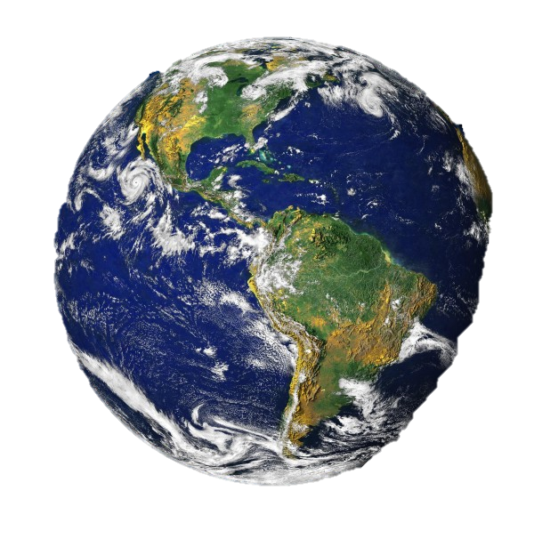
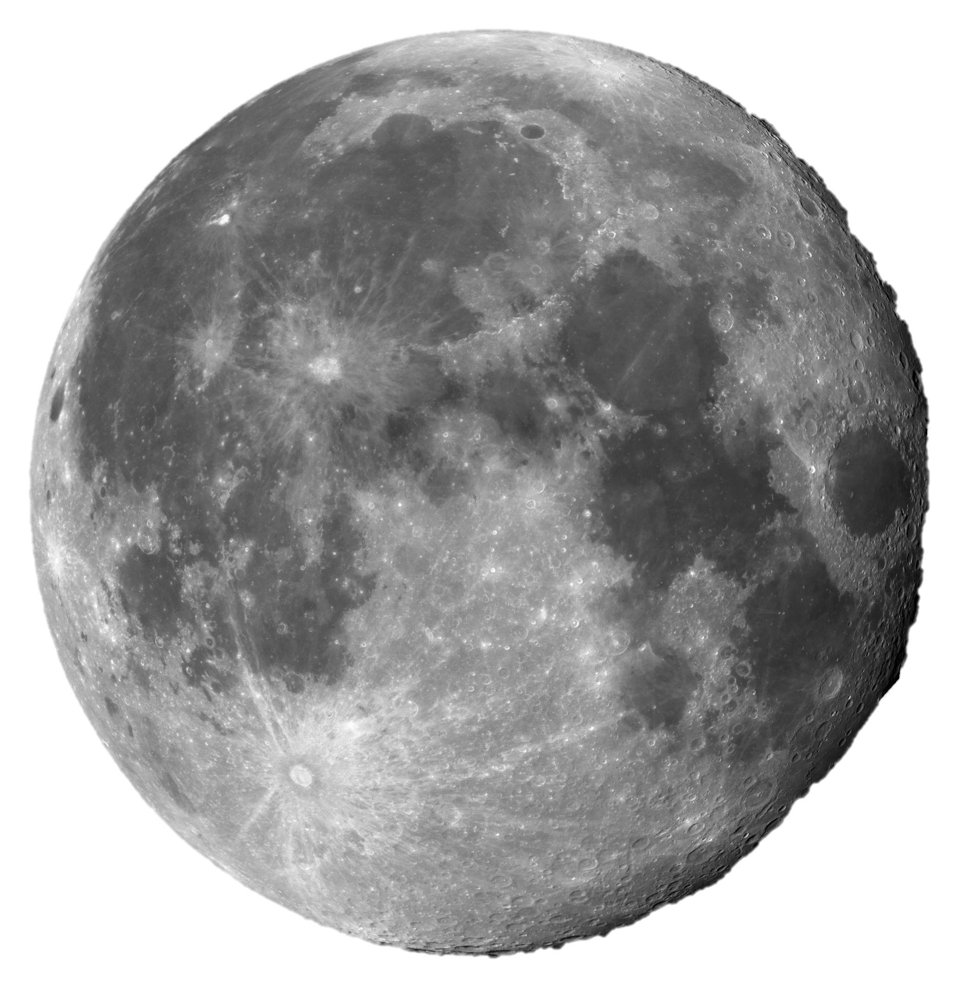
1:1-8
85,000,000 years ago

Slide 13
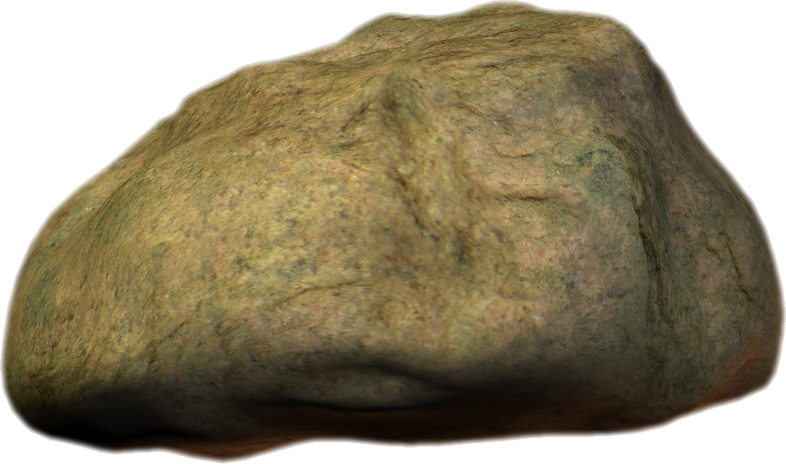
1:1-8
This Photo by Unknown Author is licensed under CC BY-SA

Slide 14
1:1-8

Slide 15
1:1-8
Dr. Kent Hovind

Slide 16
1:1-8

Slide 17
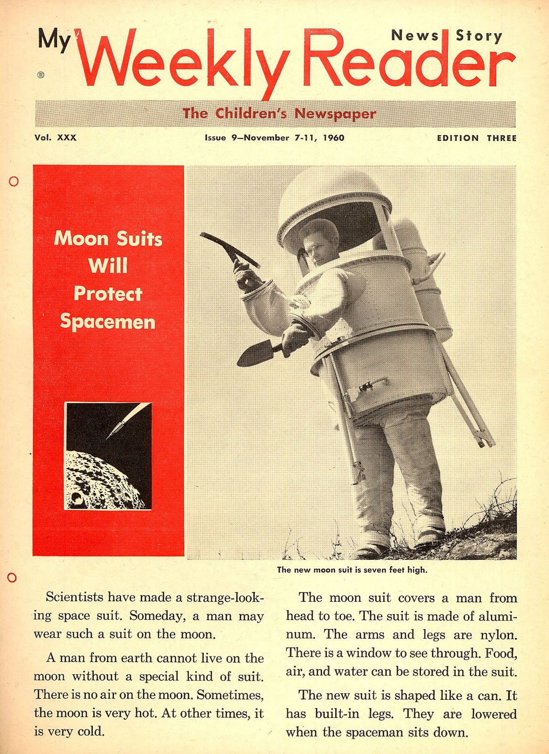
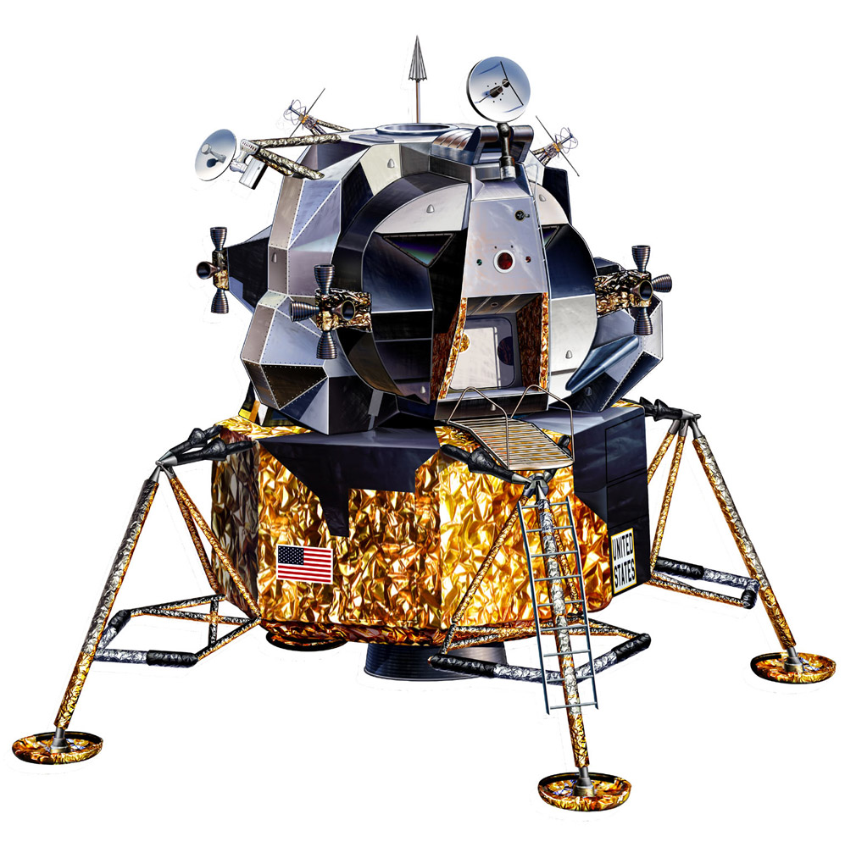
1:1-8
Lunar Landing Module

Slide 18
1:1-8

Slide 19
1:1-8
Heb. 11:6 ~ But without faith it is impossible to please Him, for he who comes to God must believe that He is, and that He is a rewarder of those who diligently seek Him.

Slide 20
1:1-8

Slide 21
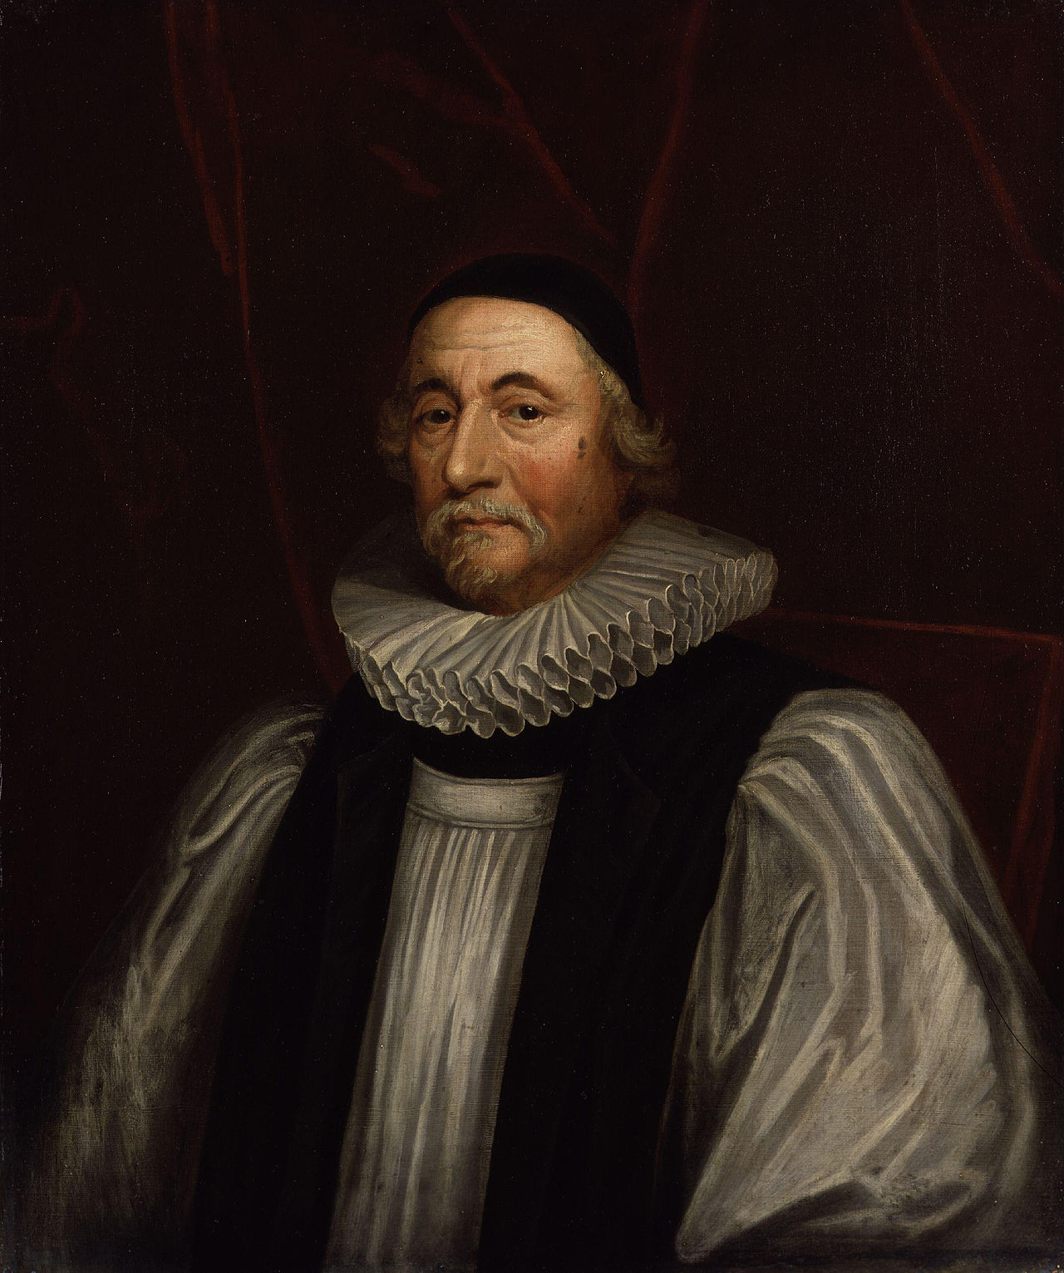
1:1-8
Around 6:00 pm,
Oct. 22,
4004 BC
Archbishop James Ussher
(1581-1656)

Slide 22
1:1-8
Gap Theory
Gen. 1:1 ~ In the beginning God created the heavens and the earth.
Gen. 1:2 ~ The earth was without form, and void; and darkness was on the face of the deep. And the Spirit of God was hovering over the face of the waters.
Gen. 1:1
Gen. 1:2
indeterminate
eons of time
without form ~ tohu
void ~ bohu

Slide 23
1:1-8

Slide 24
1:1-8
Eph 1:4 ~ … He chose us in Him before the foundation of the world,
1 Cor. 15:45 ~ And so it is written, “The first man Adam became a living being.” The last Adam became a life-giving spirit.
If we can’t trust there was the first man Adam, can we trust there was a last Adam Jesus?

Slide 25
1:1-8

Slide 26
1:1-8
hovering ~ rachaph – to shake or flutter

Slide 27
1:1-8

Slide 28
1:1-8
Rev. 21:23 ~ The city had no need of the sun or of the moon to shine in it, for the glory of God illuminated it. The Lamb is its light.

Slide 29
1:1-8
day ~ yom – with numeral adjective = always 24-hour period
e.g. “1st day,” “2nd day,” 3rd day” = 24-hour period
evening and morning with yom = always 24-hour period
e.g. “evening and morning of the day” = 24-hour period

Slide 30
1:1-8
Ex. 20:10-11 ~ ¹⁰ but the seventh day is the Sabbath of the Lord your God. In it you shall do no work: you, nor your son, nor youyr daughter, nor your male servant, nor your female servant, nor your cattle, nor your stranger who is within your gates. ¹¹ For in six days the Lord made the heavens and the earth, the sea, and all that is in them, and rested the seventh day. Therefore the Lord blessed the Sabbath and hallowed it.

Slide 31
1:1-8

Slide 32
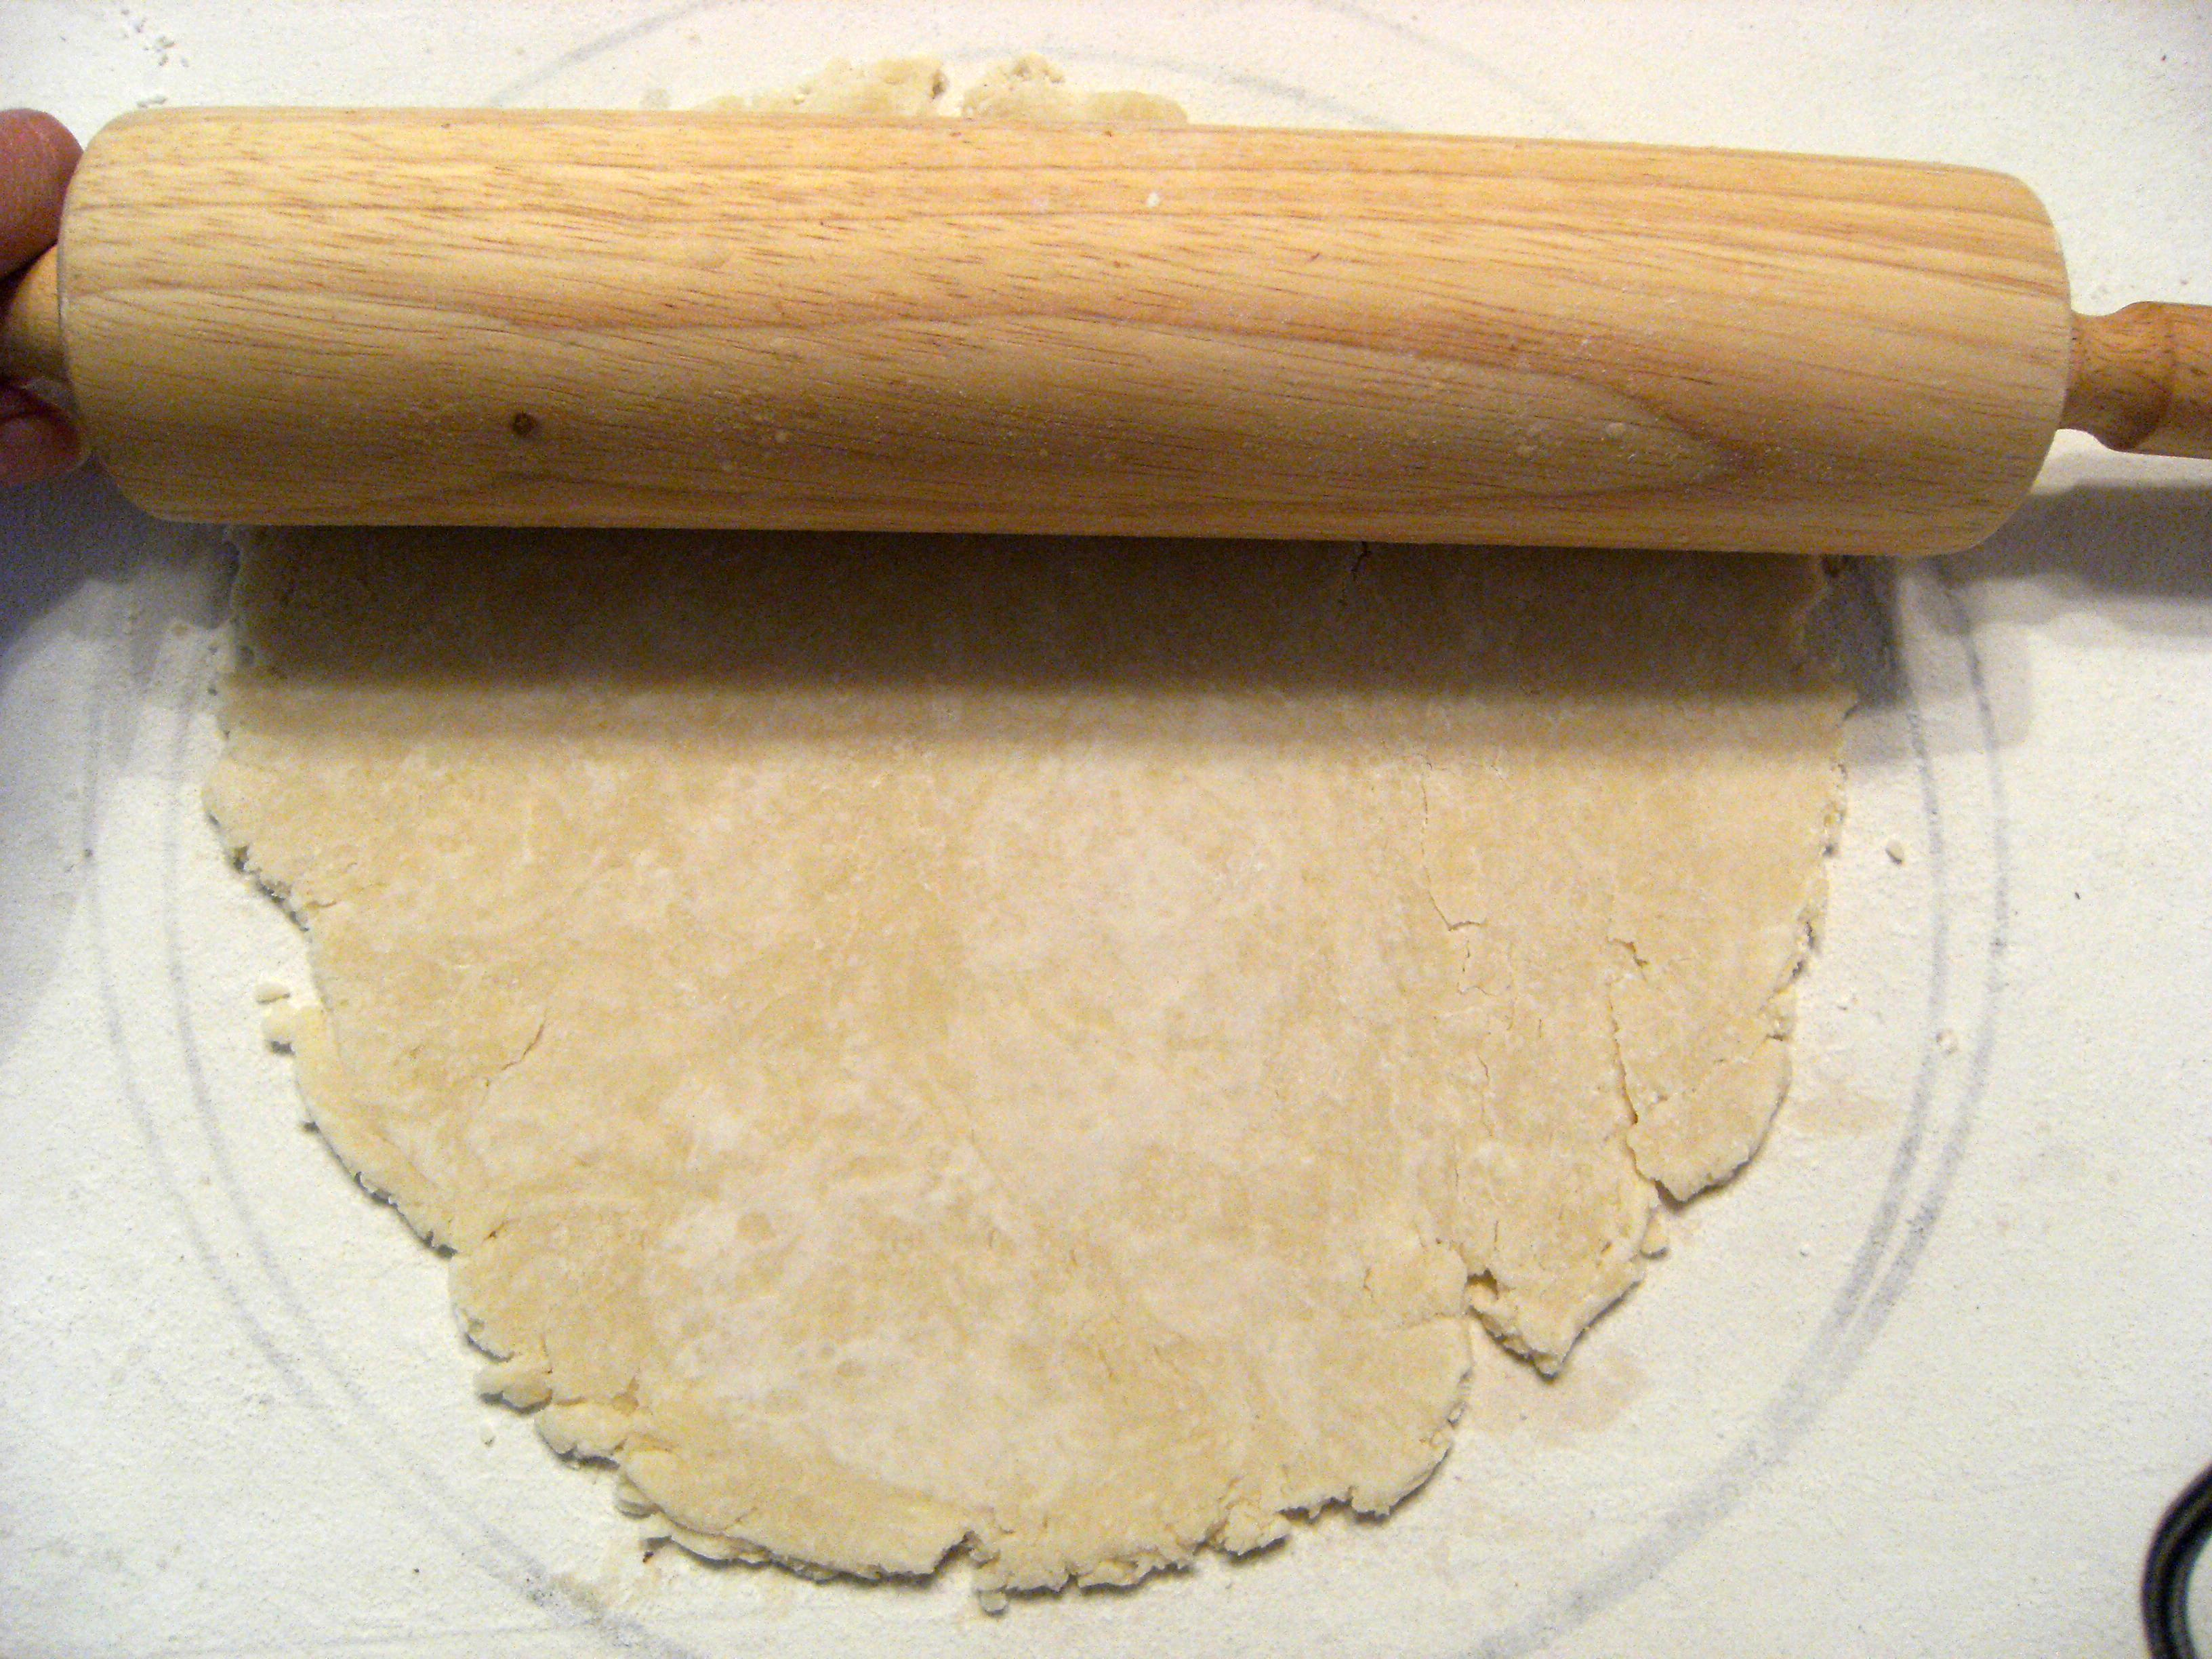
1:1-8
firmament ~ something stretched out, like hammered metal
NIV, NASB ~ expanse
This Photo by Unknown Author is licensed under CC BY-SA-NC

Slide 33
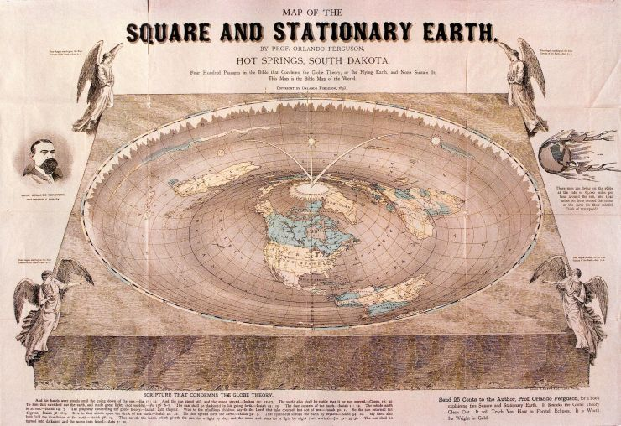
1:1-8
Flat Earth Society
This Photo by Unknown Author is licensed under CC BY-SA-NC

Slide 34
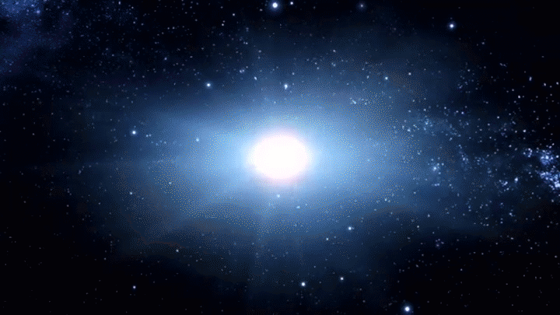
1:1-8
This Photo by Unknown Author is licensed under CC BY-SA-NC

Slide 35
1:1-8

