Slide 1

Galatians
4:18-5:9
A CD of this message will be available (free of charge) immediately following today's message
This message will be available via podcast later this week at calvaryokc.com

Slide 2
Christian metaphors:
Journey: Beloved, I beg you as sojourners and pilgrims … (1 Pet. 2:11)
War: The weapons of our warfare are not carnal … (2 Cor. 10:4)
Walk: I, therefore … beseech you to walk worthy of the calling … (Eph. 4:1)
Race: … let us lay aside every weight, and the sin which so easily ensnares us, and let us run with endurance the race that is set before us … (Heb. 12:1)
Galatians
4:18-5:9

Slide 3
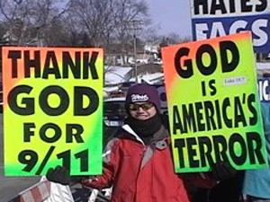
What price zealotry?
Galatians
4:18-5:9

Slide 4
2 Cor. 3:18 ~ But we all, with unveiled face, beholding as in a mirror the glory of the Lord, are being transformed into the same image from glory to glory, just as by the Spirit of the Lord.
Galatians
4:18-5:9

Slide 5
Symbolic ~ allēgoreō
Galatians
4:18-5:9

Slide 6
Outline of Galatians
Personal Experience (1-2)
Primary Doctrine (3-4)
Practical Application (5-6)
Galatians
4:18-5:9

Slide 7
NIV ~ It is for freedom that Christ has set us free. (also NASV, ESV)
Philips ~ Plant your feet firmly therefore within the freedom that Christ has won for us, and do not let yourselves be caught again in the shackles of slavery.
Galatians
4:18-5:9

Slide 8
Entangled ~ enechō – to be ensnared or trapped
Galatians
4:18-5:9

Slide 9
Estranged ~ katargeō (to render powerless) + apo (away from)
Fallen from ~ ekpiptō – literally, fallen out of grace
Galatians
4:18-5:9

Slide 10
Hindered ~ enkoptō – literally, to cut in
Galatians
4:18-5:9

Slide 11
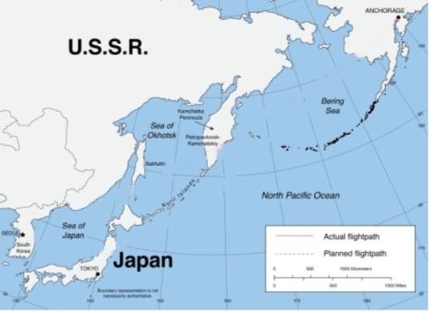
Korean Air fl 007
Planned flight path
Actual flight path
Galatians
4:18-5:9

