Slide 1

Galatians
2:1-10
A CD of this message will be available (free of charge) immediately following today's message
This message will be available via podcast later this week at calvaryokc.com

Slide 2
100 points
2 points
1 point
2 points
Galatians
2:1-10

Slide 3
"John Wesley came to save the Indians but who will save John Wesley?"
Galatians
2:1-10

Slide 4
David Guzik ~ "What love and sensitivity on Paul’s part! It would have been easy for him to say, 'I’m right and anyone who disagrees with me is wrong, and I can’t wait to get in their face publicly.' But he didn’t. He knew that being right didn’t give you the privilege of being rude."
Galatians
2:1-10

Slide 5
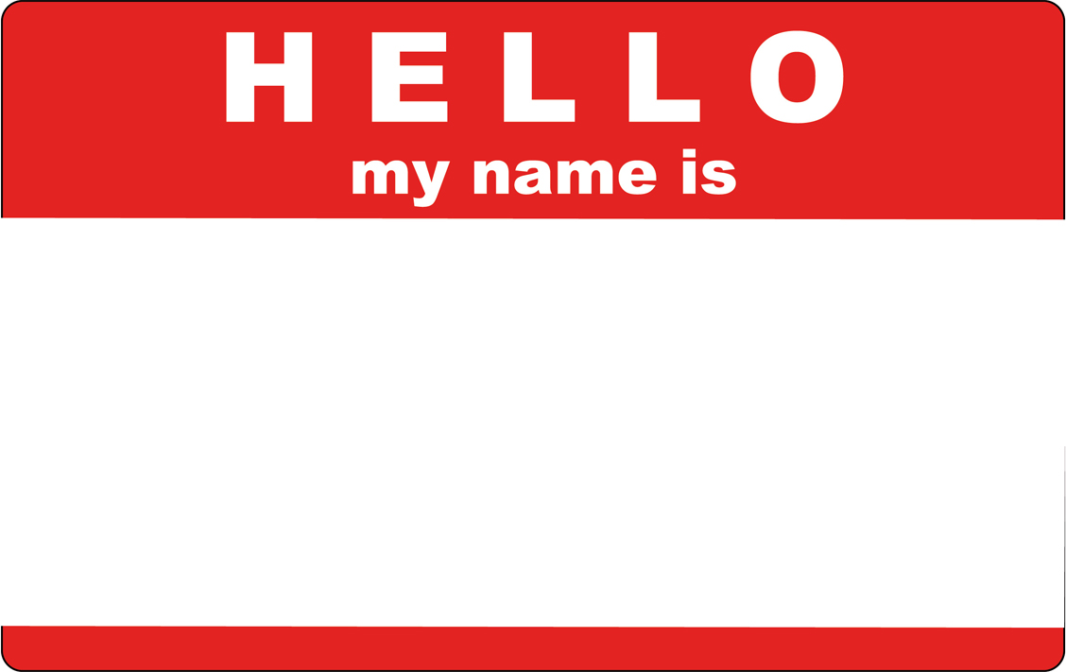
False brethren ~ NLT, so-called Christians
Pseudadelphos
False Brother
Galatians
2:1-10

Slide 6
3 R's of religion:
Rules
Regulations
Rituals
Galatians
2:1-10

Slide 7
St. Augustine ~ "In essentials, unity; in non-essentials, liberty; in all things, charity"
Galatians
2:1-10

