Slide 1

Galatians
1:1-8
A CD of this message will be available (free of charge) immediately following today's message
This message will be available via podcast later this week at calvaryokc.com

Slide 2
Murphy's First Law for Wives: If you ask your husband to pick up five items at the store and then you add one more as an afterthought, he will forget two of the first five.
Lerman's Law of Technology: Any technical problem can be overcome given enough time and money.
Corollary: You are never given enough time or money.
Law of the Search: The first place to look for anything is the last place you would expect to find it.
Corollary: It will not be in the last place you expect to find it.
Galatians
1:1-8

Slide 3
Kauffman's Paradox of the Corporation: The less important you are to the corporation, the more your tardiness or absence is noticed.
The Salary Axiom: The pay raise is just large enough to increase your taxes and just small enough to have no effect on your take-home pay.
Miller's Law of Insurance: Insurance covers everything except what happens.
Kenny's Law of Auto Repair: The part requiring the most consistent repair or replacement will be housed in the most inaccessible location.
Galatians
1:1-8

Slide 4
The Grocery Bag Law: The candy bar you planned to eat on the way home from the market is hidden at the bottom of the grocery bag.
Yeager's Law: Washing machines break down only during the wash cycle.
Corollary: All breakdowns occur on the plumber's day off.
Lampner's Law of Employment: When leaving work late, you will go unnoticed. When you leave work early, you will meet the boss in the parking lot.
Galatians
1:1-8

Slide 5
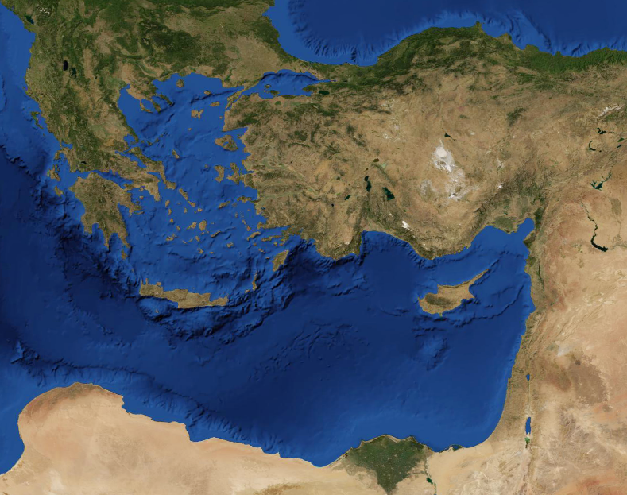
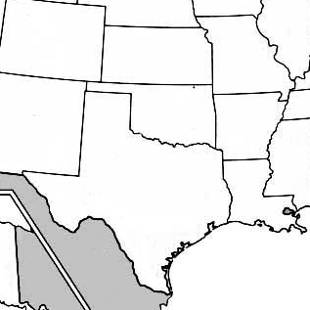
Kansas
Galatia
Galatia
Texas
Galatians
1:1-8

Slide 6
Personal experince with (1-2)
GOD'S
GRACE
Primary doctrine of (3-4)
Practical application in (5-6)
Galatians
1:1-8

Slide 7
GRACE
od's
iches
t
hrist's
xpense
"God's unmerited favor"
Galatians
1:1-8

Slide 8
From ~ ek – out from among
Galatians
1:1-8

Slide 9
For (our sins) ~ huper; above, beyond
Galatians
1:1-8

Slide 10
Marvel; turning away ~ present tense
Turning away ~ metatithēmi – to change place
Soon ~ tacheōs – quickly
It is really blowing my mind that you are so quickly turning away from grace to a different "gospel." (MSV)
Galatians
1:1-8

Slide 11
Two different Greek words for another
heteros ~ another of a different kind
allos ~ another of the same kind
Different (v. 6) ~ heteros - KJV, another
Another (v. 7) ~ allos
Galatians
1:1-8

Slide 12
Trouble ~ tarassō – to agitate, to cause one inward commotion, to strike one's spirit with fear and dread
Galatians
1:1-8

Slide 13
Accursed ~ anathema
Galatians
1:1-8

Slide 14
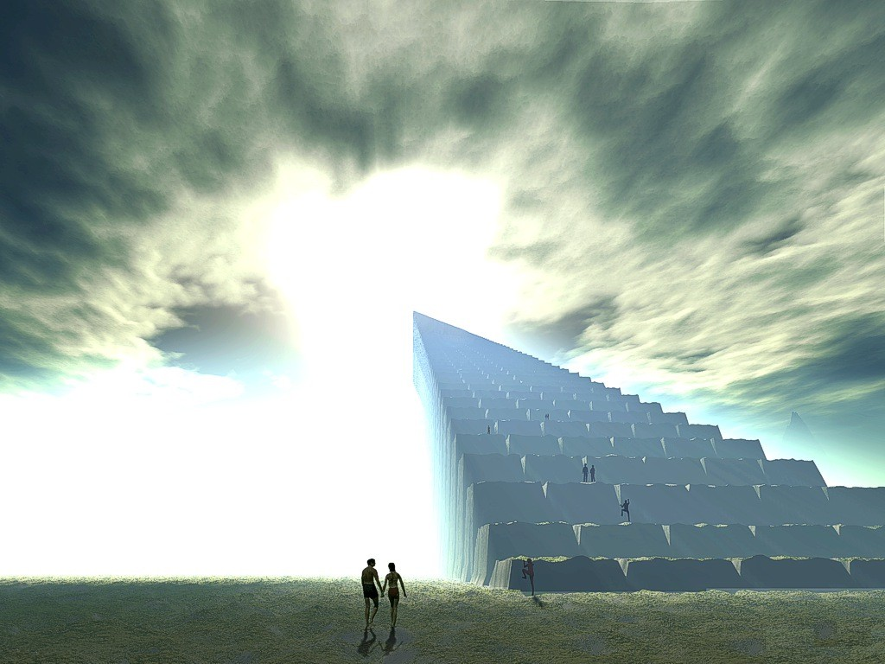
1 Cor. 13:10 ~ But when that which is perfect (the eternal state) has come, then that which is in part will be done away.
Galatians
1:1-8

Slide 15

Buddhism
Jehovah's Witnesses
Judaism
Islam
Your
works
God's
perfection
Bad
works
Hinduism
My
works
Christ's
work
Good works
vs.
Mormonism
Taoism
Galatians
1:1-8

Slide 16
5289'
6" steel cable ~ Jesus' works
Cotton thread ~ My works
Galatians
1:1-8

