Slide 1
Ezekiel 46-48

Slide 2
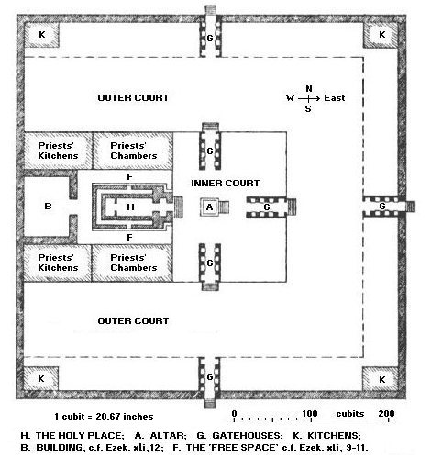
Ezekiel 46-48

Slide 3
Ezekiel 46-48

Slide 4
Ezekiel 46-48
Running ~ pakah – literally, trickling (NASB)

Slide 5
Ezekiel 46-48

Slide 6
Ezekiel 46-48
John 7:37–39 ~ ³⁷ On the last day, that great day of the feast, Jesus stood and cried out, saying, "If anyone thirsts, let him come to Me and drink. ³⁸ He who believes in Me, as the Scripture has said, out of his heart will flow rivers of living water." ³⁹ But this He spoke concerning the Spirit, whom those believing in Him would receive; for the Holy Spirit was not yet given, because Jesus was not
yet glorified.

Slide 7
Ezekiel 46-48
Joel 3:18 ~ And it will come to pass in that day
That the mountains shall drip with new wine,
The hills shall flow with milk,
And all the brooks of Judah shall be flooded with water;
A fountain shall flow from the house of the Lord
And water the Valley of Acacias.

Slide 8
Ezekiel 46-48
Zech. 14:8 ~ And in that day it shall be—
That living waters shall flow from Jerusalem,
Half of them toward the eastern sea
And half of them toward the western sea;
In both summer and winter it shall occur.

Slide 9
Ezekiel 46-48

Slide 10
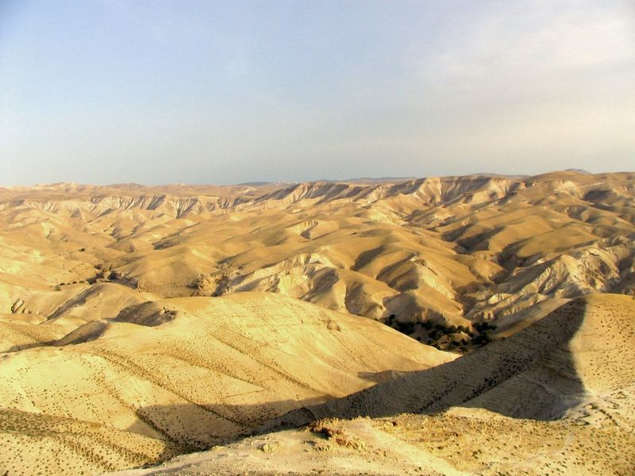
Ezekiel 46-48

Slide 11
Ezekiel 46-48

Slide 12
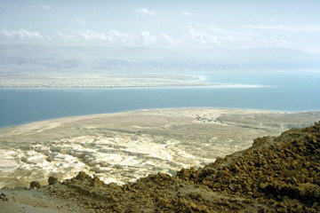
Ezekiel 46-48

Slide 13
Ezekiel 46-48

Slide 14
Ezekiel 46-48
En Gedi
En Eglaim ?

Slide 15
Ezekiel 46-48

Slide 16
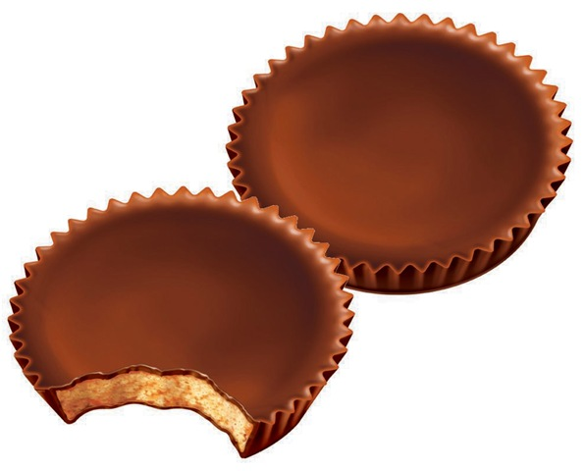
Ezekiel 46-48
Rev. 22:2 ~ NLT, On each side of the river grew a tree of life, bearing twelve crops of fruit, with a fresh crop each month.
Fruit ~ reeseoi peanutos butteron cupomai
Fruit ~ KJV, meat

Slide 17
Ezekiel 46-48

Slide 18
Ezekiel 46-48
Dan
Asher
Naphtali
Manasseh
Ephraim
Reuben
Judah
Prince
Benjamin
Simeon
Issachar
Zebulon
Gad

Slide 19
Ezekiel 46-48

Slide 20
Ezekiel 46-48
No mention of Ephraim and Manasseh
But we have Levi and Joseph

Slide 21
Ezekiel 46-48

Slide 22
Ezekiel 46-48
THE LORD IS THERE ~ YHWH Shammah

Slide 23
Ezekiel 46-48

