Slide 1
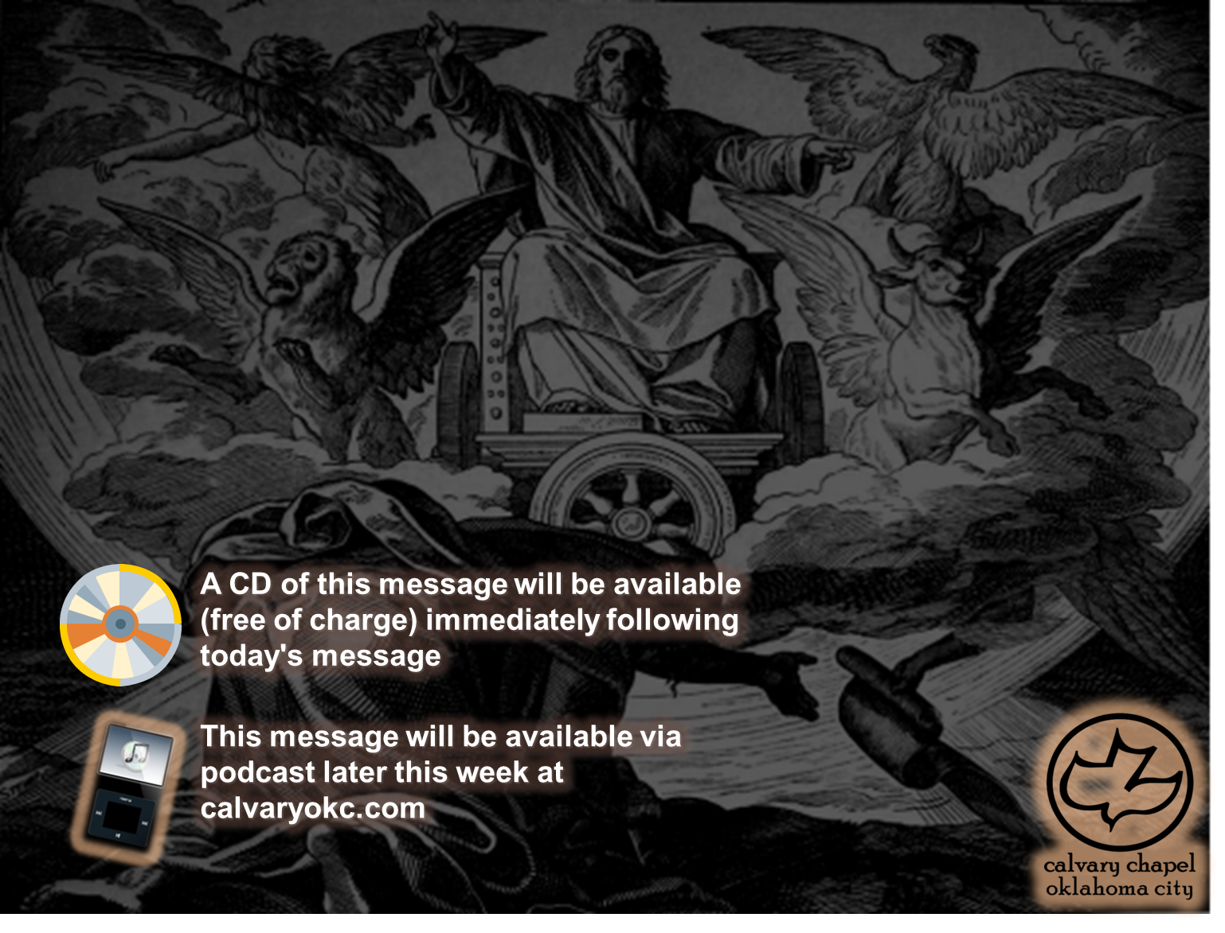
Ezekiel 43-45

Slide 2
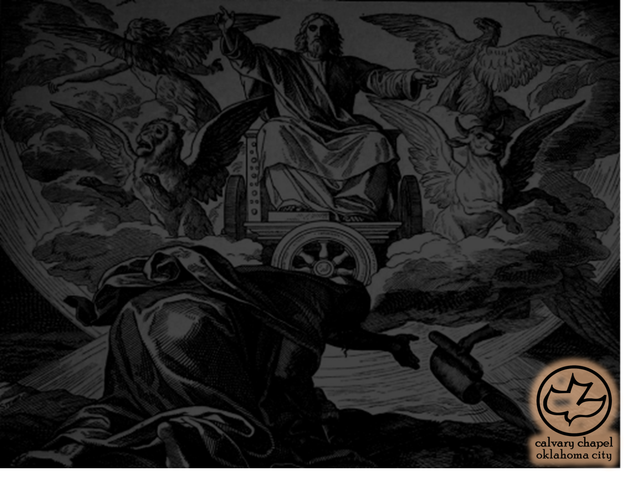
Ezekiel 43-45
When I came ~ NASB, NIV – when He came

Slide 3
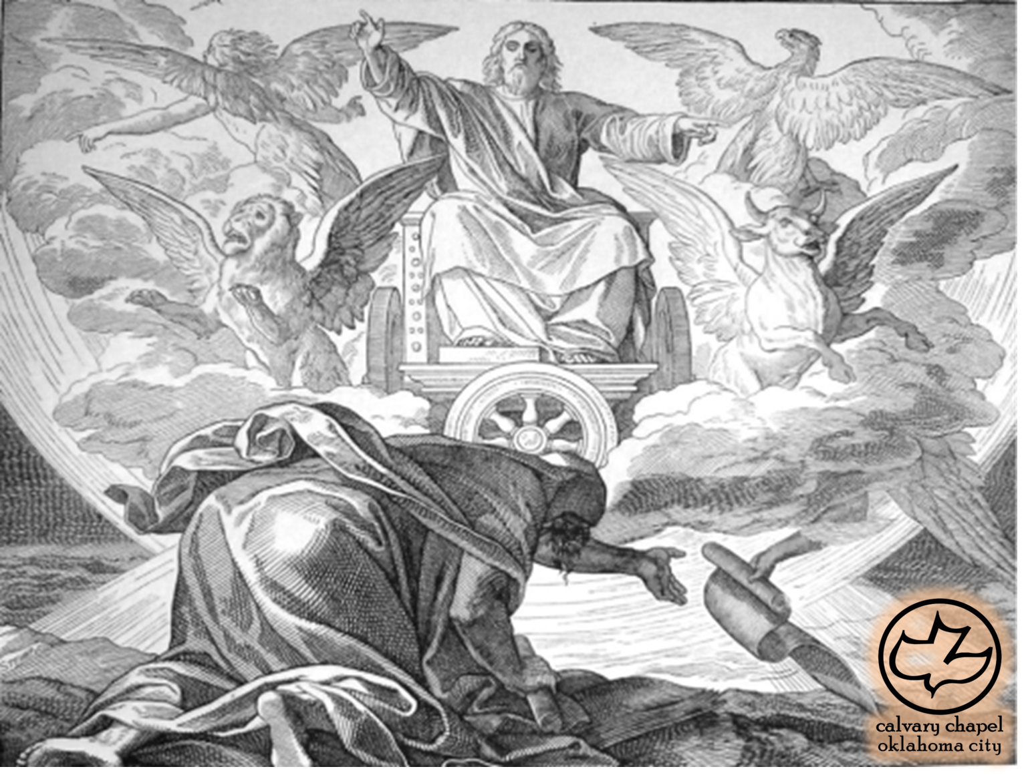
Ezekiel 43-45

Slide 4
Ezekiel 43-45
Glory ~ chapters 10-11 the glory departed
Rev. 1:15 ~ His feet were like fine brass, as if refined in a furnace, and His voice as the sound of many waters;

Slide 5
Ezekiel 43-45

Slide 6
Ezekiel 43-45
Long (or royal) cubit ~ 20.5 – 24"

Slide 7
Ezekiel 43-45

Slide 8
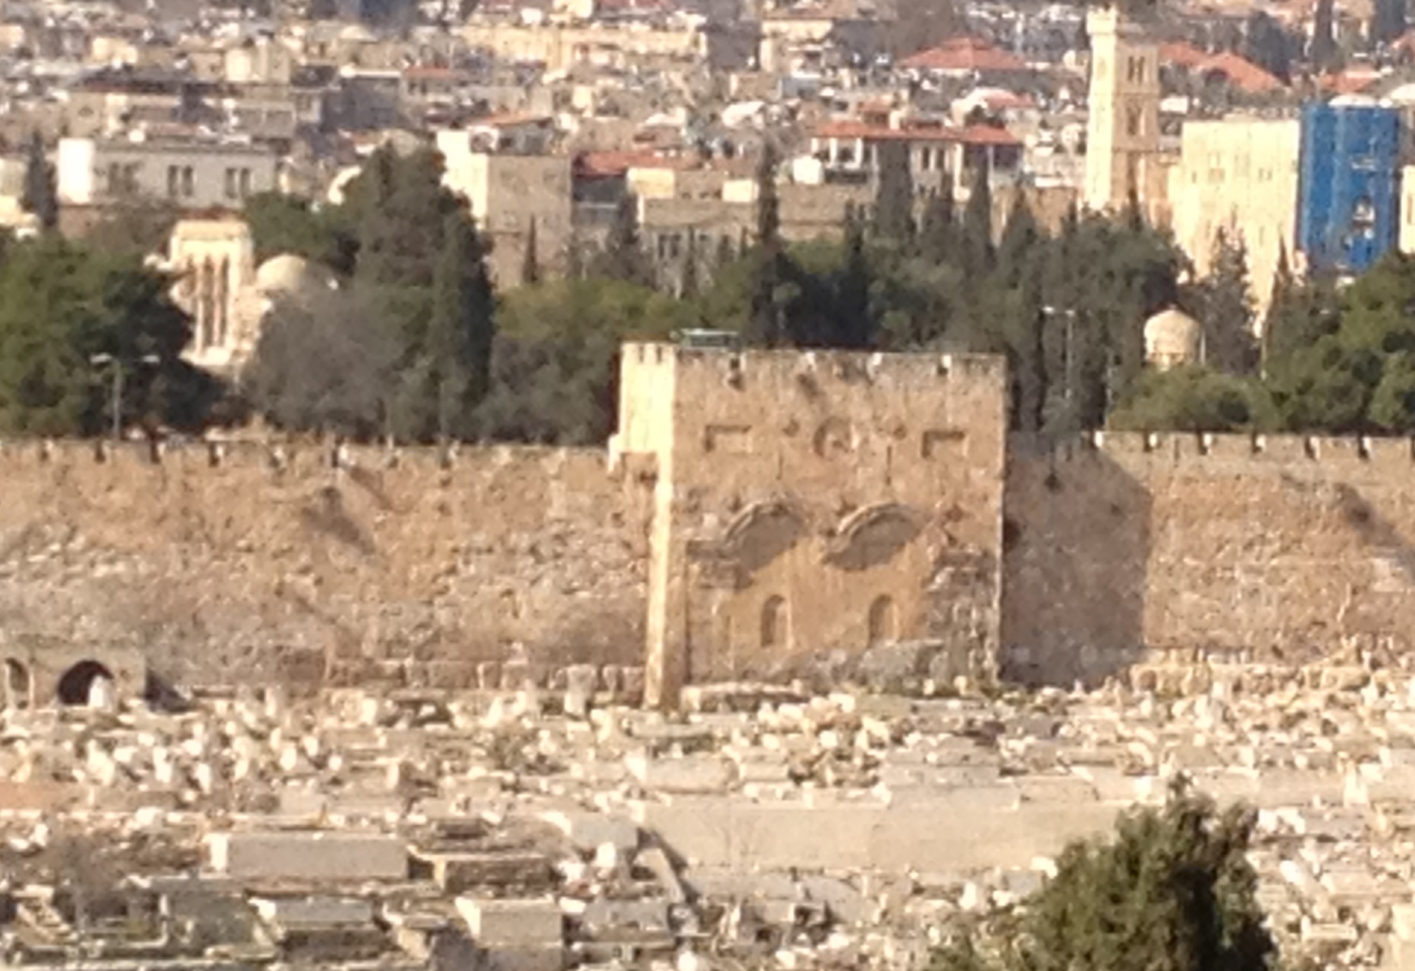
Ezekiel 43-45

Slide 9
Ezekiel 43-45

Slide 10
Ezekiel 43-45
Moody ~ "I may be tired in the work but I am not tired of the work."

Slide 11
Ezekiel 43-45

Slide 12


Ezekiel 43-45

Slide 13
Ezekiel 43-45

Slide 14
Ezekiel 43-45
Is. 65:20 ~ No more shall an infant from there live but a few days, Nor an old man who has not fulfilled his days; For the child shall die one hundred years old, But the sinner being one hundred years old shall be accursed.

Slide 15
Ezekiel 43-45

Slide 16
Ezekiel 43-45
Cubits ~ KJV, reeds

Slide 17
Ezekiel 43-45

Slide 18
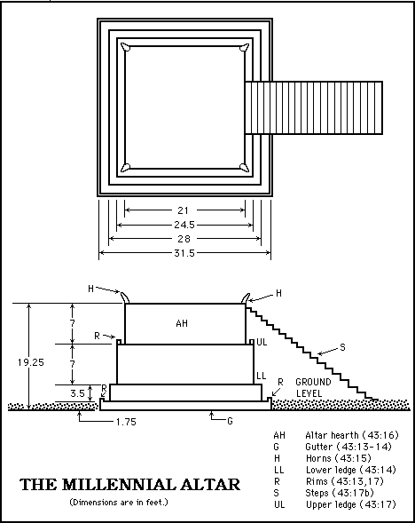
Ezekiel 43-45

Slide 19
Ezekiel 43-45

Slide 20
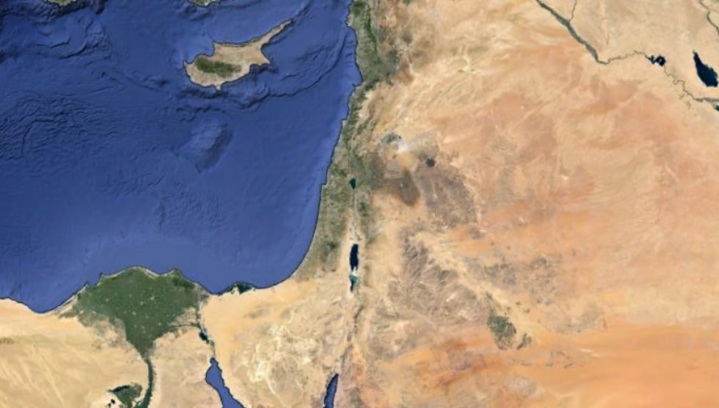
Ezekiel 43-45
Dan
Asher
Naphtali
Manasseh
Ephraim
Reuben
Judah
Prince
Benjamin
Simeon
Issachar
Zebulon
Gad

Slide 21
Ezekiel 43-45
Levites
Priests
Prince's
Portion
Jerusalem
(and districts)

Slide 22
Ezekiel 43-45

Slide 23
Ezekiel 43-45
First month ~ Nisan – New Year's Day

Slide 24
Ezekiel 43-45

Slide 25
Ezekiel 43-45
Seventh month ~ Tishri – Tabernacles

Slide 26
Ezekiel 43-45

