Slide 1
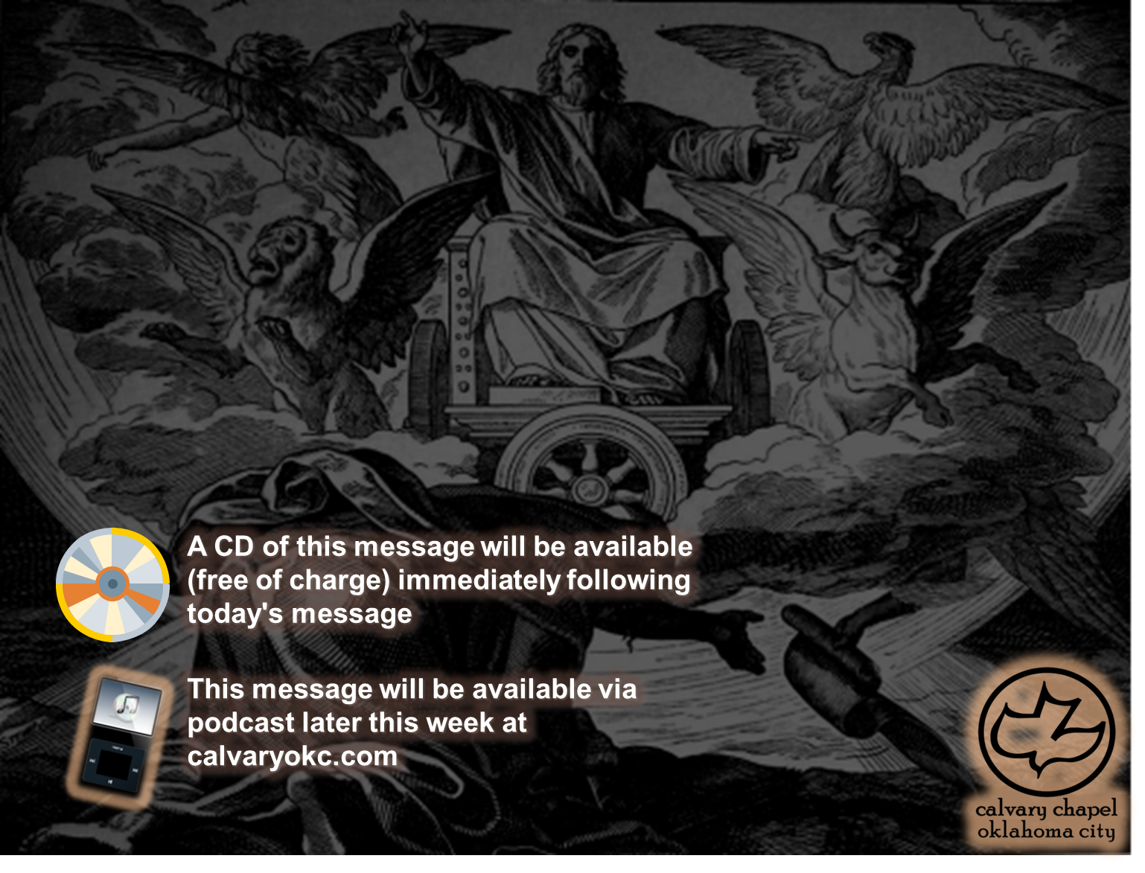
Ezekiel 40-42

Slide 2
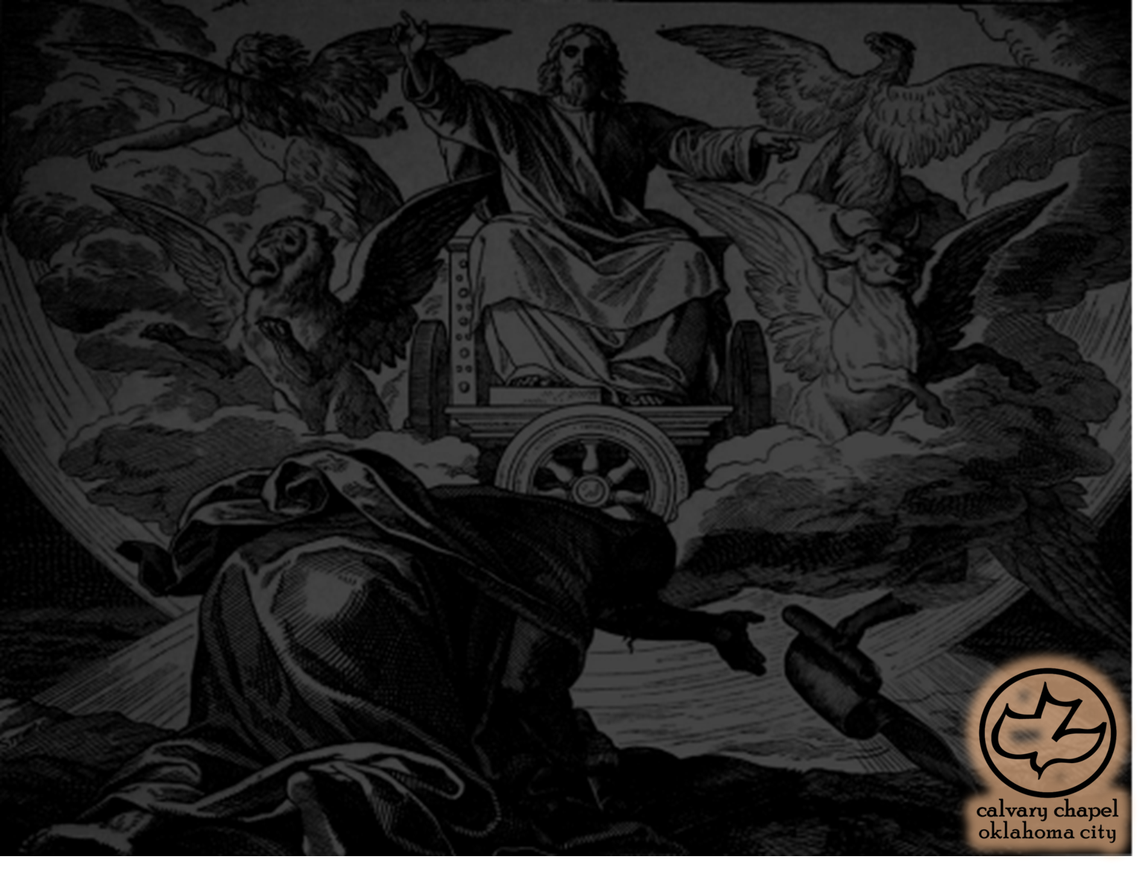
Ezekiel 40-42
Revelation 20:1-7

Slide 3
Ezekiel 40-42
Amillennialism is the belief that all (if not most) of the Old and New Testament eschatological passages are to be interpreted allegorically.
Postmillennialism is the belief that the future promises for Israel now belong to the Church and the "millennium" is Kingdom Age ushered in by the growth of the Church.
Premillennialism is the belief there is a
literal 1,000 reign of Jesus on earth following the 7 year Tribulation.

Slide 4
Ezekiel 40-42
Glorified
Church
Church
7 yr. tribulation
Millennium

Slide 5
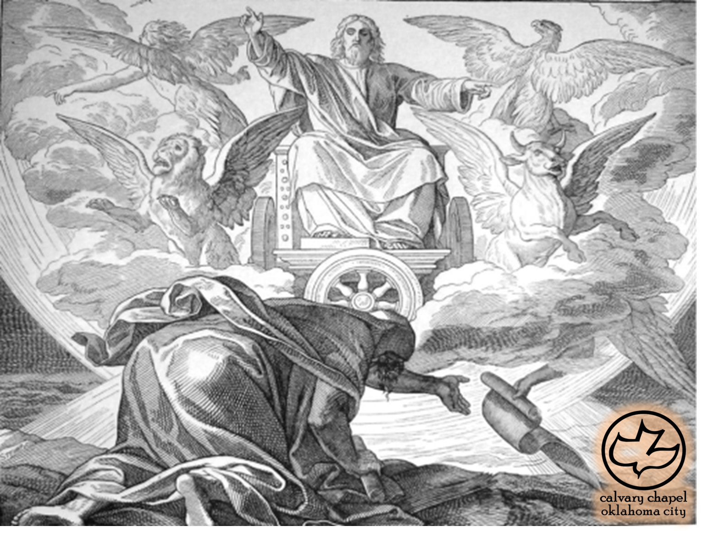
Ezekiel 40-42

Slide 6
Ezekiel 40-42
Rom. 11:1 ~ I say then, has God cast away His people? Certainly not!
Rom. 11:11 ~ I say then, have they stumbled that they should fall? Certainly not! But through their fall, to provoke them to jealousy, salvation has come to the Gentiles.

Slide 7
Ezekiel 40-42
Rom. 11:25-26 ~ ²⁵ For I do not desire, brethren, that you should be ignorant of this mystery, lest you should be wise in your own opinion, that blindness in part has happened to Israel until the fullness of the Gentiles has come in. ²⁶ And so all Israel will be saved,

Slide 8
Ezekiel 40-42

Slide 9
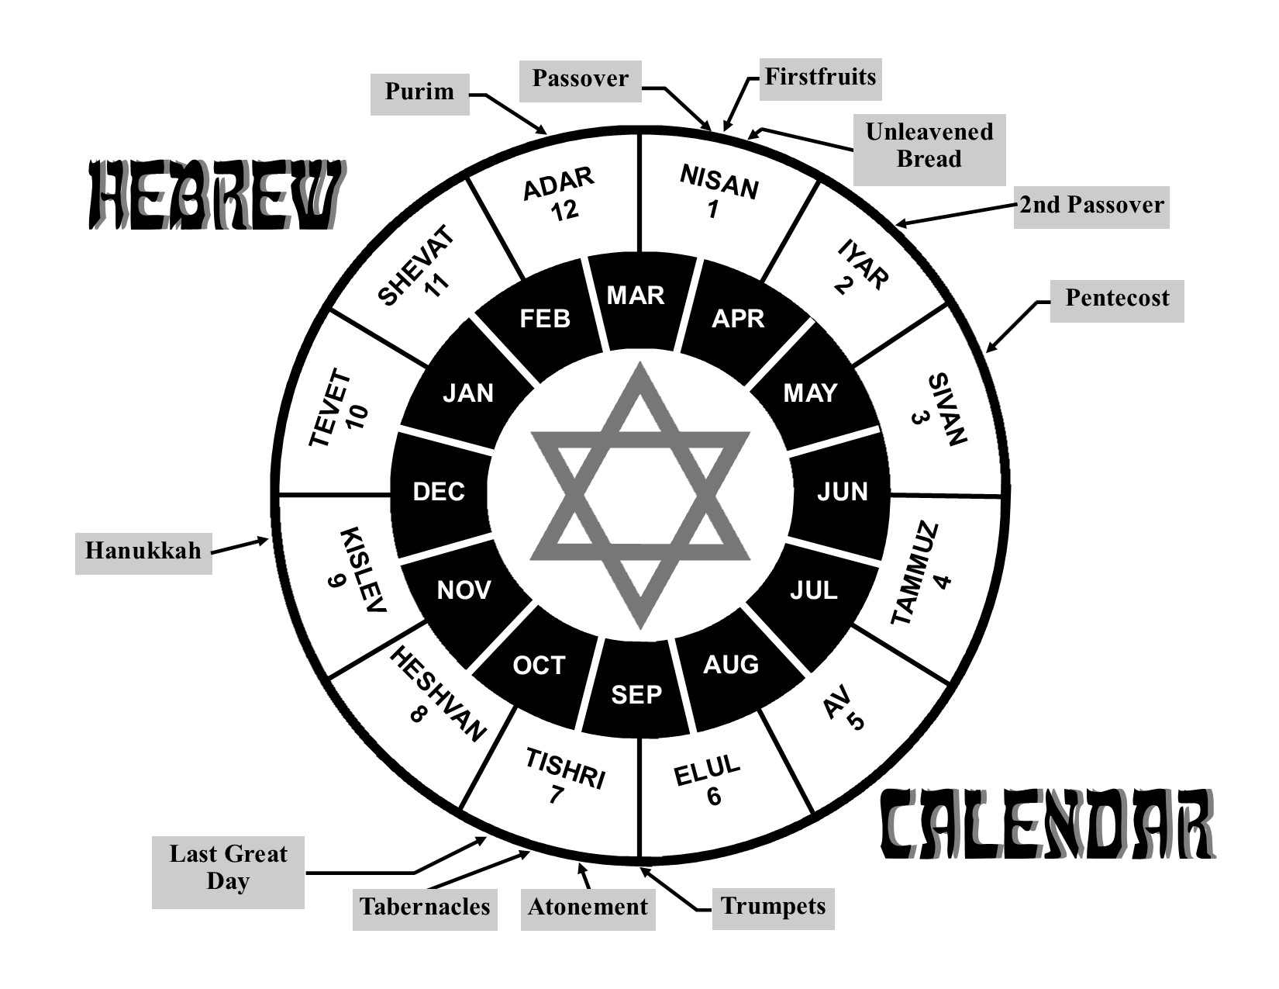
Ezekiel 40-42
10 Nisan
10 Tishri

Slide 10
Ezekiel 40-42

Slide 11
Ezekiel 40-42
Cubit and a handbreadth ~ Royal cubit = 20.5 - 24 in.
Rod ~ KJV, reed – qaneh
Rod = 10.25 – 12'

Slide 12
Ezekiel 40-42
Three views on the Temple
1. Rebuilt Temple under Ezra
2. Figurative language describing the Church
3. A future Temple not yet built

Slide 13
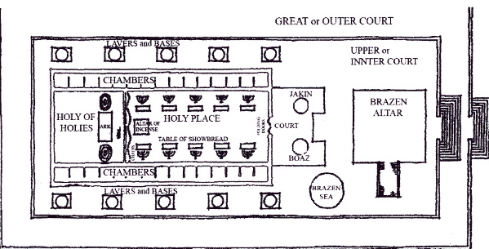
Ezekiel 40-42
Solomon's Temple

Slide 14
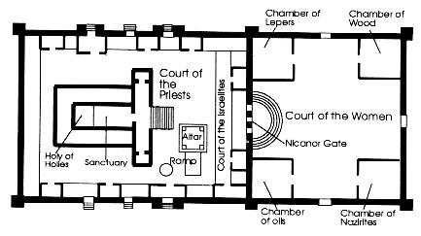
Ezekiel 40-42
Herod's Temple

Slide 15
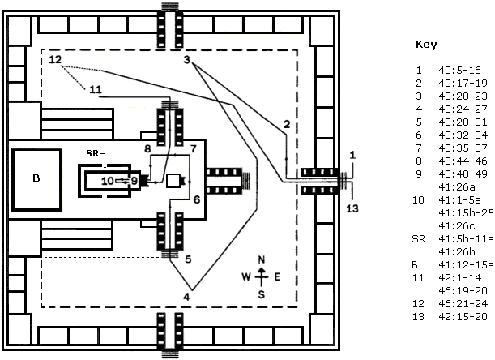
Ezekiel 40-42
Millennial Temple

Slide 16
Ezekiel 40-42
Solomon's Temple
Millennial Temple
Herod's Temple

Slide 17
Ezekiel 40-42

Slide 18
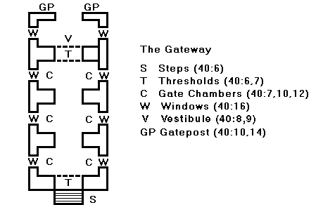
Ezekiel 40-42

Slide 19
Ezekiel 40-42

Slide 20
Ezekiel 40-42
Is. 56:7 ~ Even them I will bring to My holy mountain,
And make them joyful in My house of prayer.
Their burnt offerings and their sacrifices
Will be accepted on My altar;
For My house shall be called a house of prayer for all nations.

Slide 21
Ezekiel 40-42
Jer. 33:17-18 ~ ¹⁷ For thus says the Lord: "David shall never lack a man to sit on the throne of the house of Israel; ¹⁸ nor shall the priests, the Levites, lack a man to offer burnt offerings before Me, to kindle grain offerings, and to sacrifice continually."

Slide 22
Ezekiel 40-42
Zech. 14:21 ~ Yes, every pot in Jerusalem and Judah shall be holiness to the Lord of hosts. Everyone who sacrifices shall come and take them and cook in them. In that day there shall no longer be a Canaanite in the house of the Lord of hosts.

Slide 23
Ezekiel 40-42
Heb. 10:12-18 ~ ¹² But this Man, after He had offered one sacrifice for sins forever, sat down at the right hand of God, ¹³ from that time waiting till His enemies are made His footstool. ¹⁴ For by one offering He has perfected forever those who are being sanctified.
¹⁵ But the Holy Spirit also witnesses to us; for after He had said before,
¹⁶ "This is the covenant that I will
make with them after those days,
says the Lord: I will put My laws into their hearts, and in their minds I will write them," ¹⁷ then He adds, "Their sins and their lawless deeds I will remember no more." ¹⁸ Now where there is remission of these, there is no longer an offering for sin.

Slide 24
Ezekiel 40-42
Acts 21:26 ~ Then Paul took the men, and the next day, having been purified with them, entered the temple to announce the expiration of the days of purification, at which time an offering should be made for each one of them.

Slide 25
Ezekiel 40-42

Slide 26
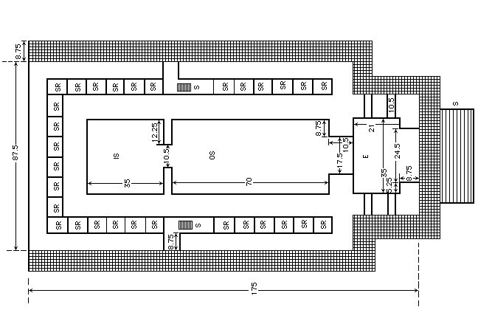
Ezekiel 40-42

Slide 27
Ezekiel 40-42

