Slide 1
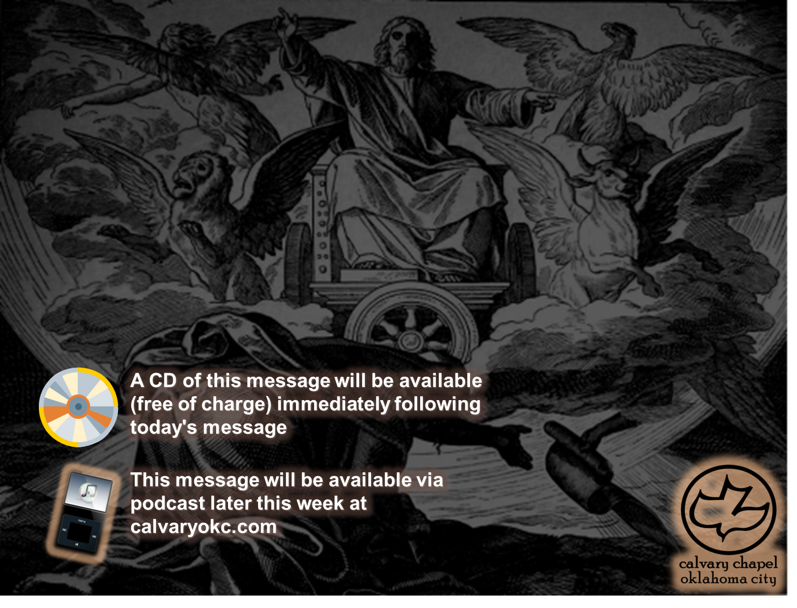
Ezekiel 35-37

Slide 2
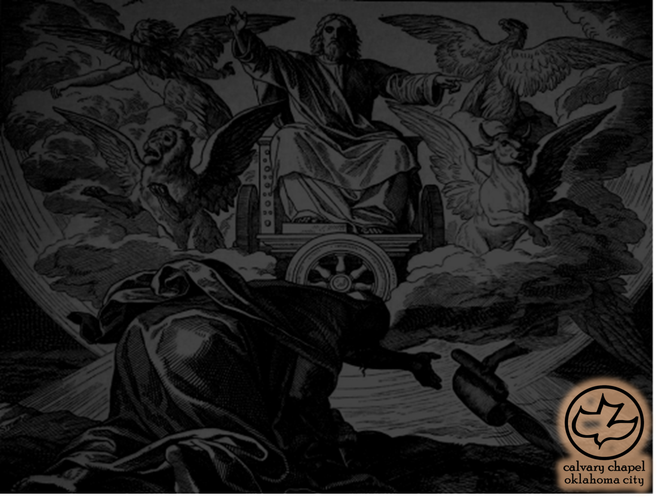
Ezekiel 35-37
Ancient (v. 5) ~ better, KJV – perpetual

Slide 3
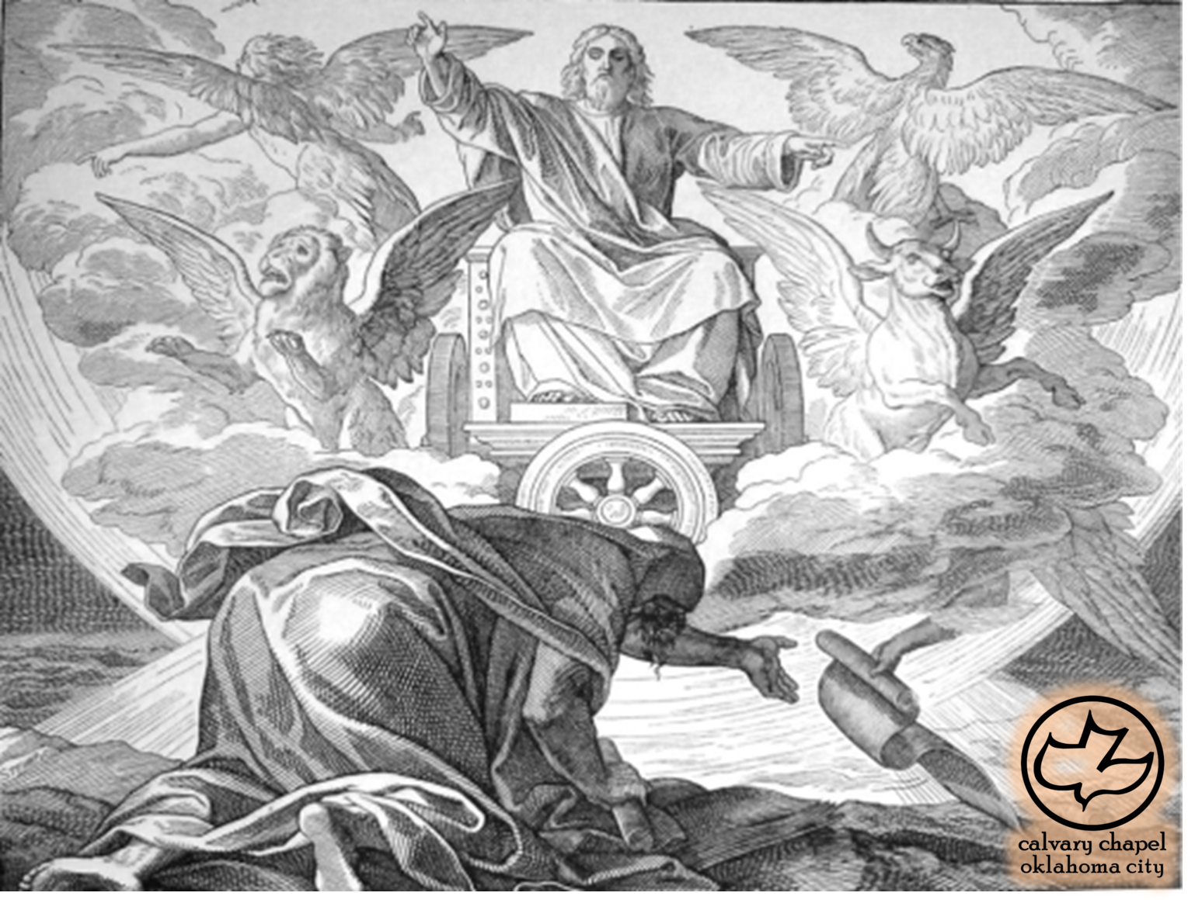
Ezekiel 35-37

Slide 4
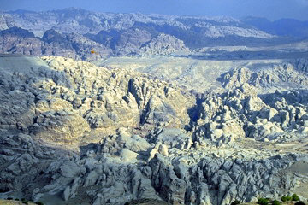
Ezekiel 35-37

Slide 5
Ezekiel 35-37

Slide 6
Ezekiel 35-37
Mark Twain ~ "Of all the lands there are for dismal scenery, I think Palestine must be the prince … Palestine sits in sackcloth and ashes. Over it broods the spell of a curse that has withered its fields and fettered its energies … Nazareth is forlorn … Bethlehem and Bethany, in their poverty and their humiliation, have nothing about them now to remind one that they once knew the high honor of the Savior's presence … Renowned Jerusalem itself, the stateliest name in history, has lost all its ancient grandeur, and is become a
pauper village…"

Slide 7
Ezekiel 35-37

Slide 8
Ezekiel 35-37
Gen. 13:14-15 ~ ¹⁴ And the Lord said to Abram, after Lot had separated from him: "Lift your eyes now and look from the place where you are — northward, southward, eastward, and westward; ¹⁵ for all the land which you see I give to you and your descendants forever."

Slide 9
Ezekiel 35-37

Slide 10
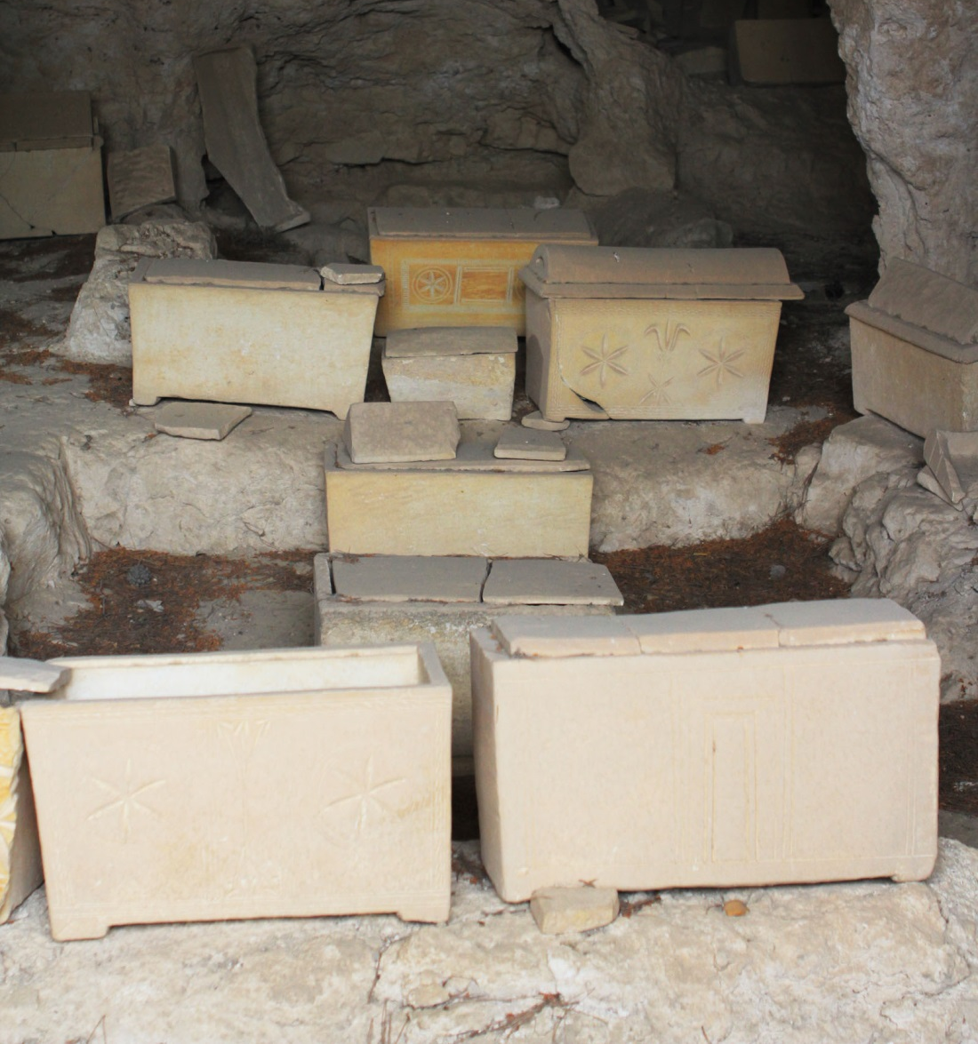
Ezekiel 35-37

Slide 11
Ezekiel 35-37

Slide 12
Ezekiel 35-37
Breath ~ ruach
Also spirit and wind
Greek equivalent = pneuma

Slide 13
Ezekiel 35-37

Slide 14
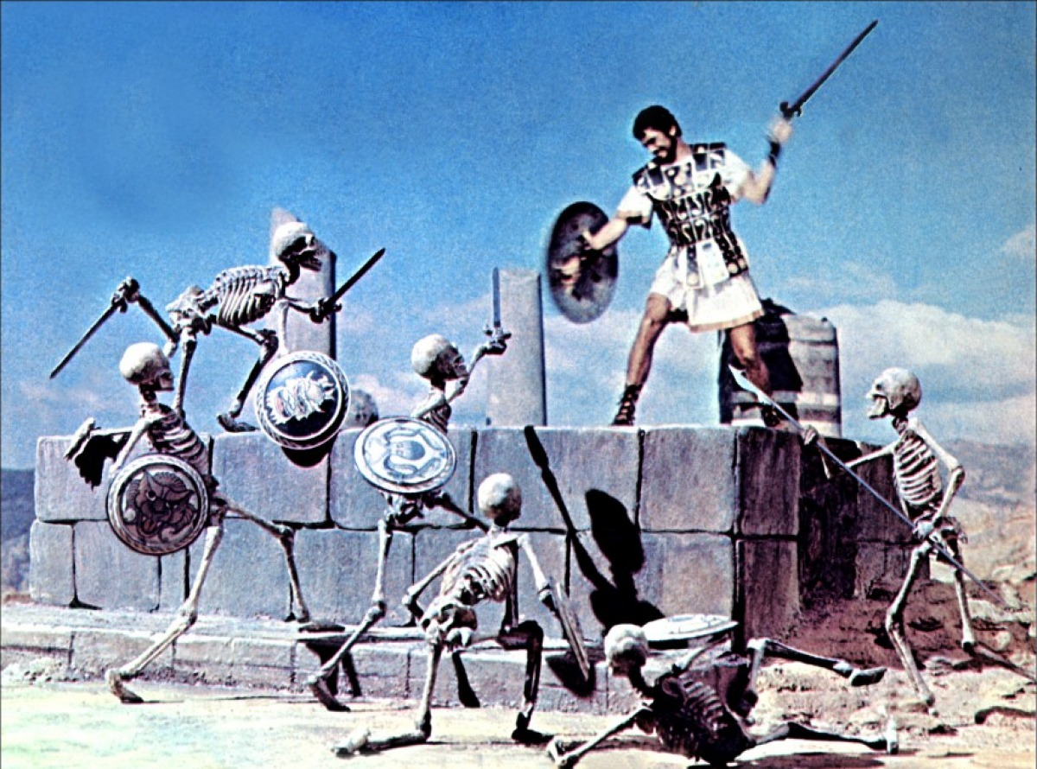
Ezekiel 35-37

Slide 15
Ezekiel 35-37

Slide 16
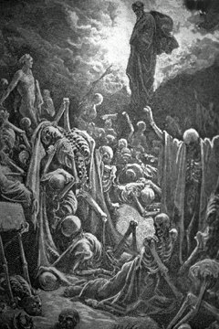
Ezekiel 35-37

Slide 17
Ezekiel 35-37

Slide 18
Ezekiel 35-37
Matt. 24:31 ~ And He will send His angels with a great sound of a trumpet, and they will gather together His elect from the four winds, from one end of heaven to the other.

Slide 19
Ezekiel 35-37

Slide 20
Ezekiel 35-37
Rev. 21:3-4 ~ ³ And I heard a loud voice from heaven saying, "Behold, the tabernacle of God is with men, and He will dwell with them, and they shall be His people. God Himself will be with them and be their God. ⁴ And God will wipe away every tear from their eyes; there shall be no more death, nor sorrow, nor crying. There shall be no more pain, for the former things have passed away."

Slide 21
Ezekiel 35-37

