Slide 1
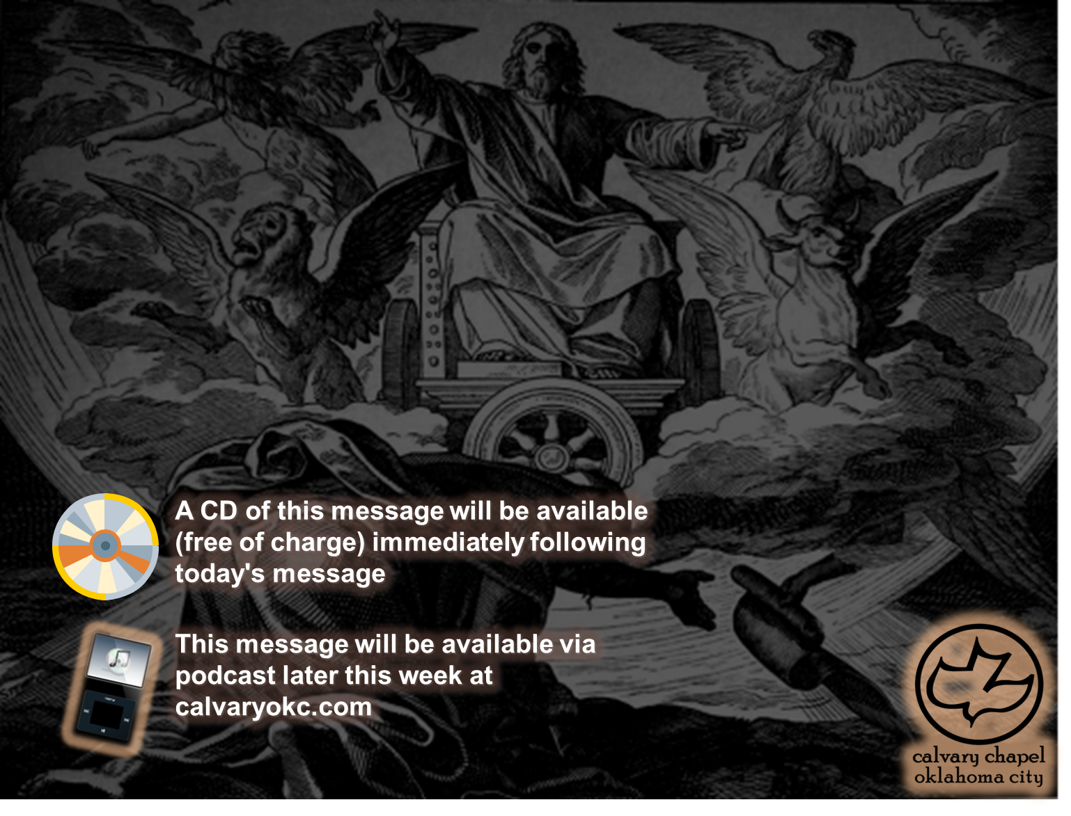
Ezekiel 33-34

Slide 2
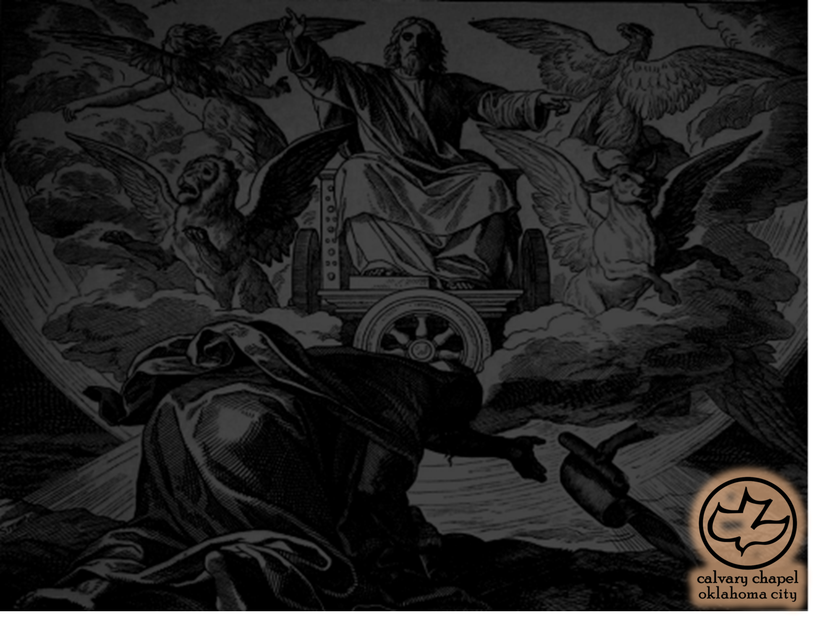
Ezekiel 33-34
Jeffrey Peters ~ "Physical death is real to us all and we feel its pangs and pain. But somehow eternal death does not seem so real to us. We all have loved ones who are living without Christ and who will go to hell if they die in that condition, yet we rarely shed a tear for their souls. As long as the death of the body seems more important to us than spiritual death, evangelism will always lack the urgency that charact-
erizes New Testament life and witness."

Slide 3
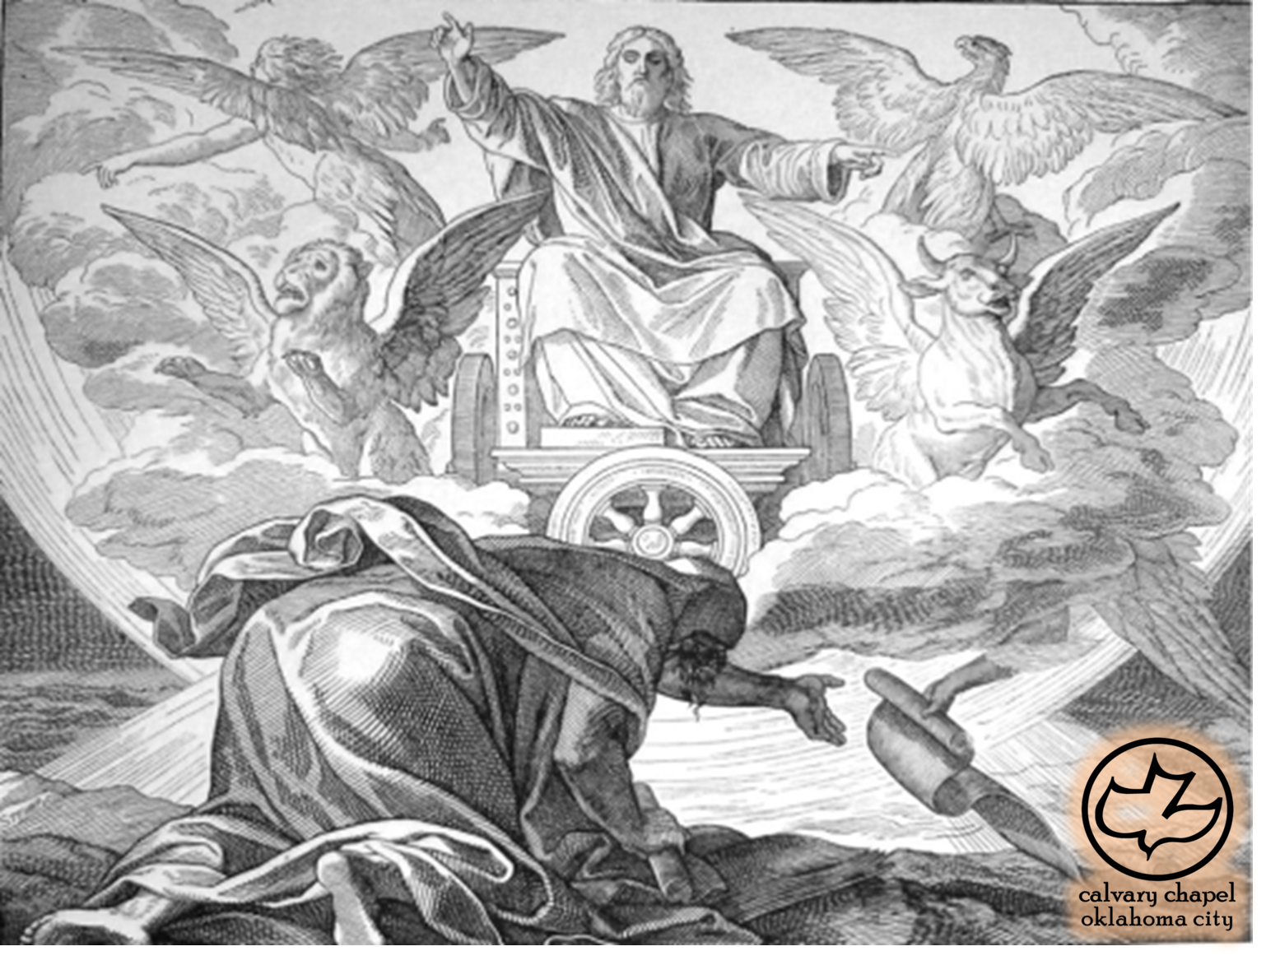
Ezekiel 33-34

Slide 4
Ezekiel 33-34
Eph. 6:12 ~ For we do not wrestle against flesh and blood, but against principalities, against powers, against the rulers of the darkness of this age, against spiritual hosts of wickedness in the heavenly places.

Slide 5
Ezekiel 33-34

Slide 6
Ezekiel 33-34
Ps. 116:15 ~ Precious in the sight of the Lord
Is the death of His saints.

Slide 7
Ezekiel 33-34
John 1:17 ~ For the law was given through Moses, but grace and truth came through Jesus Christ.
TLB ~ For Moses gave us only the Law with its rigid demands and merciless justice, while Jesus Christ brought us loving forgiveness as well.

Slide 8
Ezekiel 33-34
Rom. 10:5-10 ~ ⁵ For Moses writes about the righteousness which is of the law, “The man who does those things shall live by them.” ⁶ But the righteousness of faith speaks in this way, “Do not say in your heart, ‘Who will ascend into heaven?’” (that is, to bring Christ down from above) ⁷ or, “ ‘Who will descend into the abyss?’ ” (that is, to bring Christ up from the dead). ⁸ But what does it
say? “The word is near you, in your
mouth and in your heart” (that is, the word of faith which we preach): ⁹ that if you confess with your mouth the Lord Jesus and believe in your heart that God has raised Him from the dead, you will be saved. ¹⁰ For with the heart one believes unto righteousness, and with the mouth confession is made unto salvation.

Slide 9
Ezekiel 33-34
2 Pet. 3:9 ~ The Lord is not slack concerning His promise, as some count slackness, but is longsuffering toward us, not willing that any should perish but that all should come to repentance.

Slide 10
Ezekiel 33-34

Slide 11
Ezekiel 33-34
Shall be remembered ~ KJV, shall be mentioned

Slide 12
Ezekiel 33-34

Slide 13
Ezekiel 33-34
Jan. 9, 585 BC

Slide 14
Ezekiel 33-34

Slide 15
Ezekiel 33-34
Jam. 1:23-25 ~ ²³ For if anyone is a hearer of the word and not a doer, he is like a man observing his natural face in a mirror; ²⁴ for he observes himself, goes away, and immediately forgets what kind of man he was. ²⁵ But he who looks into the perfect law of liberty and continues in it, and is not a forgetful hearer but a doer of the work, this one will be blessed in what he does.

Slide 16
Ezekiel 33-34

Slide 17
Ezekiel 33-34
Garden of renown ~ KJV, plant of renown

Slide 18
Ezekiel 33-34

