Slide 1
Ezekiel 30-32

Slide 2
Ezekiel 30-32
Wail ~ KJV, howl

Slide 3
Ezekiel 30-32

Slide 4
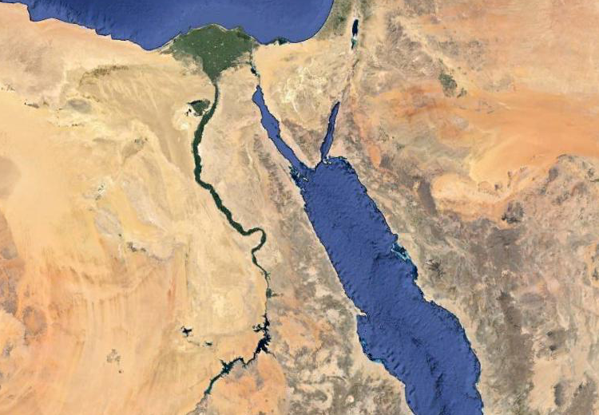
Ezekiel 30-32
Migdol
Syrene

Slide 5
Ezekiel 30-32

Slide 6
Ezekiel 30-32
Apr. 29 587 BC

Slide 7
Ezekiel 30-32

Slide 8
Ezekiel 30-32
June 21, 587 BC

Slide 9
Ezekiel 30-32

Slide 10
Ezekiel 30-32
Dan. 4:11-12 ~ ¹¹ The tree grew and became strong;
Its height reached to the heavens,
And it could be seen to the ends of all the earth.
¹² Its leaves were lovely,
Its fruit abundant,
And in it was food for all.
The beasts of the field found shade under it,
The birds of the heavens dwelt in its branches,
And all flesh was fed from it.

Slide 11
Ezekiel 30-32
Matthew 13:31–32 ~ ³¹ Another parable He put forth to them, saying: "The kingdom of heaven is like a mustard seed, which a man took and sowed in his field, ³² which indeed is the least of all the seeds; but when it is grown it is greater than the herbs and becomes a tree, so that the birds of the air come and nest in its branches."

Slide 12
Ezekiel 30-32

Slide 13
Ezekiel 30-32
Prov. 16:18 ~ Pride goes before destruction,
And a haughty spirit before a fall.

Slide 14
Ezekiel 30-32

Slide 15
Ezekiel 30-32
Uncircumcised ~ unbelievers

Slide 16
Ezekiel 30-32

Slide 17
Ezekiel 30-32
Eze. 30:20
Apr. 28, 587 BC
Eze. 31:1
Jun. 21, 587 BC
Eze. 32:1
Mar. 3, 585 BC
589 BC
588 BC
587 BC
586 BC
585 BC
Siege of Jerusalem (Jan. 588 BC - Aug. 586 BC)

Slide 18
Ezekiel 30-32

Slide 19
Ezekiel 30-32
Monstere ~ tannim – probably a Nile crocodile

Slide 20
Ezekiel 30-32

Slide 21
Ezekiel 30-32
Carcass ~ NASB, refuse; NIV, remains; KJV (literally), height

Slide 22
Ezekiel 30-32

Slide 23
Ezekiel 30-32
U. S. ~ almost 250 years
Egypt ~ almost 2500 years

Slide 24
Ezekiel 30-32

Slide 25
Ezekiel 30-32
Hell ~ sheol (ESV, NASB)

Slide 26
Ezekiel 30-32

Slide 27
Ezekiel 30-32
Assyria ~ KJV, Asshur

Slide 28
Ezekiel 30-32

