Slide 1
Ezekiel 23-24

Slide 2
Ezekiel 23-24
Oholah ~ a tent (as in a pagan worship site)
Oholibah ~ My tent is in her

Slide 3
Ezekiel 23-24

Slide 4
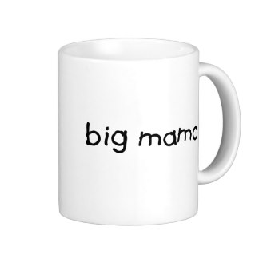
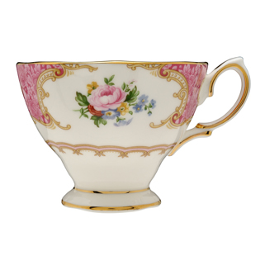
Ezekiel 23-24
Big
Mama

Slide 5
Ezekiel 23-24

Slide 6
Ezekiel 23-24
Tear at ~ KJV, pluck off (literal)

Slide 7
Ezekiel 23-24

Slide 8
Ezekiel 23-24
You
Me
Them
Sin-o-meter

Slide 9
Ezekiel 23-24

Slide 10
Ezekiel 23-24
Jan. 15, 588 BC

Slide 11
Ezekiel 23-24

Slide 12
Ezekiel 23-24
Scum ~ JFB, poisonous scum; NASB, rust

Slide 13
Ezekiel 23-24

Slide 14
Ezekiel 23-24
Lev. 17:13-14 ~ ¹³ Whatever man of the children of Israel, or of the strangers who dwell among you, who hunts and catches any animal or bird that may be eaten, he shall pour out its blood and cover it with dust; ¹⁴ for it is the life of all flesh. Its blood sustains its life. Therefore I said to the children of Israel, "You shall not eat the blood of any flesh, for the life of all flesh is its blood. Whoever eats it shall
be cut off."

Slide 15
Ezekiel 23-24
Is. 5:20 ~ Woe to those who call evil good, and good evil; Who put darkness for light, and light for darkness; Who put bitter for sweet, and sweet for bitter!

Slide 16
Ezekiel 23-24

Slide 17
Ezekiel 23-24
1 Cor. 2:14 ~ But the natural man does not receive the things of the Spirit of God, for they are foolishness to him; nor can he know them, because they are spiritually discerned.

Slide 18
Ezekiel 23-24

Slide 19
Ezekiel 23-24
Stroke ~ KJV, 22x plague(d); 3x slaughter

Slide 20
Ezekiel 23-24

Slide 21
Ezekiel 23-24
Bind your turban ~ KJV, bind the tire
Bread of sorrow ~ KJV, NASB, bread of men (literal)
Message ~ Keep your grief to yourself. No public mourning. Get dressed as usual and go about your work—none of the usual funeral rituals.

Slide 22
Ezekiel 23-24

Slide 23
Ezekiel 23-24
Two important lessons of Bible prophecy:
The Bible currently has a 100% track record fulfilling prophecy
And every one of them have so far been fulfilled literally

Slide 24
Ezekiel 23-24

