Slide 1
Ezekiel 21-22

Slide 2
Ezekiel 21-22
Heart ~ literally loins (as in KJV)

Slide 3
Ezekiel 21-22

Slide 4
Ezekiel 21-22
Strike your thigh ~ or, beat your breast (as in NIV)

Slide 5
Ezekiel 21-22

Slide 6
Ezekiel 21-22
1st captivity 605 BC
2nd captivity 597 BC
3rd captivity 586 BC
610BC
600BC
590BC

Slide 7
Ezekiel 21-22

Slide 8
Ezekiel 21-22
Jerusalem
Rabbah

Slide 9
Ezekiel 21-22
Images ~ teraphim (Gen. 31)
Targum Pseudo-Jonathan says they were shrunken heads 1st born adult males

Slide 10
Ezekiel 21-22

Slide 11
Ezekiel 21-22
Overthrown ~ better, ruin (NIV, NASB) or rubble

Slide 12
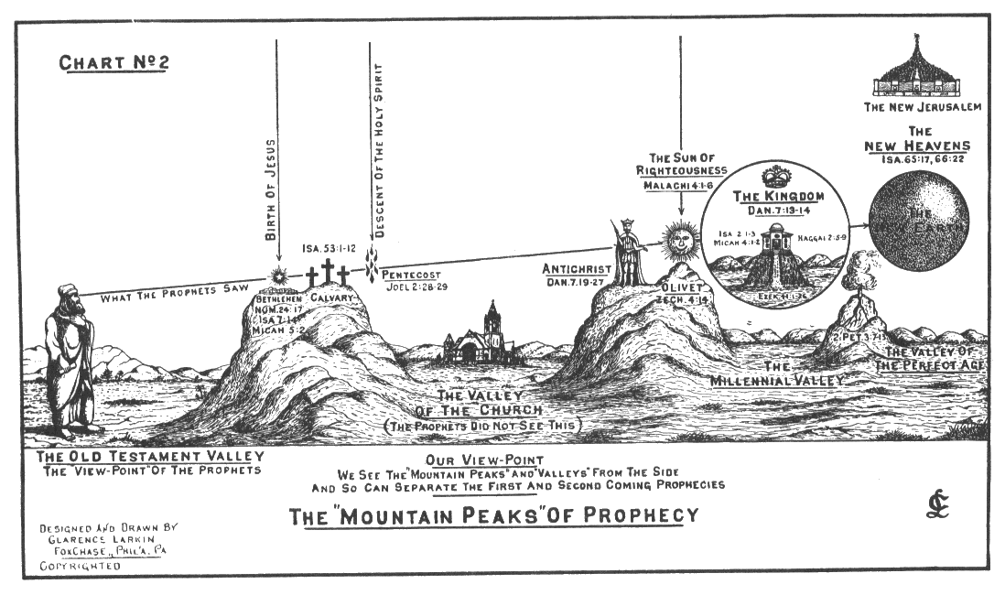
Ezekiel 21-22

Slide 13
Ezekiel 21-22
Gen. 49:10 ~ The scepter shall not depart from Judah,
Nor a lawgiver from between his feet,
Until Shiloh comes;
And to Him shall be the obedience of the people.

Slide 14
Ezekiel 21-22

Slide 15
Ezekiel 21-22
Reproach ~ NIV, insults

Slide 16
Ezekiel 21-22

Slide 17
Ezekiel 21-22
Lev. 18:8 ~ The nakedness of your father's wife you shall not uncover; it is your father's nakedness.

Slide 18
Ezekiel 21-22

Slide 19
Ezekiel 21-22
misery. It is a holy God's answer to the violation of divine law by human beings whose very nature is to rebel against him."
Peter Jeffery ~ "It is not 'conviction of sin' for a person to feel bad because he or she is drinking too much or generally making a mess of life. Sin is not just a violation of socially accepted standards. To see sin only in social or moral terms will not lead people to conviction. Sin must be seen in the light of the law and holiness of God. The gospel is not an aspirin for the aches of life, to
soothe and comfort people in their

Slide 20
Ezekiel 21-22

Slide 21
Ezekiel 21-22
"Lord," I said, "I want to be your man, not my own. So to you I give my money, my car—even my home."
Then, smug and content, I relaxed with a smile And whispered to God, "I bet it’s been a while, Since anyone has given so much – so freely?" His answer surprised me. He replied,
"Not really."

Slide 22
Ezekiel 21-22
"Not a day has gone by since the beginning of time, That someone hasn’t offered meager nickels and dimes, Golden altars and crosses, contributions and penance, Stone monuments and steeples; but why not repentance?

Slide 23
Ezekiel 21-22
"The money, the statues, the cathedrals you’ve built, Do you really think I need your offerings of guilt? What good is money that’s meant only to salve The hurting conscience that so many of you have?

Slide 24
Ezekiel 21-22
"Your lips know no prayers. Your eyes, no compassion. But you will go to church (when church-going’s in fashion).
"Just give me a tear—a heart ready to mold. And I’ll give you a mission, a message so bold— That a fire will be stirred where there was only death, And your heart will be flamed by my life
and my breath."

Slide 25
Ezekiel 21-22
I stuck my hands in my pockets and kicked at the dirt. It’s tough to be corrected (I guess my feelings were hurt). But it was worth the struggle to realize the thought. That the cross isn’t for sale and Christ’s blood can’t be bought. Author: Max Lucado ~ Christ’s Blood Can’t Be Bought

Slide 26
Ezekiel 21-22

