Slide 1
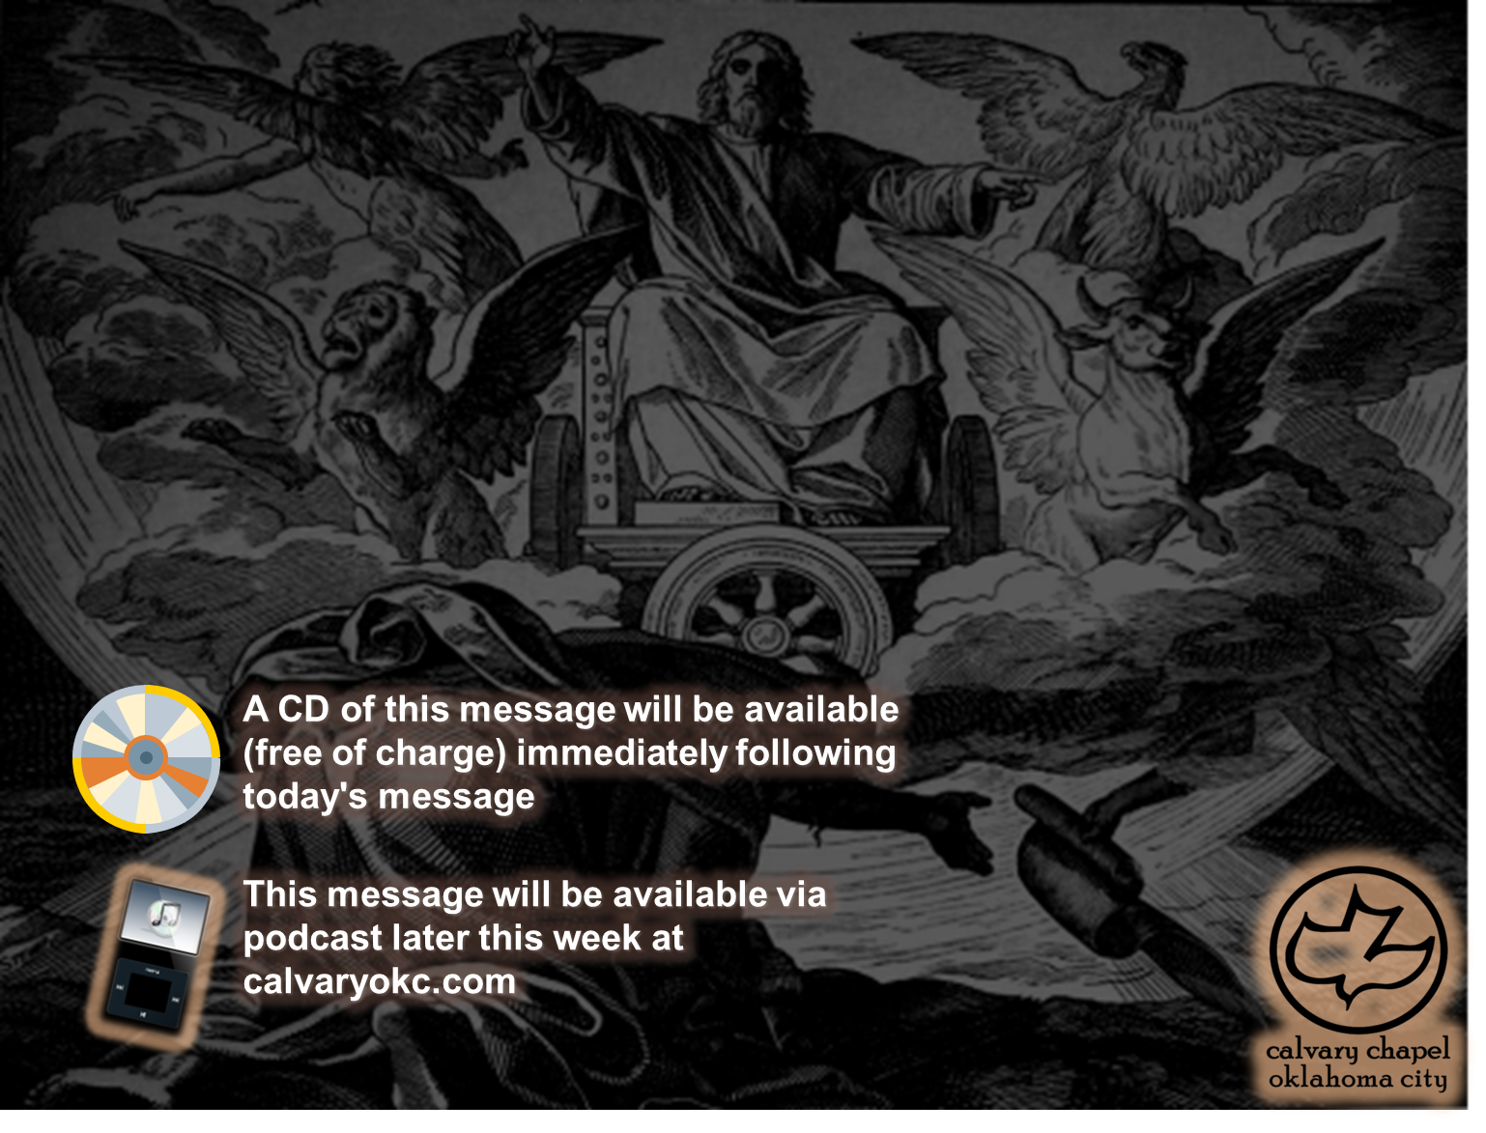
Ezekiel 17-18

Slide 2
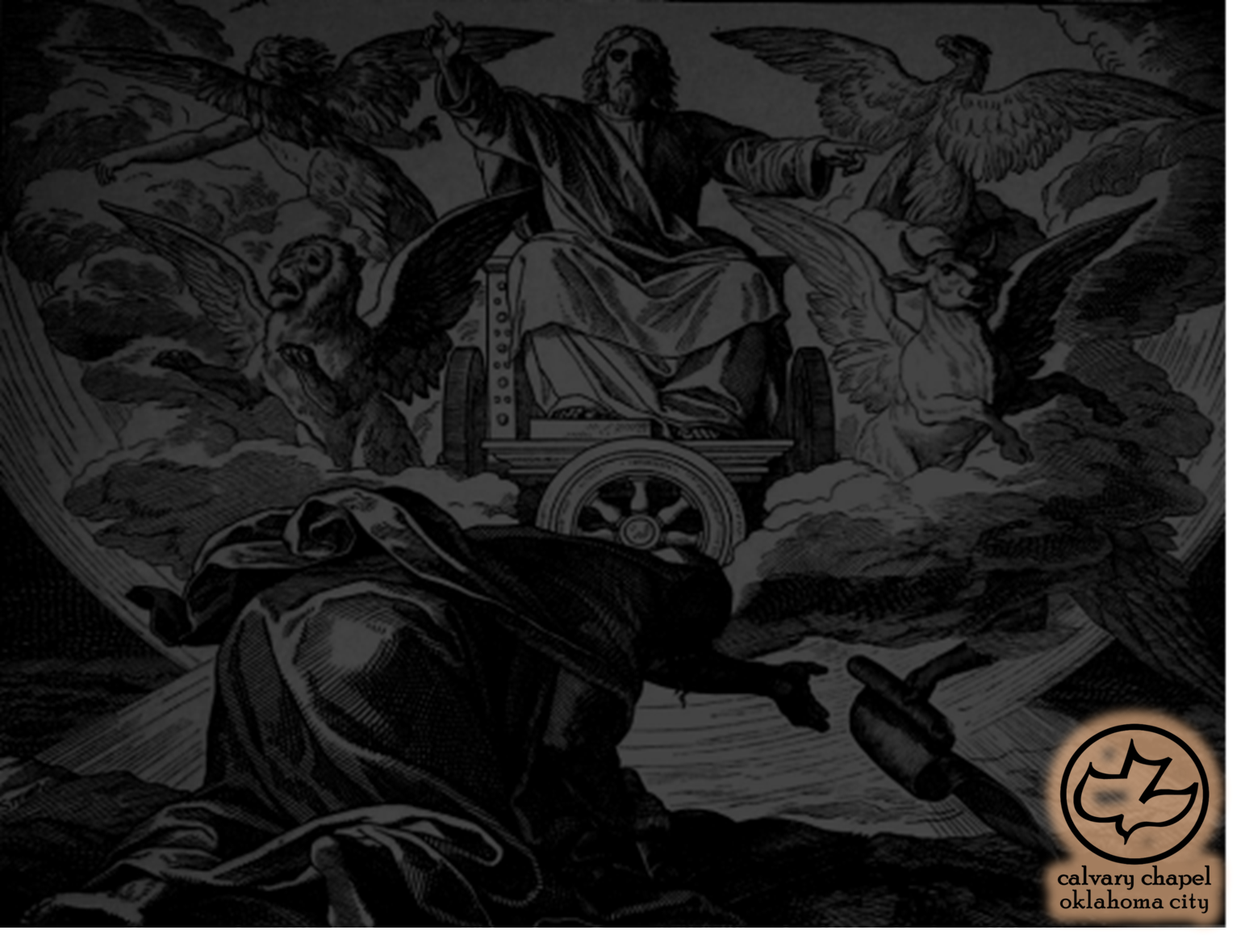
Ezekiel 17-18
1st deportation ~ 605 BC
Jehoiakim rebelled, allying with Egypt
605BC
595BC
585BC
Jehoiakim died, succeeded by Jehoiachin
Jehoiachin taken captive
Zedekiah placed as puppet ruler
Zedekiah rebels (587 BC)
2nd deportation ~ 597

Slide 3
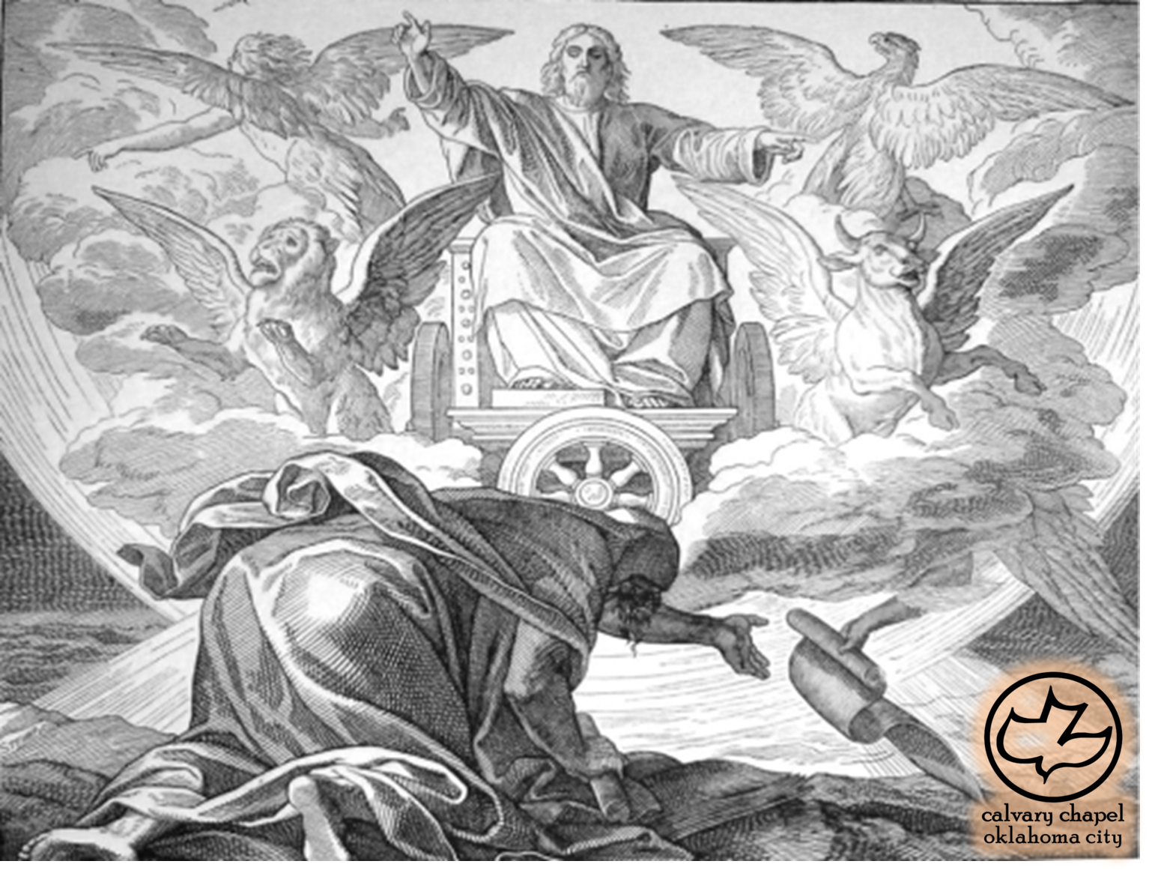
Ezekiel 17-18

Slide 4
Ezekiel 17-18
1st great eagle ~ Nebuchadnezzar
Cedar ~ house of David
Twig ~ Jehoiachin
Land of trade ~ KJV, land of traffic
Offspring ~ Zedekiah
2nd great eagle ~ Pharaoh

Slide 5
Ezekiel 17-18

Slide 6
Ezekiel 17-18
I will take ~ emphatic – "I Myself will take"

Slide 7
Ezekiel 17-18

Slide 8
Ezekiel 17-18
In Jerusalem too ~ Jer. 31:29

Slide 9
Ezekiel 17-18

Slide 10
Ezekiel 17-18
Jam. 2:26 ~ For as the body without the spirit is dead, so faith without works is dead also.

Slide 11
Ezekiel 17-18

Slide 12
Ezekiel 17-18
Ex. 22:26 ~ If you ever take your neighbor's garment as a pledge, you shall return it to him before the sun goes down.
Also Deut. 24:12

Slide 13
Ezekiel 17-18

Slide 14
Ezekiel 17-18
Prov. 22:6 ~ Train up a child in the way he should go,
And when he is old he will not depart from it.

Slide 15
Ezekiel 17-18

Slide 16
Ezekiel 17-18
Ex. 20:5 ~ For I, the Lord your God, am a jealous God, visiting the iniquity of the fathers on the children to the third and fourth generations of those who hate Me.

Slide 17
Ezekiel 17-18
Joe Wright's prayer before Kansas legislature, Jan. 1996 ~ "Heavenly Father, we come before you today to ask Your forgiveness and to seek Your direction and guidance. We know Your Word says, "Woe to those who call evil good." but that is exactly what we have done. We have lost our spiritual equilibrium and reversed our values. We confess that:
We have ridiculed the absolute
truth of Your Word and called it Pluralism.
We have worshipped other gods and called it multiculturalism.
We have endorsed perversion and called it alternative lifestyle.
We have exploited the poor and called it the lottery.
We have rewarded laziness and called it welfare.
We have killed our unborn and
profanity and pornography and called it freedom of expression.
We have ridiculed the time-honored values of our forefathers and called it enlightenment.
Search us, O God, and know our hearts today; try us and see if there be any wicked way in us; cleanse us from every sin, and set us free. Guide and bless these men and women who have
been sent here by the people of
called it choice.
We have shot the abortionist and called it justifiable.
We have neglected to discipline our children and called it building self-esteem.
We have abused power and called it politics.
We have coveted our neighbor's possessions and called it ambition.
We have polluted the air with
Kansas, and who have been ordained by You, to govern this great state. Grant them Your wisdom to rule and may their decisions direct us to the center of Your will. I ask it in the name of Your Son, the Living Savior, Jesus Christ, amen.

Slide 18
Ezekiel 17-18
Jer. 31:31–33 ~ ³¹ "Behold, the days are coming," says the Lord, "when I will make a new covenant with the house of Israel and with the house of Judah— ³² not according to the covenant that I made with their fathers in the day that I took them by the hand to lead them out of the land of Egypt, My covenant which they broke, though I was a husband to them, says the Lord. ³³ But this is the covenant that I will make with the
house of Israel after those days, says the Lord: I will put My law in their minds, and write it on their hearts; and I will be their God, and they shall be My people."

Slide 19
Ezekiel 17-18

Slide 20
Ezekiel 17-18
Eze. 33:11 ~ "As I live," says the Lord God, "I have no pleasure in the death of the wicked, but that the wicked turn from his way and live."

Slide 21
Ezekiel 17-18

