Slide 1
Ezekiel 12-13

Slide 2
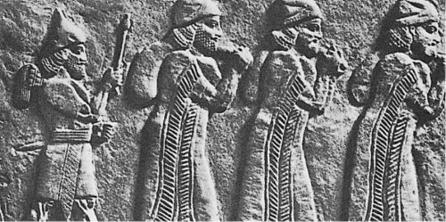
Ezekiel 12-13

Slide 3
Ezekiel 12-13

Slide 4
Ezekiel 12-13
Fulfilled in 2 Kings 25:4-7

Slide 5
Ezekiel 12-13

Slide 6
Ezekiel 12-13
2 Pet. 3:1-4 ~ ¹ Beloved, I now write to you this second epistle (in both of which I stir up your pure minds by way of reminder), ² that you may be mindful of the words which were spoken before by the holy prophets, and of the commandment of us, the apostles of the Lord and Savior, ³ knowing this first: that scoffers will come in the last days, walking according to their own lusts, ⁴ and saying, “Where is the promise of His coming? For since the fathers fell asleep, all things continue as they
were from the beginning of creation.”

Slide 7
Ezekiel 12-13

Slide 8
Ezekiel 12-13
Eph. 2:19-20 ~ ¹⁹ Now, therefore, you are no longer strangers and foreigners, but fellow citizens with the saints and members of the household of God, ²⁰ having been built on the foundation of the apostles and prophets, Jesus Christ Himself being the chief cornerstone,

Slide 9
Ezekiel 12-13

Slide 10
Ezekiel 12-13
NIV ~ Your prophets, O Israel, are like jackals among ruins.

Slide 11
Ezekiel 12-13

Slide 12
Ezekiel 12-13
Nonsense ~ shav – same as Ex. 20:7

Slide 13
Ezekiel 12-13

Slide 14
Ezekiel 12-13
Untempered ~ tawphēl – literally tasteless, unseasoned or insipid
NIV, NASB ~ whitewash(ed)

Slide 15
Ezekiel 12-13

Slide 16
Ezekiel 12-13
KJV ~ that sew pillows to all armholes

Slide 17
Ezekiel 12-13

Slide 18
Ezekiel 12-13
Mark 9:42 ~ But whoever causes one of these little ones who believe in Me to stumble, it would be better for him if a millstone were hung around his neck, and he were thrown into the sea.

Slide 19
Ezekiel 12-13

