Slide 1
Ezekiel 10-11

Slide 2
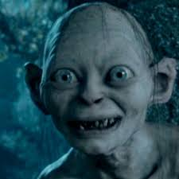
Ezekiel 10-11
Cherubim ~ plural for Cherub
KJV, cherubims

Slide 3
Ezekiel Ezekiel 10-11

Slide 4
Ezekiel 10-11
Beryl stone ~ NASB, Tarshish stone

Slide 5
Ezekiel 10-11

Slide 6
Ezekiel 10-11
Wheel ~ NIV, NASB, better – whirling wheel

Slide 7
Ezekiel 10-11

Slide 8
Ezekiel 10-11
Face of a cherub ~ NLT, face of an ox

Slide 9
Ezekiel 10-11

Slide 10
Ezekiel 10-11
cf. 9:3 and 1 Sam. 4:3 ~ Ichabod
No glory or the glory has departed

Slide 11
Ezekiel 10-11

Slide 12
Ezekiel 10-11
Cherubim
Protectors
God's holiness
Seraphim
Proclaimers

Slide 13
Ezekiel 10-11

Slide 14
Ezekiel 10-11
Jaazaniah ~ Jehovah hears
Pelatiah ~ Jehovah delivers

Slide 15
Ezekiel 10-11

Slide 16
Ezekiel 10-11
NASB ~ who say, "Is not the time near to build houses? This city is the pot and we are the flesh."

Slide 17
Ezekiel 10-11

Slide 18
Ezekiel 10-11
Riblah
Jerusalem

Slide 19
Ezekiel 10-11

Slide 20
Ezekiel 10-11
East side ~ i.e. Mount of Olives
Zech. 14:4 ~ And in that day His feet will stand on the Mount of Olives, which is in front of Jerusalem on the east; and the Mount of Olives will be split in its middle from east to west by a very large valley.

Slide 21
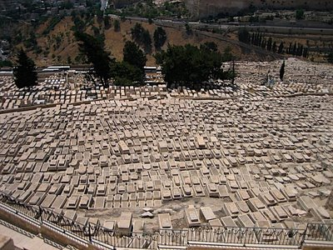
Ezekiel 10-11

Slide 22
Ezekiel 10-11

Slide 23
Ezekiel 10-11
Jeremiah 31:31–33 ~ ³¹ "Behold, the days are coming," says the Lord, "when I will make a new covenant with the house of Israel and with the house of Judah— ³² not according to the covenant that I made with their fathers in the day that I took them by the hand to lead them out of the land of Egypt, My covenant which they broke, though I was a husband to them, says the Lord. ³³ But this is the covenant that I will make with the house of Israel after those days, says the Lord: I will put My law in their minds, and write it on their hearts; and I will be their
God, and they shall be My people."

Slide 24
Ezekiel 10-11
Rom. 11:25-26a ~ ²⁵ For I do not desire, brethren, that you should be ignorant of this mystery, lest you should be wise in your own opinion, that blindness in part has happened to Israel until the fullness of the Gentiles has come in. ^{26a} And so all Israel will be saved …

Slide 25
Ezekiel 10-11

