Slide 1
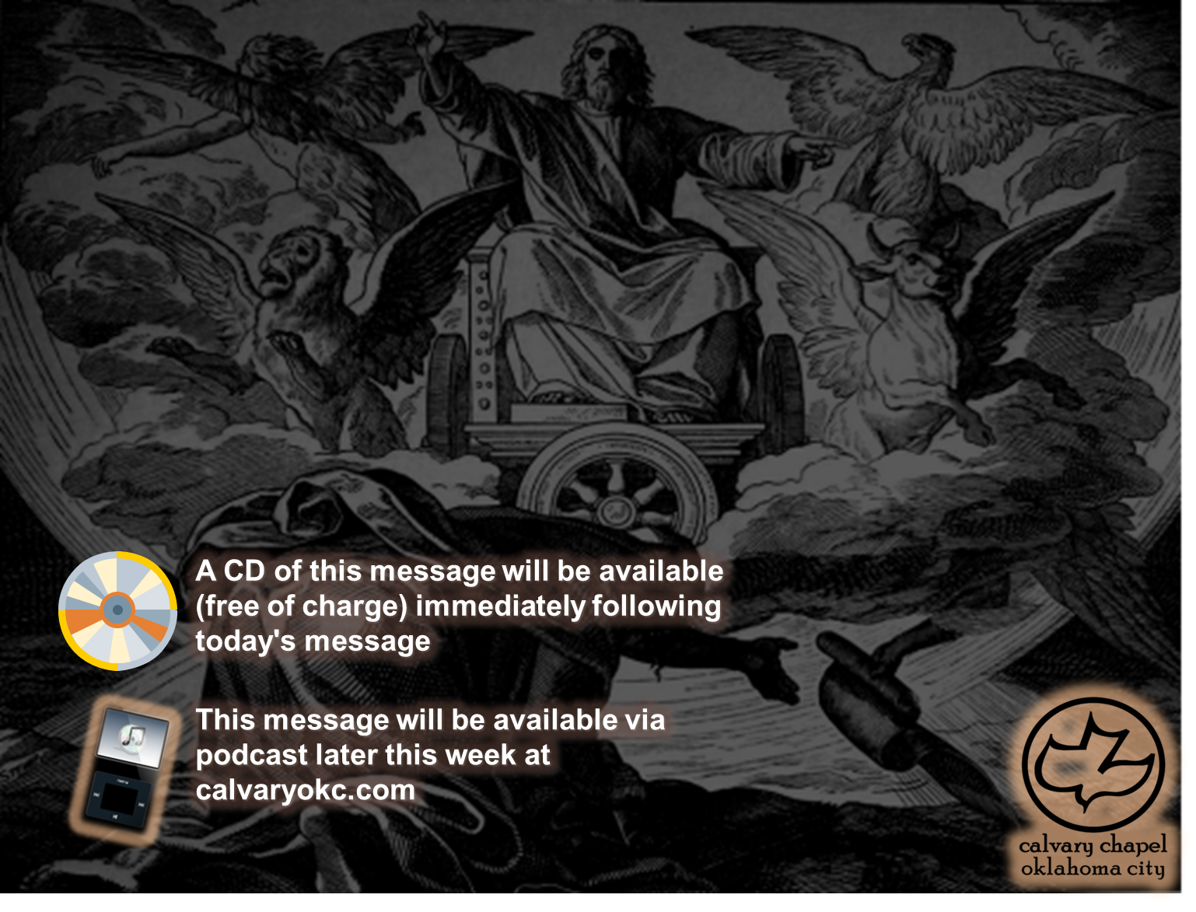
Ezekiel 8-9

Slide 2
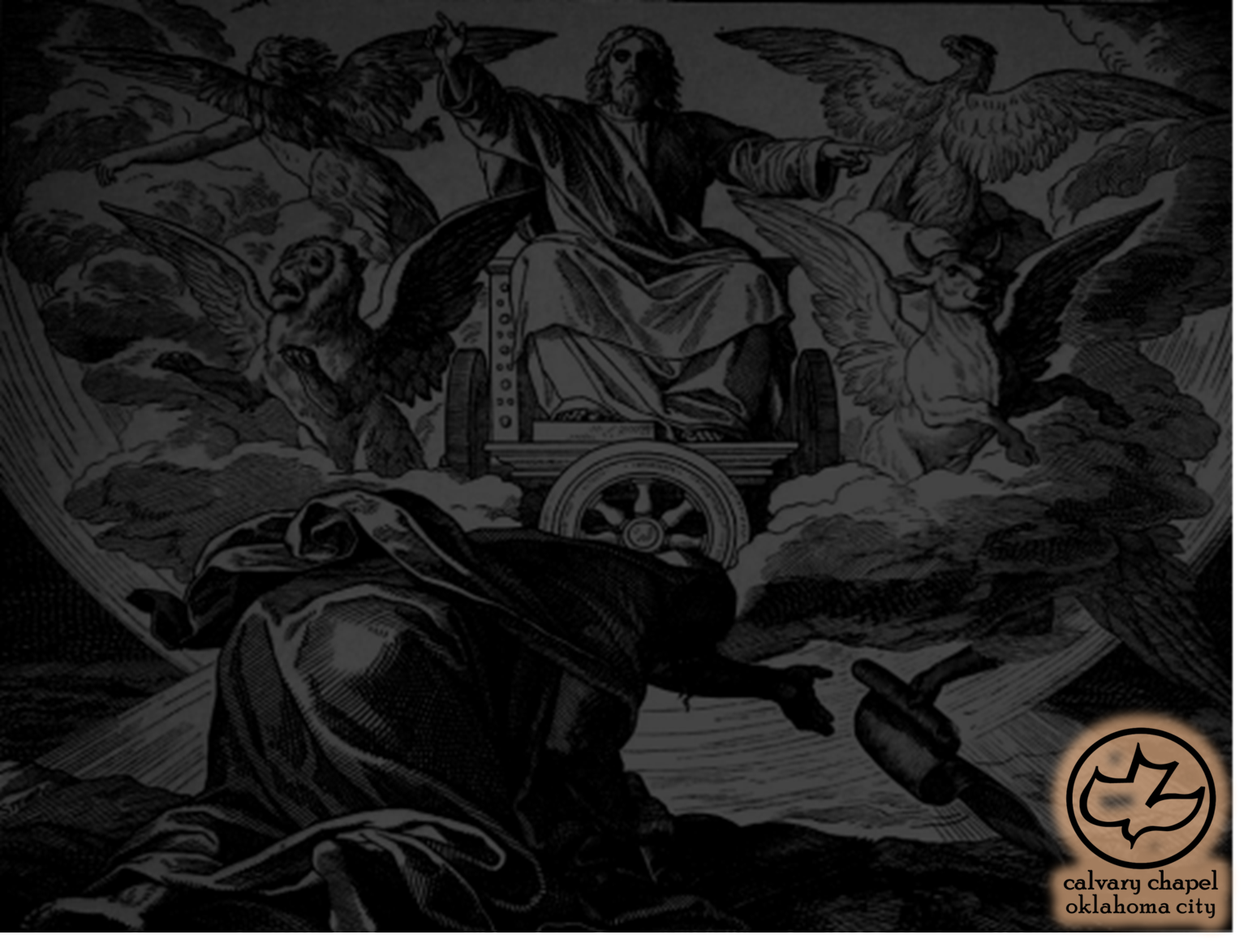
Ezekiel 8-9
Sept. 17 (NLT), 592 BC

Slide 3
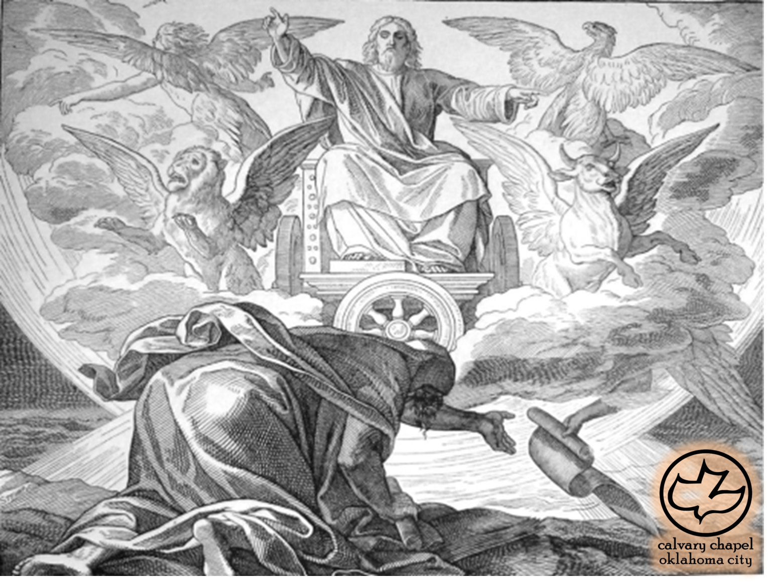
Ezekiel 8-9

Slide 4
Ezekiel 8-9
Fire ~ esh
Man ~ ish – so rendered in LXX

Slide 5
Ezekiel 8-9

Slide 6
Ezekiel 8-9
Glory ~ kabowd
shekinah doesn't occur in the Old Testament
From a word meaning to dwell or to settle

Slide 7
Ezekiel 8-9

Slide 8
Ezekiel 8-9
Manasseh (reigned 686-642 BC)
Amon (reigned 642-640 BC)
Josiah (reigned 640-609 BC)

Slide 9
Ezekiel 8-9

Slide 10
Ezekiel 8-9
Nimrod/Semiramis
Osiris/Isis ~ Egypt
Dionysus/Semele ~ Greek
Bacchus/Stimula ~ Roman
Shiva/Kali ~ Hindu
Tammuz/Ishtar ~ Babylonian

Slide 11
Ezekiel 8-9

Slide 12
Ezekiel 8-9
NLT ~ … thumbing their noses at me, and provoking my anger?

Slide 13
Ezekiel 8-9

Slide 14
Ezekiel 8-9
Mark ~ literally, tav ח
Originally an "x" or a "+"

Slide 15
Ezekiel 8-9

