Slide 1
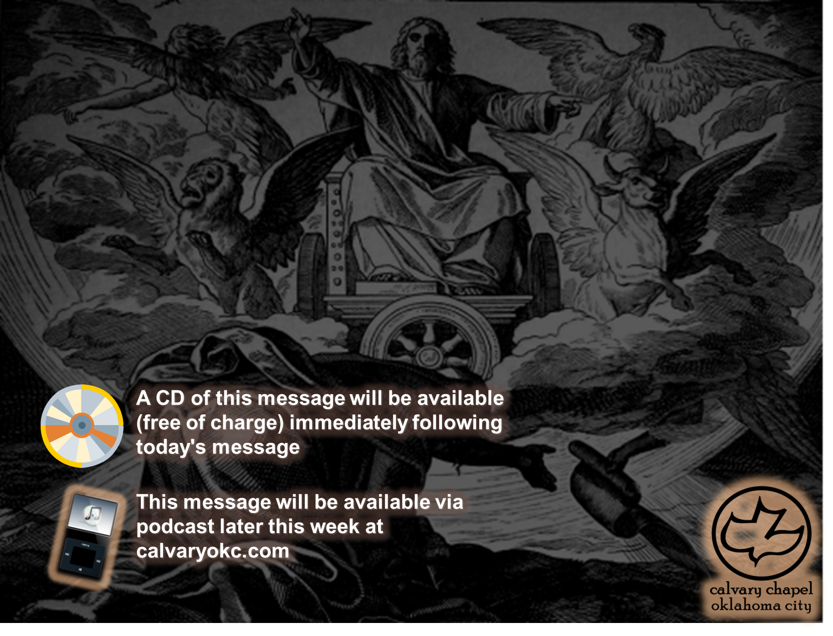
Ezekiel 5-7

Slide 2
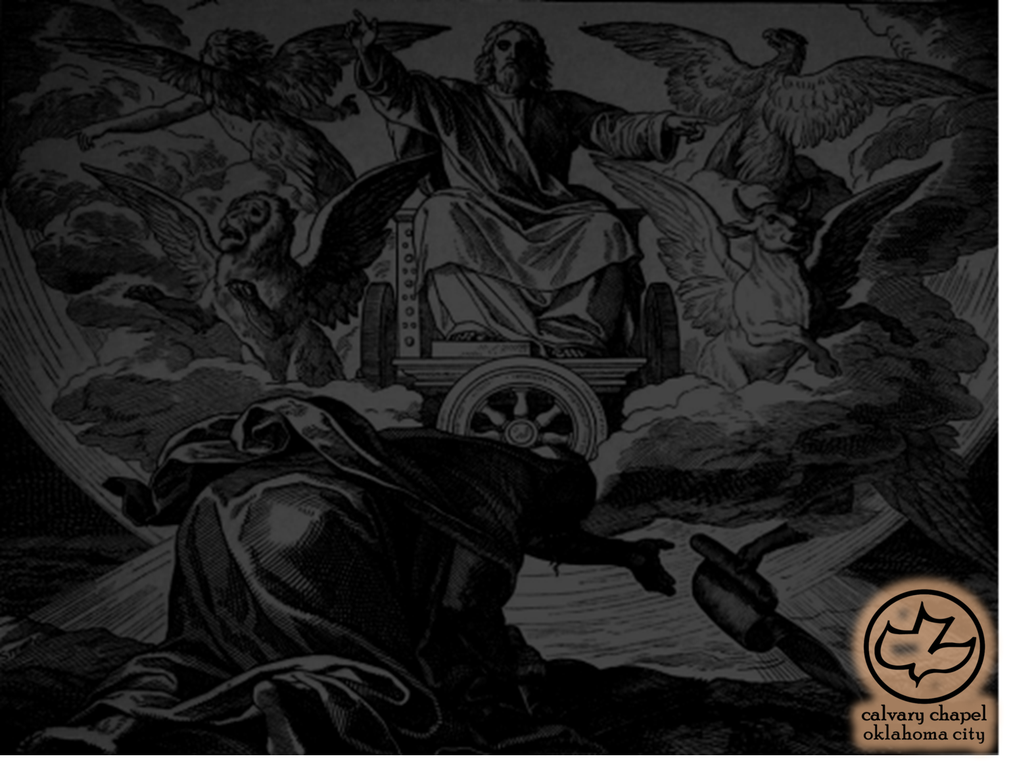
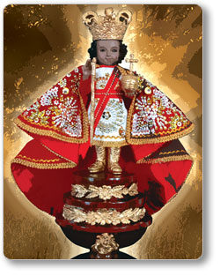
Ezekiel 5-7
Chuck Smith ~ "The Church is full of 'rutuals' today"

Slide 3
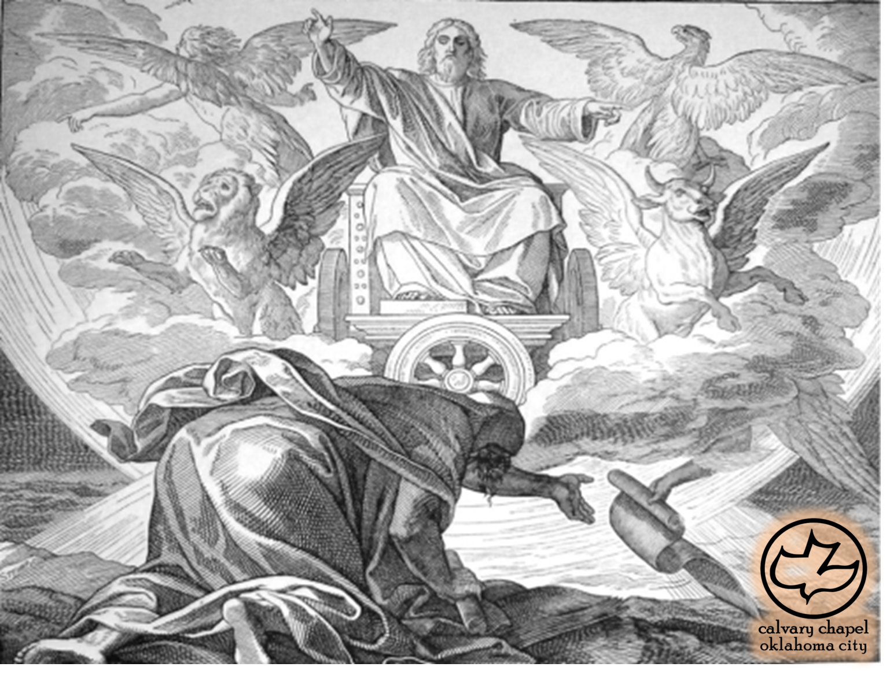
Ezekiel 5-7

Slide 4
Ezekiel 5-7
… shall know that I am the LORD ~ 62x

Slide 5
Ezekiel 5-7

Slide 6
Ezekiel 5-7
Crushed ~ KJV, I am broken

Slide 7
Ezekiel 5-7

Slide 8
Ezekiel 5-7
Pound ~ NASB – better, clap

Slide 9
Ezekiel 5-7

Slide 10
Ezekiel 5-7
BC 610 605 600 595 590 585
Jerusalem Stock Exchange

Slide 11
Ezekiel 5-7

Slide 12
Ezekiel 5-7
The Message ~ I’ll turn my face so I won’t have to look as my treasured place and people are violated, As violent strangers walk in and desecrate place and people—

Slide 13
Ezekiel 5-7

