Slide 1
Ezekiel 1:1-3:3

Slide 2
Ezekiel 1:1-3:3
1st deportation (Daniel) ~ 605 BC
3rd deportation 586 BC
615BC
585BC
545BC
Ezekiel’s visions ~ 592-571 BC
2nd deportation (Ezekiel) ~ 597 BC

Slide 3
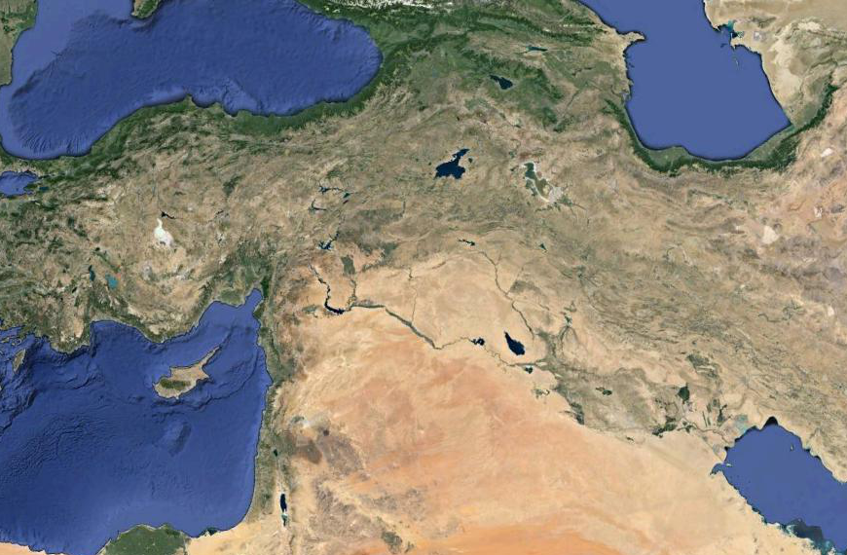
Ezekiel 1:1-3:3
Tigris River
Euphrates River
Chebar River
Babylon

Slide 4
Ezekiel 1:1-3:3

Slide 5
Ezekiel 1:1-3:3
Ps. 48:2 ~ Beautiful in elevation, the
joy of the whole earth,
Is Mount Zion on the sides of the north, the city of the great King.
Is. 14: !3-14 ~ ¹³ For you have said in your heart: "I will ascend into heaven, I will exalt my throne above the stars of God; I will also sit on the mount of the congregation, on the farthest sides of the north; ¹⁴ I will ascend above the heights of the clouds, I will be like the Most High."

Slide 6
Ezekiel 1:1-3:3
Amber ~ NIV, NASB ~ better, glowing metal

Slide 7
Ezekiel 1:1-3:3

Slide 8
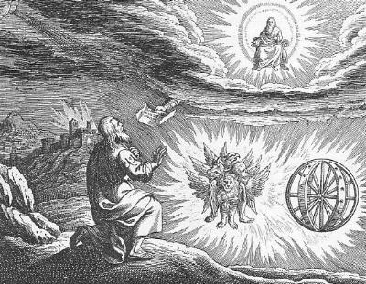
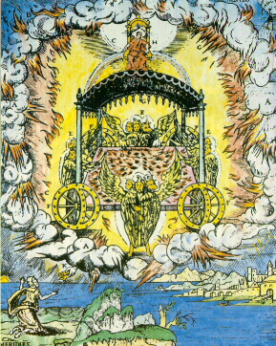
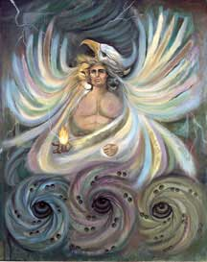
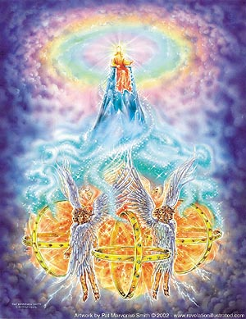
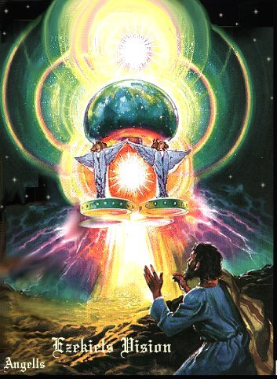
Ezekiel 1:1-3:3

Slide 9
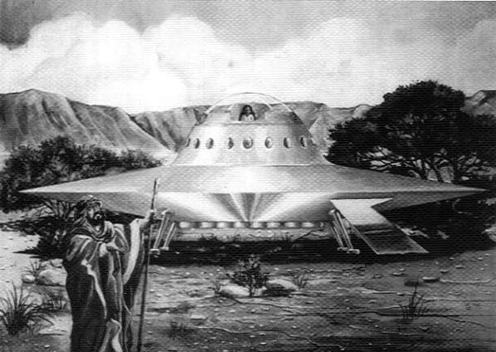
Ezekiel 1:1-3:3

Slide 10
Ezekiel 1:1-3:3
Man
Lion
Ox
Eagle
Luke
Matthew
Mark
John

Slide 11
Ezekiel 1:1-3:3
Ephraim - Calf
Benjamin
35400
108100
Dan
67200
Naphtali
53400
Mark
Manasseh
32200
Asher
41500
Dan - Eagle
Ephraim
40500
John
151450
Levites
157600
Tabernacle
Reuben - Man
Luke
Judah
74600
Simeon
59300
Judah - Lion
Issachar
54400
Mark
Gad
45650
Reuben
46500
Zebulun
57400
N
186400

Slide 12
Ezekiel 1:1-3:3

Slide 13
Ezekiel 1:1-3:3
Firmament ~ NASB, NIV (better), expanse – the ancients viewed the sky as a huge dome

Slide 14
Ezekiel 1:1-3:3

Slide 15
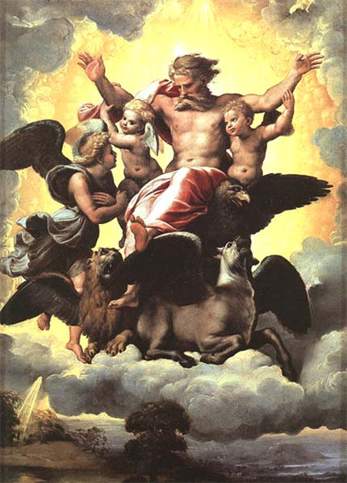
Ezekiel 1:1-3:3

Slide 16
Ezekiel 1:1-3:3

Slide 17
Ezekiel 1:1-3:3
Son of man ~ 1st of 90x in Ezekiel

Slide 18
Ezekiel 1:1-3:3

Slide 19
Ezekiel 1:1-3:3
Lord God ~ Adonai Yahweh
217x in Ezekiel; 103x elsewhere

Slide 20
Ezekiel 1:1-3:3

Slide 21
Ezekiel 1:1-3:3
Dwell among scorpions ~ nasb (in the Qal stem) – sit on scorpions

Slide 22
Ezekiel 1:1-3:3

Slide 23
Ezekiel 1:1-3:3
וְאַתָּ֣ה בֶן־אָדָ֗ם שְׁמַע֙ אֵ֤ת
וְאַתָּ֣ה בֶן־אָדָ֗ם שְׁמַע֙ אֵ֤ת
אֲשֶׁר־אֲנִי֙ מְדַבֵּ֣ר אֵלֶ֔יךָ
אֲשֶׁר־אֲנִי֙ מְדַבֵּ֣ר אֵלֶ֔יךָ
Verso
Recto
אַל־תְּהִי־מֶ֖רִי כְּבֵ֣ית הַמֶּ֑רִי
אַל־תְּהִי־מֶ֖רִי כְּבֵ֣ית הַמֶּ֑רִי

Slide 24
Ezekiel 1:1-3:3

Slide 25
Ezekiel 1:1-3:3
Ps. 119-103 ~ How sweet are Your words to my taste,
Sweeter than honey to my mouth!
Matt. 4:4 ~ It is written, “Man shall not live by bread alone, but by every word that proceeds from the mouth of God."

Slide 26
Ezekiel 1:1-3:3

