Slide 1

EXODUS
18-19

Slide 2

EXODUS
18-19
Ex. 15:14-15 ~ ¹⁴ The people will hear and be afraid;
Sorrow will take hold of the inhabitants of Philistia.
¹⁵ Then the chiefs of Edom will be dismayed;
The mighty men of Moab,
Trembling will take hold of them;
All the inhabitants of Canaan will melt away.

Slide 3

EXODUS
18-19

Slide 4
EXODUS
18-19
well-being ~ shalom

Slide 5
EXODUS
18-19

Slide 6
EXODUS
18-19
KJV ~ to the people?

Slide 7
EXODUS
18-19

Slide 8

EXODUS
18-19
Damien Kyle (CC Modesto) ~ “No one should ever counsel anybody related to
the Word of God who doesn’t fear
God more than they fear the
person they are counseling.”

Slide 9
EXODUS
18-19

Slide 10
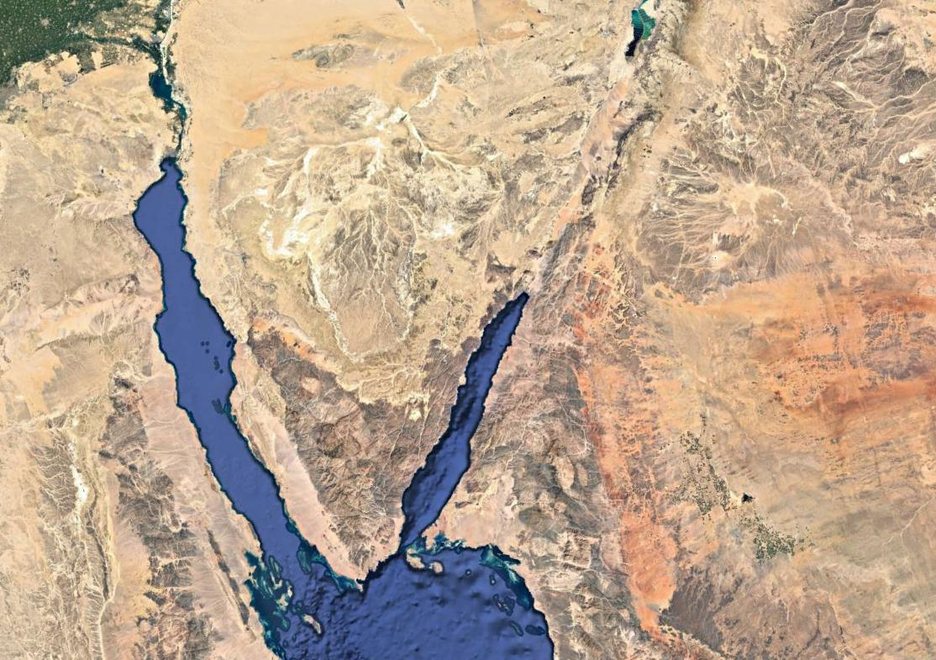
EXODUS
18-19
Wilderness of Sinai
Mt. Sinai

Slide 11
EXODUS
18-19

Slide 12
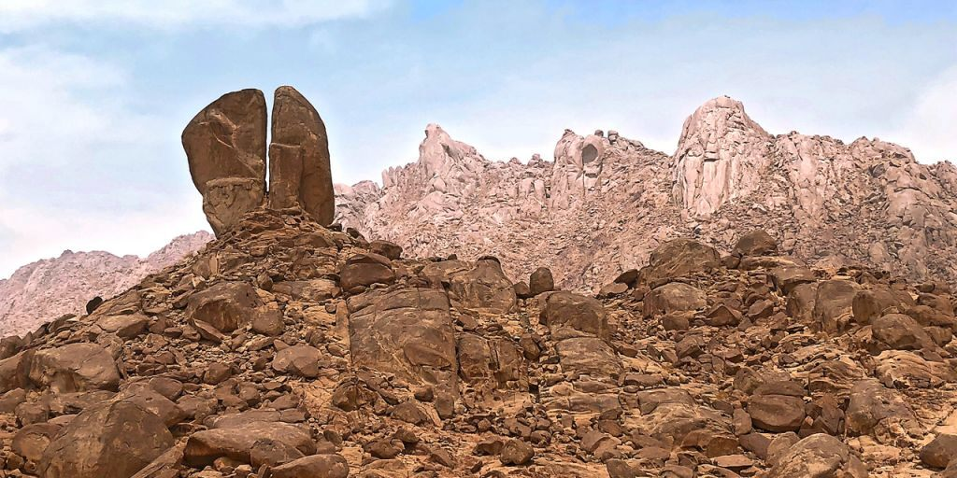
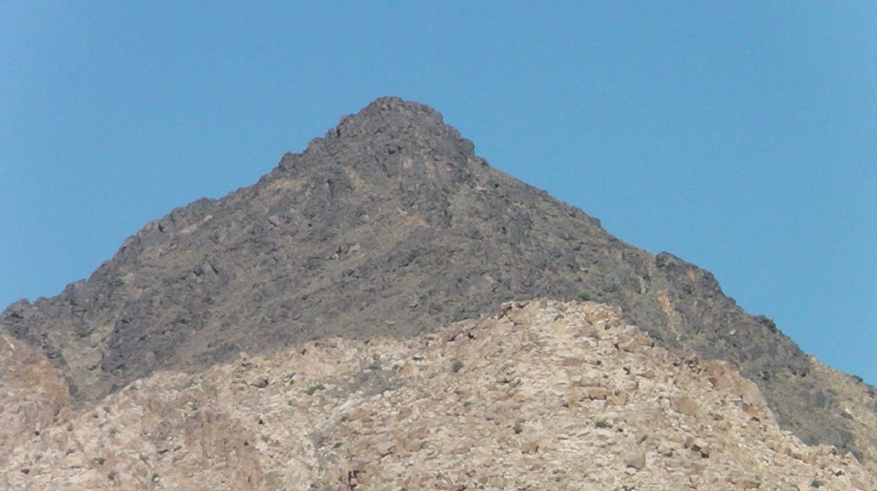
EXODUS
18-19
Jebel el-Lawz, Saudi Arabia
Jebel Maqla, Saudi Arabia

Slide 13
EXODUS
18-19

Slide 14
EXODUS
18-19
Gal. 3:24 ~ Therefore the law was our tutor to bring us to Christ, that we might be justified by faith.

Slide 15
EXODUS
18-19

Slide 16
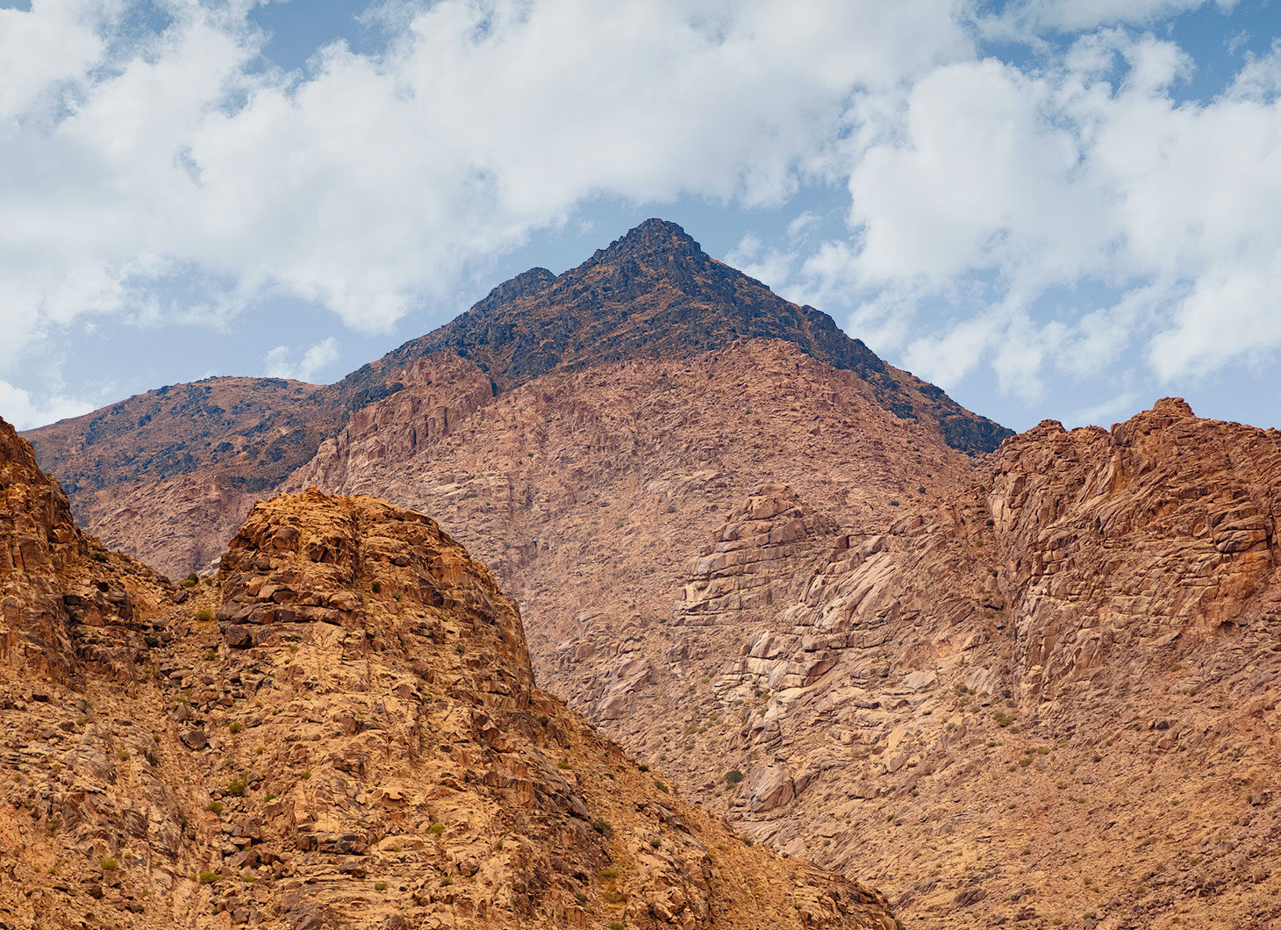

EXODUS
18-19

Slide 17
EXODUS
18-19

