Slide 1
EXODUS
16-17

Slide 2
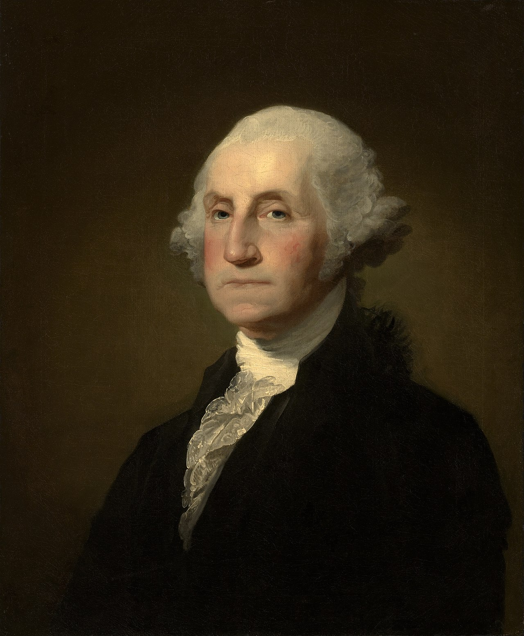
EXODUS
16-17
George Washington (1732-1799 ~
“Then we should have another
article providing that no foreign
nation with an army exceeding
3,000 men be allowed to invade.”

Slide 3
EXODUS
16-17

Slide 4
EXODUS
16-17
Goshen
Route of
the Exodus
Arabia
Wilderness of Sin
Mt. Sinai

Slide 5
EXODUS
16-17

Slide 6
EXODUS
16-17
pots of meat ~ KJV, fleshpots

Slide 7
EXODUS
16-17

Slide 8
EXODUS
16-17
What is it? ~ KJV, It is manna:

Slide 9
EXODUS
16-17

Slide 10
EXODUS
16-17
John 6:57-58 ~ ⁵⁷ “As the living Father sent Me, and I live because of the Father, so he who feeds on Me will live because of Me. ⁵⁸ This is the bread which came down from heaven—not as your fathers ate the manna, and are dead. He who eats this bread will live forever.”
He wants to be our
sole
diet
soul

Slide 11
EXODUS
16-17
Others 4%
Nitrogen 3%
$1985.77
Hydrogen 10%
Carbon 18%
Oxygen
Carbon
Hydrogen
99%
Oxygen 65%
Nitrogen
Calcium
Phosphorus

Slide 12
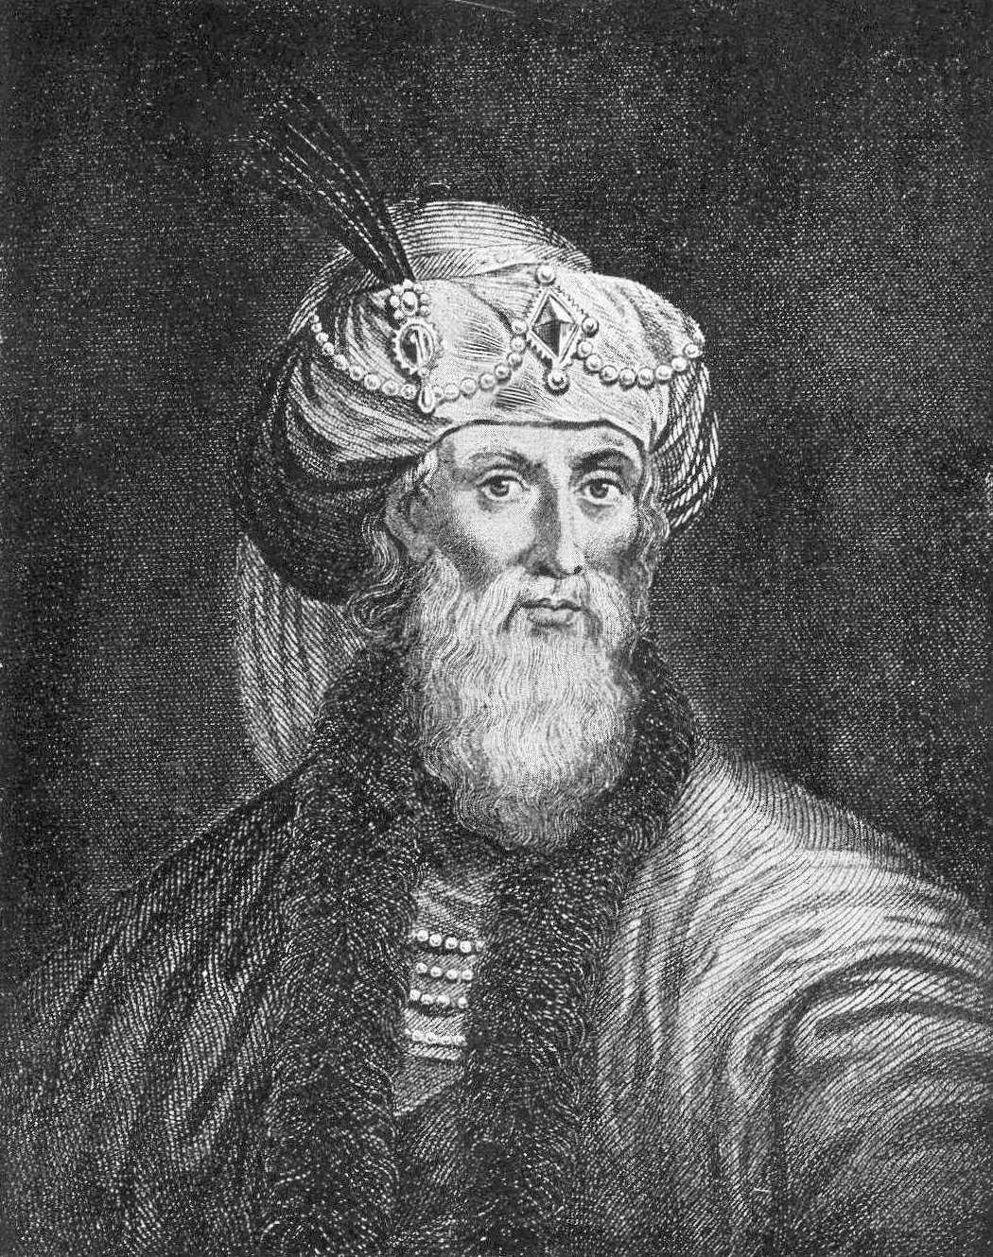
EXODUS
16-17
Josephus (AD 30 – c. 100) ~ “So divine and wonderful a food was this! It also supplied the want of
other sorts of food to those that fed on
it. And even now in all that place this
manna comes down in rain; according to
what Moses then obtained of God, to
send it to the people for their sustenance
… So the Hebrews were very joyful at
what was sent them from heaven.
Now they made use of this food for forty years: or as long as they were in the wilderness.”
(Antiquities of the Jews, book 3)

Slide 13
EXODUS
16-17

Slide 14
EXODUS
16-17
omer ≈ ½ gallon
ephah ≈ bushel

Slide 15
EXODUS
16-17

Slide 16
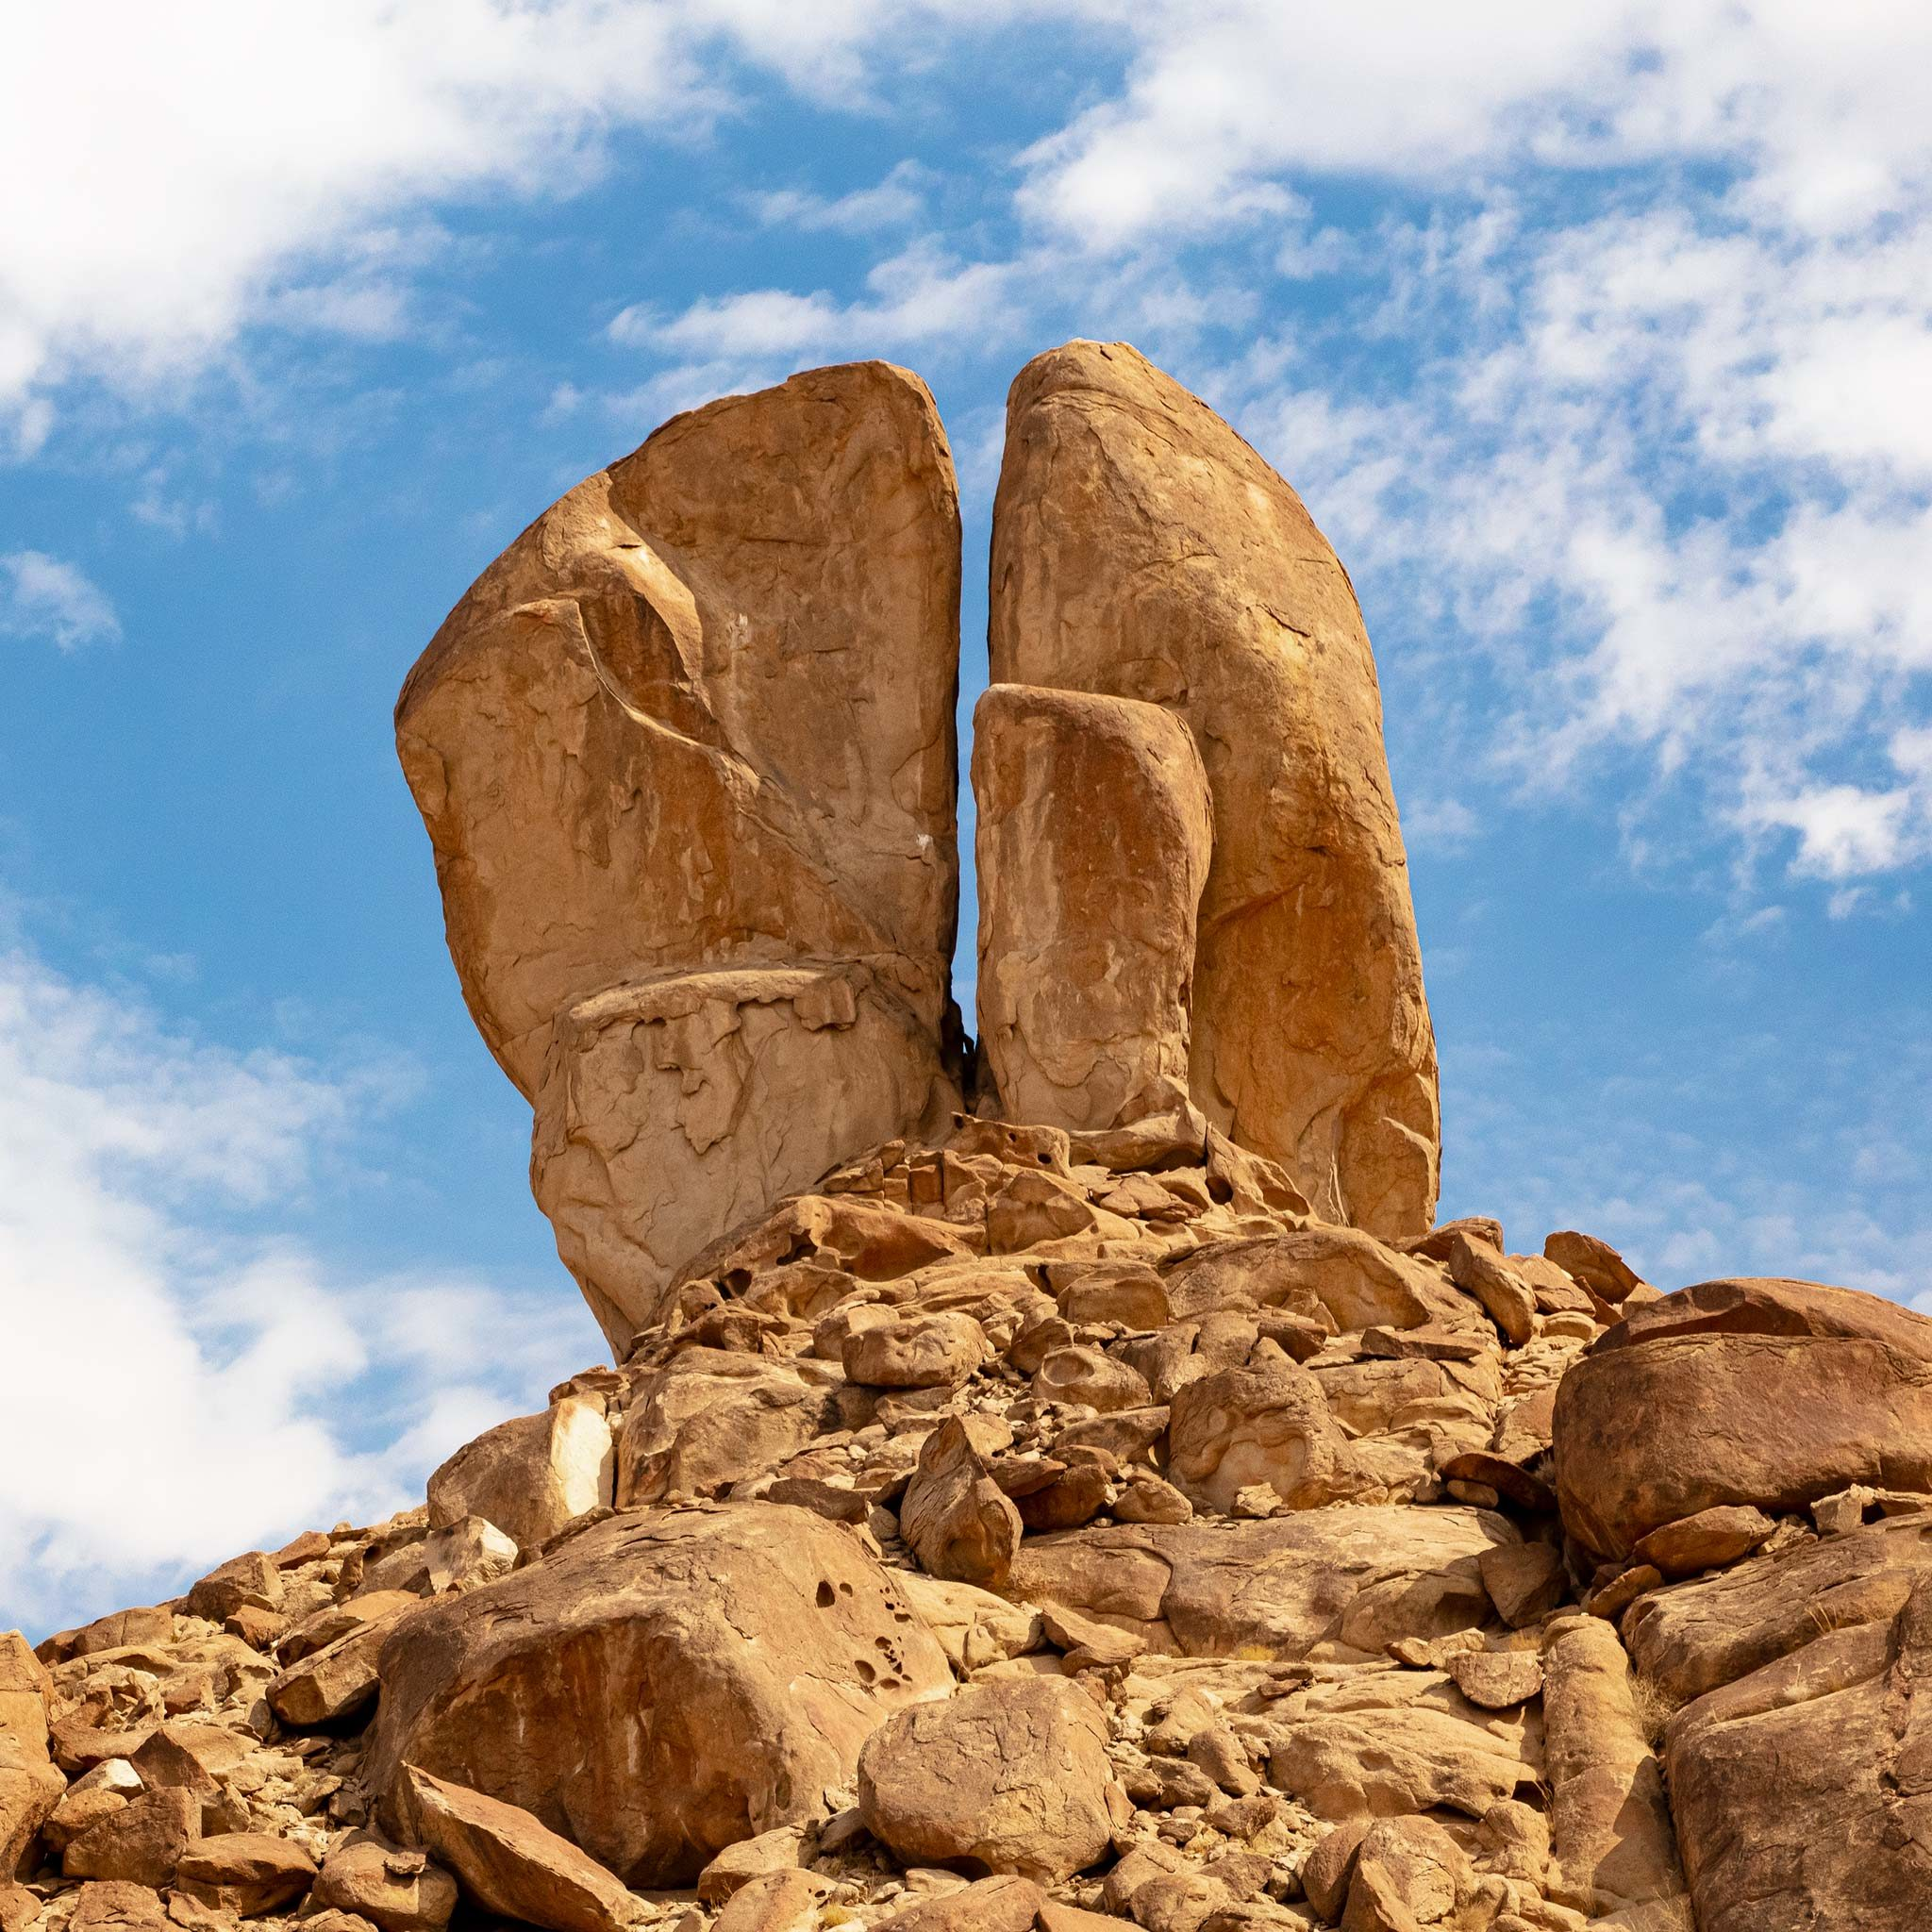
EXODUS
16-17
Jebel el Lawz, Saudi Arabia

Slide 17
EXODUS
16-17
Is. 55:1-3a ~ ¹ Ho! Everyone who thirsts, Come to the waters; And you who have no money, Come, buy and eat. Yes, come, buy wine and milk Without money and without price. ² Why do you spend money for what is not bread, And your wages for what does not satisfy? Listen carefully to Me, and eat what is good, And let your soul delight itself in abundance. ^{3a} Incline your ear, and come to Me. Hear, and your soul shall live;

Slide 18
EXODUS
16-17
1 Cor. 10:1-4 ~ ¹ Moreover, brethren, I do not want you to be unaware that all our fathers were under the cloud, all passed through the sea, ² all were baptized into Moses in the cloud and in the sea, ³ all ate the same spiritual food, ⁴ and all drank the same spiritual drink. For they drank of that spiritual Rock that followed them, and that Rock was Christ.

Slide 19
EXODUS
16-17

Slide 20
EXODUS
16-17
Massah ~ tempted
Meribah ~ contended

Slide 21
EXODUS
16-17

Slide 22
EXODUS
16-17
Esau
Eliphaz
Timnah
Amalek
Gen. 36:12

Slide 23
EXODUS
16-17

Slide 24
EXODUS
16-17
Matt. 11:12 ~ And from the days of John the Baptist until now the kingdom of heaven suffers violence, and the violent take it by force.
NLT ~ And from the time John the Baptist began preaching until now, the Kingdom of Heaven has been forcefully advancing, and violent people are attacking it.
Matt. 5:6 ~ Blessed are those who hunger and thirst for righteousness,
For they shall be filled.

Slide 25
EXODUS
16-17

Slide 26
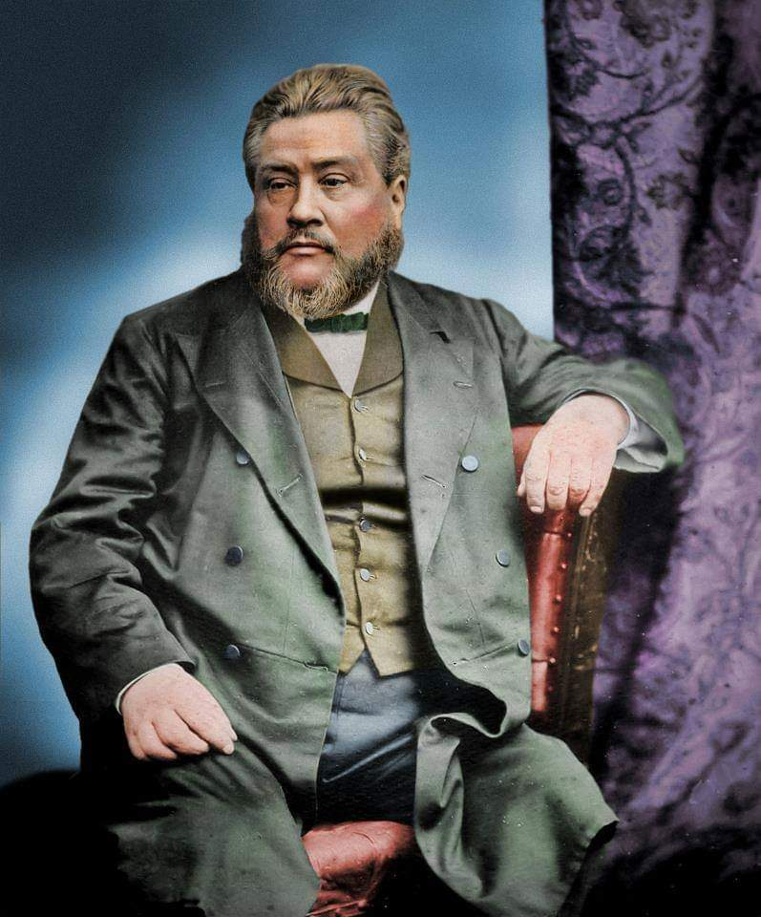
EXODUS
16-17
C. H. Spurgeon (1834-1892) ~
Our deceitful heart reveals an
almost satanic shrewdness in
self-deception … if you say you
have no sin you have achieved
a fearful success, you have put
our your own eyes, and
perverted your own reason!”

Slide 27
EXODUS
16-17

Slide 28
EXODUS
16-17
Exodus ~ ex (out) + hodos (way, path or road)
Mark 12:26 ~ But concerning the dead, that they rise, have you not read in the book of Moses, in the burning bush passage, how God spoke to him, saying, “I am the God of Abraham, the God of Isaac, and the God of Jacob”?

Slide 29
EXODUS
16-17

