Slide 1
EXODUS
14-15

Slide 2
EXODUS
14-15
boldness ~ KJV, high hand

Slide 3
EXODUS
14-15

Slide 4
EXODUS
14-15
Is. 43:11 ~ I, even I, am the Lord, and besides Me there is no savior.
Lam. 3:26 ~ It is good that one should hope and wait quietly for the salvation of the Lord.

Slide 5
EXODUS
14-15

Slide 6
EXODUS
14-15
peace ~ literally, shall be made speechless

Slide 7
EXODUS
14-15

Slide 8
EXODUS
14-15
1) Rest in Him
Hebrews 3-4
2) Obedience
Micah 6:8 ~ He has shown you, O man, what
is good And what does the Lord require of you;
But to do justly,
To love mercy,
And to walk humbly with your God?

Slide 9
EXODUS
14-15

Slide 10
EXODUS
14-15
Yam Suph (Ex. 15:22 and 20 other times in the Old Testament)
Traditional interpretation ~ Sea of Reeds
Strong case the Hebrew word means to end, to terminate or to consume

Slide 11
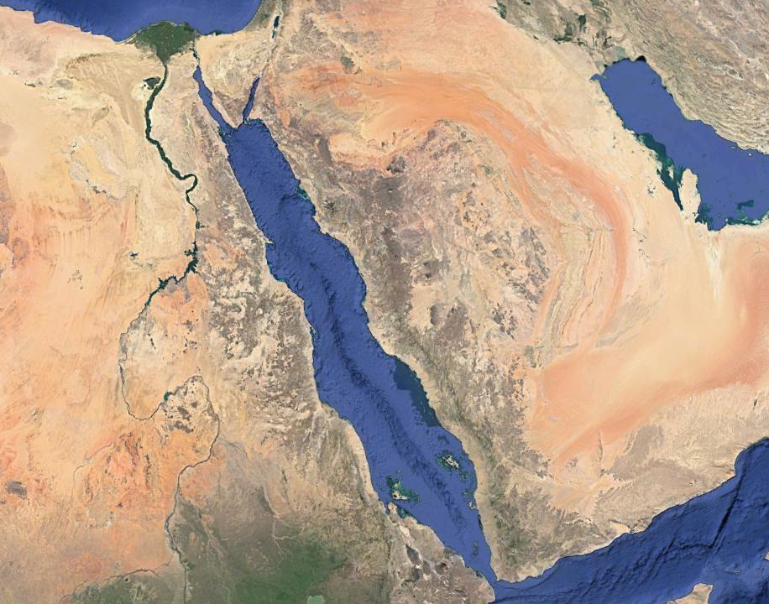
EXODUS
14-15
Gulf of Aqaba
Gulf of Suez
Arabia
Red Sea

Slide 12
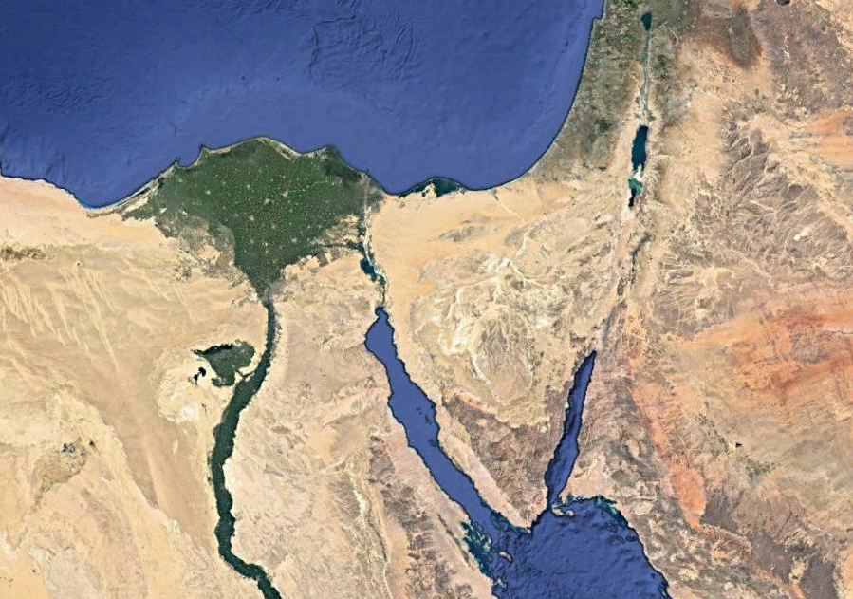
EXODUS
14-15
1 Kings 9:26 ~ King Solomon also built a fleet of ships at Ezion Geber, which is near Elath on the shore of the Red Sea, in the land of Edom.
Goshen
Arabia
Mt. Sinai
Gulf of Aqaba
Gulf of Suez

Slide 13
EXODUS
14-15

Slide 14
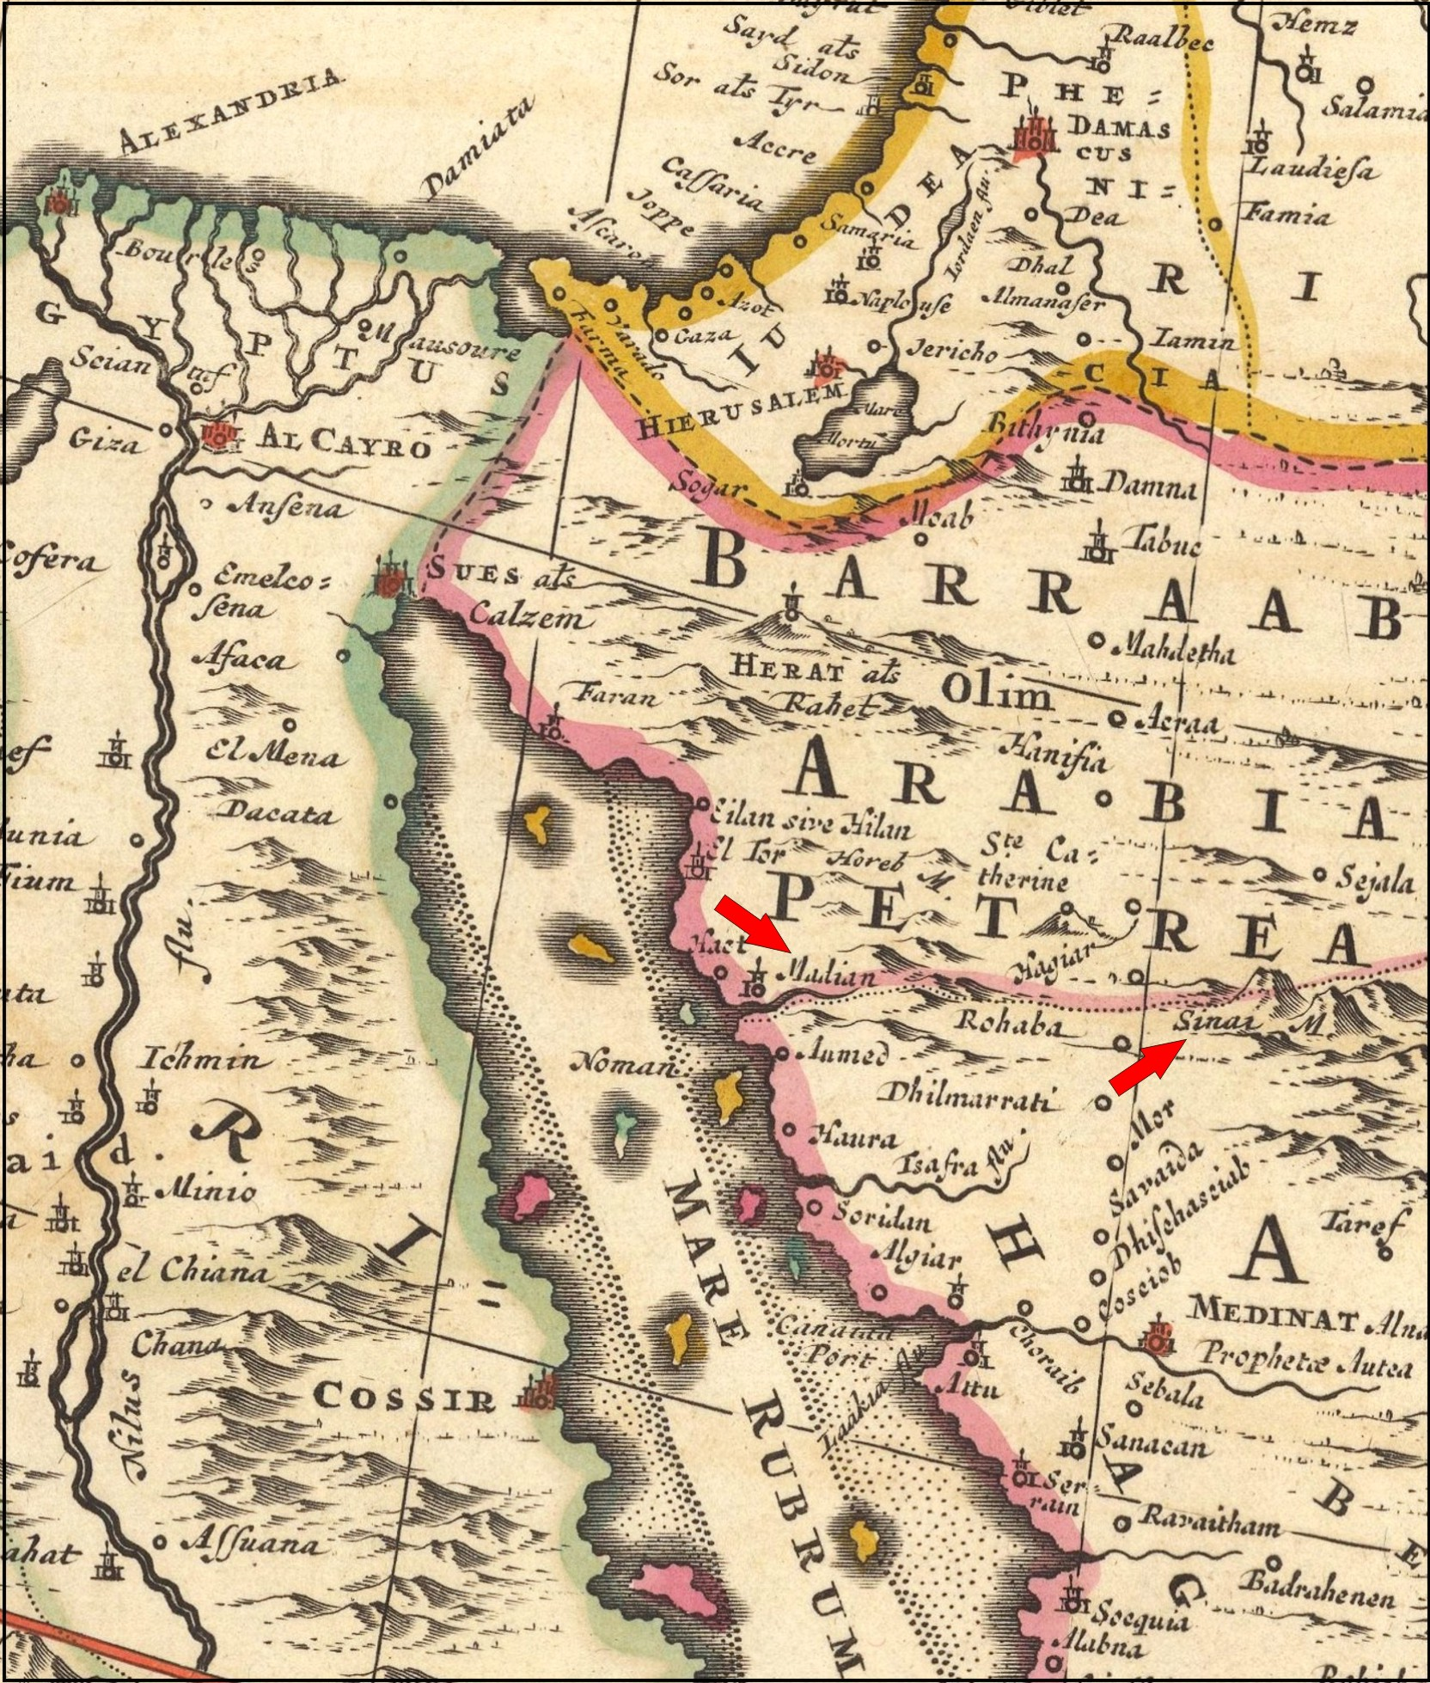
EXODUS
14-15

Slide 15
EXODUS
14-15
Abraham Ortelius, 1598

Slide 16
EXODUS
14-15

Slide 17
EXODUS
14-15
took off ~ NASB, caused to swerve
suwr ~ to turn aside or take away

Slide 18
EXODUS
14-15

Slide 19
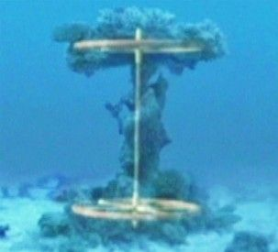
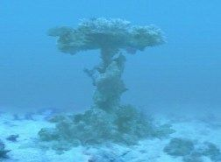
EXODUS
14-15

Slide 20
EXODUS
14-15

Slide 21
EXODUS
14-15
Philistia ~ KJV, Palestina

Slide 22
EXODUS
14-15

Slide 23
EXODUS
14-15
The Lord who heals ~ literally, YHWH Raphah

Slide 24
EXODUS
14-15

