Slide 1
EXODUS
12-13

Slide 2
EXODUS
12-13
Originally ~ ABIB
Later ~ NISAN
DATSON
In the ancient Sumerian cuneiform ~
ÏþćũĐΜ
Mar
Apr
May
Jun
Jul
Aug
Sep
Oct
Nov
Dec
Jan
Feb
Mar
Nisan
Iyar
Sivan
Tammuz
Av
Elul
Tishri
Heshvan
Chislev
Tevet
Shevat
Adar
Religious New Year
Civil New Year

Slide 3
EXODUS
12-13
1447 BC | 1446 BC
Av
Elul
Tishri
Heshvan
Chislev
Tevet
Shevat
Adar
Nisan
9 months

Slide 4
EXODUS
12-13

Slide 5
EXODUS
12-13
unleavened bread ~ leaven is a type of sin
bitter herbs ~ endive or horseradish

Slide 6
EXODUS
12-13

Slide 7
EXODUS
12-13
entrails ~ KJV, purtenance – literally, midst (innards)
Psalm 34:20 ~ He guards all his bones;
Not one of them is broken.
John 19:36 ~ For these things were done that the Scripture should be fulfilled, “Not one of His bones shall be broken.”

Slide 8
EXODUS
12-13

Slide 9
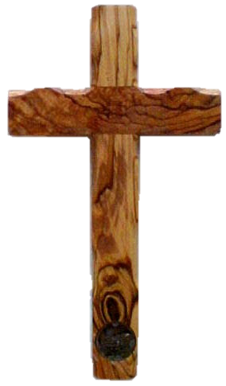
EXODUS
12-13
1400 BC
1000 BC
600 BC
200 BC
Passover
(c. 1450 BC)
Calvary
(AD 33)
This Photo by Unknown Author is licensed under CC BY-SA

Slide 10
EXODUS
12-13

Slide 11
EXODUS
12-13
armies ~ NASB, hosts; NIV, divisions
1 Cor. 5:7-8 ~ ⁷ Therefore purge out the old leaven, that you may be a new lump, since you truly are unleavened. For indeed Christ, our Passover, was sacrificed for us. ⁸ Therefore let us keep the feast, not with old leaven, nor with the leaven of malice and wickedness, but with the unleavened bread of sincerity and truth.

Slide 12
EXODUS
12-13

Slide 13
EXODUS
12-13
afikoman
dessert – epikomoi
He who is coming – aphikomenos

Slide 14
EXODUS
12-13

Slide 15
EXODUS
12-13
Heb. 10:29 ~ Of how much worse punishment, do you suppose, will he be thought worthy who has trampled the Son of God underfoot, counted the blood of the covenant by which he was sanctified a common thing, and insulted the Spirit of grace?

Slide 16
EXODUS
12-13

Slide 17
EXODUS
12-13
plundered ~ KJV, spoiled

Slide 18
EXODUS
12-13

Slide 19
EXODUS
12-13
Succoth ~ a place of booths (or tents, lean tos)

Slide 20
EXODUS
12-13

Slide 21
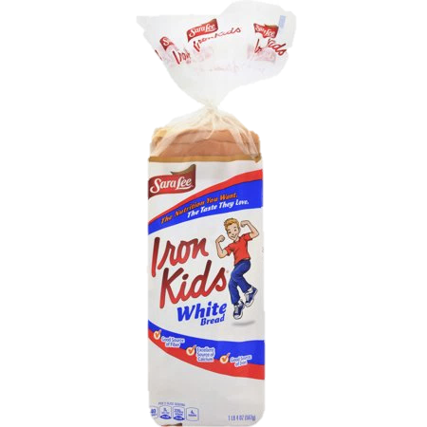
EXODUS
12-13

Slide 22
EXODUS
12-13

Slide 23
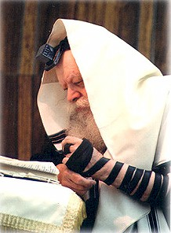
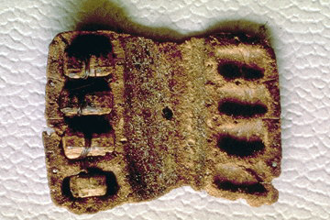
EXODUS
12-13
Scrolls containing
Ex. 13:1-16; Deut. 6:4-9 and Deut. 11:13-21
Phylactery (tefillin) found in Qumran

Slide 24
EXODUS
12-13

Slide 25
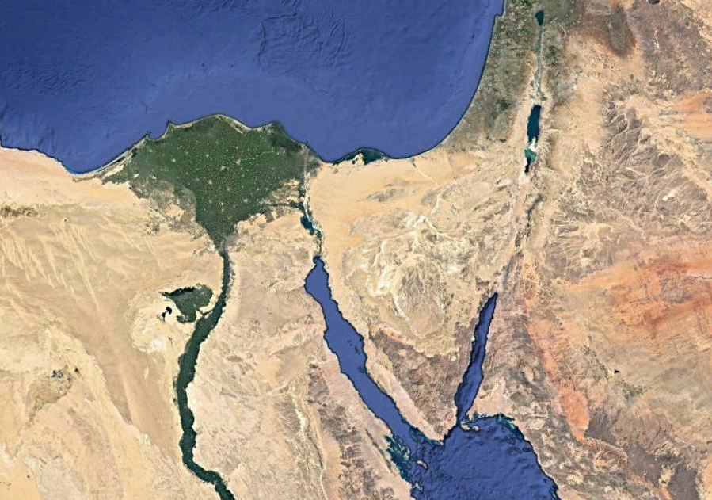
EXODUS
12-13
Philistia
Goshen
Possible Route

Slide 26
EXODUS
12-13

Slide 27
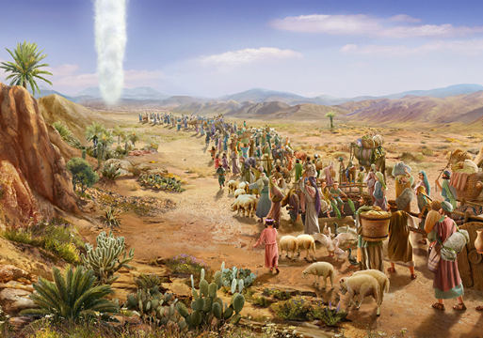
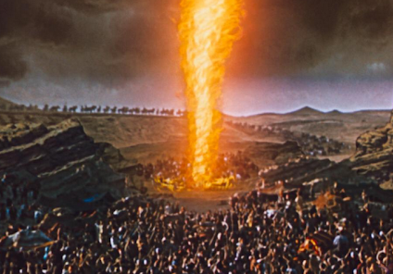
EXODUS
12-13

Slide 28
EXODUS
12-13

