Slide 1
EXODUS
7:8-9:7

Slide 2
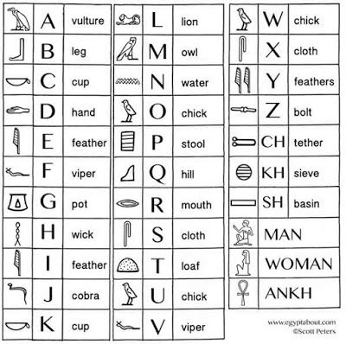
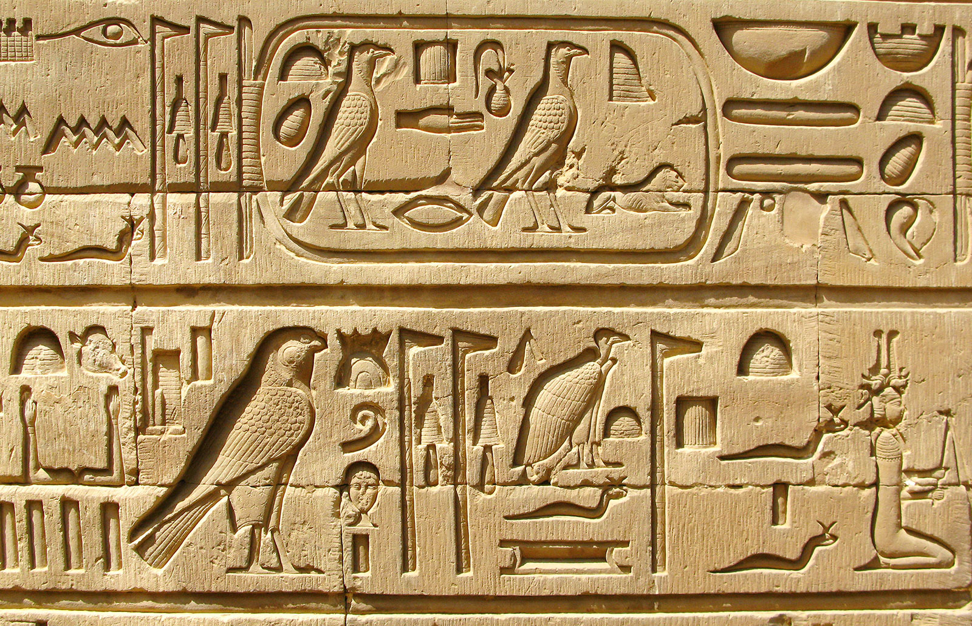
EXODUS
7:8-9:7
Hieroglyphics ~ priestly or sacred (hieros) carvings (glyphō)
Over 2,000 gods in the Egyptian pantheon

Slide 3
EXODUS
7:8-9:7
Ex. 5:2 ~ And Pharaoh said, “Who is the Lord, that I should obey His voice to let Israel go? I do not know the Lord, nor will I let Israel go.”

Slide 4
EXODUS
7:8-9:7

Slide 5
EXODUS
7:8-9:7
serpent ~ tanniyn – could also mean crocodile
Also translated sea monster
Gen. 3 and Ex. 4 ~ nachash

Slide 6
EXODUS
7:8-9:7

Slide 7
EXODUS
7:8-9:7
•
Belch!

Slide 8
EXODUS
7:8-9:7

Slide 9
EXODUS
7:8-9:7
v. 14 ~ kabed – heavy
v. 13 ~ chazaq – strengthen

Slide 10
EXODUS
7:8-9:7
Horus was incarnation of Osiris
Nile was the bloodstream of Osiris
Pharaoh was incarnation of Horus

Slide 11
EXODUS
7:8-9:7

Slide 12
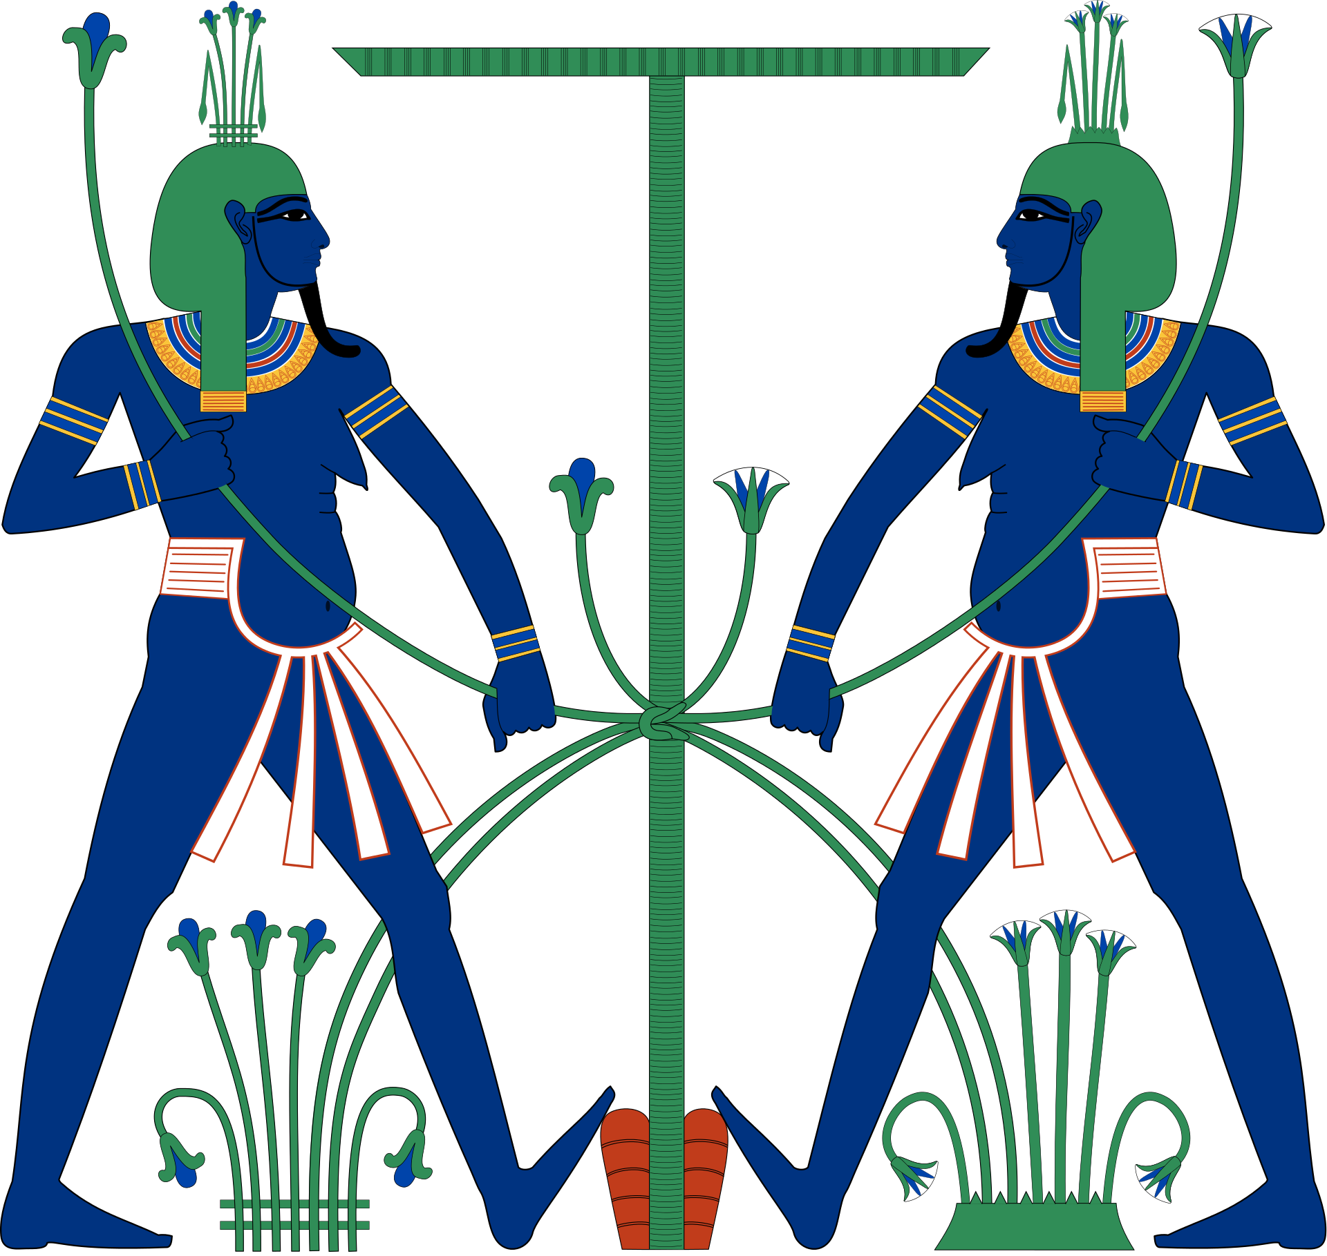
EXODUS
7:8-9:7
Hapi, god of the annual flooding of the Nile

Slide 13
EXODUS
7:8-9:7

Slide 14
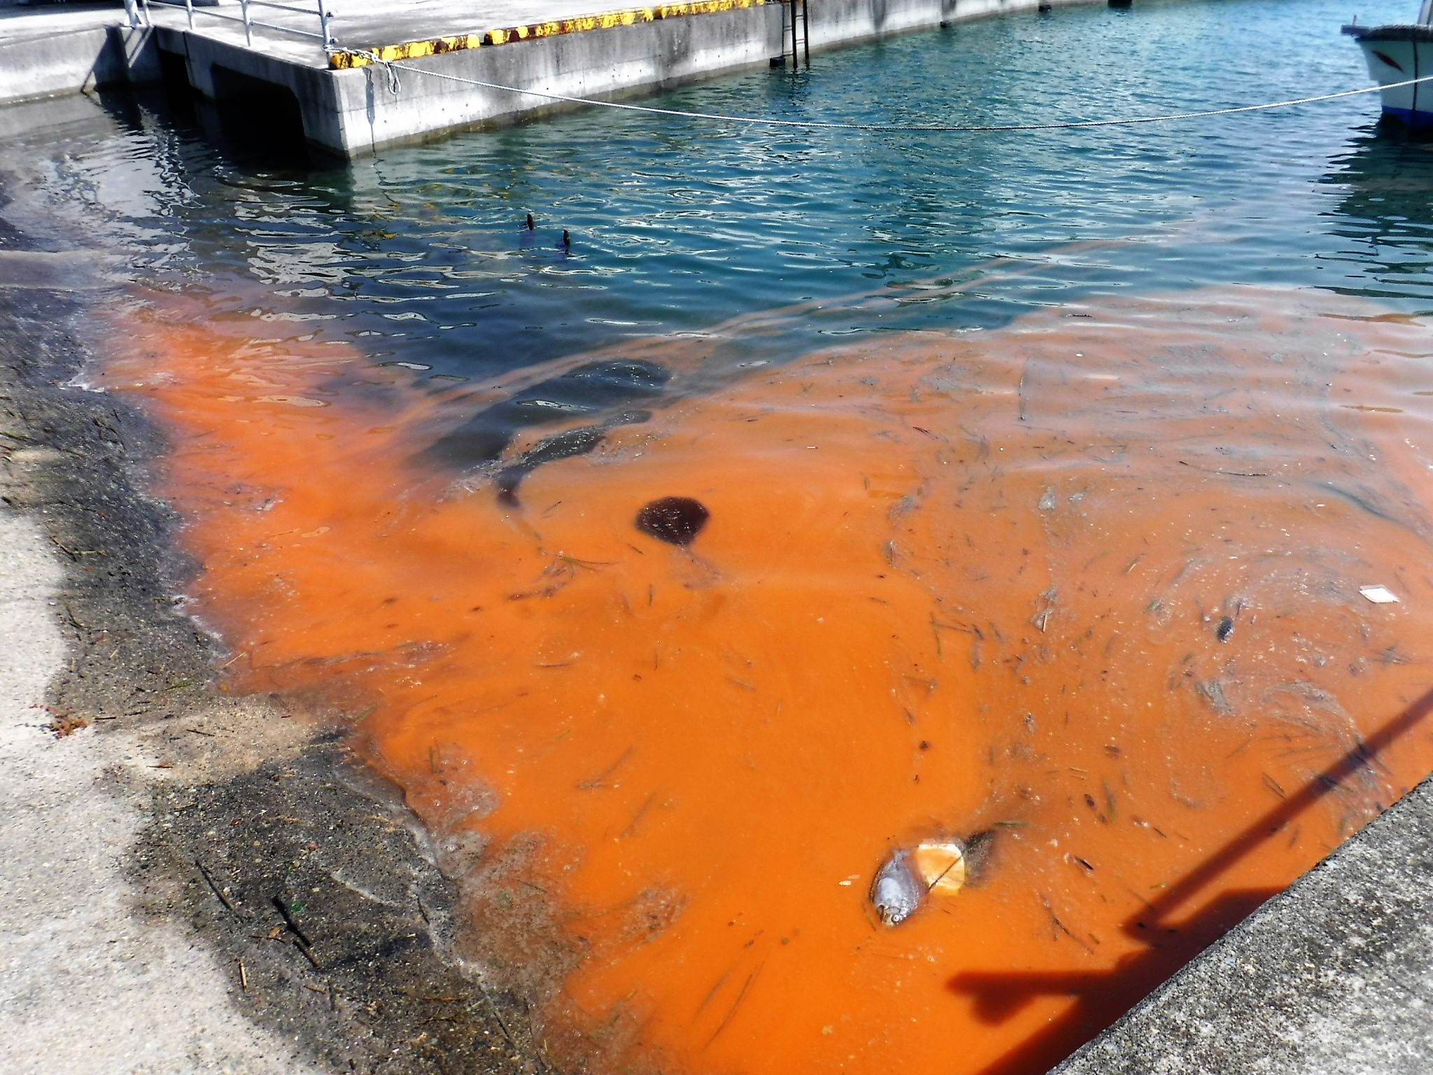
EXODUS
7:8-9:7
The Red Tide

Slide 15
EXODUS
7:8-9:7

Slide 16
EXODUS
7:8-9:7
This … is proof of evolution
This Photo by Unknown Author is licensed under CC BY-NC-ND

Slide 17
EXODUS
7:8-9:7

Slide 18
EXODUS
7:8-9:7
Heqet, the frog goddess of fertility

Slide 19
EXODUS
7:8-9:7

Slide 20
EXODUS
7:8-9:7
Esmerelda
Samantha

Slide 21
EXODUS
7:8-9:7

Slide 22
EXODUS
7:8-9:7
It is not the room service of the indulgent
Prayer is not the flare gun of the desperate
It is the confidence of the adopted

Slide 23
EXODUS
7:8-9:7

Slide 24
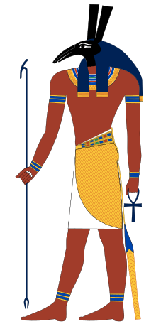
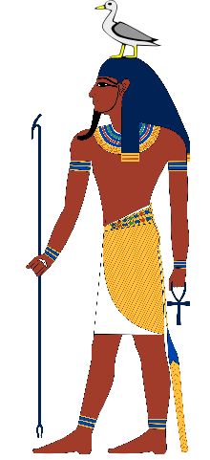
EXODUS
7:8-9:7
Set, god of the desert
Geb, the earth god

Slide 25
EXODUS
7:8-9:7

Slide 26
EXODUS
7:8-9:7
lice ~ NIV, NASB – gnats
Hebrew, kennim – to dig

Slide 27
EXODUS
7:8-9:7

Slide 28
EXODUS
7:8-9:7
difference ~ peduth – redeem

Slide 29
EXODUS
7:8-9:7

Slide 30
EXODUS
7:8-9:7
flies ~ literally, swarms (NASB, of insects)

Slide 31
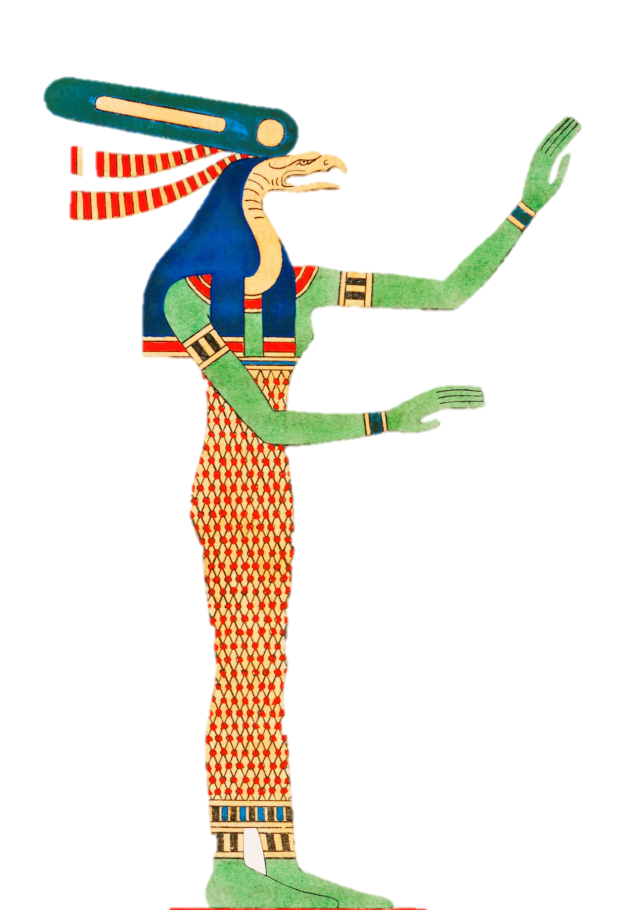
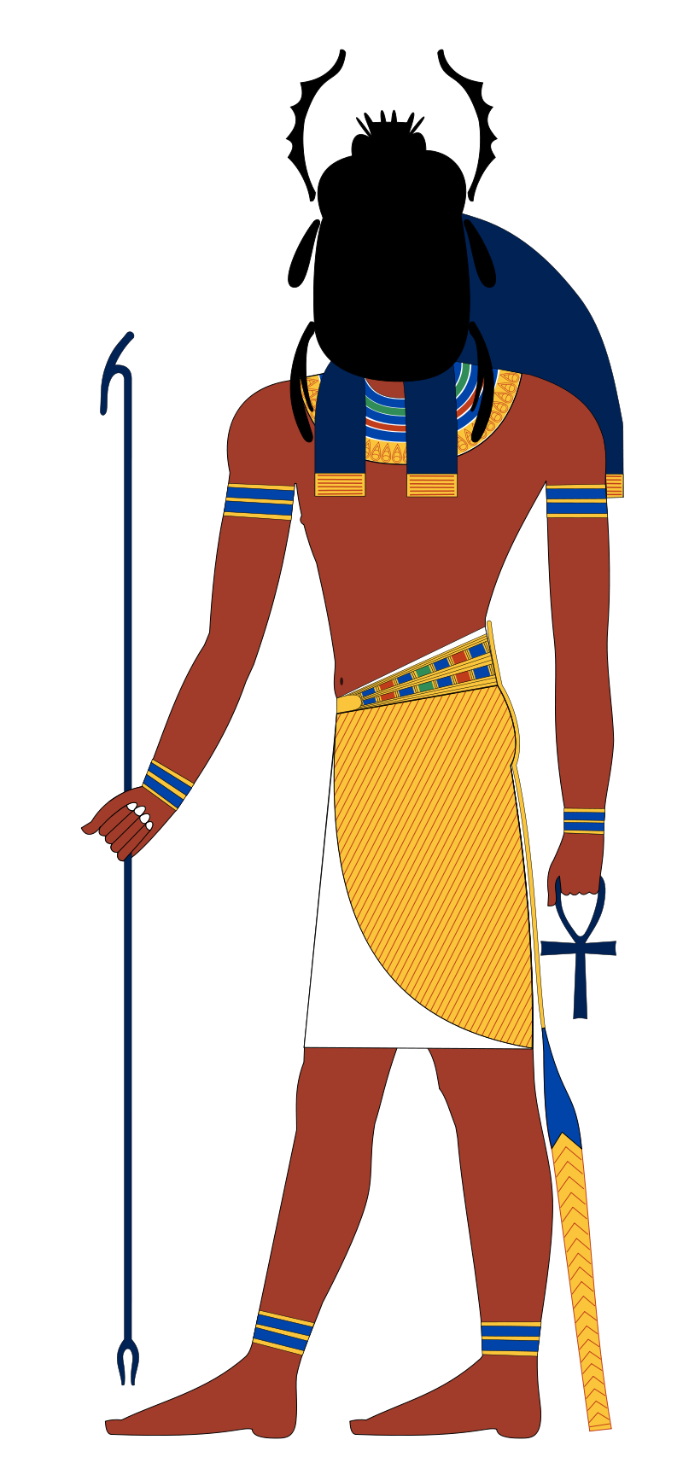
EXODUS
7:8-9:7
Wadjet, the protector goddess of Lower Egypt
Khepri, the god of the dung-beetle

Slide 32
EXODUS
7:8-9:7

Slide 33
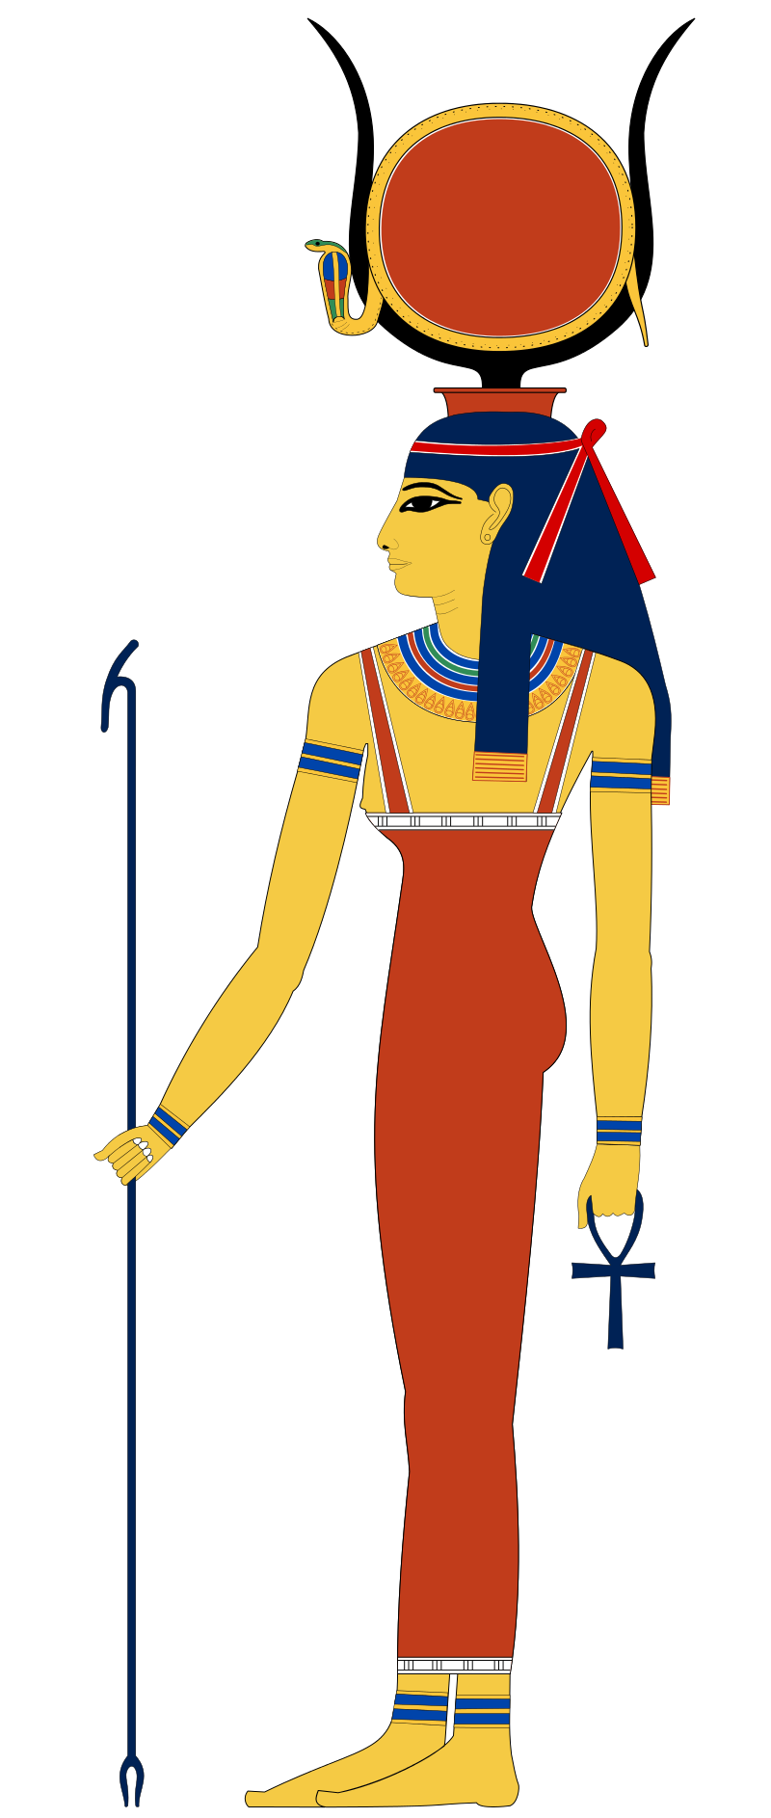
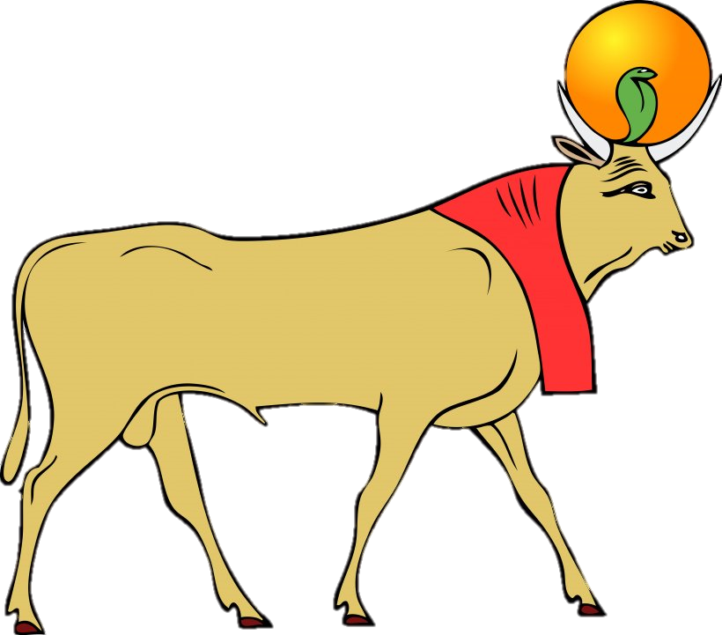
EXODUS
7:8-9:7
Hathor, the mother goddess
Apis, the god of bull

Slide 34
EXODUS
7:8-9:7

Slide 35
EXODUS
7:8-9:7
pestilence ~ KJV, murrain

Slide 36
EXODUS
7:8-9:7

