Slide 1
EXODUS
4:18-7:7

Slide 2
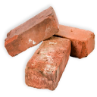
EXODUS
4:18-7:7
harden ~ chazaq – strengthen
kabed ~ heavy (primary word for harden)
This Photo by Unknown Author is licensed under CC BY-SA
This Photo by Unknown Author is licensed under CC BY-SA-NC

Slide 3
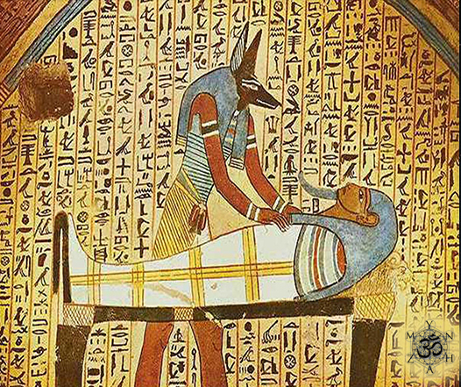
EXODUS
4:18-7:7
Ammit, crocodile head
leopard torso
rhino backside

Slide 4
EXODUS
4:18-7:7

Slide 5
EXODUS
4:18-7:7
encampment ~ KJV, inn

Slide 6
EXODUS
4:18-7:7

Slide 7
EXODUS
4:18-7:7
Calvary Chapel Pastor Claims To Teach The Bible Verse By Verse But Kinda Skips Through The Book Of Numbers
“Teaching Verse by Verse through the Bible.
..except for Numbers, and Deuteronomy. And we’ll have to see about Song of Solomon.
”

Slide 8
EXODUS
4:18-7:7

Slide 9
EXODUS
4:18-7:7
false words ~ KJV, let them not regard vain words

Slide 10
EXODUS
4:18-7:7

Slide 11
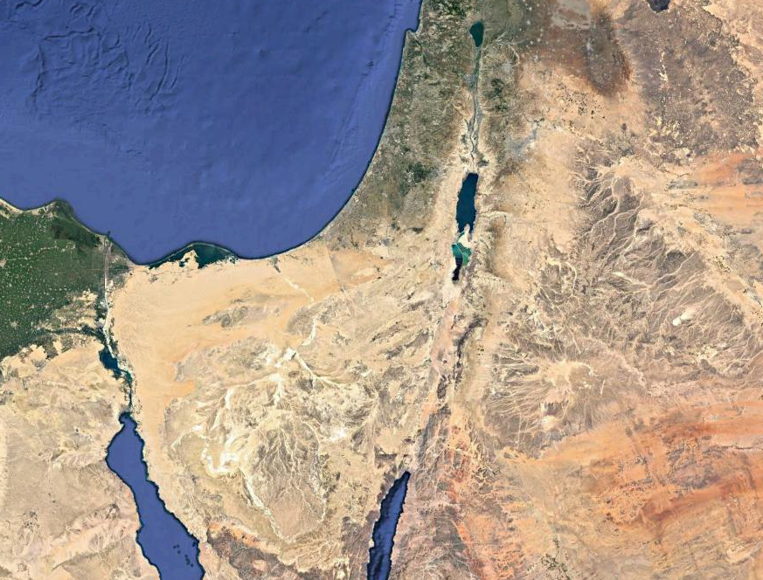
EXODUS
4:18-7:7
Carmel
104 mi.
Beersheba
257 mi.
Horeb

Slide 12
EXODUS
4:18-7:7

Slide 13
EXODUS
4:18-7:7
God Almighty ~ El Shaddai – sustainer, provider
Lord ~ Yahweh, the Promise Keeper

Slide 14
EXODUS
4:18-7:7

Slide 15
EXODUS
4:18-7:7
1. I will bring you out
2. I will rescue you
3. I will redeem you
4. I will take you as My people
5. I will be your God
6. I will bring you into the land
7. I will give it to you

Slide 16
EXODUS
4:18-7:7

Slide 17
EXODUS
4:18-7:7
Levi
Marari
Gershom
Kohath
Amram
Aaron
Moses

Slide 18
EXODUS
4:18-7:7

Slide 19
EXODUS
4:18-7:7
armies ~ NLT, NIV, better – clans

Slide 20
EXODUS
4:18-7:7

Slide 21
EXODUS
4:18-7:7
God:
Yes, I will
Yes, you can
Moses:
No, I won’t
No, I can’t

Slide 22
EXODUS
4:18-7:7

Slide 23
EXODUS
4:18-7:7
Ex. 12:12 ~ For I will pass through the land of Egypt on that night, and will strike all the firstborn in the land of Egypt, both man and beast; and against all the gods of Egypt I will execute judgment: I am the LORD.
Click
Num. 33:4 ~ For the Egyptians were burying all their firstborn, whom the Lord had killed among them. Also on their gods the Lord had executed judgments.

Slide 24
EXODUS
4:18-7:7

Slide 25
EXODUS
4:18-7:7
He was teaching Moses to walk by faith
He was allowing Pharaoh to fill up his rebellion
Click

Slide 26
EXODUS
4:18-7:7

