Slide 1

EXODUS
1:1-2:25

Slide 2

EXODUS
1:1-2:25
Exodus ~ ex (out) + hodos (way, path or road)
Mark 12:26 ~ But concerning the dead, that they rise, have you not read in the book of Moses, in the burning bush passage, how God spoke to him, saying, “I am the God of Abraham, the God of Isaac, and the God of Jacob”?

Slide 3

EXODUS
1:1-2:25

Slide 4
EXODUS
1:1-2:25
Gen. 1:28 ~ Then God blessed them, and God said to them, “Be fruitful and multiply; fill the earth and subdue it; have dominion over the fish of the sea, over the birds of the air, and over every living thing that moves on the earth.”

Slide 5
EXODUS
1:1-2:25

Slide 6
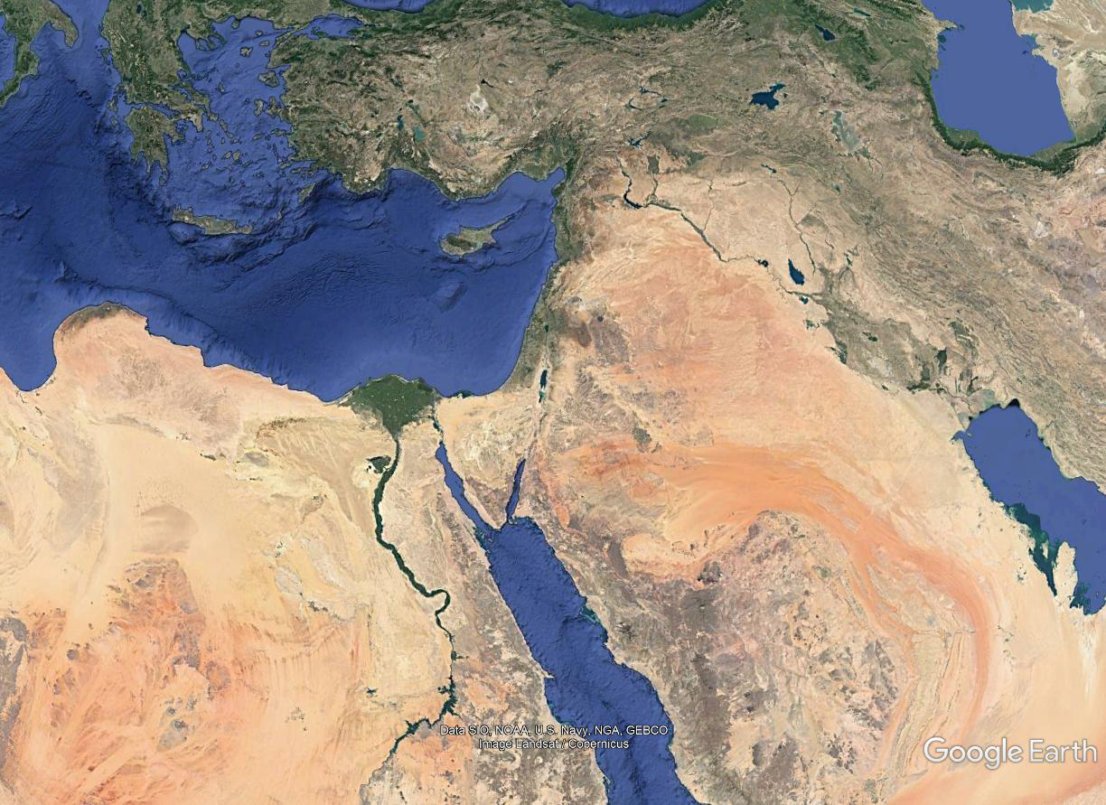
EXODUS
1:1-2:25
Hyksos (Shepherd kings) ruled Lower Egypt from 1650-1550 BC
Goshen
Lower Egypt
Upper Egypt

Slide 7
EXODUS
1:1-2:25

Slide 8
EXODUS
1:1-2:25
1 Kings 6:1 ~ And it came to pass in the four hundred and eightieth year after the children of Israel had come out of the land of Egypt, in the fourth year of Solomon's reign over Israel, in the month of Ziv, which is the second month, that he began to build the house of the Lord.
996 BC + 480 years = 1446 BC

Slide 9
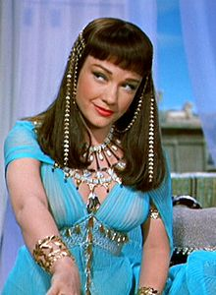
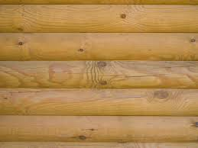
EXODUS
1:1-2:25
Hyksos driven out
(c. 1550 BC)
Thutmose II reigns
(1510 BC)
Amenhotep II reigns
(1450 BC)
Thutmose I kills 1st born
(c. 1528 BC)
Moses kills Egyptian
(1487 BC)
1525 BC
1500 BC
1475 BC
1450 BC
(dates approx.)
Moses born
(1525 BC)
Thutmose III
(1483 BC)
Amenhotep I enslaves Israelites
( 1548 BC)
Hatshepsut begins co-regency
( 1504 BC)
Moses returns
( 1447 BC)

Slide 10
EXODUS
1:1-2:25

Slide 11
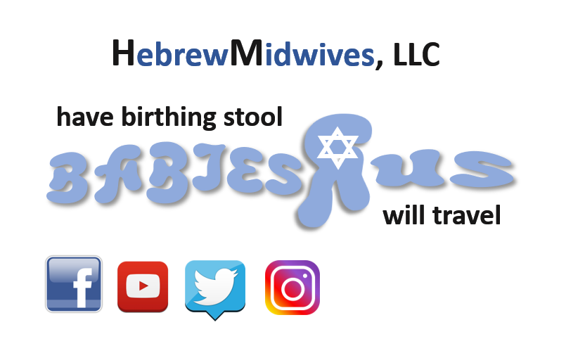
EXODUS
1:1-2:25

Slide 12
EXODUS
1:1-2:25

Slide 13




EXODUS
1:1-2:25
White lie
Black lie
Lie-o-meter

Slide 14
EXODUS
1:1-2:25

Slide 15
EXODUS
1:1-2:25
ark ~ tebah – only here and Gen. 6-9
Ark of the Covenant ~ arōn

Slide 16
EXODUS
1:1-2:25

Slide 17
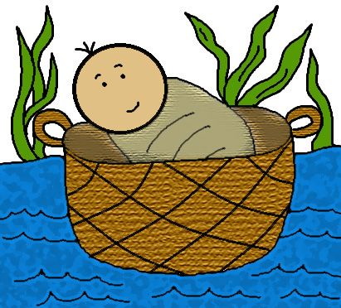
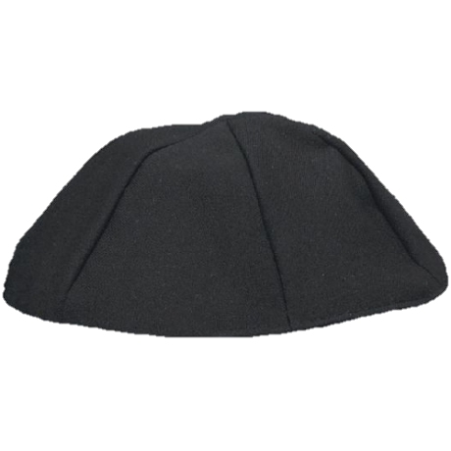
EXODUS
1:1-2:25

Slide 18
EXODUS
1:1-2:25

Slide 19
EXODUS
1:1-2:25
285 miles
Midian

Slide 20
EXODUS
1:1-2:25

Slide 21
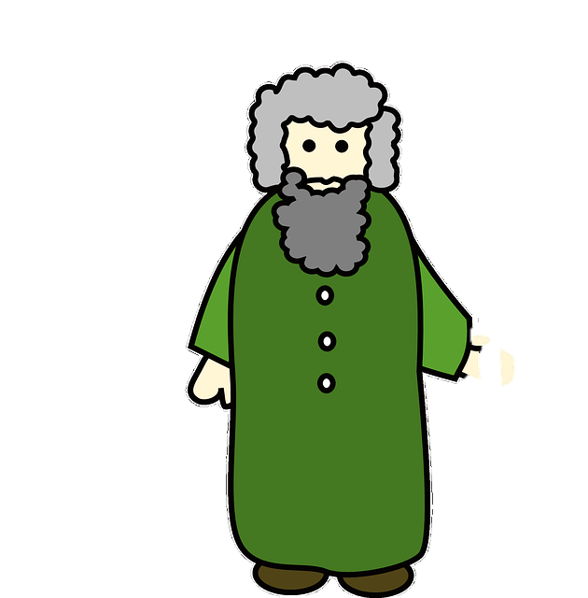
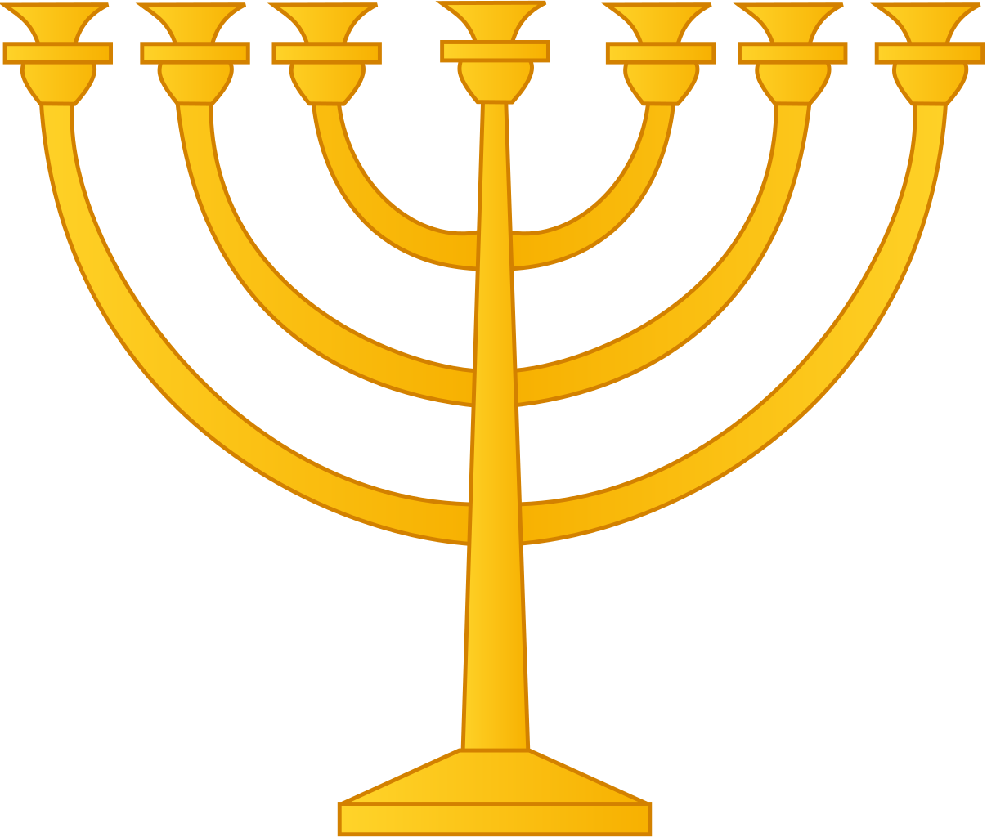
EXODUS
1:1-2:25

Slide 22
EXODUS
1:1-2:25

Slide 23
EXODUS
1:1-2:25
Reuel ~ friend of God
Also known as Jethro

Slide 24
EXODUS
1:1-2:25

Slide 25
EXODUS
1:1-2:25
Zipporah ~ little bird

Slide 26
EXODUS
1:1-2:25

Slide 27
EXODUS
1:1-2:25
1 Tim. 6:6 ~ Now godliness with contentment is great gain.

Slide 28
EXODUS
1:1-2:25

