Slide 1

Ephesians 6:10-24

Slide 2
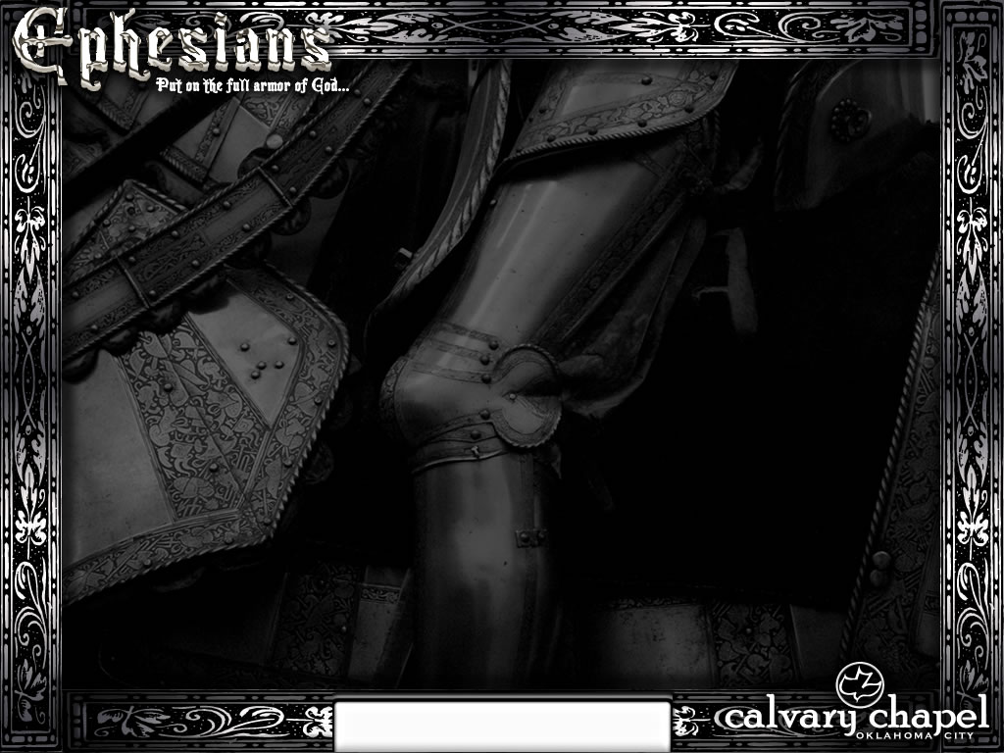

Sit
Walk
Stand
Eph. 1:1-3:21
Eph. 6:10-24
Eph. 4:1-6:9
Ephesians 6:10-24

Slide 3
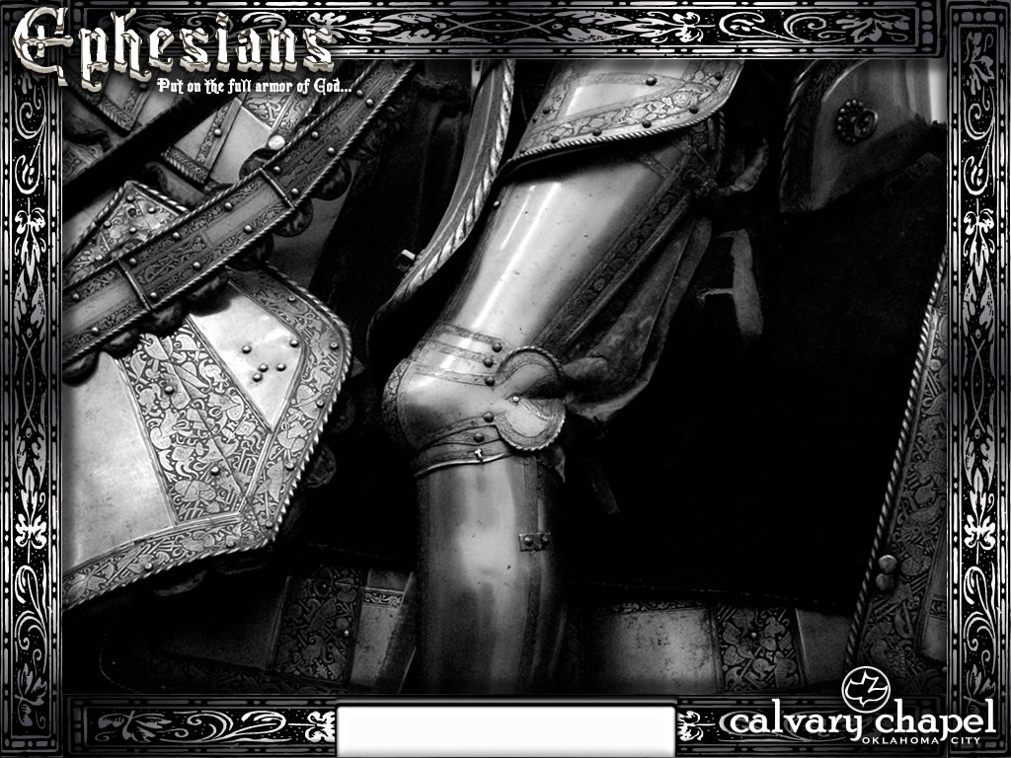
Ephesians 6:10-24

Slide 4
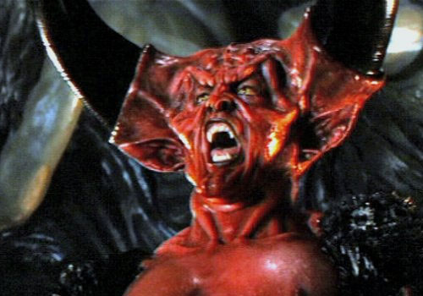

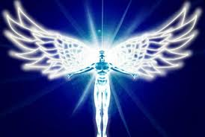
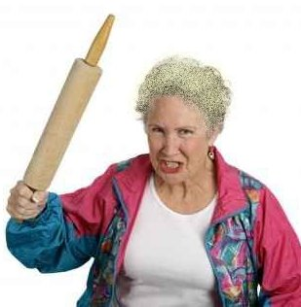


Angel of Light
Ephesians 6:10-24

Slide 5
Ephesians 6:10-24

Slide 6
Be strong ~ endunamoō – present tense, passive voice, imperative mood
Wiles ~ methodia
"Satan wastes no ammunitions on those who are dead in trespasses and sins." – Corrie ten Boom
Ephesians 6:10-24

Slide 7
Ephesians 6:10-24

Slide 8
Eph. 1:3 ~ Blessed be the God and Father of our Lord Jesus Christ, who has blessed us with every spiritual blessing in the heavenly places in Christ,
Ephesians 6:10-24

Slide 9
Ephesians 6:10-24

Slide 10

Soul
Mind
Will
Emotions
Ephesians 6:10-24

Slide 11
Ephesians 6:10-24

Slide 12
The Mind:
1 Cor. 8:1b ~ Knowledge puffs up, but love edifies.
2 Tim. 3:5a ~ … having a form of godliness but denying its power.
2 Tim 3:7 ~ … always learning and never able to come to the knowledge of the truth.
Ephesians 6:10-24

Slide 13
The Will:
Luke 12:34 ~ For where your treasure is, there your heart will be also.
Phil. 2:3-4 ~ ³ Let nothing be done through selfish ambition or conceit, but in lowliness of mind let each esteem others better than himself. ⁴ Let each of you look out not only for his own interests, but also for the interests of others.
Ephesians 6:10-24

Slide 14
The Emotions:
Prov. 14:29 ~ He who is slow to wrath has great understanding, But he who is impulsive exalts folly.
Prov. 16:32 ~ He who is slow to anger is better than the mighty, And he who rules his spirit than he who takes a city.
2 Tim. 1:7 ~ For God has not given us a spirit of fear, but of power and of love and of a sound mind.
Ephesians 6:10-24

Slide 15
Ephesians 6:10-24

Slide 16
Rulers ~ kosmokratōr – kosmos (world) + krateō (to have power or to control)
Ephesians 6:10-24

Slide 17
Ephesians 6:10-24

Slide 18
Hang therefore … and have done all, hang (MSV)
Ephesians 6:10-24

Slide 19
Ephesians 6:10-24

Slide 20
Faith ~ pistis (pisteuō, verb) = trust
Ephesians 6:10-24

Slide 21
Ephesians 6:10-24

Slide 22
Word ~ rhēma – same as in 5:26 (washing of water by the word)
Ephesians 6:10-24

Slide 23
Ephesians 6:10-24

Slide 24
Judas' Kiss
I wonder how it makes you feel when the prodigal won't come home
I wonder how it makes you feel when he'd rather be on his own
I wonder what it's like for you when a lamb has gone astray
I wonder what it's like for you when your children disobey
Ephesians 6:10-24

Slide 25
Judas' Kiss
I wonder how it makes you feel when no one seeks your face
I wonder how it makes you feel when they give up in the race
I wonder what it's like for you when they willingly disobey
I wonder what it's like for you when they willingly walk away
Ephesians 6:10-24

Slide 26
Judas' Kiss
It must be like another thorn struck in your brow
It must be like another close friend's broken vow
It must be like another nail right through your wrist
It must be just like …
just like Judas' kiss
Ephesians 6:10-24

Slide 27
Ephesians 6:10-24

Slide 28
⁴ Nevertheless I have this against you, that you have left your first love.
Rev. 2 ~
⁵ Remember therefore from where you have fallen; repent and do the first works,
Ephesians 6:10-24

Slide 29
Ephesians 6:10-24

