Slide 1

Ephesians 6:1-9

Slide 2
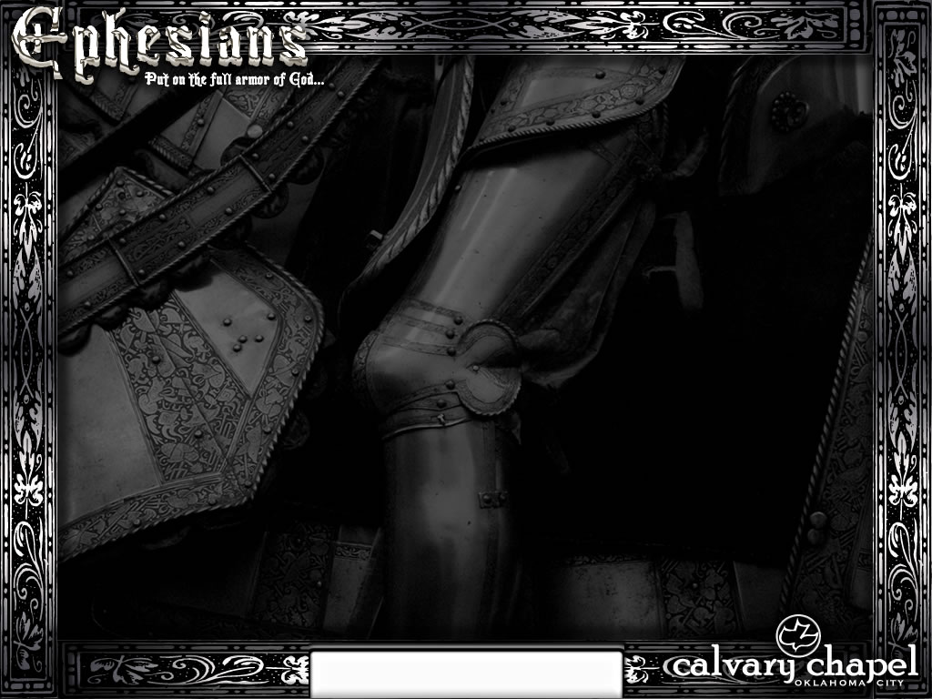

Sit
Walk
Eph. 1:1-3:21
Eph. 4:1-6:9
Ephesians 6:1-9

Slide 3
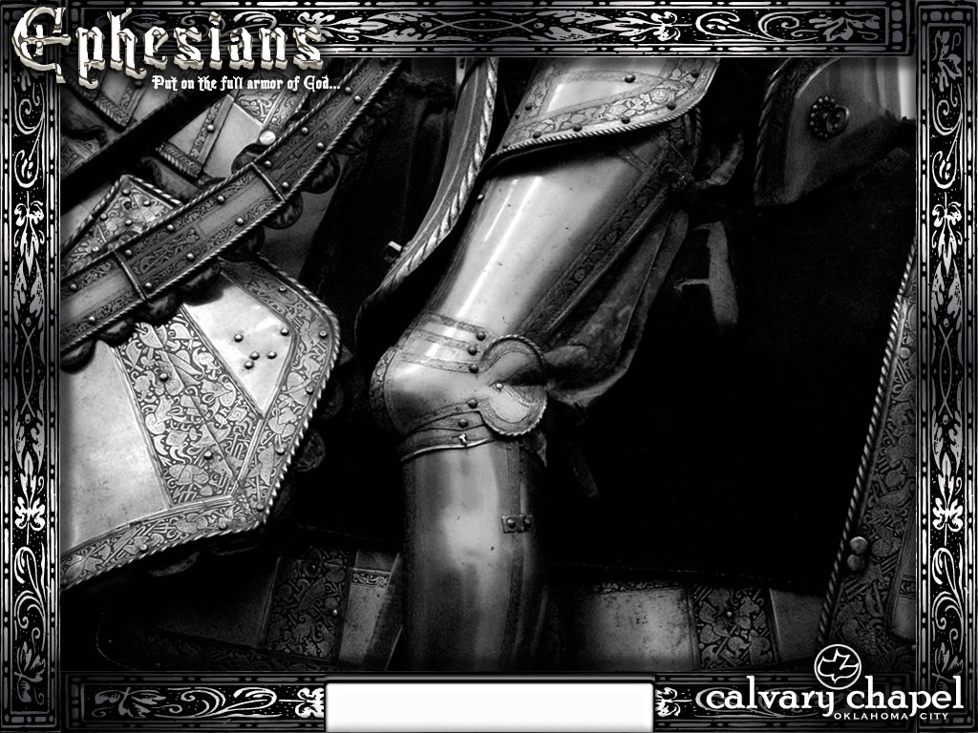
Ephesians 6:1-9

Slide 4
Kids' rules:
1. There is no such thing as childproofing your house.
2. If you hook a dog leash over a ceiling fan, the motor is not strong enough to rotate a 42 pound boy wearing batman underwear and a superman cape.
3. It is strong enough however to spread paint on all four walls of a 20 by 20 foot room.
4. You should not throw baseballs up when the ceiling fan is on.
5. When using the ceiling fan as a bat you have to throw the ball up a few times before you get a hit.
6. A ceiling fan can hit a baseball a long way.
7. The glass in windows (even double pane) doesn't stop a baseball hit by a ceiling fan.
Ephesians 6:1-9

Slide 5
Kids' rules:
8. When you hear the toilet flush and the words "Uh-oh," it's already too late.
9. A six year old can start a fire with a flint rock even though a 36 year old man says they can only do it in the movies.
10. A magnifying glass can start a fire even on an overcast day.
11. Legos will pass through the digestive tract of a four year old.
12. No matter how much Jell-O you put in a swimming pool you still can't walk on water.
13. Pool filters do not like Jell-O.
Ephesians 6:1-9

Slide 6
Kids' rules:
14. Garbage bags do not make good parachutes.
15. You probably do not want to know what that odor is.
16. Always look in the oven before you turn it on.
17. The spin cycle on the washing machine does not make earth worms dizzy.
18. It will however make cats dizzy.
19. Cats throw up twice their body weight when dizzy.
20. Quiet does not necessarily mean "don't worry."
21. A good sense of humor will get you through most problems in life (unfortunately, mostly in retrospect).
Ephesians 6:1-9

Slide 7
Ephesians 6:1-9

Slide 8
"The children now love luxury. They have bad manners, contempt for authority, they show disrespect to their elders … They no longer rise when elders enter the room. They contradict their parents, chatter before company, gobble up dainties at the table, cross their legs, and are tyrants over their teachers."
– Socrates 5th century BC
Ephesians 6:1-9

Slide 9
Ephesians 6:1-9

Slide 10
Obey ~ hupokouō – to hear under
Ephesians 6:1-9

Slide 11
Ephesians 6:1-9

Slide 12
Live long in the land
Prevent from doing something life threatening
Protect from stoning
Preserve the culture
Deut. 21:18–21 ¹⁸ If a man has a stubborn and rebellious son who will not obey the voice of his father or the voice of his mother, and who, when they have chastened him, will not heed them, ¹⁹ then his father and his mother shall take hold of him and bring him out to the elders of his city, to the gate of his city. ²⁰ And they shall say to the elders of his city, "This son of ours is stubborn and rebellious; he will not obey our voice; he is a glutton and a drunkard." ²¹ Then all the men of his city shall stone him to death with stones; so you shall put away the evil from among you, and all Israel shall hear and fear.
Ephesians 6:1-9

Slide 13
Ephesians 6:1-9

Slide 14
Training ~ paideia – KJV, nurture
Discipline, chastening (whole gamut)
Admonition ~ nouthesia – to place in the mind
Deut. 6:4 (Shema) ~ Hear, O Israel: The LORD our God, the LORD is one!
Provoke ~ parorgizō – to cause to be with heat
Ephesians 6:1-9

Slide 15
Ephesians 6:1-9

Slide 16
"Spare the rod; spoil the child"
Prov. 13:24 ~ He who spares his rod hates his son
Ephesians 6:1-9

Slide 17
Ephesians 6:1-9

Slide 18
This is why:
We have been placed in Christ (1:1-3:21)
Gave us spiritual leaders (4:1-16)
Put off anger, bitterness and corrupt speech (4:17-32)
Live chaste lives and to put all others before ourselves (5:1-17)
Be filled with His Spirit and to mutually submit to each other (5:18-21)
Wives submit to husbands as to the Lord and husbands love wives as Christ loves them (5:22-33)
Children obey your parents (6:1-4)
Employees and employers both work for Jesus (6:5-9)
Ephesians 6:1-9

Slide 19
Ephesians 6:1-9

