Slide 1
Ephesians 5:22-24

Slide 2
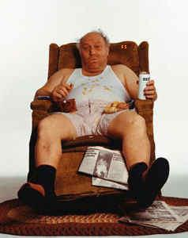
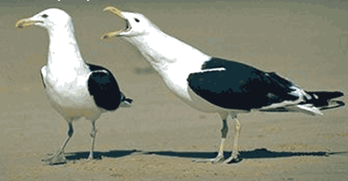
Deaf Husband
Blind Wife
Ephesians 5:22-24

Slide 3
Ephesians 5:22-24

Slide 4
Rules for being female:
1. The female always makes the rules.
2. The rules are subject to change at any time without prior notification.
3. No male can possibly know all the rules.
4. The majority of all rules must be made up on the fly.
5. The female is never wrong.
6. If the female is wrong. It is because of a flagrant misunderstanding which was a direct result of something the male did or said wrong…
7. If rule #6 applies, the male must apologize immedi -ately for causing the misunderstanding.
Ephesians 5:22-24

Slide 5
Rules for being female:
8. The female can change her mind at any given point in time.
9. The male must never change his mind without express written consent from the female.
10. The female has every right to be angry or upset at anytime.
11. The male must remain calm at all times, unless the female wants him to be angry or upset.
12. The female must under no circumstances let the male know whether or not she wants him to be angry or upset.
13. Any attempt to document these rules could result in bodily harm.
14. If the female has PMS, all rules are null and void.
Ephesians 5:22-24

Slide 6
Ephesians 5:22-24

Slide 7
Ephesians 5:22-24

Slide 8
Ephesians 5:22-24

Slide 9
Gen. 3:16 ~ To the woman He said: "I will greatly multiply your sorrow and your conception; In pain you shall bring forth children; Your desire shall be for your husband, And he shall rule over you."
t^{e}shukah ~ desire
to control
Gen. 4:7 ~ ⁶ So the LORD said to Cain, "Why are you angry? And why has your countenance fallen? ⁷ If you do well, will you not be accepted? And if you do not do well, sin lies at the door. And its desire is for you, but you should rule over it."
Ephesians 5:22-24

Slide 10
Ephesians 5:22-24

Slide 11
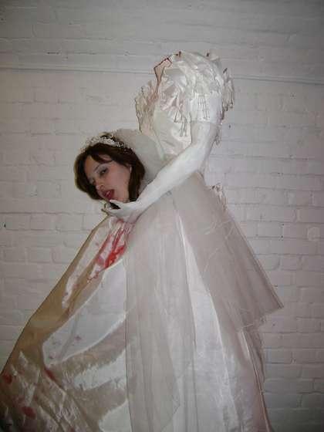
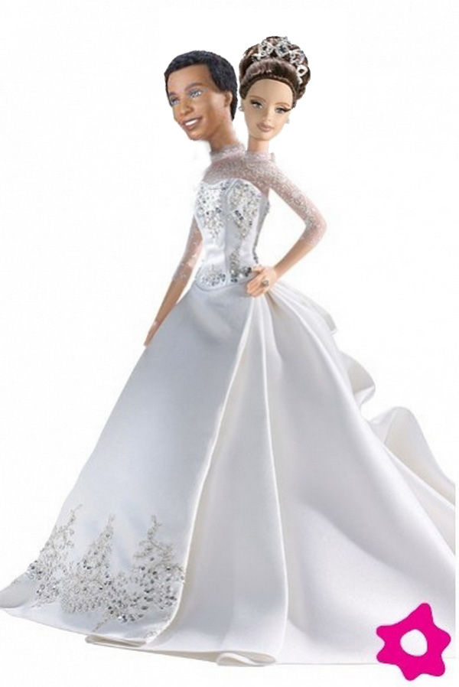
1 Cor. 11:3 ~ But I want you to know that the head of every man is Christ, the head of woman is man, and the head of Christ is God.
Ephesians 5:22-24

Slide 12
Ephesians 5:22-24

Slide 13
D. G. Barnhouse ~ "I believe that women are superior to men
… at being women."
Charlotte Whitton ~ "Whatever women do they must do twice as well as men to be thought half as good.
Luckily this is not difficult."
Ephesians 5:22-24

Slide 14
Ephesians 5:22-24

Slide 15
Submit ~ hupotassō – to remain under
Military: "to arrange in a military fashion under the command of a leader"
Civil: "a voluntary attitude of giving in, cooperating, assuming responsibility, and carrying a burden"
Ephesians 5:22-24

Slide 16
Ephesians 5:22-24

Slide 17
Submission is not:
Submission is:
1. A doormat
1. An attitude
2. An action ("The Bible says I gotta submit")
2. Voluntary attitude of giving in, cooperating, assuming responsibility, and carrying a burden (never coerced)
3. Obedience (Sin)
3. Phil. 2:3 ~ Let nothing be done through selfish ambition or conceit, but in lowliness of mind let each esteem others better than himself.
4. Manipulation
4. Trusting God for the outcome
Ephesians 5:22-24

Slide 18
Ephesians 5:22-24

Slide 19
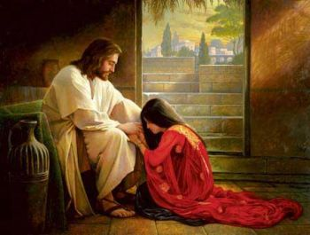
Likewise ~ homoiōs – equally, in the same way
Ephesians 5:22-24

Slide 20
Ephesians 5:22-24

Slide 21
Eccl. 10:4 ~ If the spirit of the ruler rises against you, Do not leave your post; For conciliation pacifies great offenses.
ESV ~ If the anger of the ruler rises against you, do not leave your place, for calmness will lay great offenses to rest.
Ephesians 5:22-24

Slide 22
Ephesians 5:22-24

