Slide 1

Ephesians 5:1-21

Slide 2
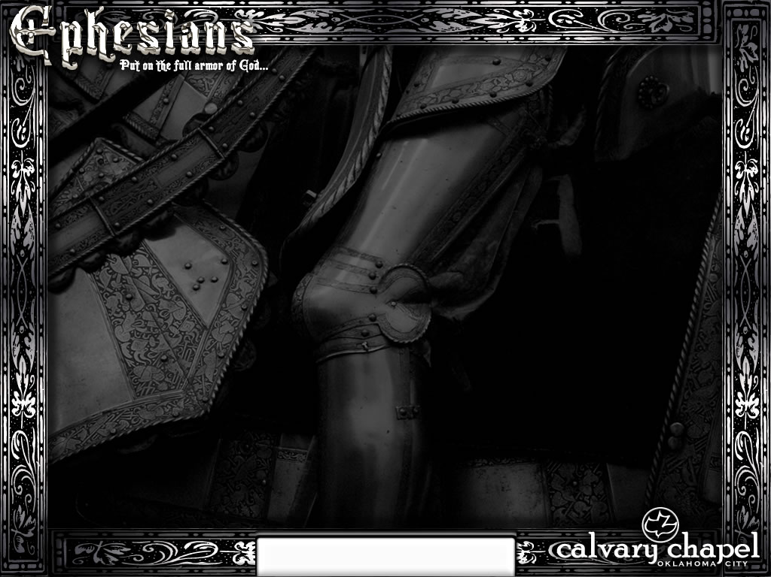
es
Bab
y
i
Ephesians 5:1-21

Slide 3
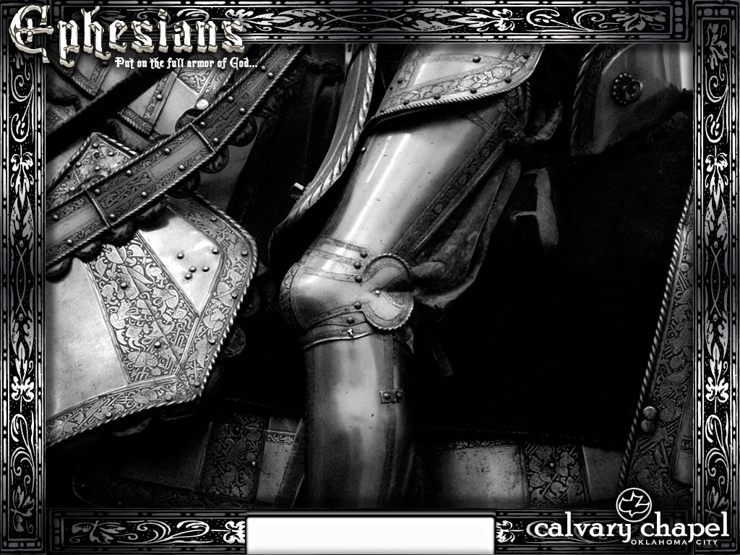
Ephesians 5:1-21

Slide 4
Imitators ~ mimētēs
Ephesians 5:1-21

Slide 5
Ephesians 5:1-21

Slide 6
Fitting ~ KJV, convenient
Fornication ~ porneia – all sexual impurity
Not even be named ~ niv, not even a hint
Ephesians 5:1-21

Slide 7
Ephesians 5:1-21

Slide 8
"This is heard on every side today. But, Paul says, that is impossible. If anyone really loves another, he would never practice sex outside of marriage. To do so would injure the other because sex outside of marriage is incomplete, abortive, unfulfilling and injurious. Therefore, you cannot combine the two. There is no such thing as sexual relations outside of marriage done in love." – Ray Stedman
Ephesians 5:1-21

Slide 9
Ephesians 5:1-21

Slide 10
Foolish talking ~ mōrologia
Mōros ~ moron + legō (v. form of logos) to speak
Ephesians 5:1-21

Slide 11
Ephesians 5:1-21

Slide 12
Rom. 1:18 ~ For the wrath of God is revealed from heaven against all ungodliness and unrighteousness of men, who suppress the truth in unrighteousness,
Rom. 1:24 ~ Therefore God also gave them up to uncleanness, in the lusts of their hearts, to dishonor their bodies among themselves,
Ephesians 5:1-21

Slide 13
Rom. 1:26 ~ For this reason God gave them up to vile passions. For even their women exchanged the natural use for what is against nature.
Rom. 1:28 ~ And even as they did not like to retain God in their knowledge, God gave them over to a debased mind, to do those things which are not fitting;
Ephesians 5:1-21

Slide 14
Ephesians 5:1-21

Slide 15
Once ~ kjv, sometime (formerly)
FAITH
orsaking
ll
rust
im
"The faith that is not big enough to transform a life is not big enough to save a soul"
Ephesians 5:1-21

Slide 16
Ephesians 5:1-21

Slide 17
1 John 1:7 ~ But if we walk in the light as He is in the light, we have fellowship with one another, and the blood of Jesus Christ His Son cleanses us from all sin.
Ephesians 5:1-21

Slide 18
Ephesians 5:1-21

Slide 19
Expose ~ elegchō – KJV, reprove
Ephesians 5:1-21

Slide 20
Ephesians 5:1-21

Slide 21
Walk ~ peripateō – literally, to walk around (with circumspectly – diligently, accurately)
Ephesians 5:1-21

Slide 22
Ephesians 5:1-21

Slide 23
Dissipation ~ asōtia – a, negative particle + sōzō – to save
Ephesians 5:1-21

Slide 24
Ephesians 5:1-21

Slide 25
Be filled ~ pleroō
Present tense ~ often translated with an "–ing"
Passive voice ~ the subject receives the action of the sentence
E.g. "The ball was thrown over the fence."
Imperative mood ~ the subject is commanded to do the action
"Be being filled"
Ephesians 5:1-21

Slide 26
Ephesians 5:1-21

Slide 27
Submit ~ hupotassō – a voluntary attitude of giving in, cooperating, assuming responsibility, and carrying a burden
Ephesians 5:1-21

Slide 28
Ephesians 5:1-21

