Slide 1
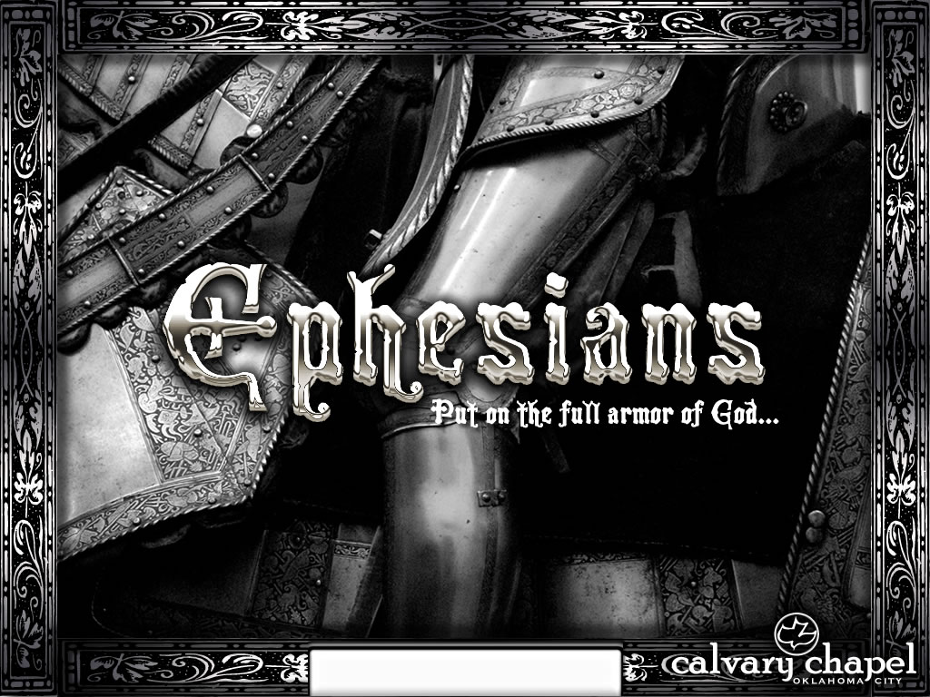
Ephesians 4:11-32

Slide 2
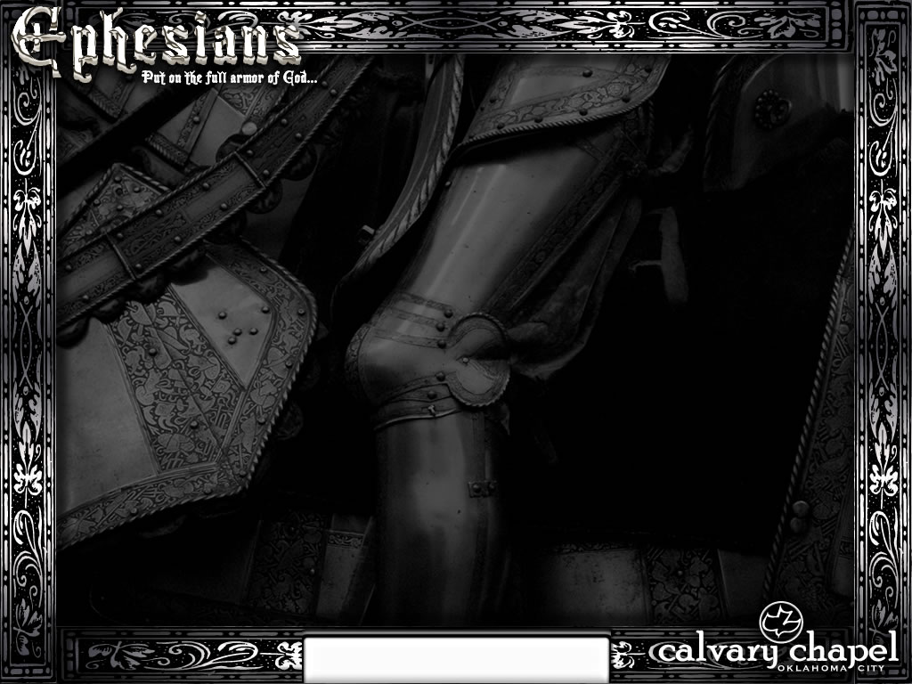
Eph. 2:219-20 ~ ¹⁹ Now, therefore, you are no longer strangers and foreigners, but fellow citizens with the saints and members of the household of God, ²⁰ having been built on the foundation of the apostles and prophets, Jesus Christ Himself being the chief cornerstone,
2 Pet. 2:1 ~ But there were also false prophets among the people, even as there will be false teachers among you, who will secretly bring in destructive heresies, even denying the Lord who bought them, and bring on themselves swift destruction.
Ephesians 4:11-32

Slide 3
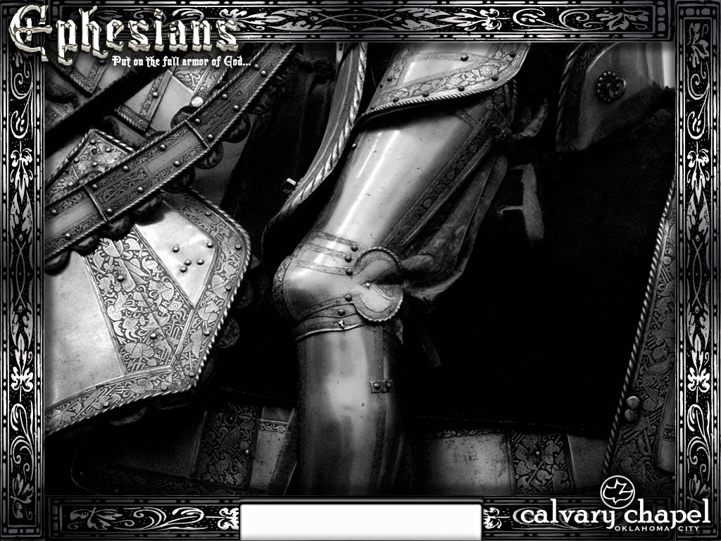
Ephesians 4:11-32

Slide 4
Philips ~ His "gifts unto men" were varied. Some he made his messengers, some prophets, some preachers of the gospel; to some he gave the power to guide and teach his people.
Ephesians 4:11-32

Slide 5
Ephesians 4:11-32

Slide 6
Rom. 12:1-2 ~ ¹ I beseech you therefore, brethren, by the mercies of God, that you present your bodies a living sacrifice, holy, acceptable to God, which is your reasonable service. ² And do not be conformed to this world, but be transformed by the renewing of your mind, that you may prove what is that good and acceptable and perfect will of God.
Ephesians 4:11-32

Slide 7
Ephesians 4:11-32

Slide 8
Past feeling ~ apalgeō – a, negative particle; algeō – to smart … i.e. to be past pain
Ephesians 4:11-32

Slide 9
Ephesians 4:11-32

Slide 10
Lusts ~ epithumia – to burn upon
Ephesians 4:11-32

Slide 11
Ephesians 4:11-32

Slide 12
"God dwells in a different realm. 'The foolishness of God is higher than human wisdom, and the weakness of God is stronger than human strength' (1 Cor. 1:25). He occupies another dimension. 'My thoughts are not like your thoughts. Your ways are not like my ways. Just as the heavens are higher than the earth, so are my ways higher than your ways and my thoughts higher than your thoughts' (Is. 55:8-9).
Make special note of the word like. God’s thoughts are not our thoughts, nor are they
Ephesians 4:11-32

Slide 13
even like ours. We aren’t even in the same neighborhood. We’re thinking, Preserve the body; He’s thinking Save the soul. We dream of a pay raise He dreams of raising the dead. We avoid pain and seek peace. God uses pain to bring peace. 'I’m going to live before I die,' we resolve. 'Die so you can live,' He instructs. We love what rusts. He loves what endures. We rejoice at our successes. He rejoices at our confessions. We show our children the Nike star with the million-dollar smile and say, 'Be like Mike.' God points to the crucified
Ephesians 4:11-32

Slide 14
carpenter with bloody lips and a torn side and says, 'Be like Christ.'
Our thoughts are not like God’s thoughts. Our ways are not like His ways. He has a different agenda. He dwells in a different dimension. He lives on another plane. And that plane is named in the first phrase of the Lord’s prayer, 'Our Father who is in heaven.'" – Max Lucado, For These Tough Times
Ephesians 4:11-32

Slide 15
Ephesians 4:11-32

Slide 16
Bar-mitzvah ~ Son of the Covenant
Toga praetexta
Toga virilis
Ephesians 4:11-32

Slide 17
Ephesians 4:11-32

Slide 18
They hauled him, trembling, to the Judgment Seat.
"O Lord, behold the man who made the nails that pierced Thy feet!"
The Master laid a thin, scarred hand upon the shame-bowed head.
"They were good nails," He said. – Kenneth W. Porter
Ephesians 4:11-32

Slide 19
Ephesians 4:11-32

