Slide 1
Ephesians 4:1-13

Slide 2
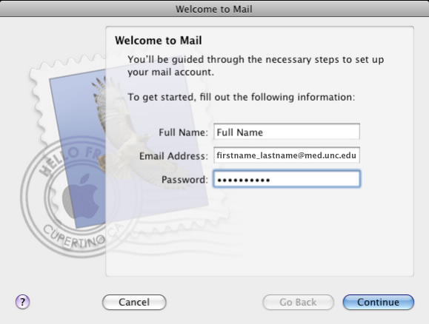
Clewis Pardee
clewis@mac.com
***********
Ephesians 4:1-13

Slide 3
Ephesians 4:1-13

Slide 4
"If our teaching of grace causes us to make light of sin, or to slight the requirements of the Savior, then we have not really under-stood either the monstrosity of our sin or the greatness of the heart that forgives it." – Bryan Chapell
Ephesians 4:1-13

Slide 5
Ephesians 4:1-13

Slide 6
Walk ~ peripateō – peri, around; pateō, to tread
To walk around; walk circumspectly
Ephesians 4:1-13

Slide 7
Worthy ~ axiōs – of equal weight
Axiom, a saying that is widely accepted on its own merits
Antecedents:
Lowliness (humility) ~ spiritual pride
Gentleness (power under control) ~ emotional reactions
Pro. 3:34 (NIV) ~ He mocks the proud mockers but gives grace to the humble.
Longsuffering (makrothumia) ~ short fused
Jam. 4:6b ~ …God resists the proud, but gives grace to the humble.
Ephesians 4:1-13

Slide 8
Ephesians 4:1-13

Slide 9
Ps. 138:6 ~ Though the Lord is on high, yet He regards the lowly; but the proud He knows from afar.
Ephesians 4:1-13

Slide 10
Ephesians 4:1-13

Slide 11
Luke 16:23 ~ And being in torments in Hades, he lifted up his eyes and saw Abraham afar off, and Lazarus in his bosom.
hadēs, not hell (as in KJV, NIV)
Ephesians 4:1-13

Slide 12
Ephesians 4:1-13

