Slide 1
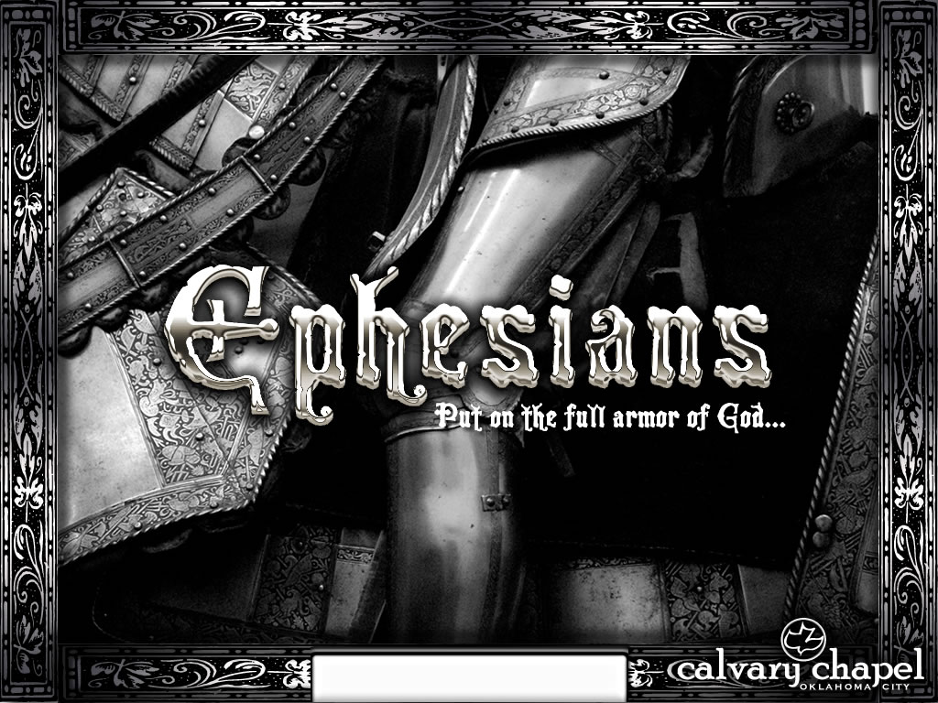
Ephesians 3:12-21

Slide 2
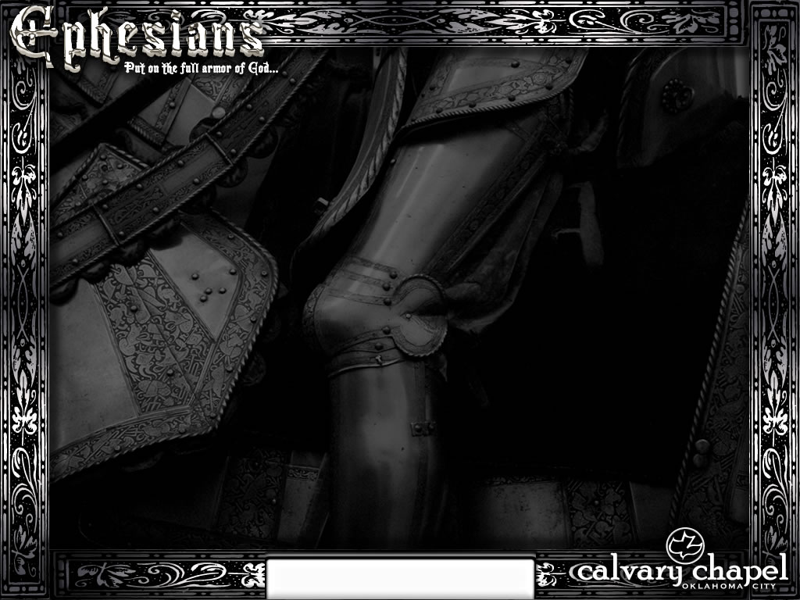
Phil. 4:22 ~ All the saints greet you, but especially those who are of Caesar’s household.
Ephesians 3:12-21

Slide 3
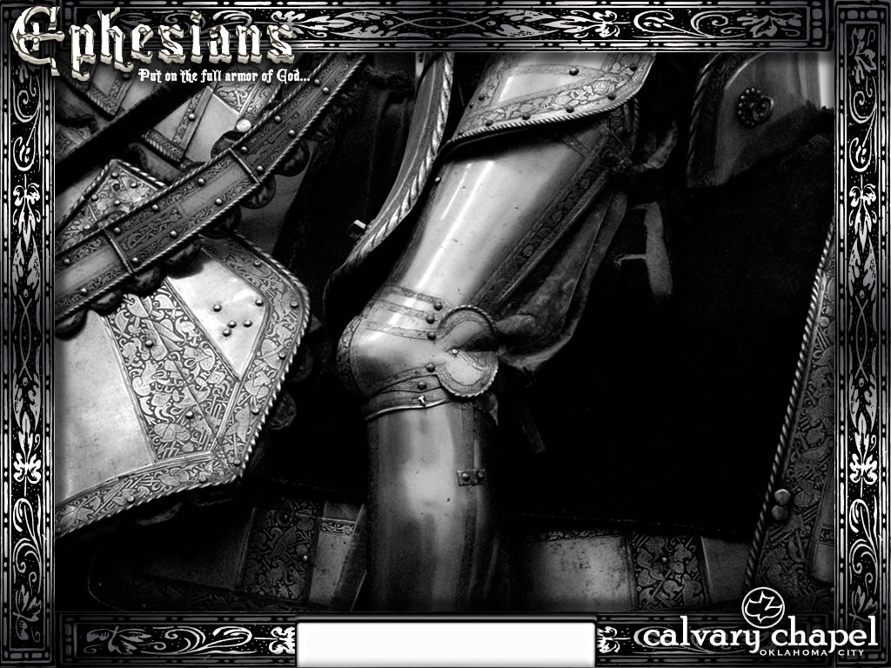
Ephesians 3:12-21

Slide 4
2 Cor. 13:5 ~ Examine yourselves as to whether you are in the faith. Test yourselves. Do you not know yourselves, that Jesus Christ is in you?
Ephesians 3:12-21

Slide 5
Ephesians 3:12-21

Slide 6
Throne
of God
Length
Height
Width
Arms of Christ
Death on Cross
Found. to Eternity
Depth
J. Vernon Magee
Ephesians 3:12-21

Slide 7
Ephesians 3:12-21

Slide 8
Know ~ ginōskō; knowledge ~ gnosis
To know experientially
Ephesians 3:12-21

Slide 9
Ephesians 3:12-21

Slide 10
Doxology ~ words of praise
Ephesians 3:12-21

Slide 11
Ephesians 3:12-21

Slide 12
Exceedingly ~ hupēr (over); abundantly ~ ek (out of) + perisso (beyond measure)
huperekperissou
Power ~ dunamis
Ephesians 3:12-21

Slide 13
Ephesians 3:12-21

Slide 14
He is able
to do
exceedingly
abundantly
above all that we could ask
or think
Ephesians 3:12-21

Slide 15
Ephesians 3:12-21

